Slide 1

Dr. Kenneth Hammonds, Presents:
 
Planning the Future,
Your Life in Future Tense: Four P’s for Creating Your Future
It’s place within the WestA 52 Spiritual Disciplines listing:
It is #34: Planning the Future
Of the 7 Categories of the 52 Disciplines, it’s in
Category 5: Wisdom which is further defined as
“Spiritual Disciplines Embracing God’s Wisdom for Everyday Living”

Slide 2
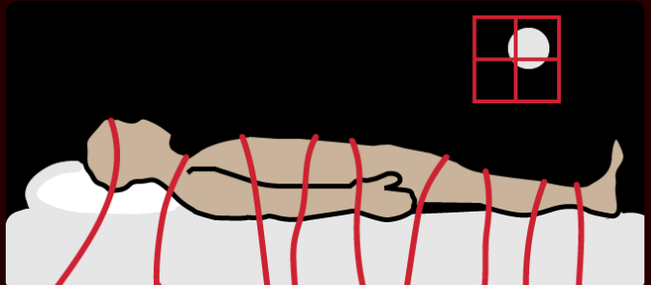


Spiritual Discipline 34:
Planning for the Future
Developing Healthy Habits for Creating the Future (release of being paralyzed by the past
and terrorized by the future)
(seeing the actualization of potentiality) Ain’t becomes IS.

Slide 3
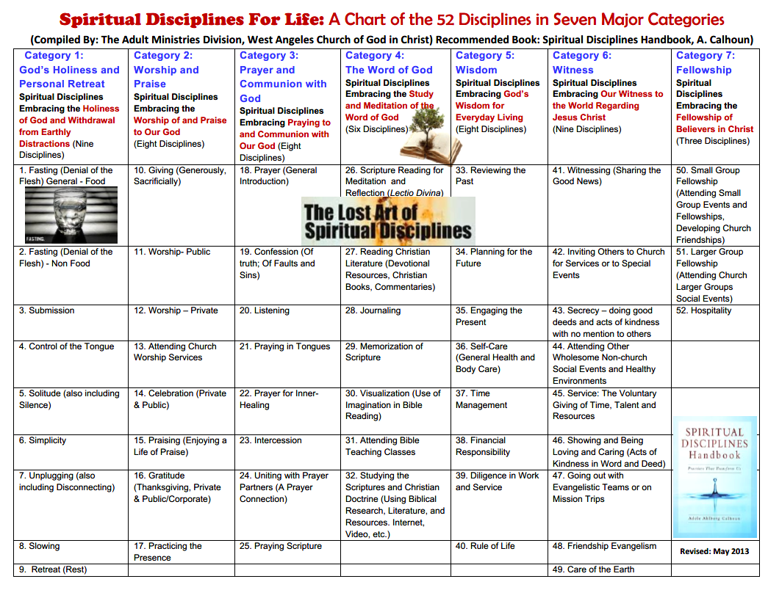

2 Timothy 2:2 DISCIPLE MAKING
(A Perfecting Believers Too Longer Modern Definition)
 
Making a Full Commitment to the Spiritual Investment of
yourself to Perfect Believers by the Mentoring of the another
for the Kingdom of God and by Empowering believers to
develop and maintain life-long Spiritual & Life Disciplines and
Relationships as they Pursue the Calling of God in their lives.
Being fully committed
Not to be memorized unless you have so much free time you have nothing else to do!

Slide 4
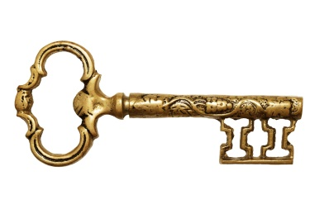
KEY SCRIPTURES
Philippians 3:13-14
New King James Version
¹³ Brethren, I do not count myself to have apprehended [reached perfection, cf. v.12]; but one thing I do, forgetting those things which are behind and reaching forward to those things which are ahead,
¹⁴ I press toward the goal for the prize of the upward call of God in Christ Jesus.

Slide 5

Move Forward
“If you can't fly then run,
if you can't run then walk,
if you can't walk then crawl, but whatever you do you have to keep moving forward.”
Dr. Martin Luther King Jr.

Slide 6
Four P’s for Creating Your Future
1. Purposeful Striving *
2. Prayer
3. Planning
4. Persistence
I pursue the goal. [the future plan]

Slide 7

Four P’s for Creating Your Future
Insights into the Ministry Life of the Apostle Paul
A man on target for creating his future and laying the foundation for Christianity’s future growth for 2,000 years
Purposeful Striving Creates the Future
Purposeful Striving (Creating the Future)
A Three-Fold Pauline Process
Forgetting (v. 13) FORGETTING those things which are behind
Anticipating (v. 13) and REACHING FORWARD to those things which are ahead,
Pressing Forward (v.14) I PRESS TOWARD the goal for . . . Gk. pursue, See
BibleHub Study. This a diligent, persistent focus and with the eye on the prize.

Slide 8
FEEL IT! SEE IT!
Can’t you just FEEL and SEE the INTENSITY of the Apostle to get the Gospel out, to heal, to teach, to encourage, and to get to work for the People of God and his Mission?
[Note: Paul was in Rome under house arrest as he wrote this epistle, and yet he never loses his focus. Indeed he seems to increase it.]
Here are the words Paul uses as he vividly describes his PASSION: Press on, pursue, run after, chase, stretch forward, run toward the goal, straining toward what is ahead, and many more as offered in modern translations and original Greek language resources.

Slide 9
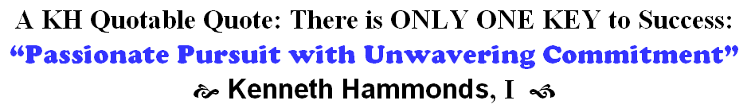

See KH’s motivational document, “Pursue with Passion”

Slide 10
2. Prayer
2. Prayer
Paul: His life was a life of prayer.
Scripture: Colossians 4:2-4
² Devote yourselves to prayer, being watchful and thankful. ³ And pray for us, too, that God may open a door for our message, so that we may proclaim the mystery of Christ, for which I am in chains. ⁴ Pray that I may proclaim it clearly, as I should.
Colossians 4:12 -Epaphras, who is one of you, a servant of Christ, saluteth you, always labouring fervently for you in prayers, that ye may stand perfect and complete in all the will of God. (KJV)
He is always wrestling in his prayers (NRSV)

Slide 11
3. Planning
3. Planning (Preparation)
Paul: Paul mentions his ministry “plans” several times in his epistles. Scriptures:
1 Corinthians 16:5-6 New King James Version [Personal Plans]
Now I will come to you when I pass through Macedonia (for I am passing through Macedonia). Perhaps I will stay with you for a while, or even spend the winter, so that you can help me on my journey, wherever I go.
Romans 15:22-24 New Revised Standard Version [Paul’s Plan to Visit Rome]
This is the reason that I have so often been hindered from coming to you.
v.23 But now that there is no more place for me to work in these regions, and since I have been longing for many years to visit you,
v. 24 I plan to do so when I go to Spain. I hope to see you while passing through and to have you assist me on my journey there, after I have enjoyed your company for a while.

Slide 12
4. Persistence [to carrying it out.]
Paul was diligent in his calling.
Scripture: The righteous are as bold as a lion. Proverbs 28:1
Midcourse Correction (MCC) a Vital Skill for
Success in Carving out Your Future
(Staying on Course when being thrown off course.)
Midcourse correction (MCC) - A KEY Point in this discussion
Definition and Explanation
A midcourse correction is a change of direction mostly coming after a crisis event or the event requires a turning point for a decision.
Midcourse correction, Conscience Alteration, Modification, Detour, Divergent Reset, or it may be a Divine Intervention
Unpredicted eventuality = a possible event or outcome.
A navigational correction made in the course of a ship, airplane, rocket, or space vehicle at some point between the beginning and end of the journey.
Some might simply call it a “Plan B.” But it is not quite so, because it is NOT in the plans at all, it simply happens.

Slide 13

Due to explosions incurred shortly after leaving Earth's atmosphere, the Apollo module did not have enough power to return safely to Earth as planned. NASA scientists planned to use the gravitational pull of the moon to shoot the module back to Earth.
The craft was launched from Kennedy Space Center on April 11, 1970, but the lunar landing was aborted after an oxygen tank in the service module (SM) failed two days into the mission. ... Without oxygen, needed for breathing and for generating electric power, the SM's propulsion and life support systems could not operate.
The commander had to be able to get around the moon in such a way that he was close enough to use its gravitational pull to complete the mission, but not so close that he would crash into it. He then had to launch the command module (the module which contained the astronauts commanding the vessel) back to the Earth so no lives would be harmed in the rescue mission.
Back on earth, engineers were faced with the daunting task of figuring out how to safely return the crew using only the equipment already aboard the spacecraft. “I think we had some divine help in this flight,” Lovell said.

Slide 14

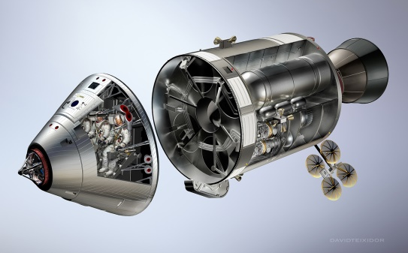
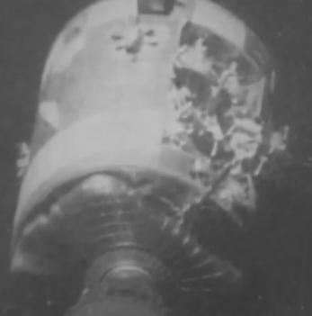
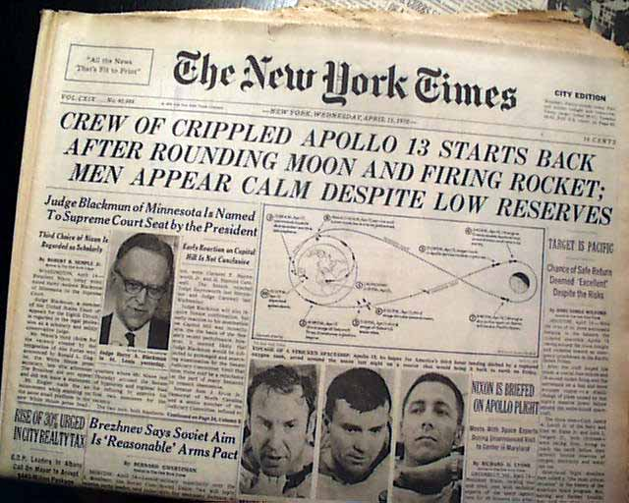
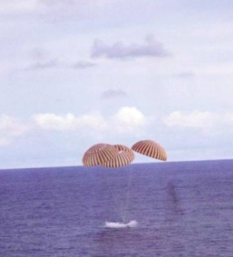
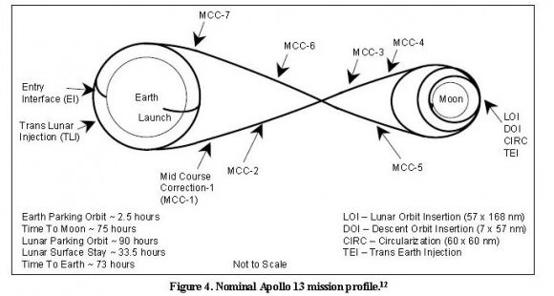
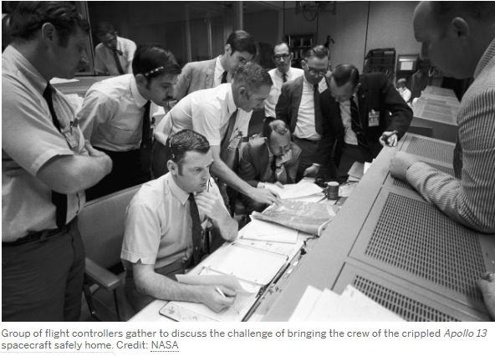
Midcourse Correction (MCC) was the KEY to the survival of
the Apollo 13 Team Voyage to the Moon. April of 1970
A MID-COURSE CORRECTION MAY ALSO BE THE KEY TO YOUR SURVIVAL.
LIFTOFF KENNEDY SPACE CENTER, FLORIDA ON APRIL 11, 1970
APOLLO COMMAND AND SERVICE MODULE
AN OXYGEN TANK ON THE SERVICE MODULE EXPLODED.
“Crew of Crippled Apollo 13 Starts Back after Rounding the Moon and Firing Rocket; Men Appear Calm Despite Low Reserves”
April 17, 1970, successful splashdown in the Pacific Ocean
NASA and its other partners solved a problem never encountered before.

Slide 15
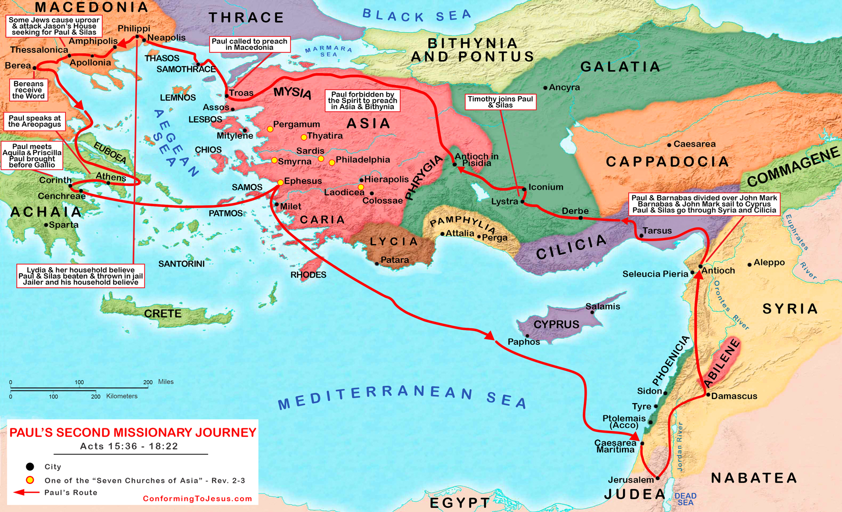
The Spirit said “No!” to going into Asia and “No!” to going to Bithynia (Acts 16:6-8).
BUT at Troas, (16:9-10, much further than he planned to go) Paul made a Midcourse Correction. Because of this MCC of the Holy Ghost, the Gospel went into Macedonia (Philippi, Thessalonica) and Greece (Corinth, Athens).

Slide 16
Your Assignment: (should you accept it)
It is a question to ponder and perhaps to ACT upon.
Open General Question: Do you believe you can create the future?
Specific Application: Your future?
Specific Application: The future of others?
If so – why do you feel you can or you cannot create the (yours or others) future?
Action and Commitment
If you believe you can create the future do like Paul, Strive Purposefully through Prayer, Planning, and Persistence.
Pursue with Passion!
If you believe you can’t create the future, best of luck in getting somewhere in life.

Slide 17

THANK YOU
for your support and your attentiveness to
Practicing & Engaging in
Healthy Habits
for Your Christian Life
and All Your Life.

