Slide 1

The healthy habit of GodlY reading-
Lectio divina

Slide 2
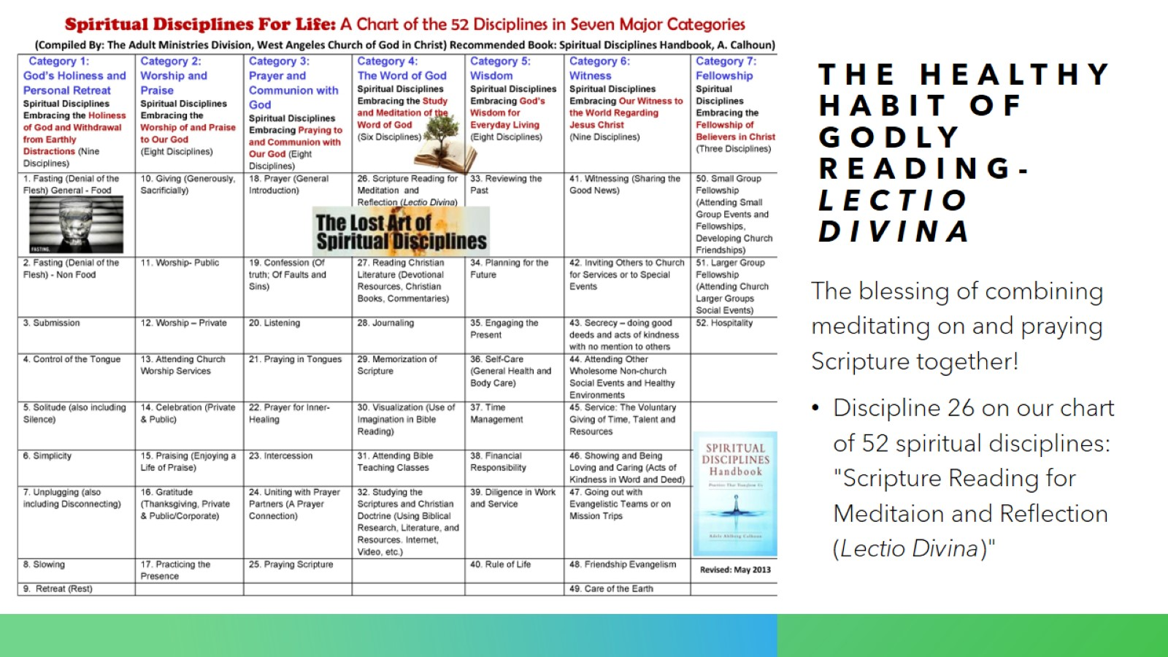
The healthy habit of godly reading-lectio divina

Slide 3
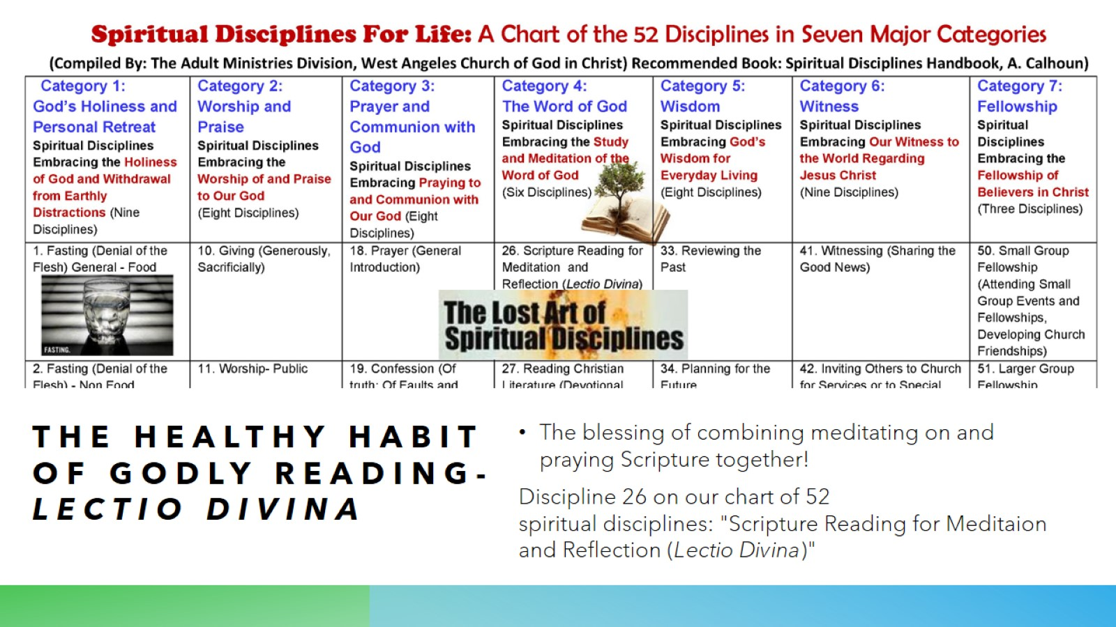
THE HEALTHY HABIT OF GODLY READING-LECTIO DIVINA

Slide 4
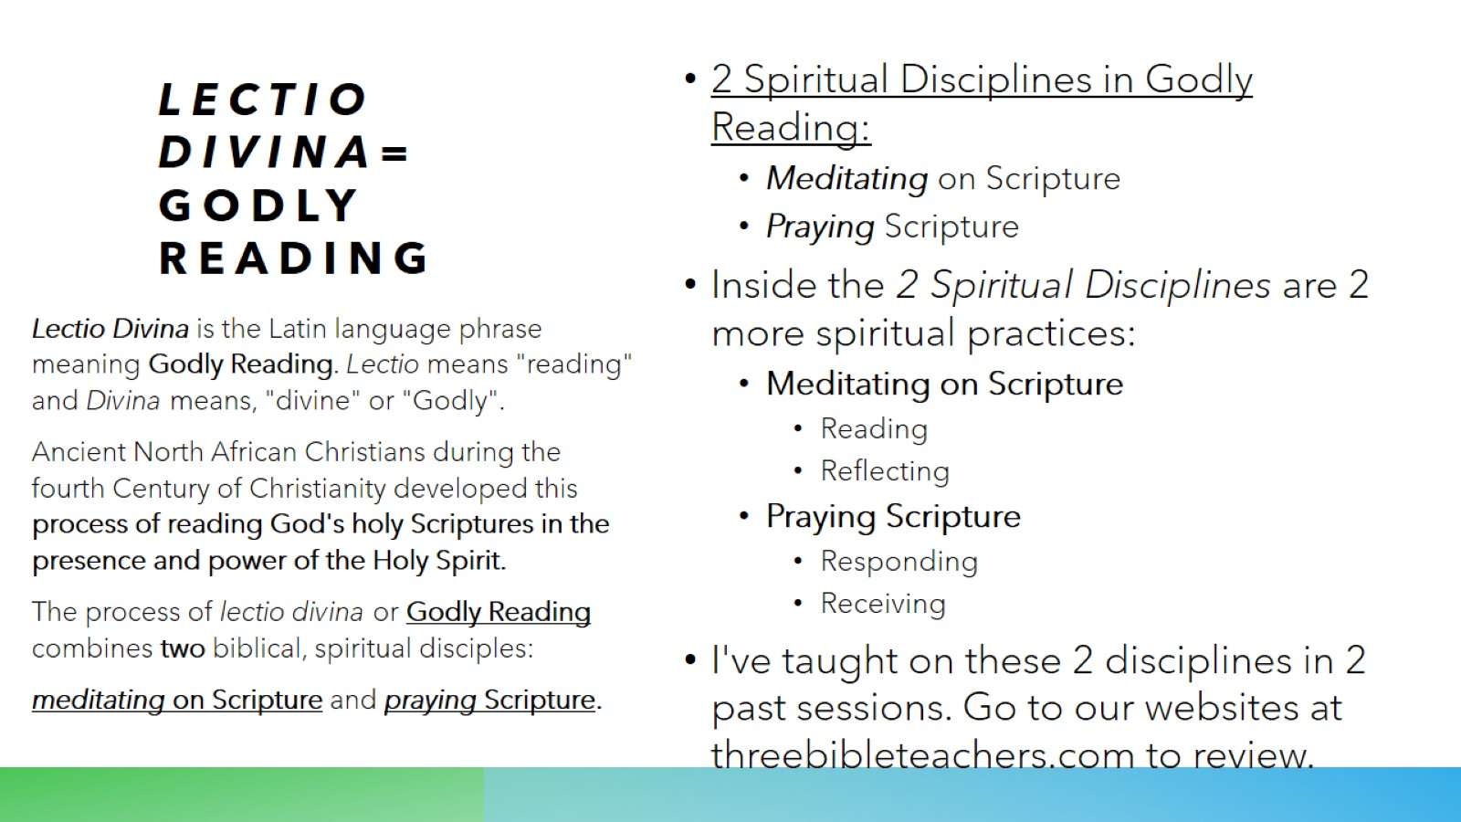
Lectio Divina=
Godly reading

Slide 5
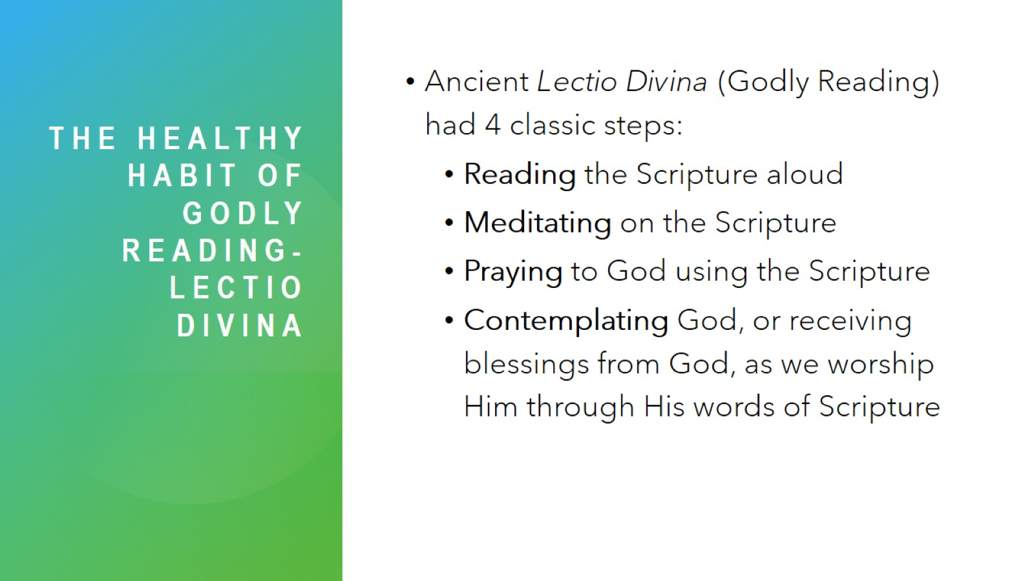
The healthy habit of godly reading-Lectio divina

Slide 6

The healthy habit of godly reading

Slide 7
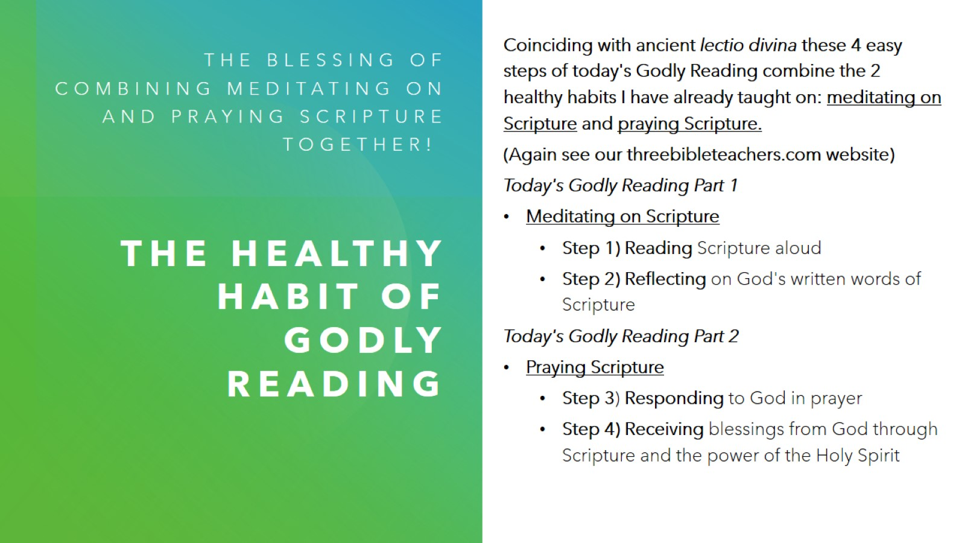
The healthy habit of GodlY reading

Slide 8
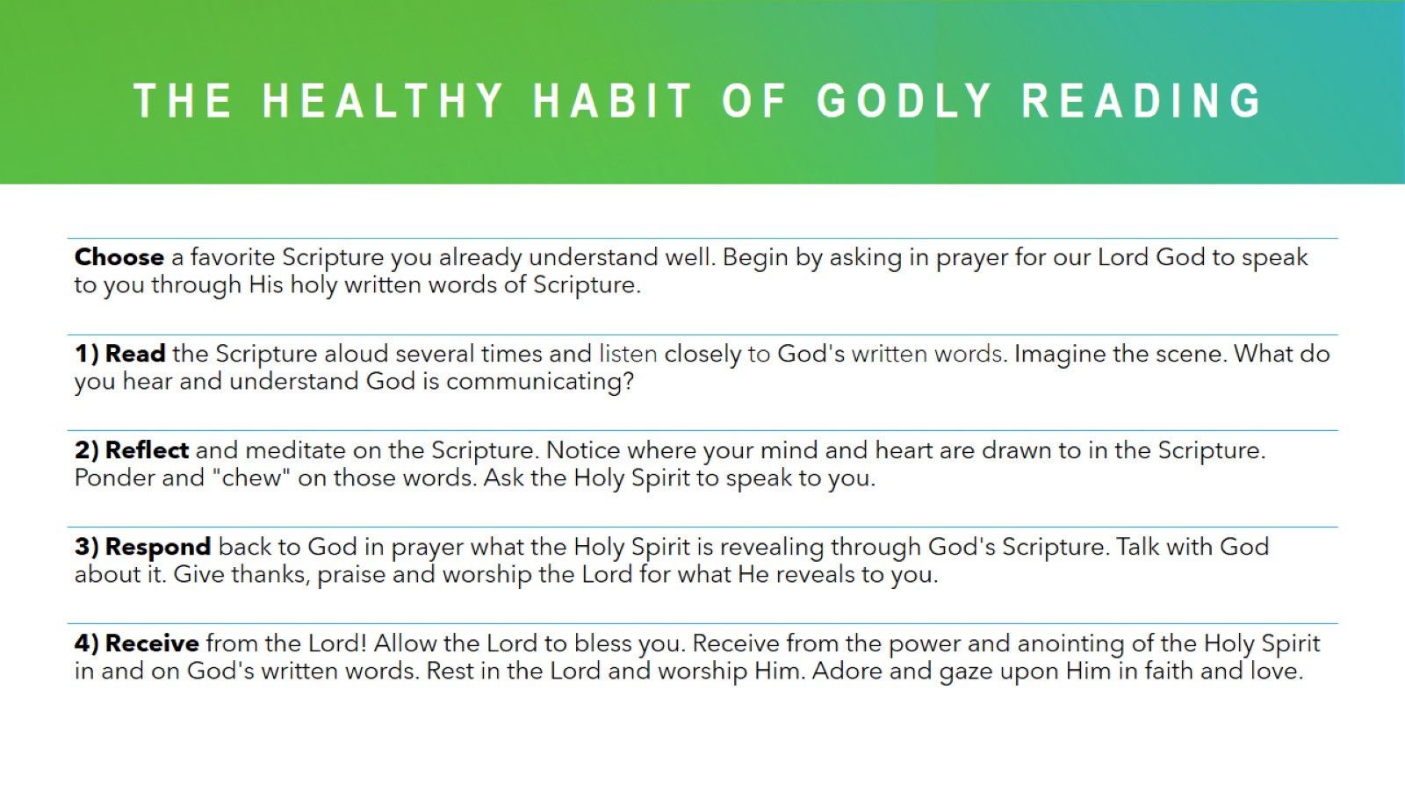
The healthy habit of godly reading

Slide 9
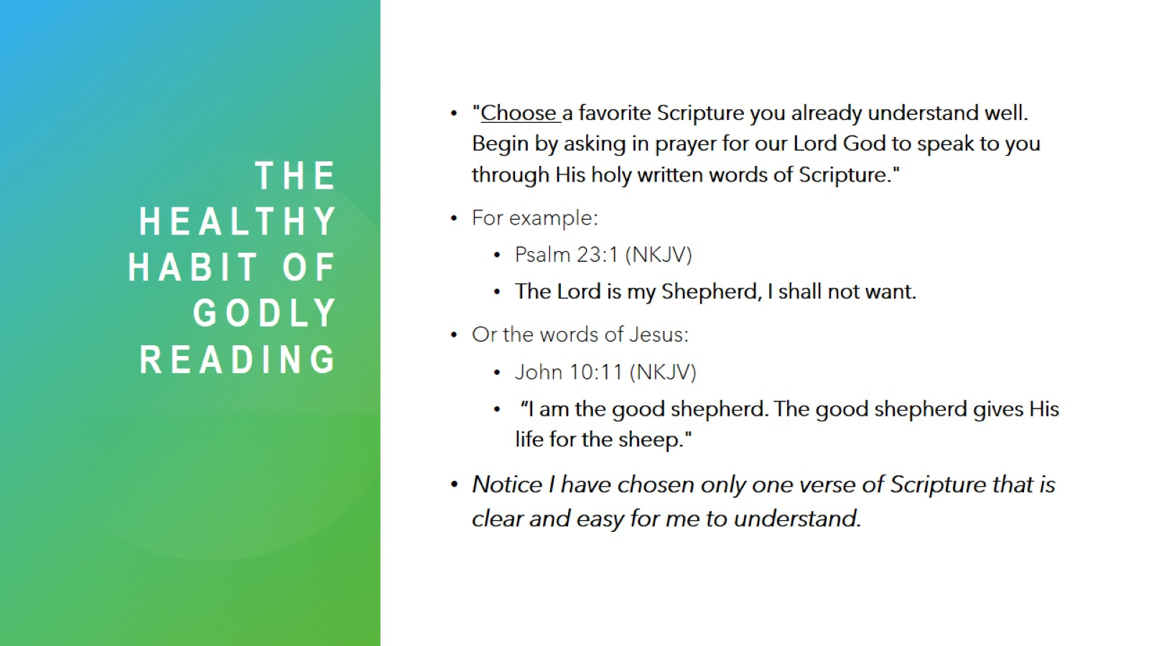
The healthy habit of godlY reading

Slide 10
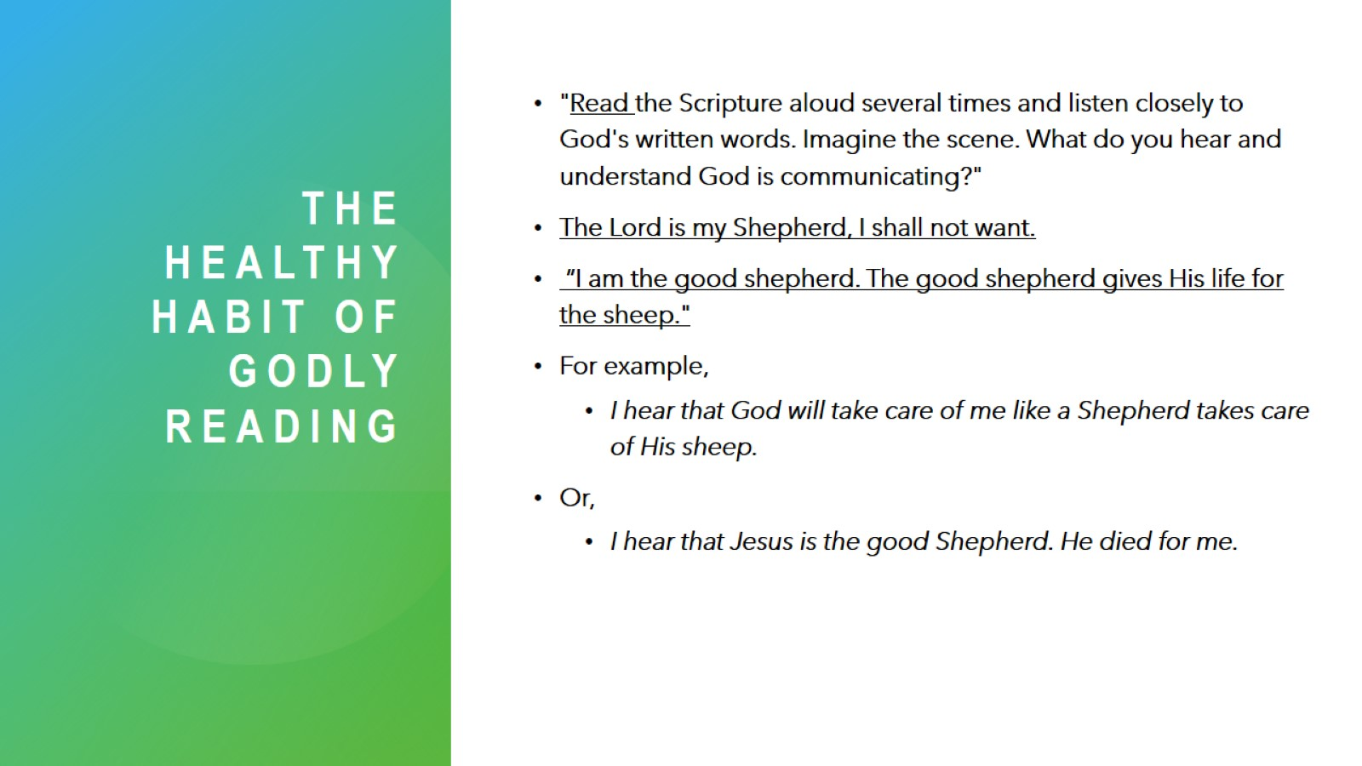
The healthy habit of godlY reading

Slide 11
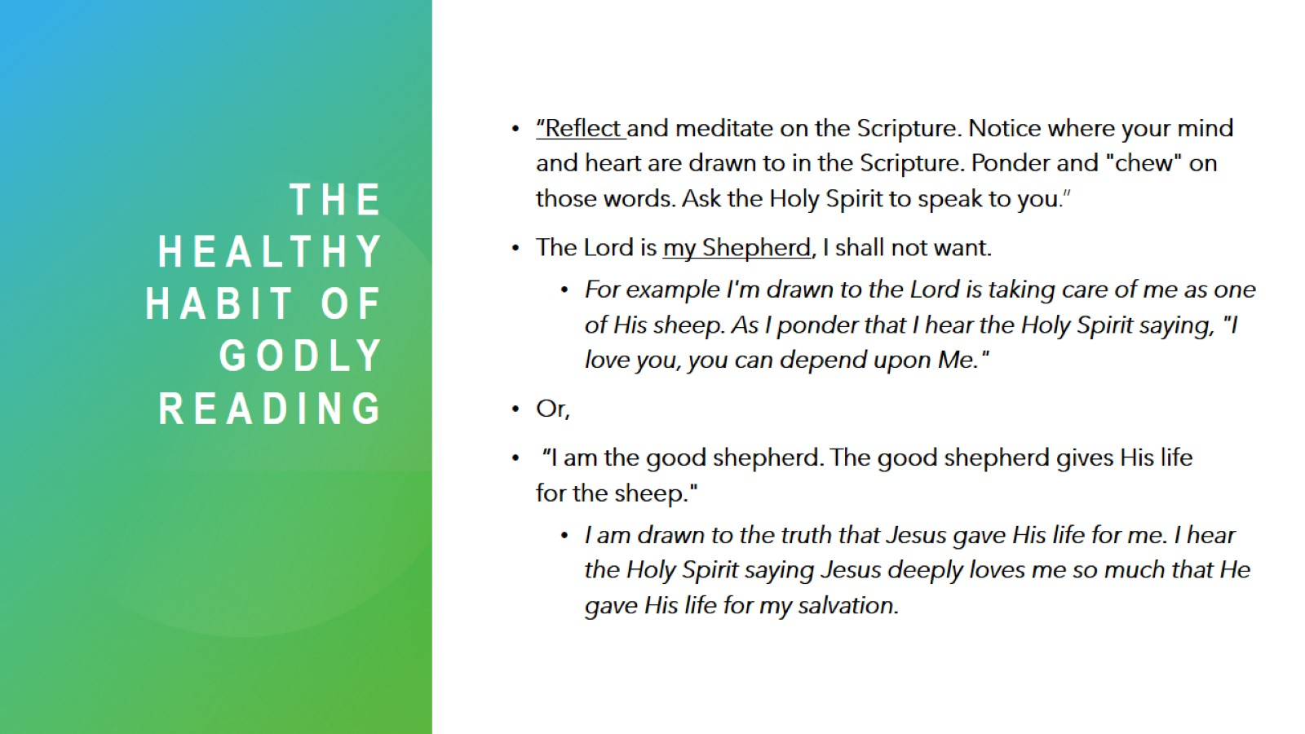
The healthy habit of godlY reading

Slide 12
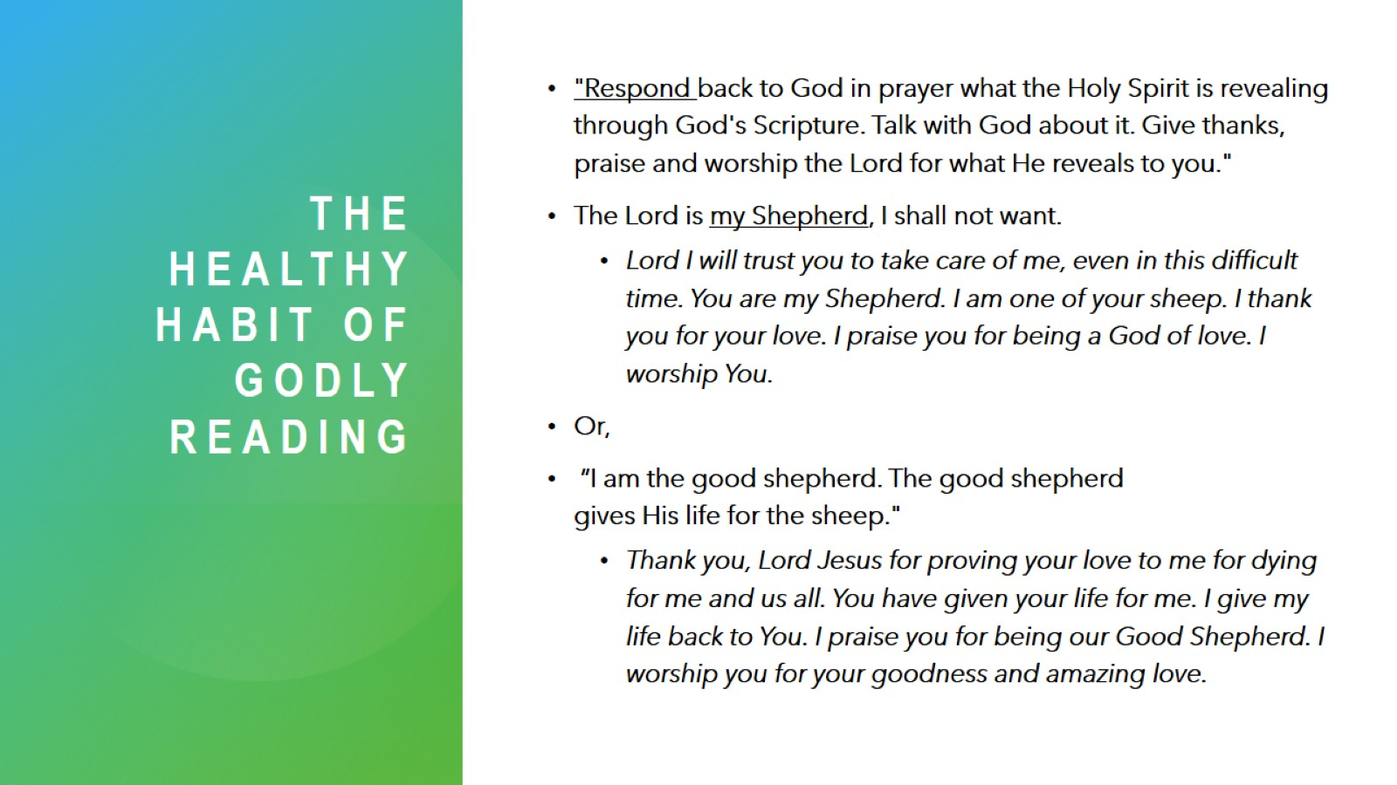
The healthy habit of godlY reading

Slide 13
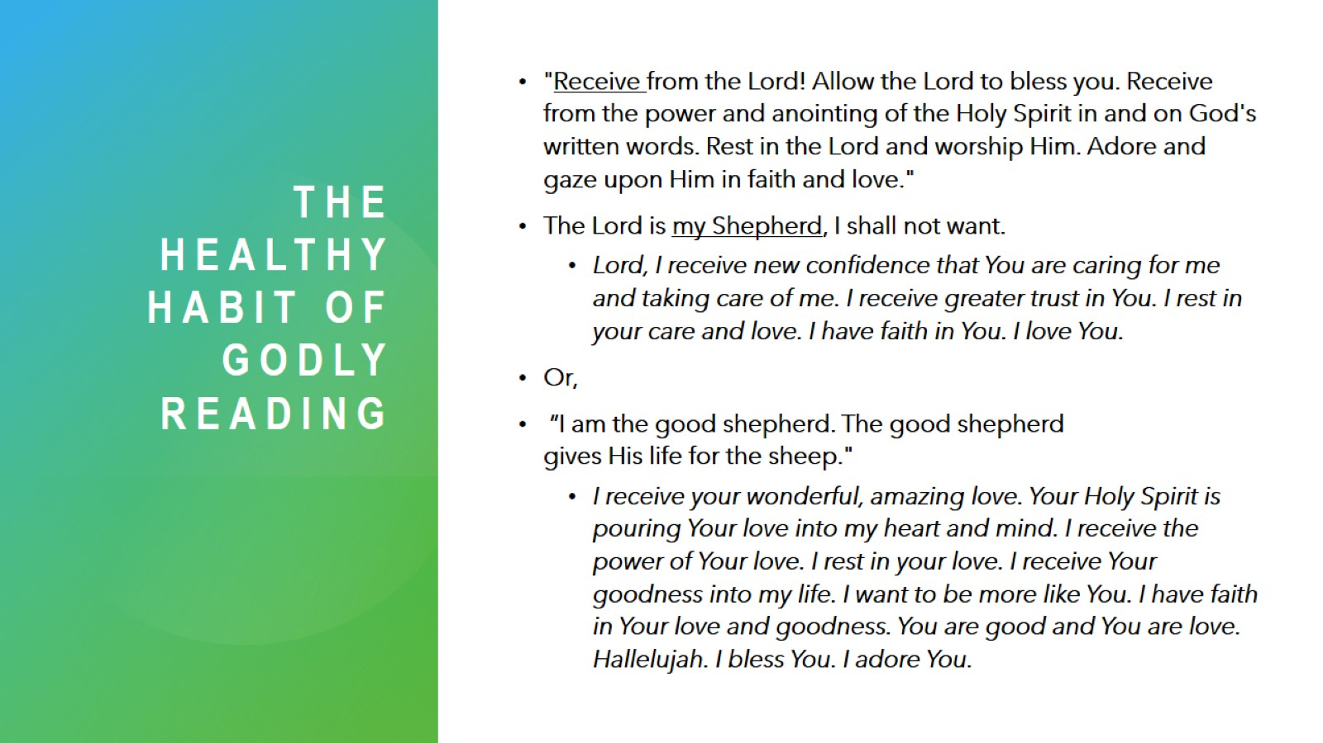
The healthy habit of godlY reading

Slide 14
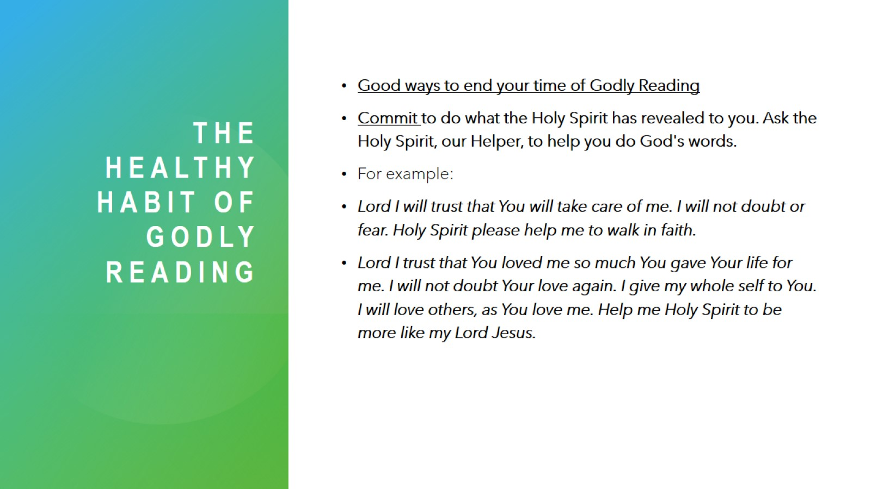
The healthy habit of godlY reading

Slide 15
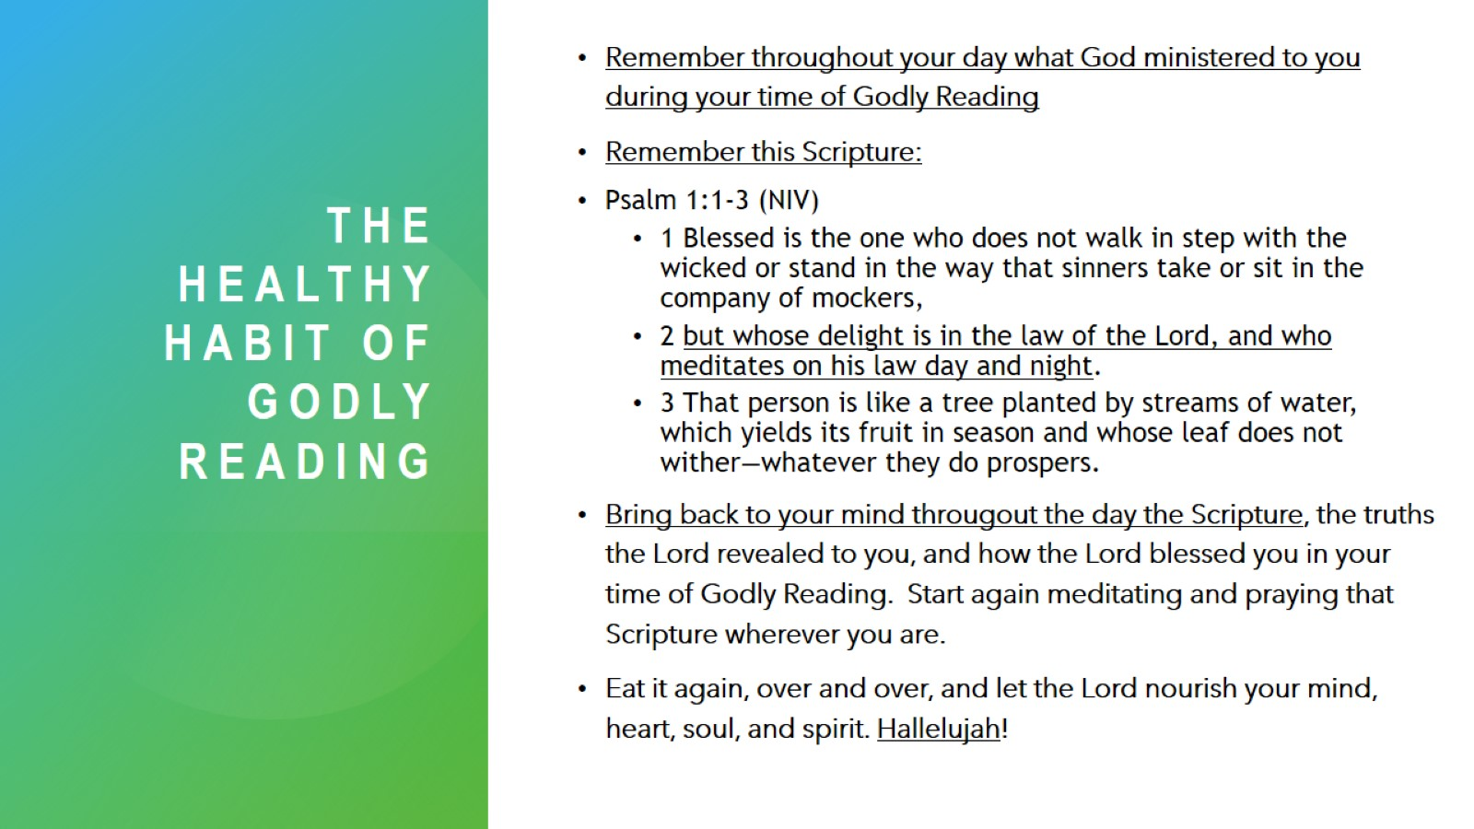
The healthy habit of godlY reading

Slide 16
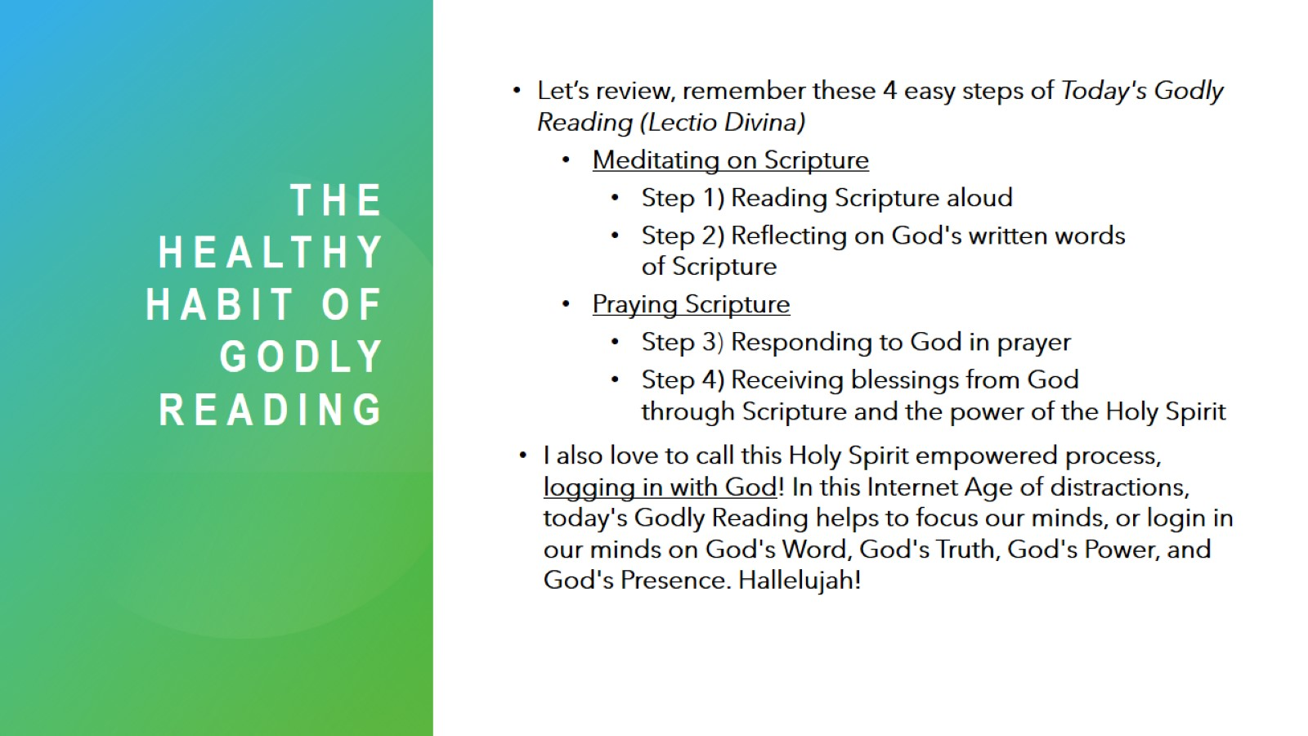
The healthy habit of godly reading

Slide 17
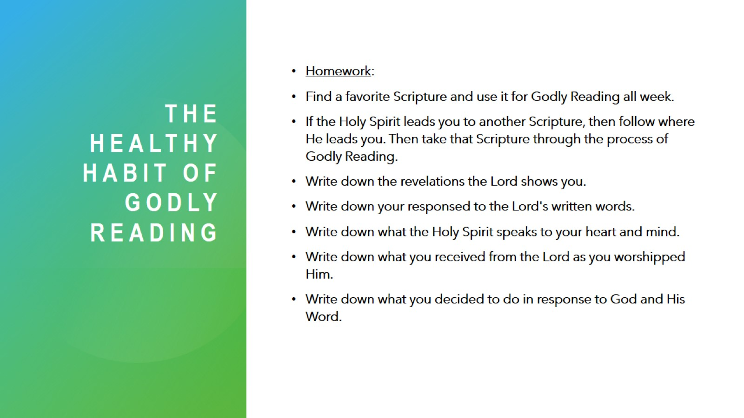
The healthy habit of godly reading

Slide 18
The healthy habit of GodlY reading-
Lectio divina

