Slide 1

Holy self-care

Slide 2

Holy self-care: a definition

Slide 3
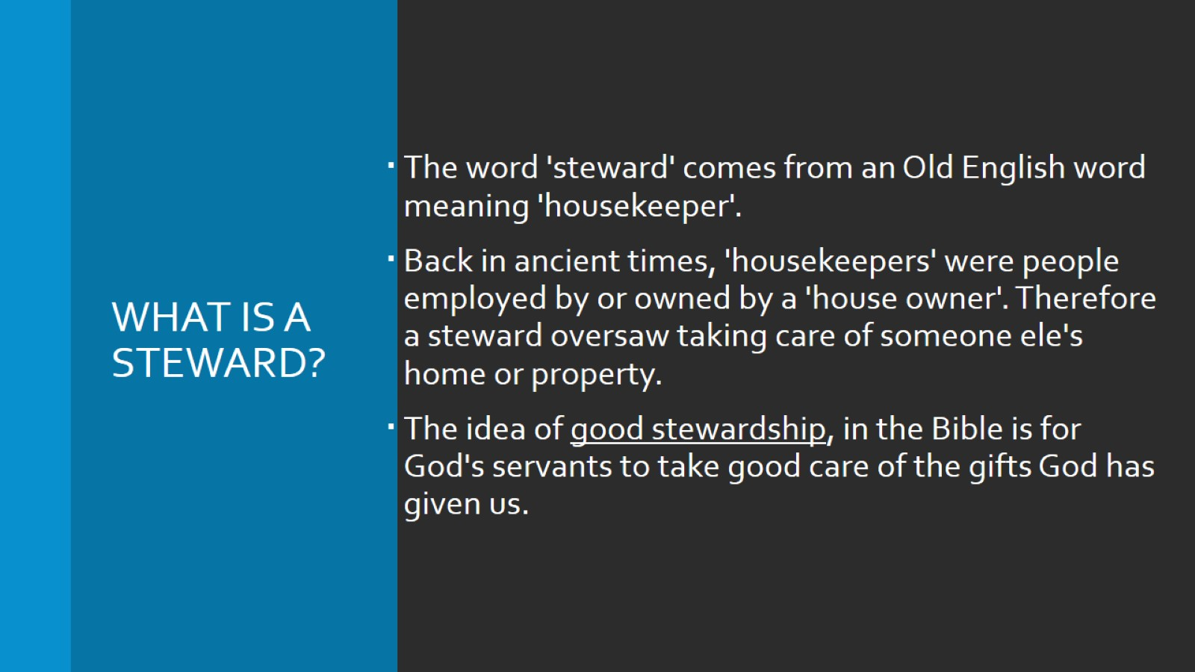
What is a steward?

Slide 4
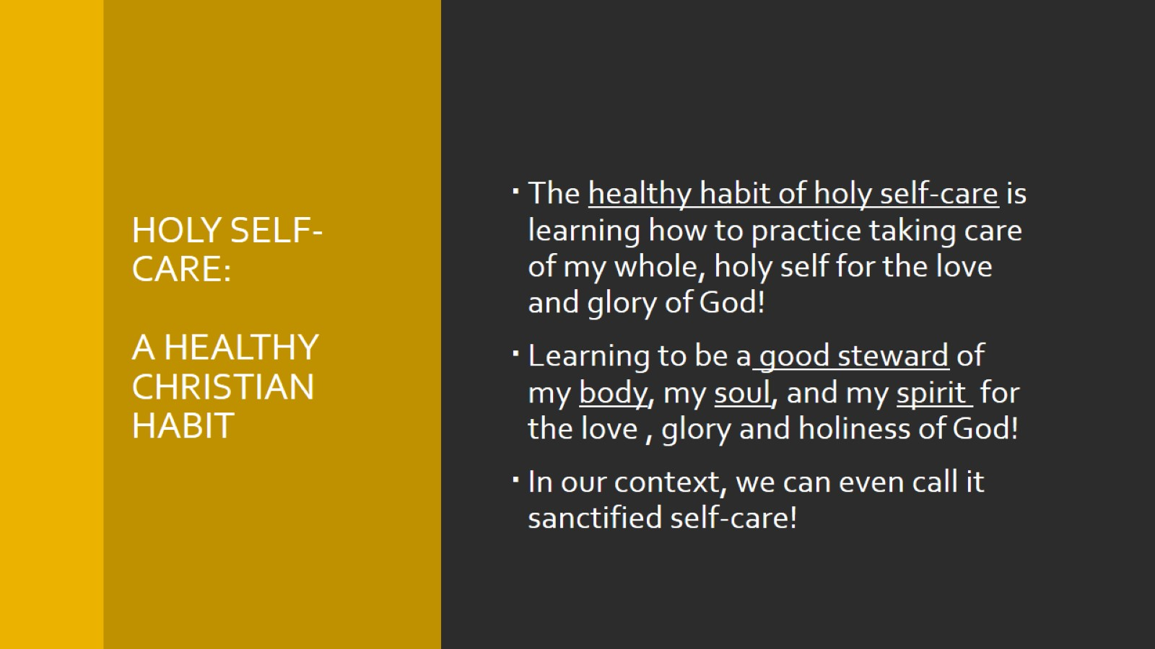
Holy self-care:
A healthy Christian Habit

Slide 5
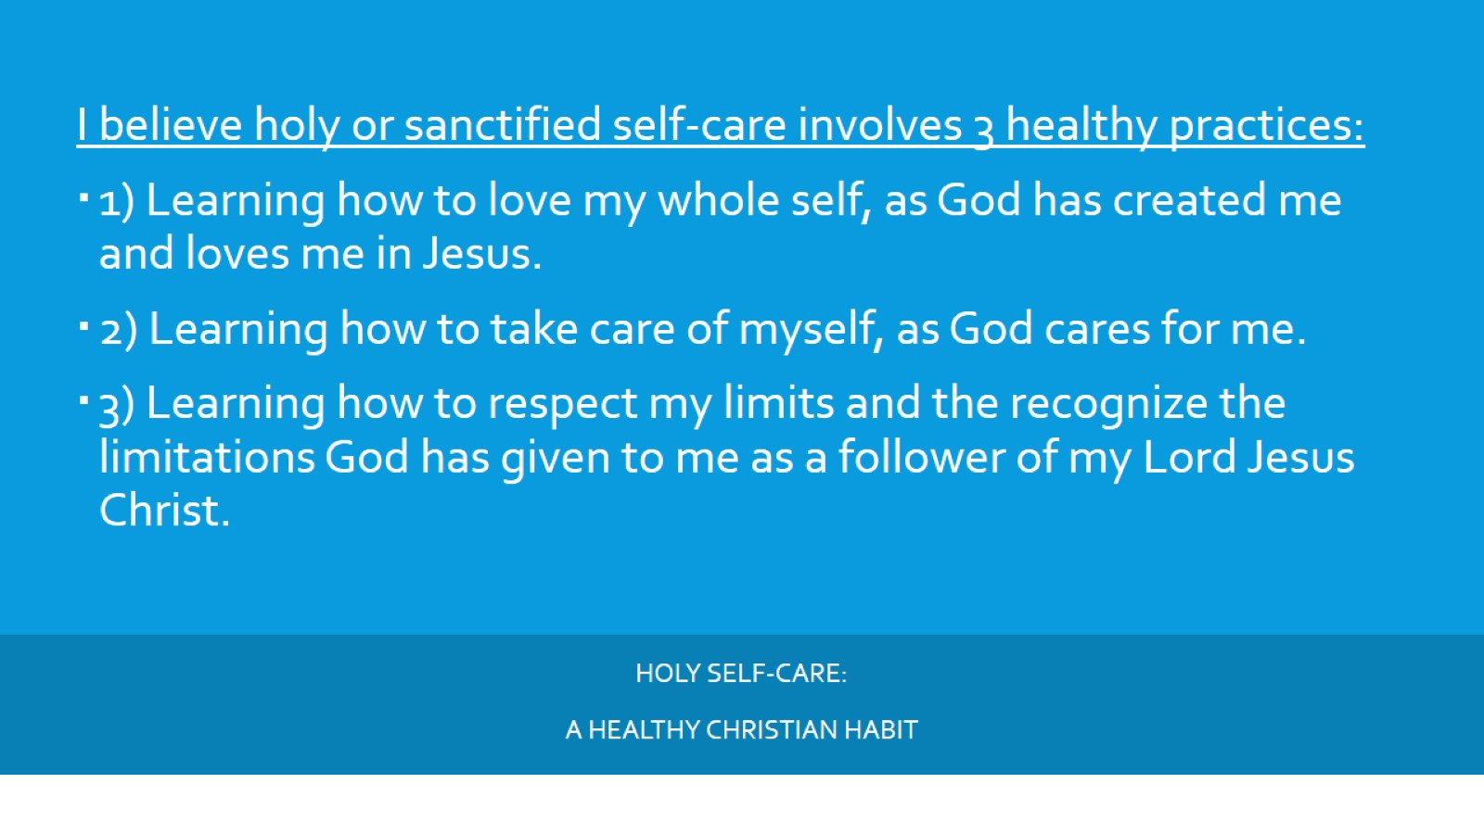
Holy self-care:
A healthy Christian Habit

Slide 6

Holy self-care:
A healthy Christian Habit

Slide 7
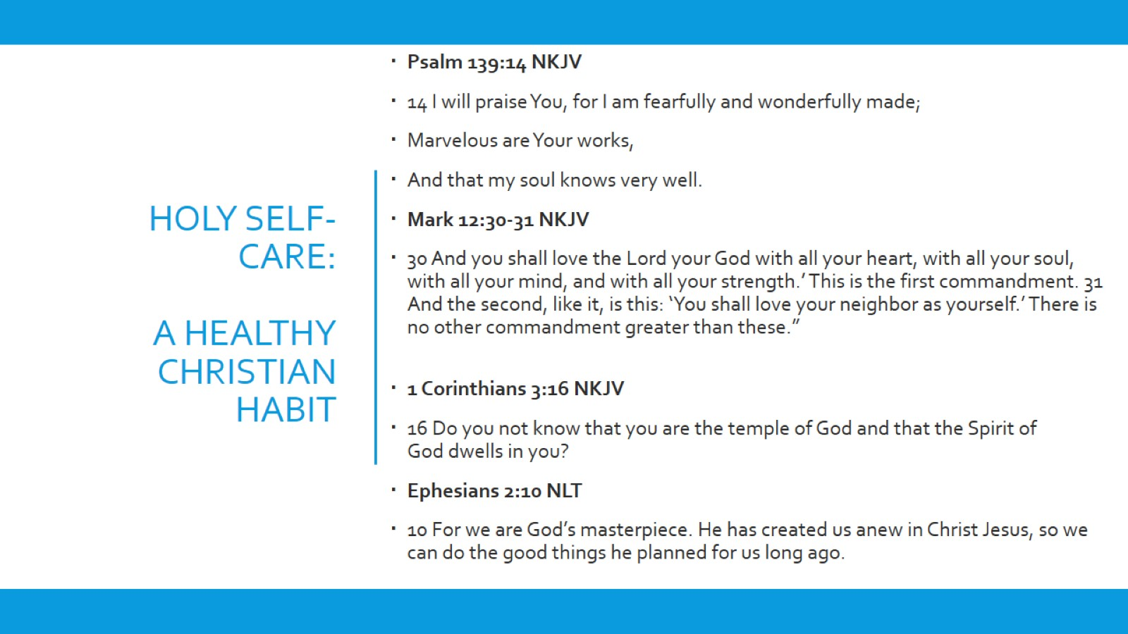
Holy self-care:
A healthy Christian Habit

Slide 8
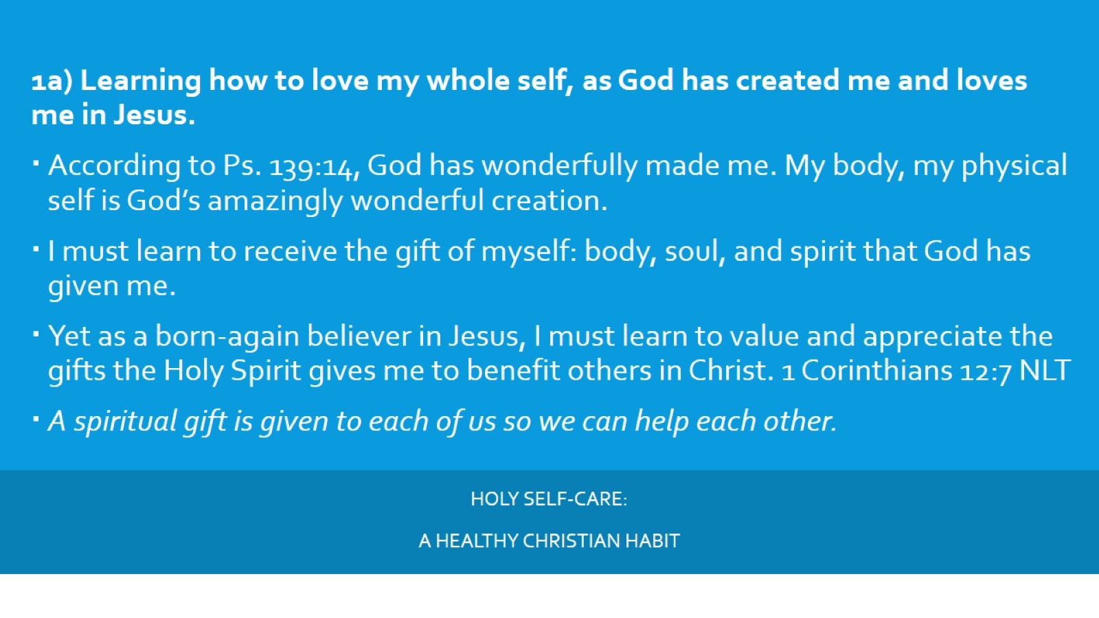
Holy self-care:
A healthy Christian Habit

Slide 9
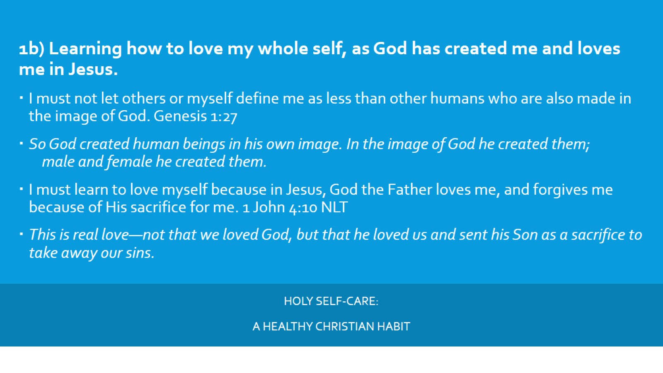
Holy self-care:
A healthy Christian Habit

Slide 10
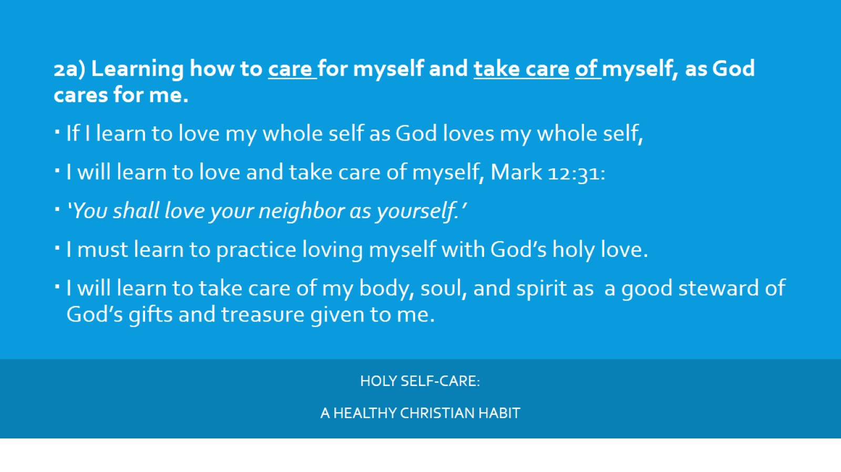
Holy self-care:
A healthy Christian Habit

Slide 11
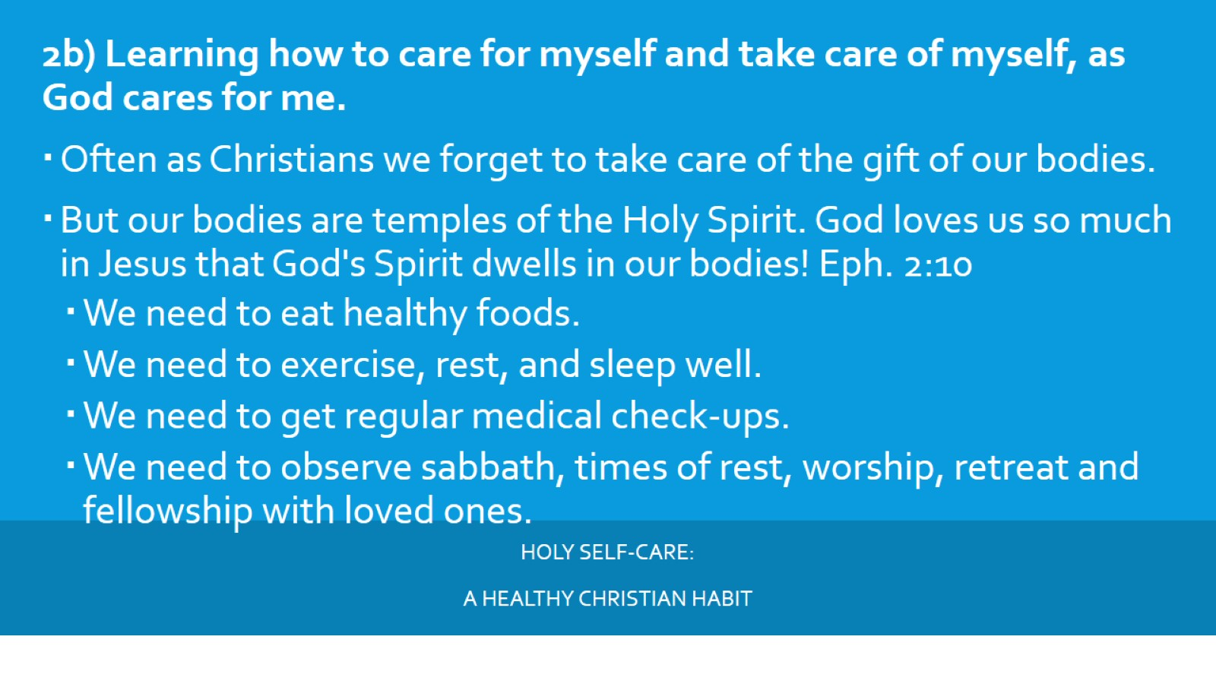
Holy self-care:
A healthy Christian Habit

Slide 12
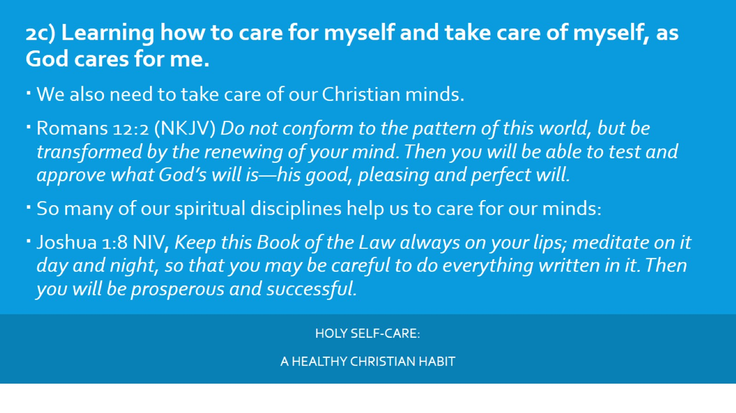
Holy self-care:
A healthy Christian Habit

Slide 13
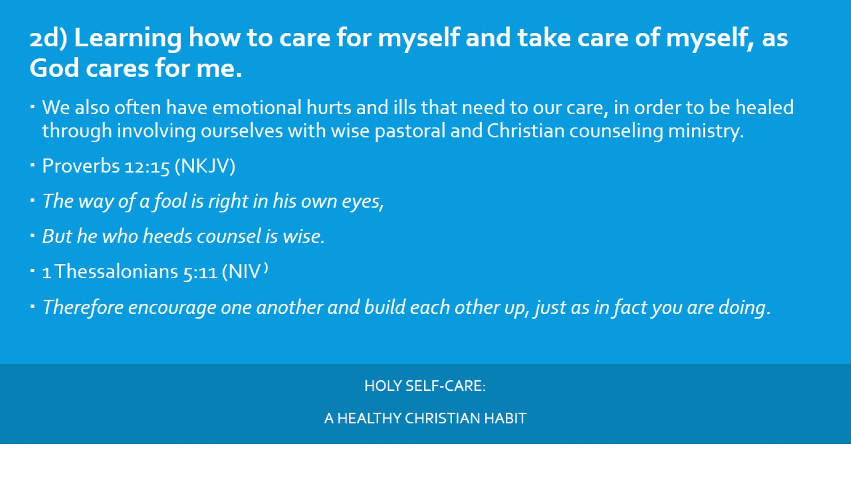
Holy self-care:
A healthy Christian Habit

Slide 14
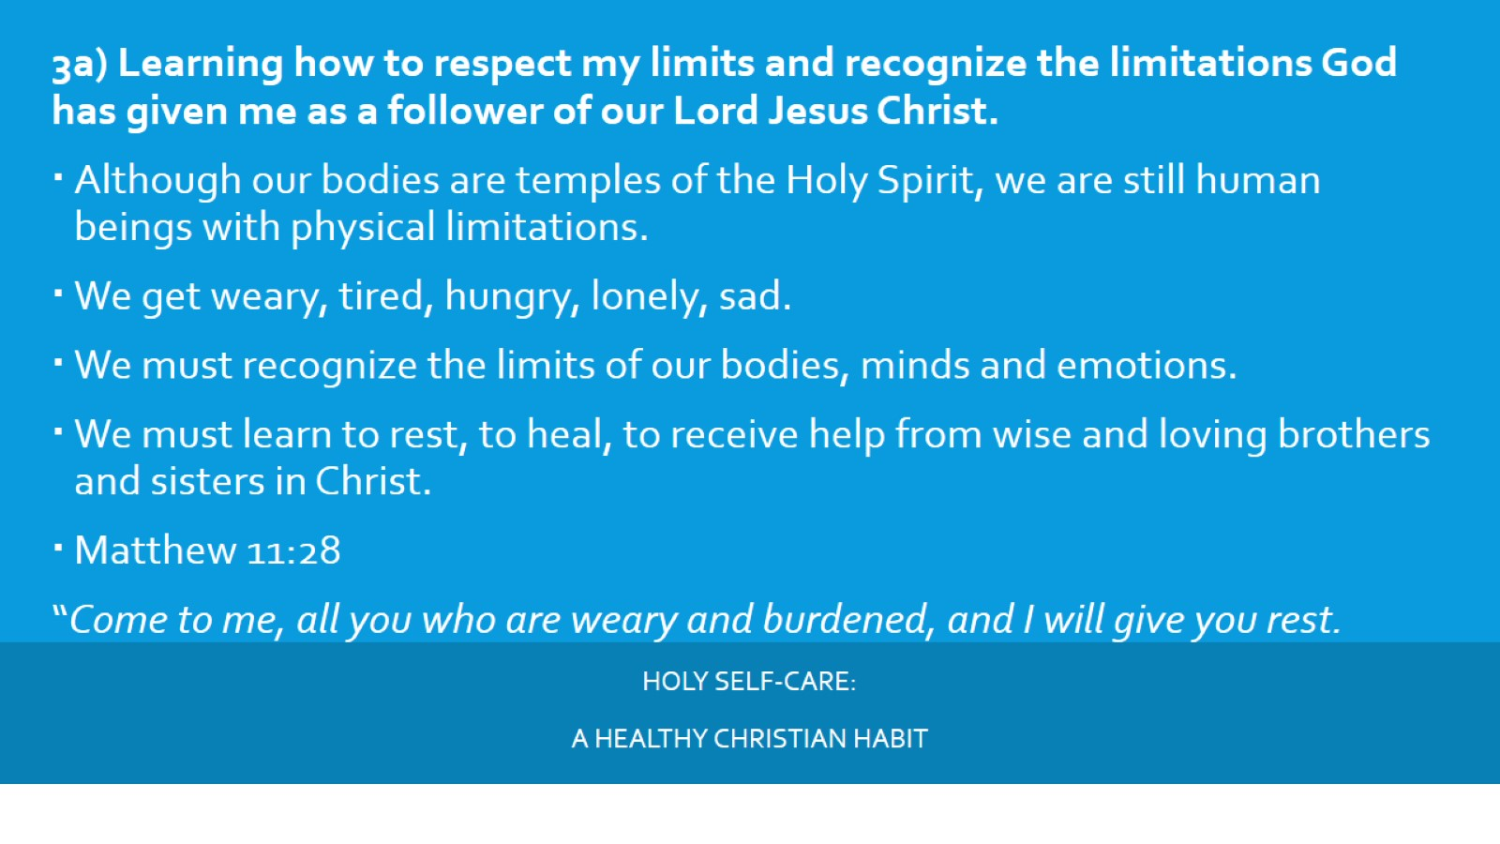
Holy self-care:
A healthy Christian Habit

Slide 15
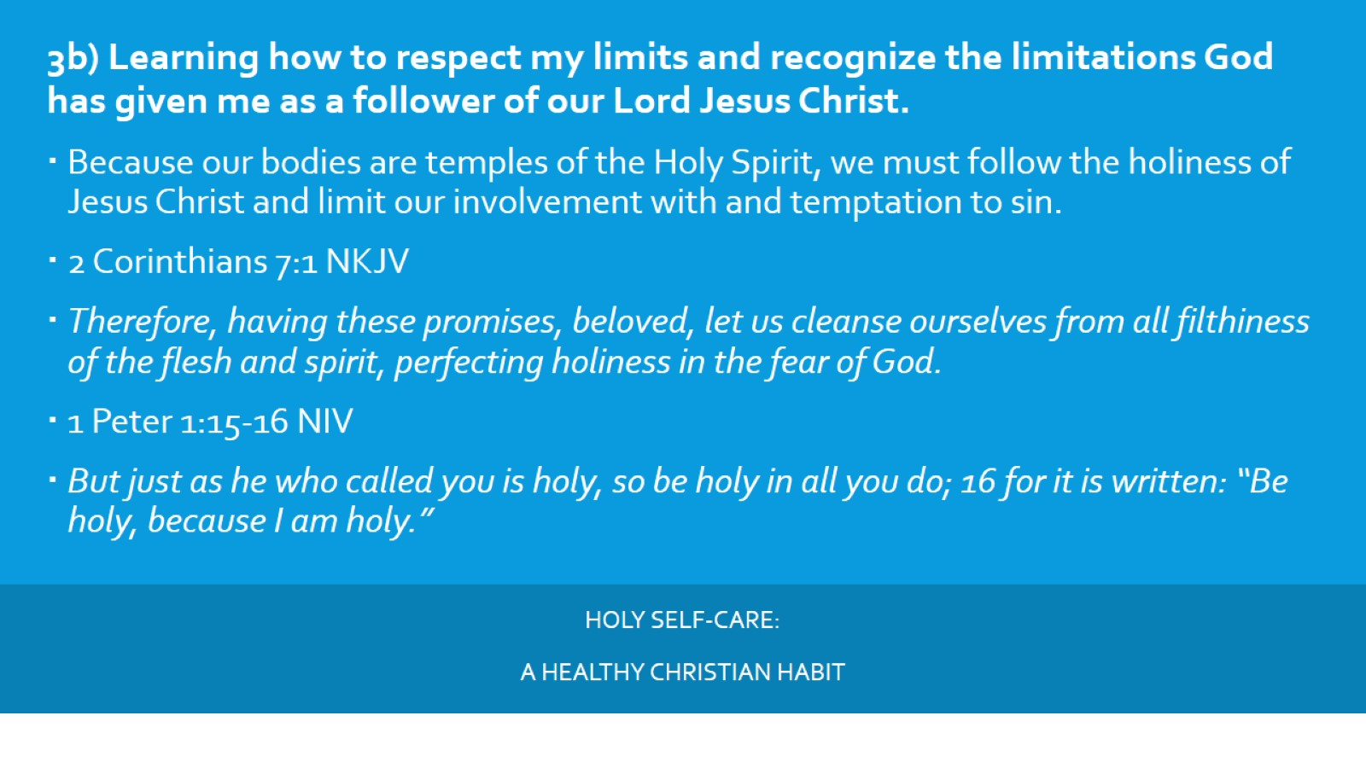
Holy self-care:
A healthy Christian Habit

Slide 16
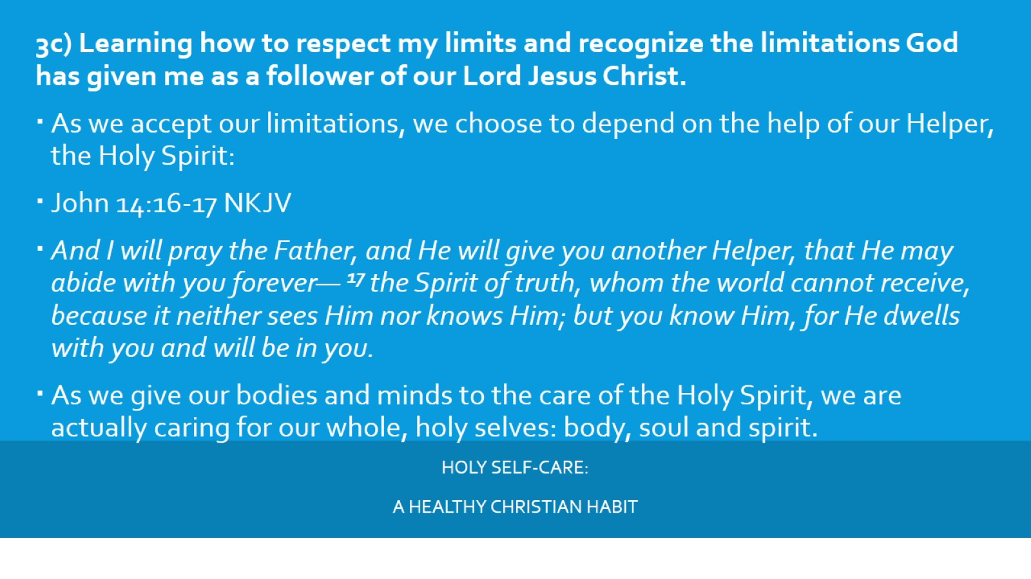
Holy self-care:
A healthy Christian Habit

Slide 17
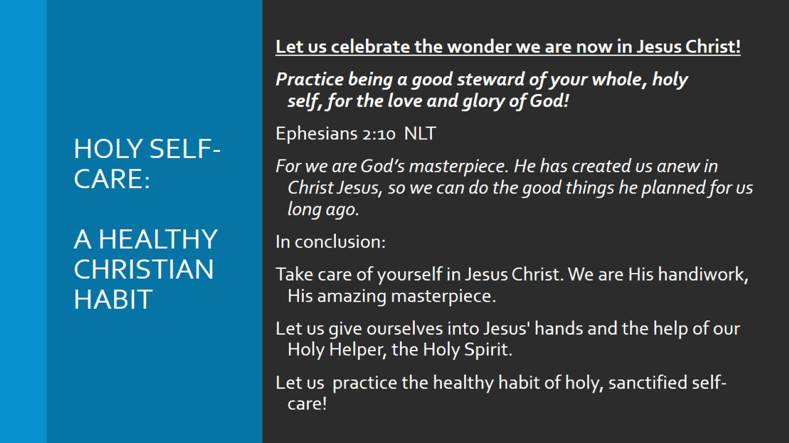
Holy self-care:
A healthy Christian Habit

Slide 18
Holy self-care

