Slide 1

Christmas and the Separation of Fact from Fiction

Slide 2
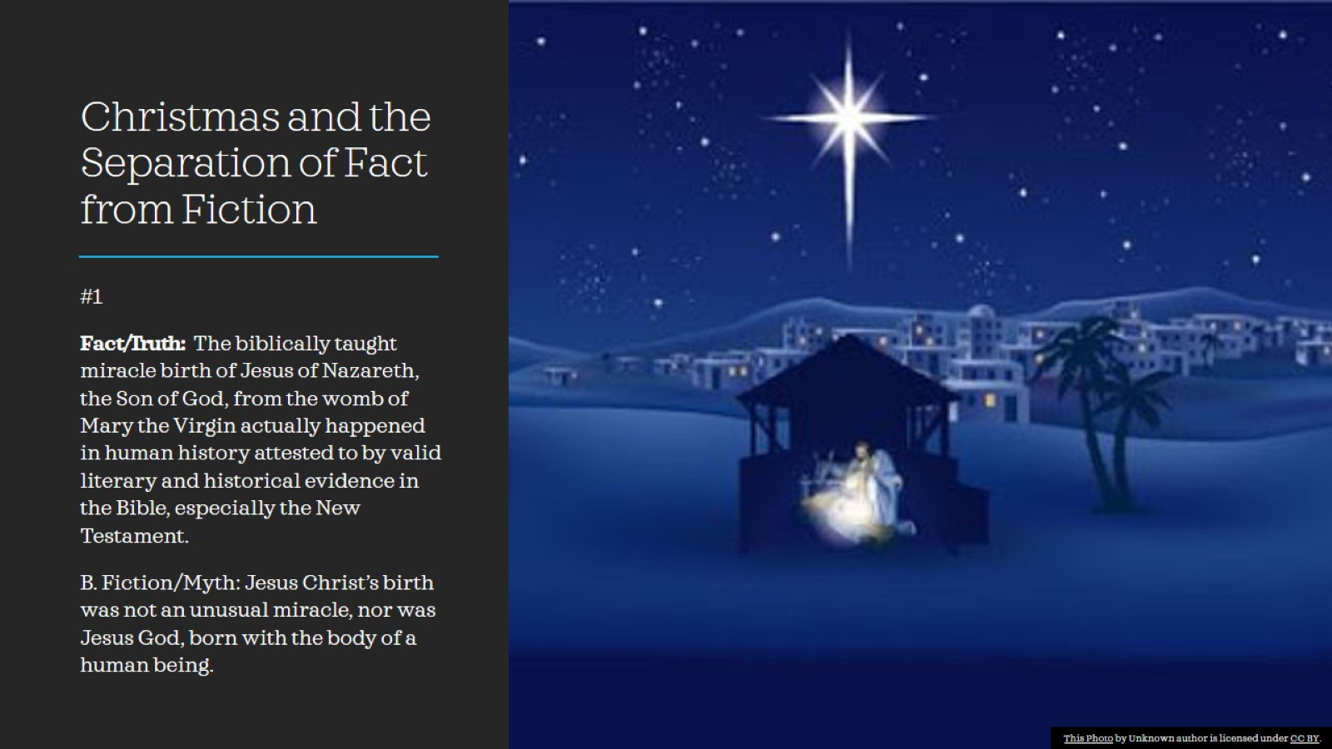
Christmas and the Separation of Fact from Fiction

Slide 3
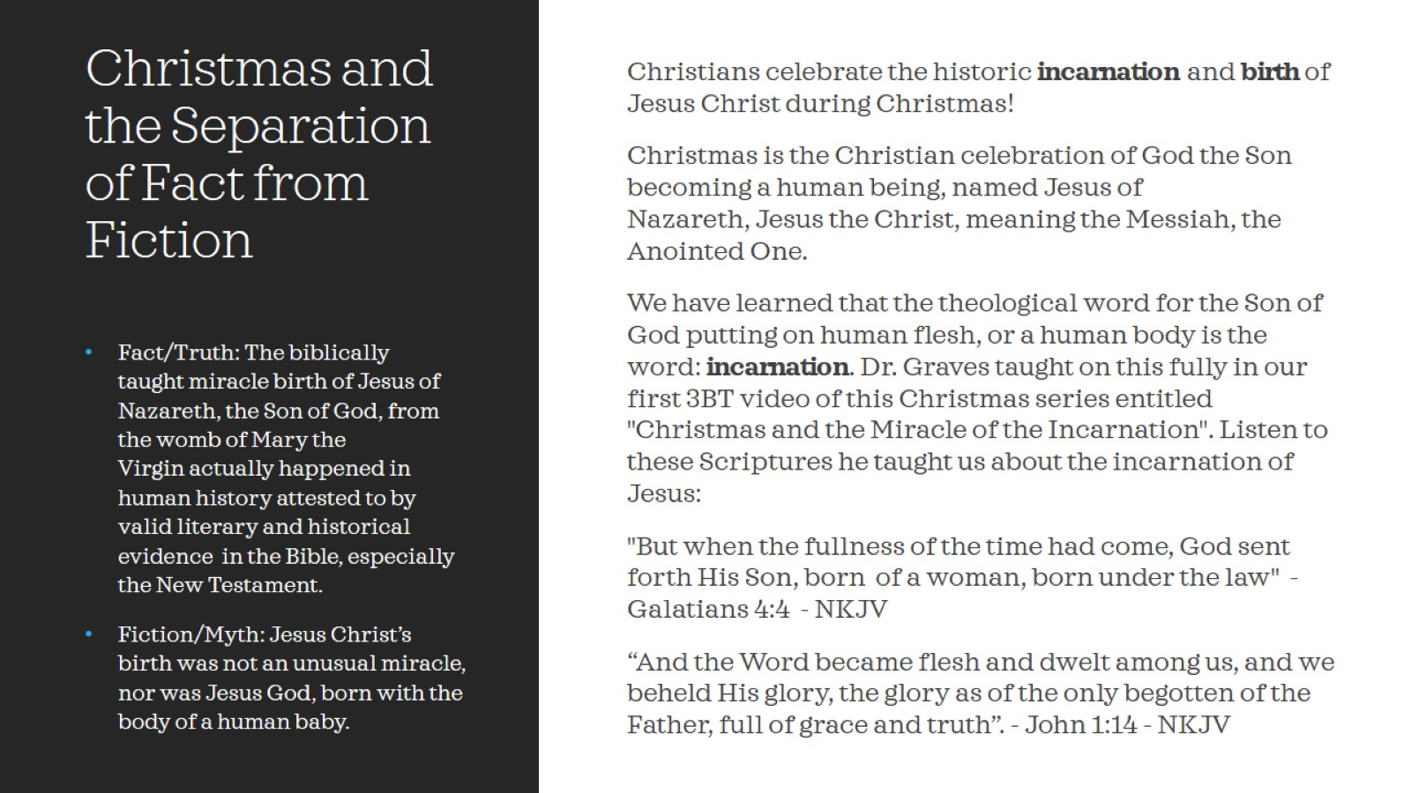
Christmas and the Separation of Fact from Fiction

Slide 4
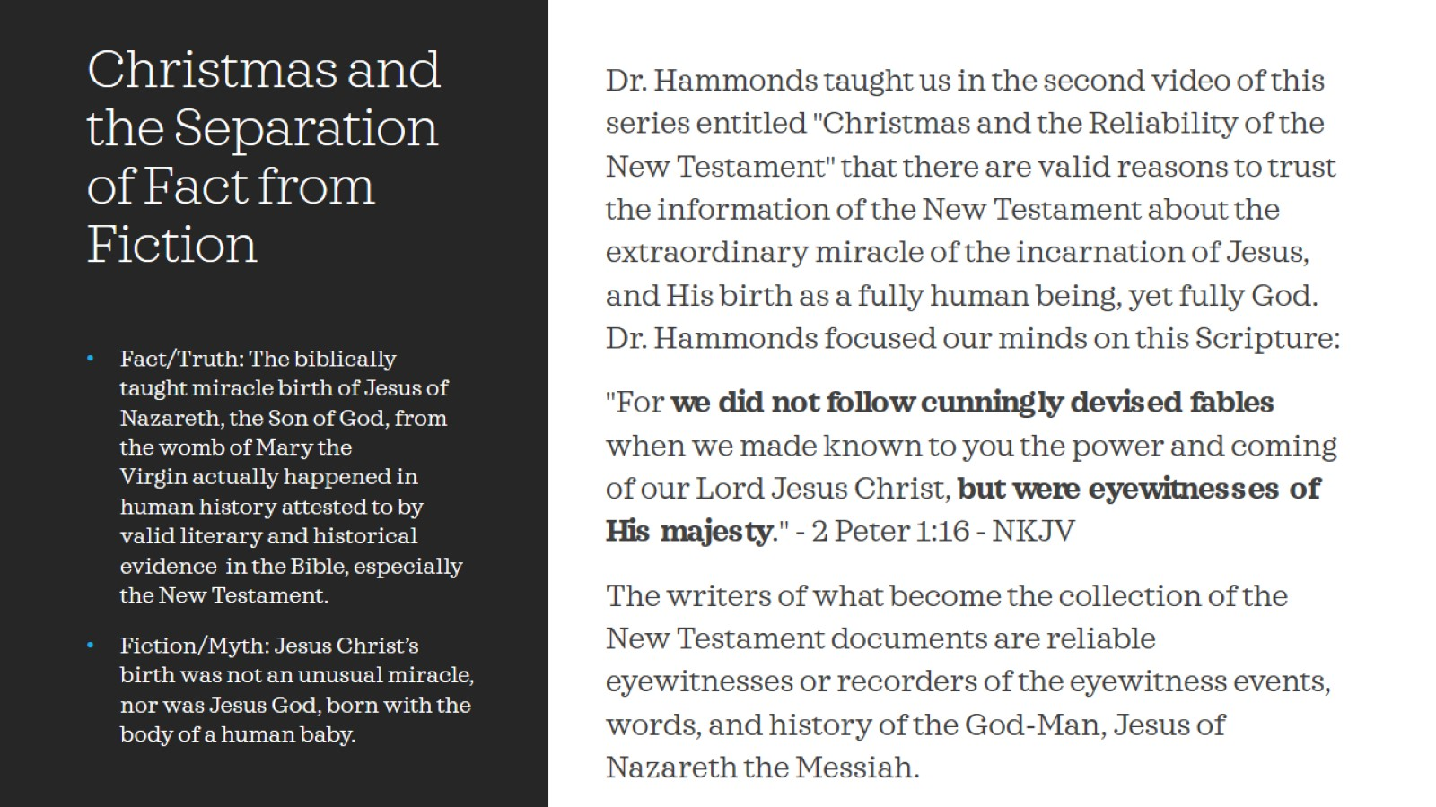
Christmas and the Separation of Fact from Fiction

Slide 5
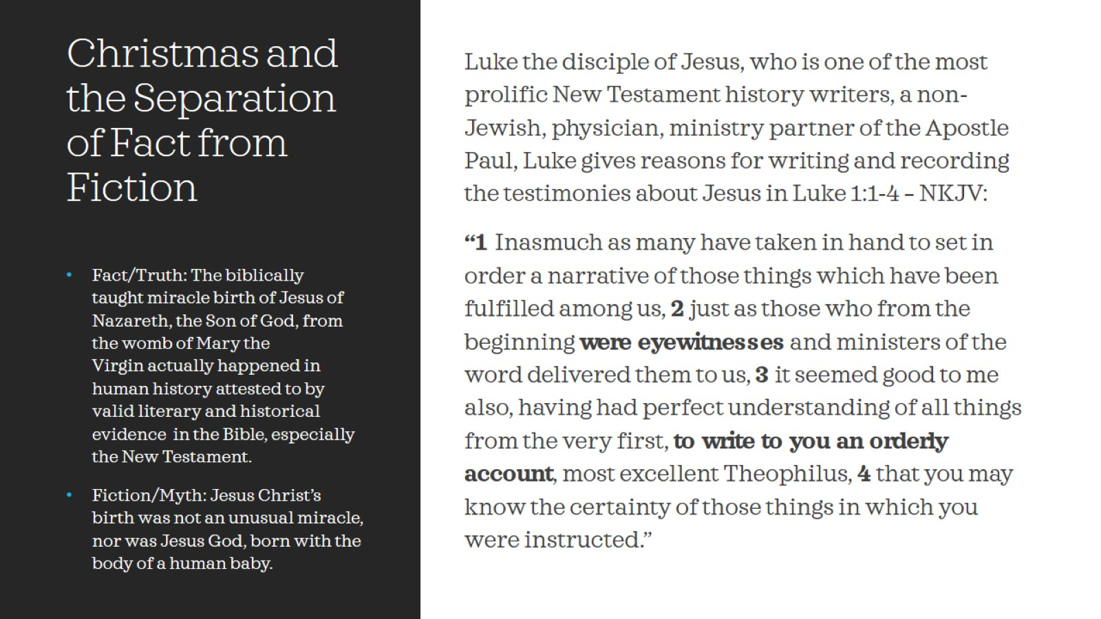
Christmas and the Separation of Fact from Fiction

Slide 6
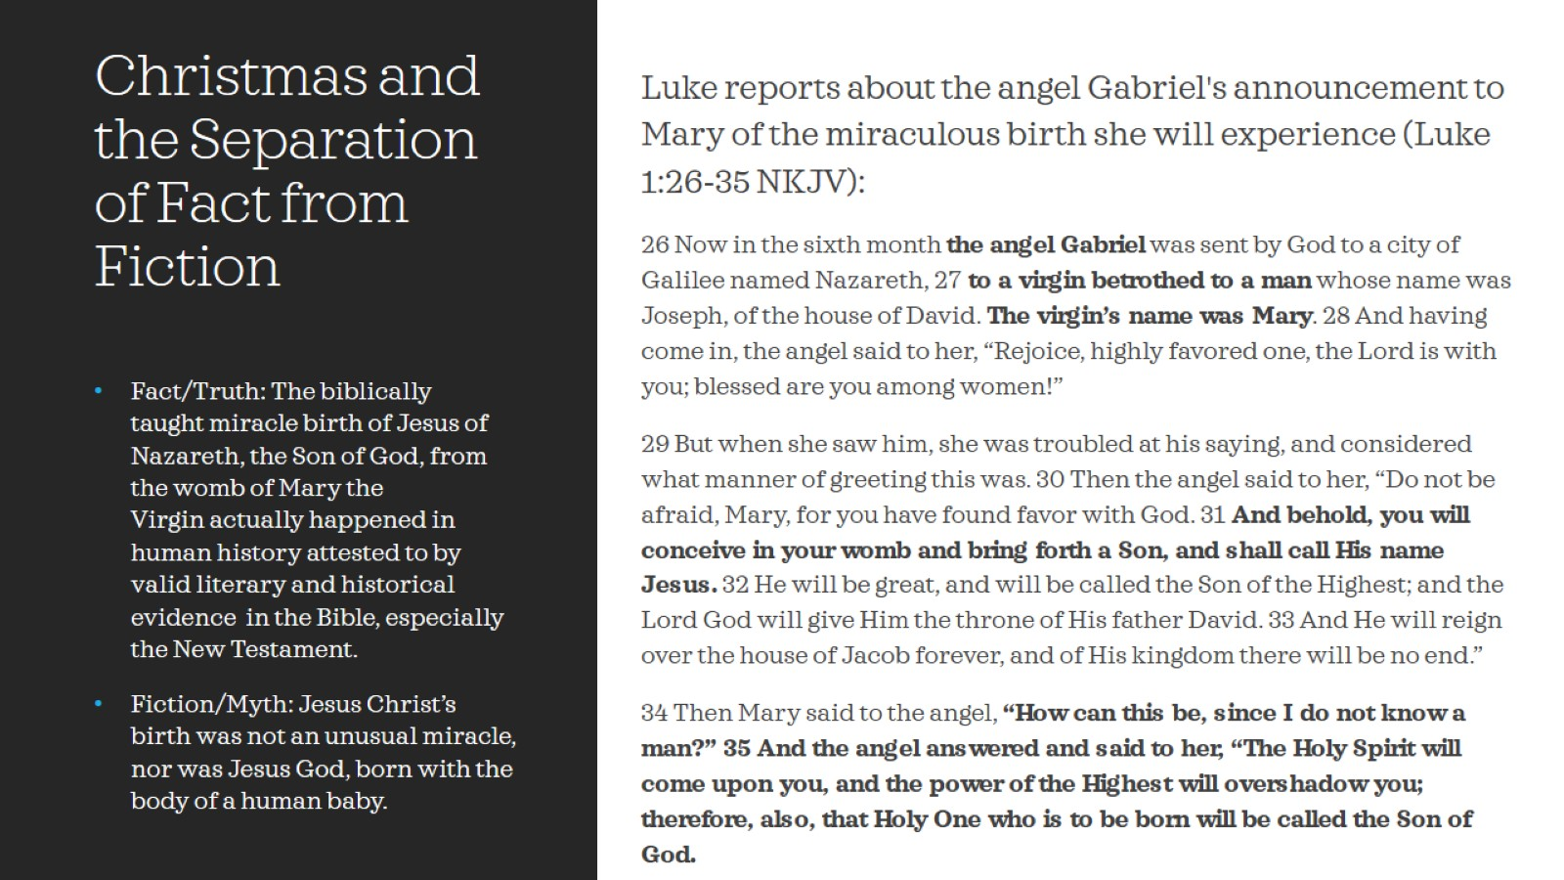
Christmas and the Separation of Fact from Fiction

Slide 7
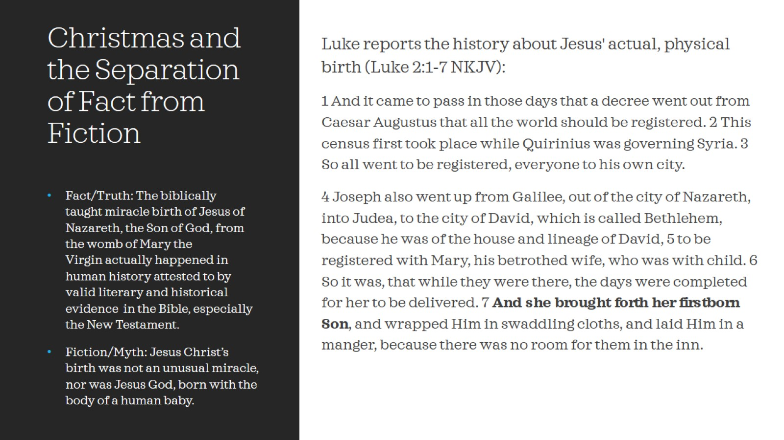
Christmas and the Separation of Fact from Fiction

Slide 8
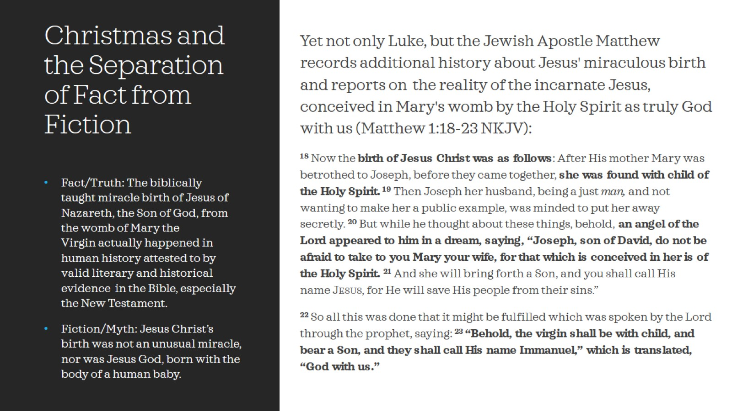
Christmas and the Separation of Fact from Fiction

Slide 9
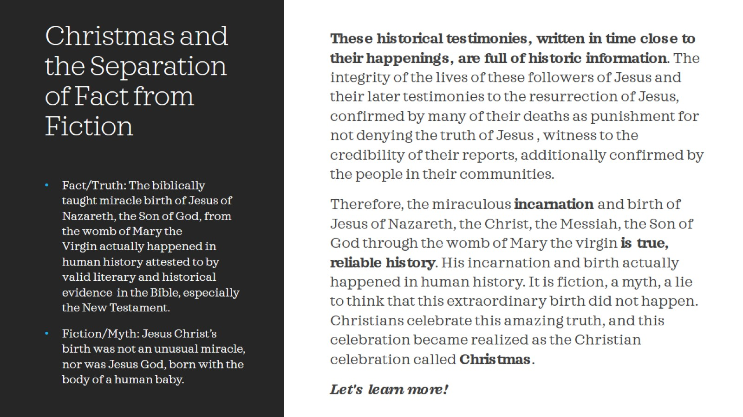
Christmas and the Separation of Fact from Fiction

Slide 10
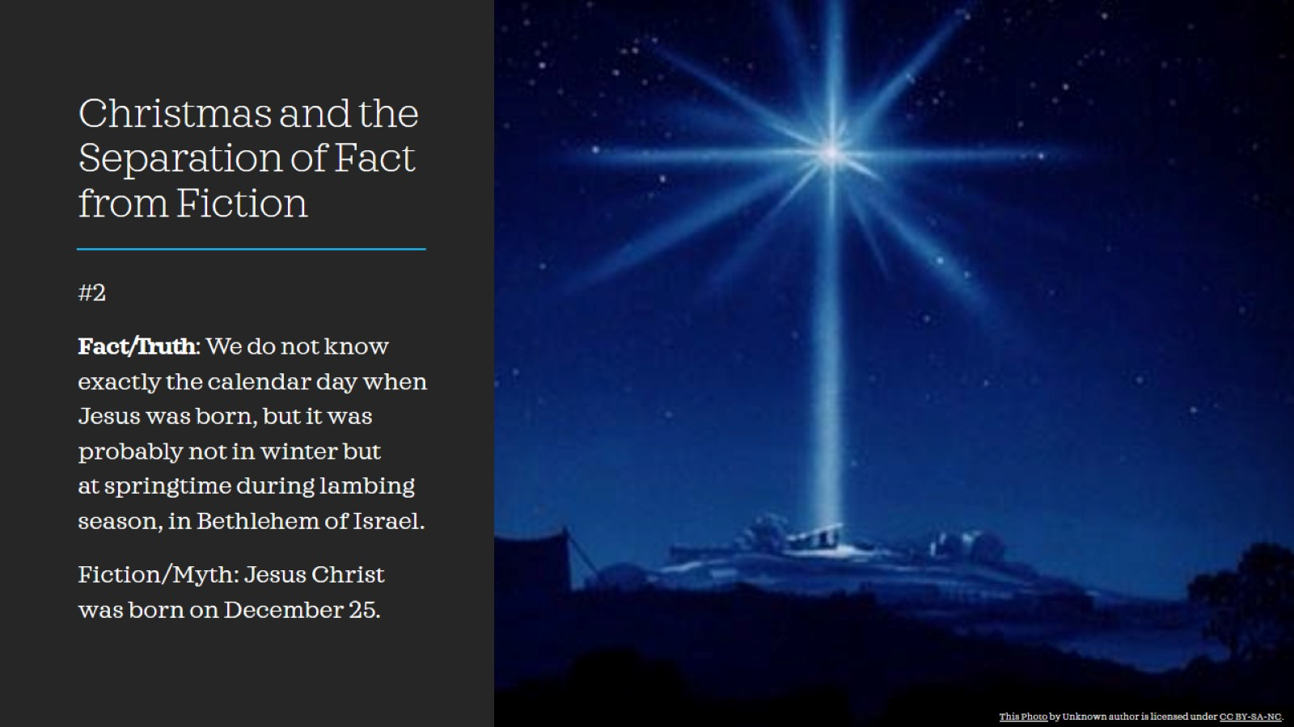
Christmas and the Separation of Fact from Fiction

Slide 11
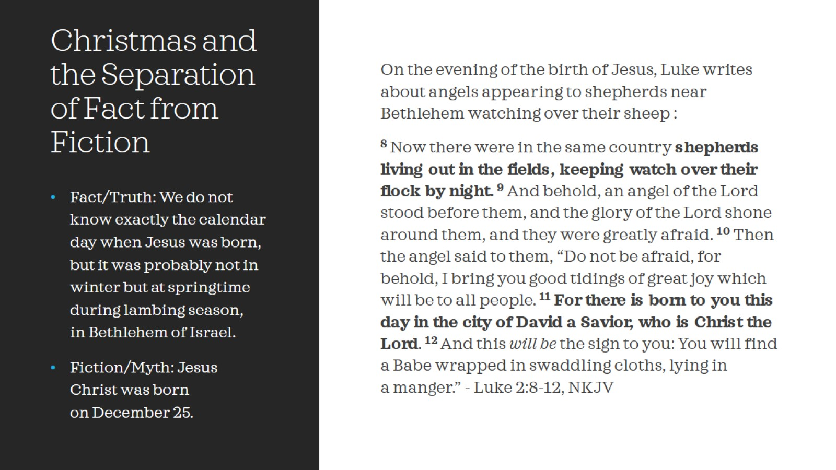
Christmas and the Separation of Fact from Fiction

Slide 12
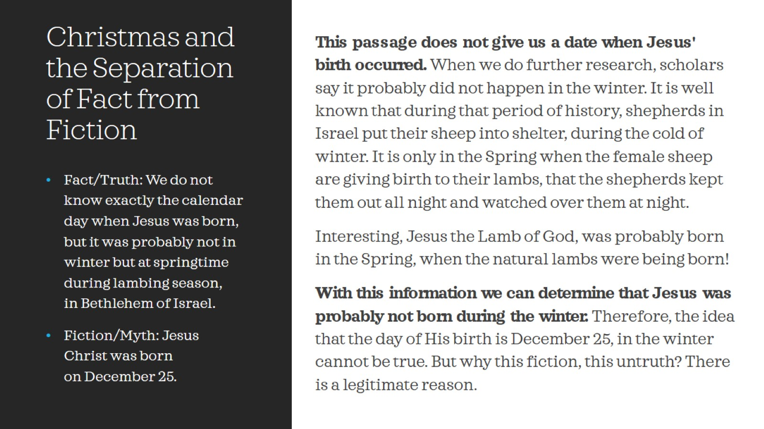
Christmas and the Separation of Fact from Fiction

Slide 13
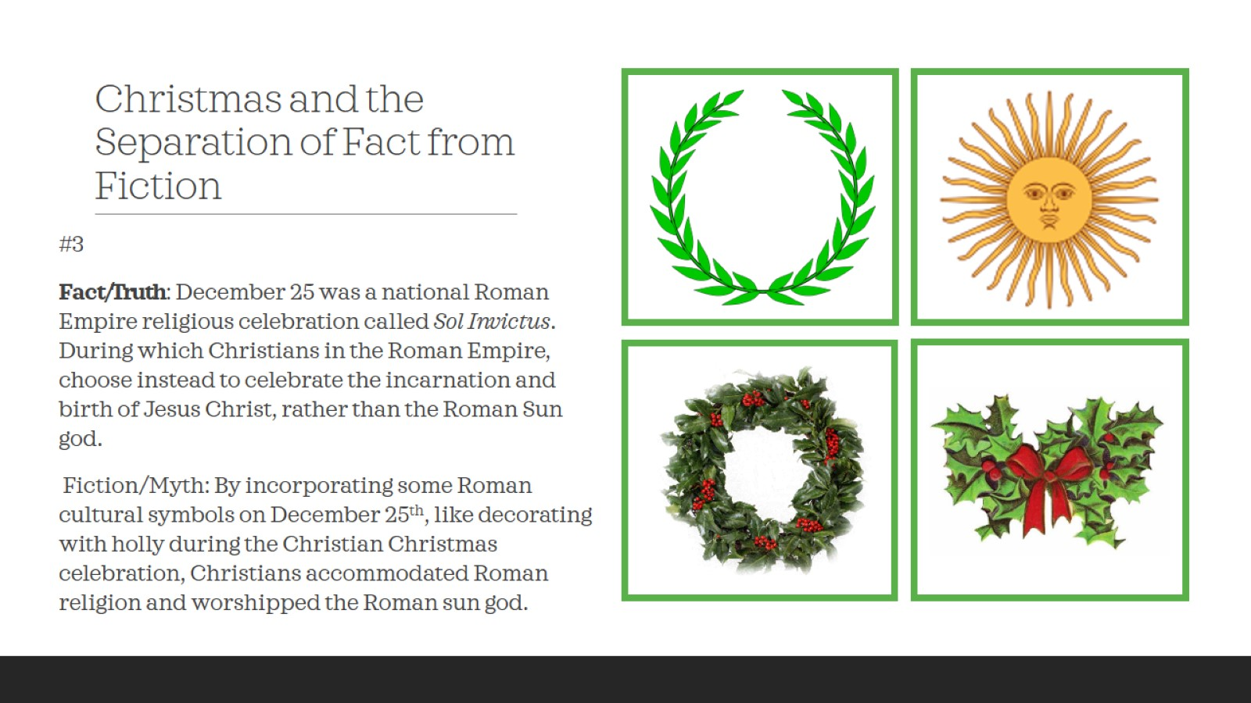
Christmas and the Separation of Fact from Fiction

Slide 14
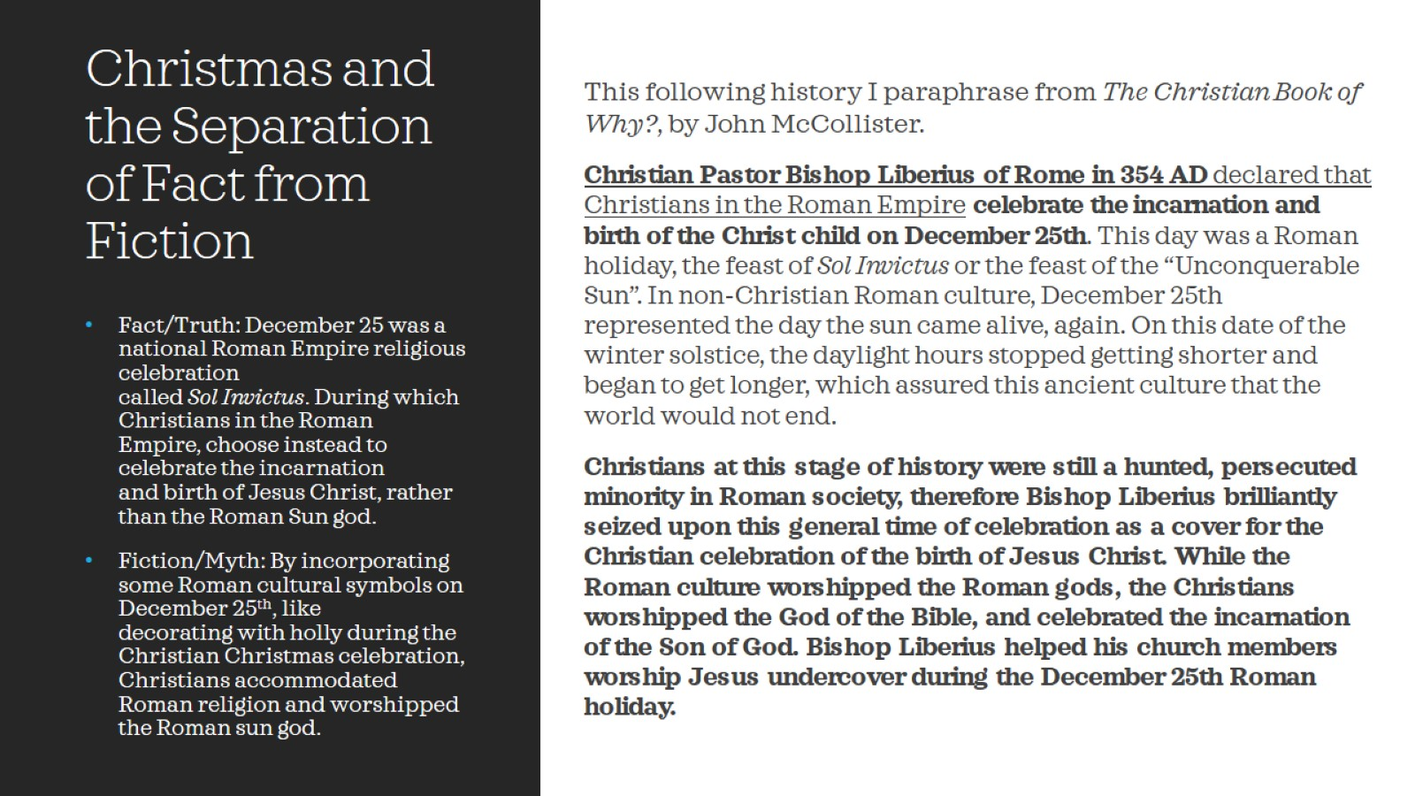
Christmas and the Separation of Fact from Fiction

Slide 15
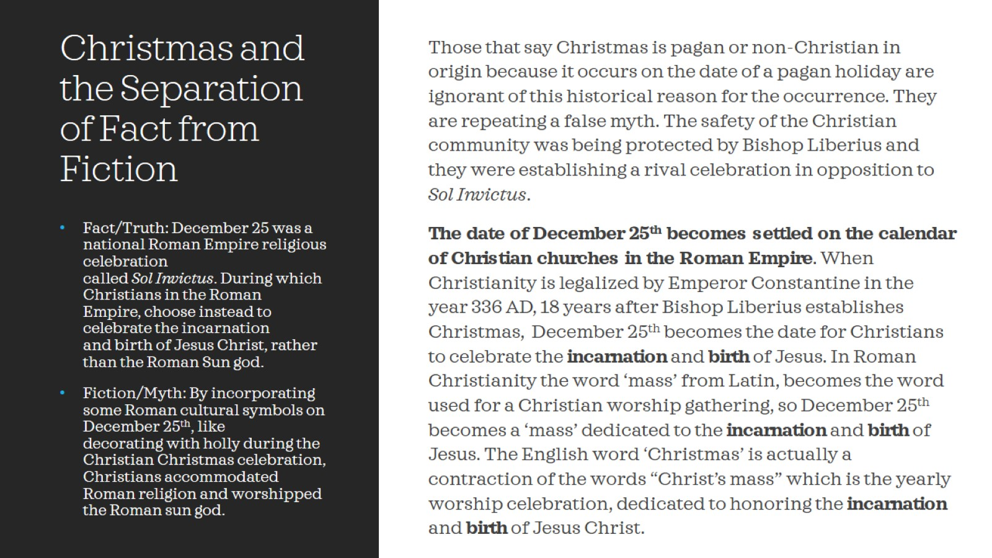
Christmas and the Separation of Fact from Fiction

Slide 16
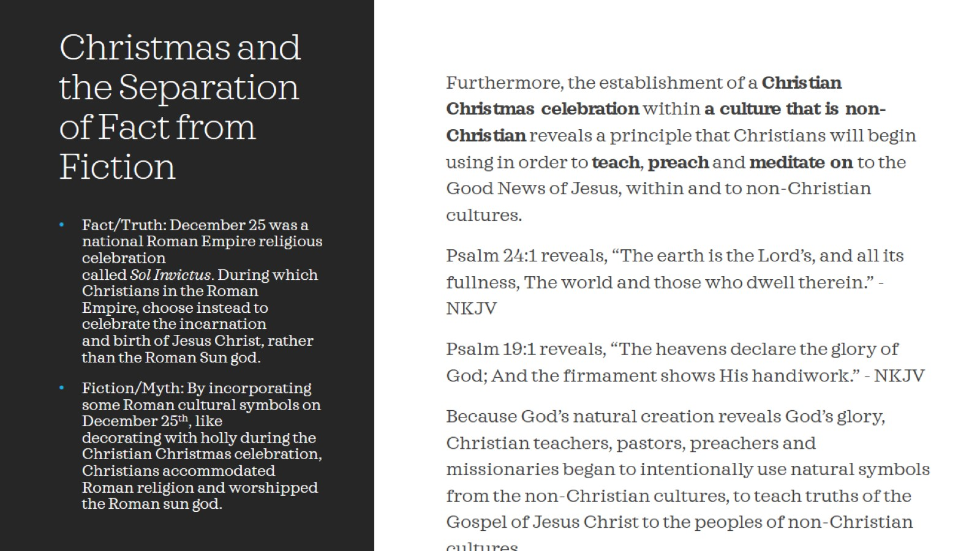
Christmas and the Separation of Fact from Fiction

Slide 17
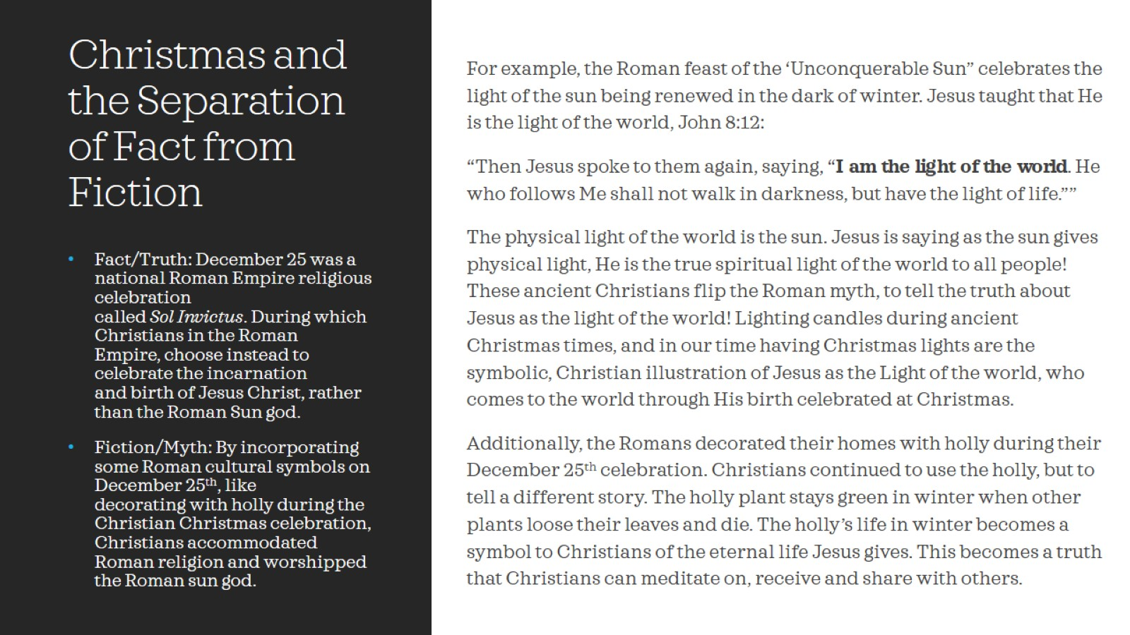
Christmas and the Separation of Fact from Fiction

Slide 18
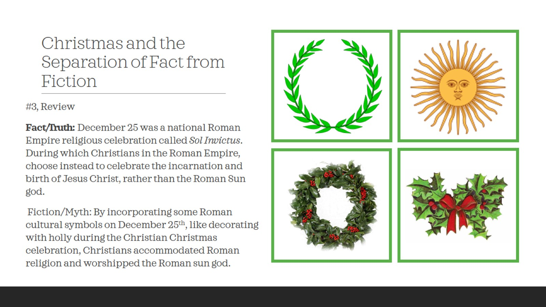
Christmas and the Separation of Fact from Fiction

Slide 19
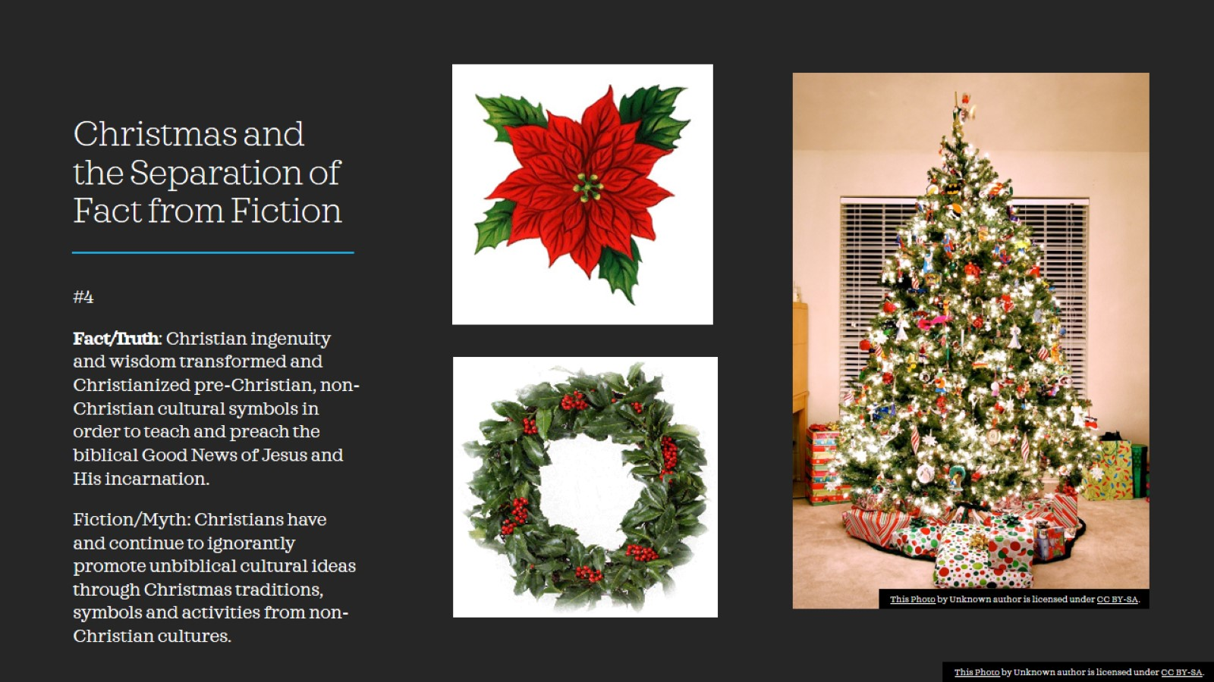
Christmas and the Separation of Fact from Fiction

Slide 20
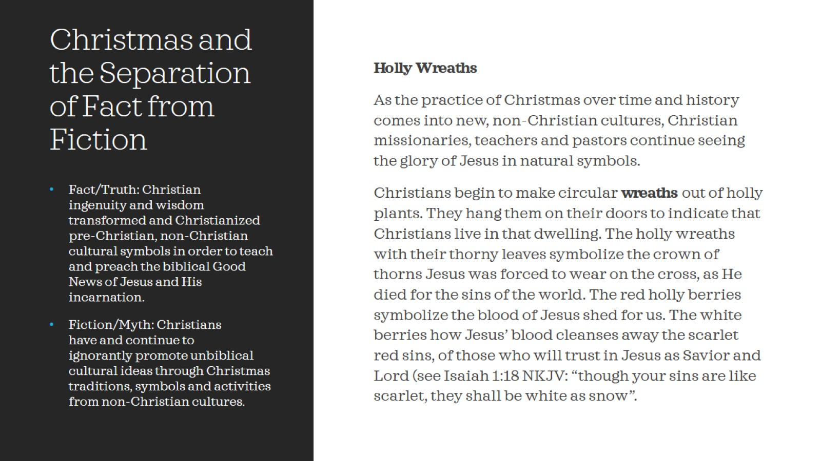
Christmas and the Separation of Fact from Fiction

Slide 21
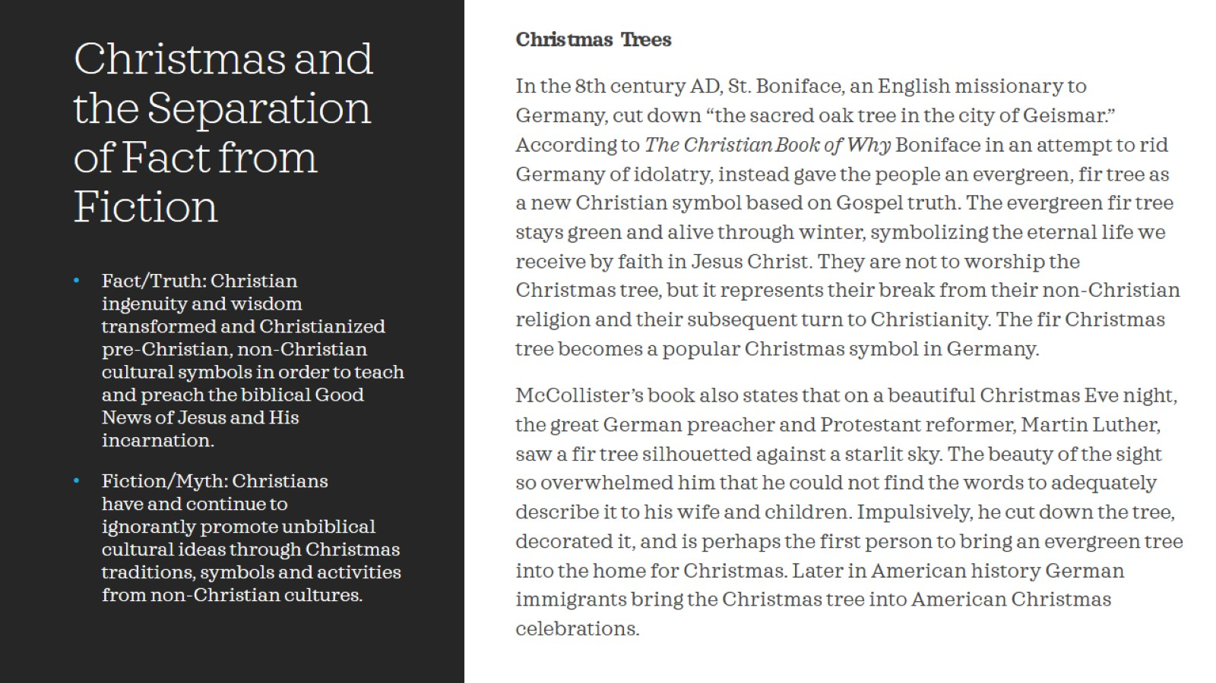
Christmas and the Separation of Fact from Fiction

Slide 22
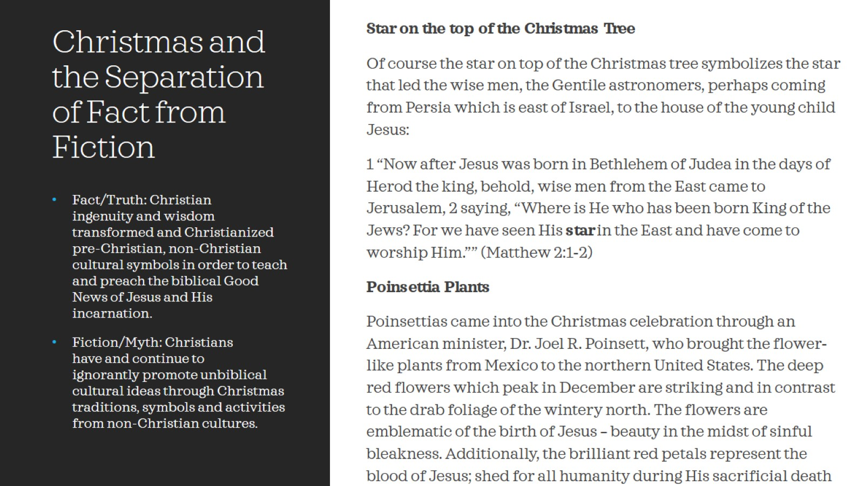
Christmas and the Separation of Fact from Fiction

Slide 23
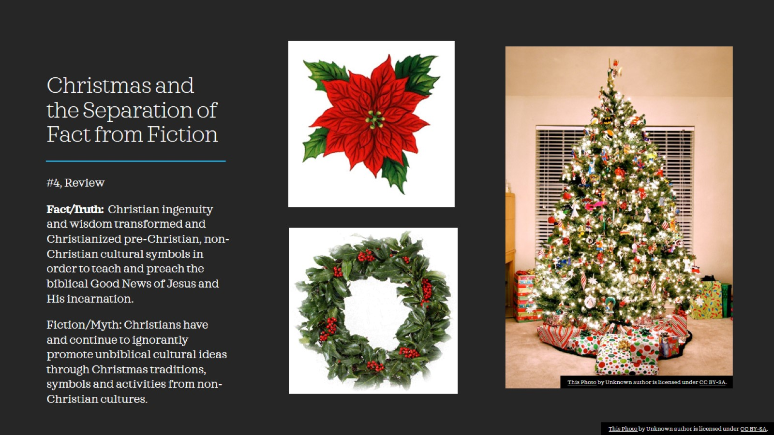
Christmas and the Separation of Fact from Fiction

Slide 24
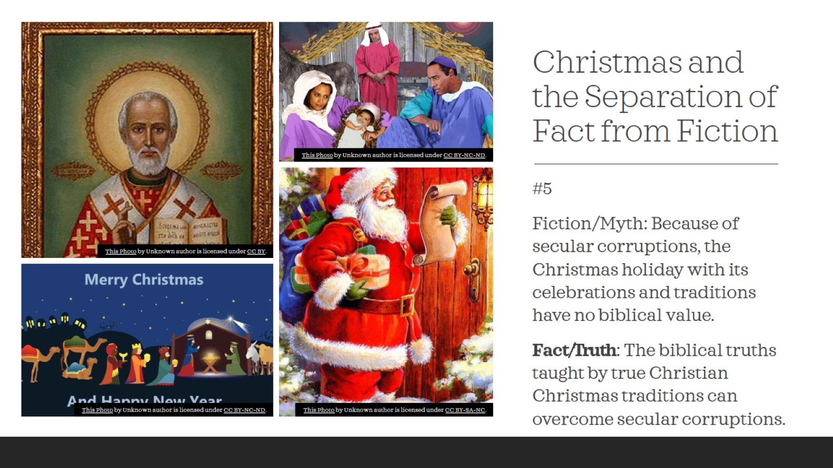
Christmas and the Separation of Fact from Fiction

Slide 25
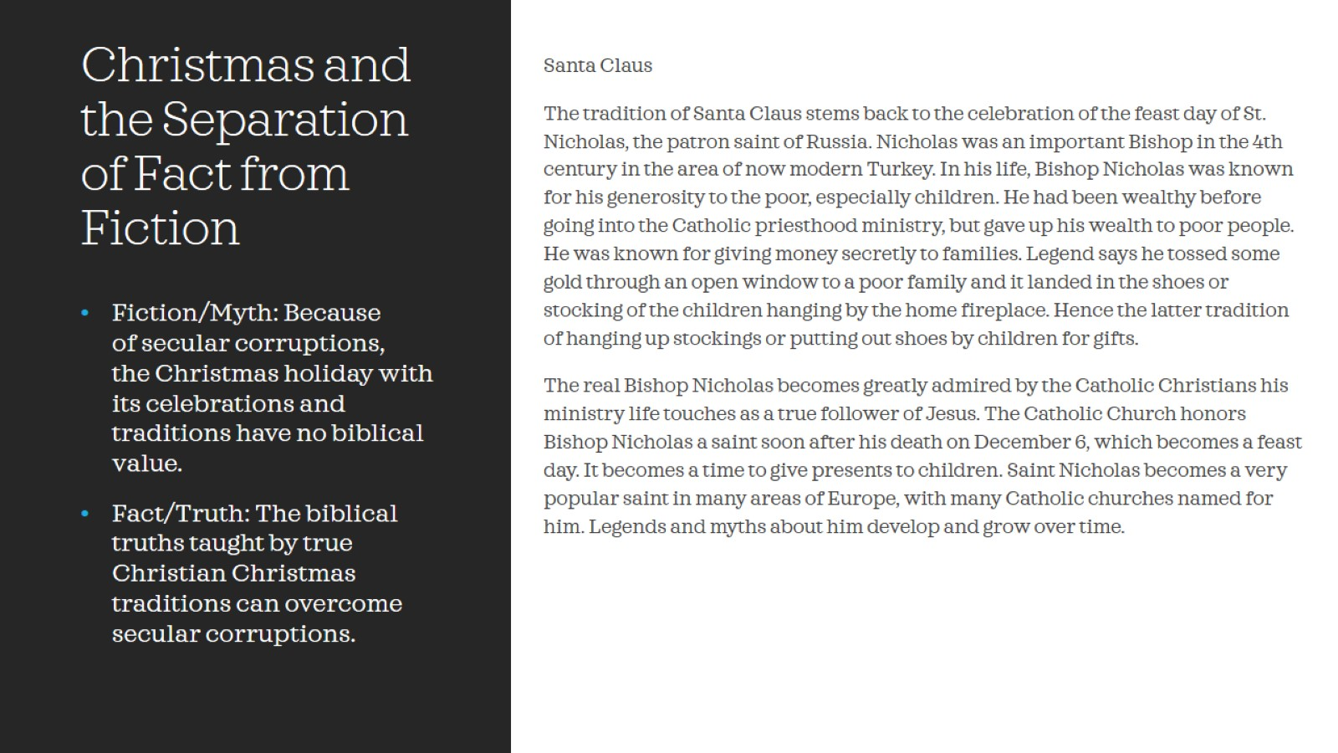
Christmas and the Separation of Fact from Fiction

Slide 26
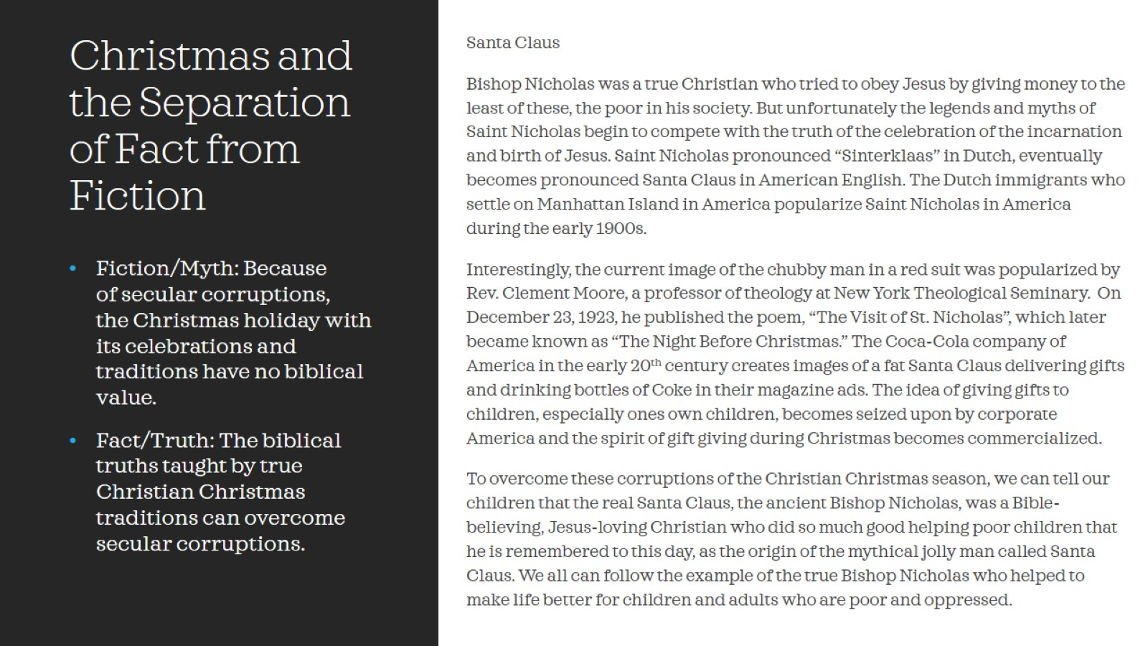
Christmas and the Separation of Fact from Fiction

Slide 27
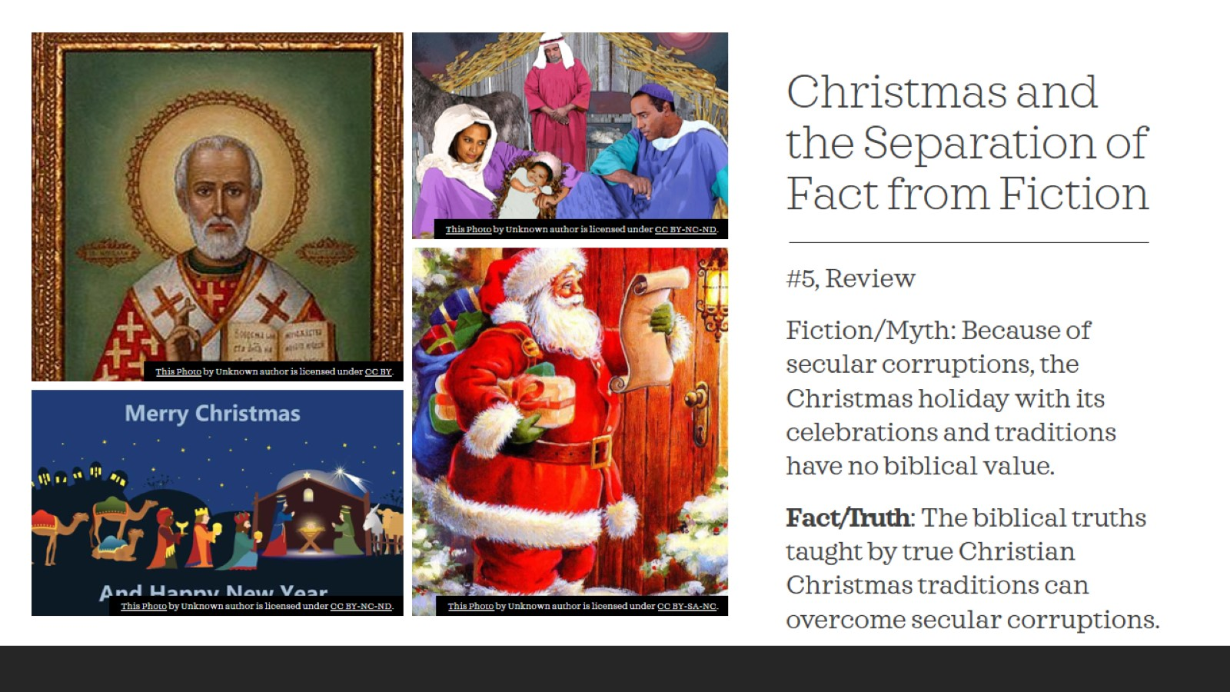
Christmas and the Separation of Fact from Fiction

Slide 28

Christmas and the Separation of Fact from Fiction

Slide 29
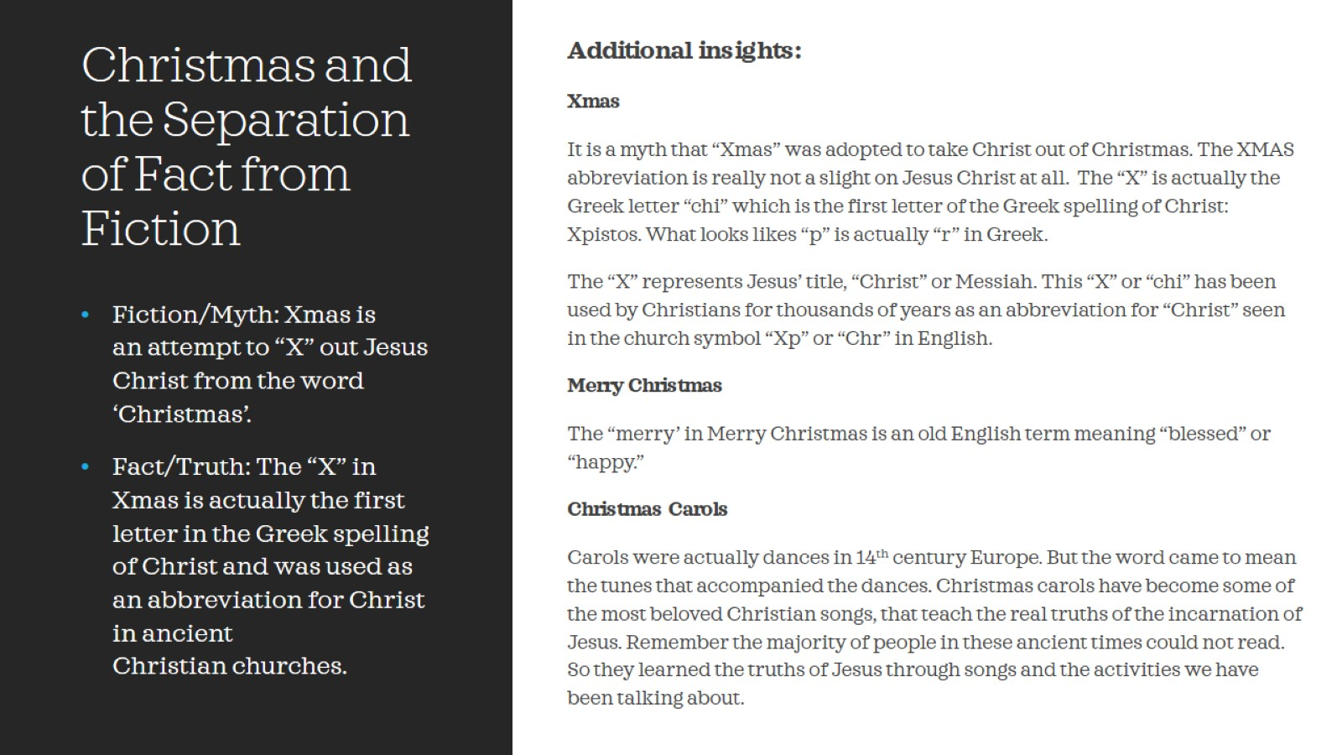
Christmas and the Separation of Fact from Fiction

Slide 30
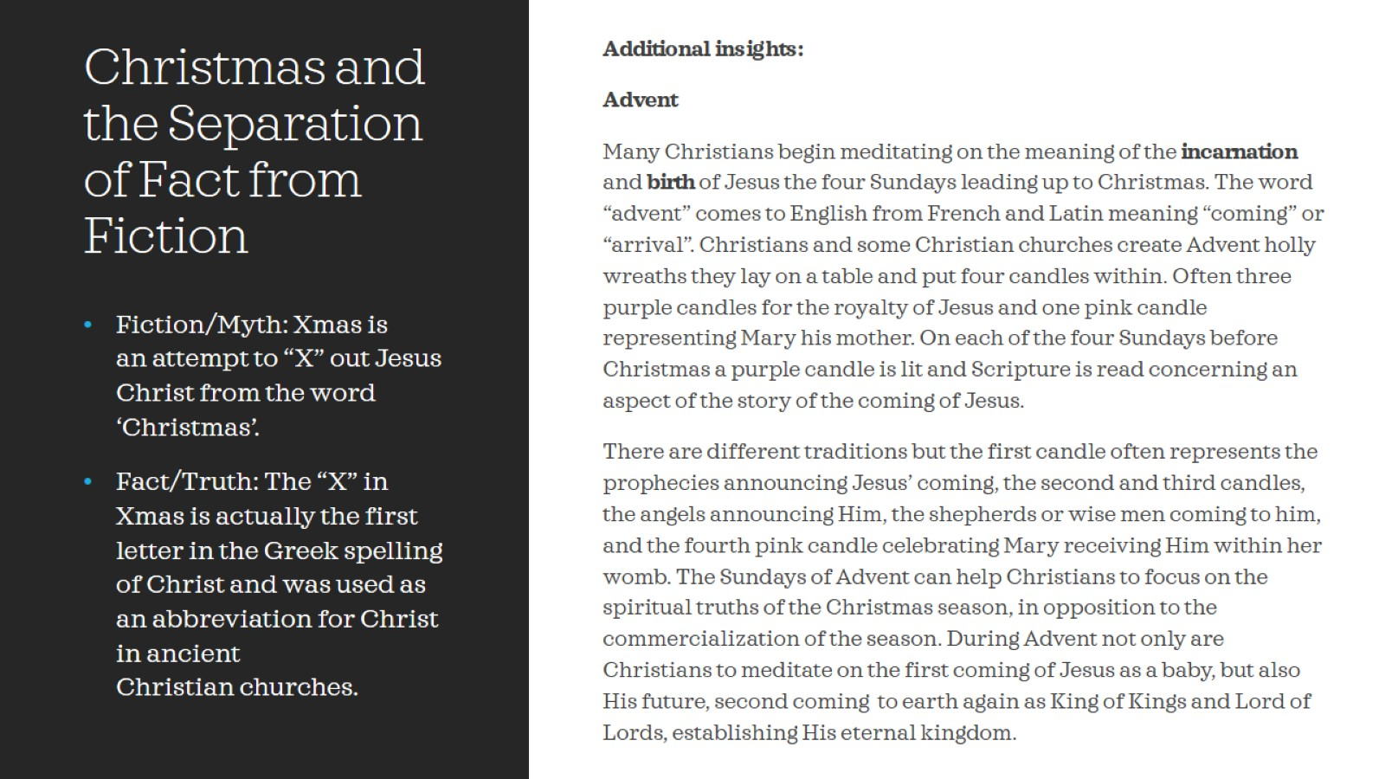
Christmas and the Separation of Fact from Fiction

Slide 31

Christmas and the Separation of Fact from Fiction

Slide 32

Christmas and the Separation of Fact from Fiction

Slide 33
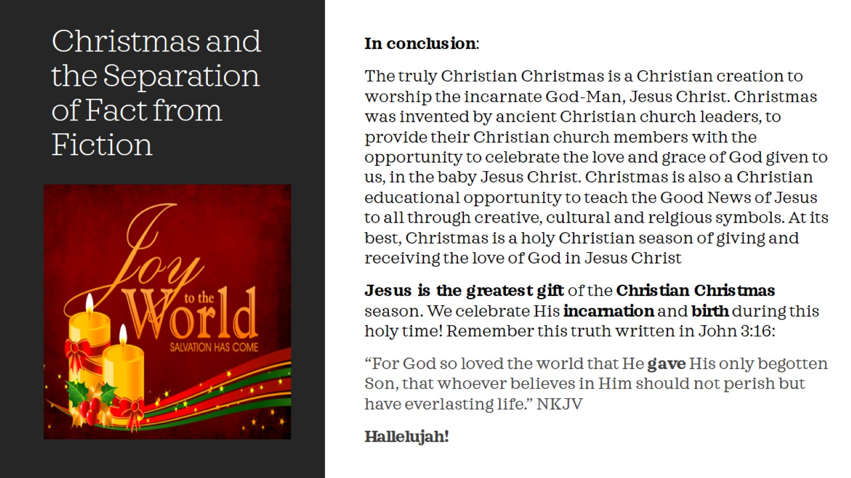
Christmas and the Separation of Fact from Fiction

Slide 34
Christmas and the Separation of Fact from Fiction

