Slide 1

The Anástasis (Resurrection)
10 Personal Benefits of the Resurrection of Jesus, the Christ
(The Resurrection of the Living Lord and Christ,
and Abundant Living In Him)
 Dr. Kenneth Hammonds 
New Testament Greek Training
Leadership Development & Life Coaching
KenHammonds.com; KH@KenHammonds.com

Slide 2
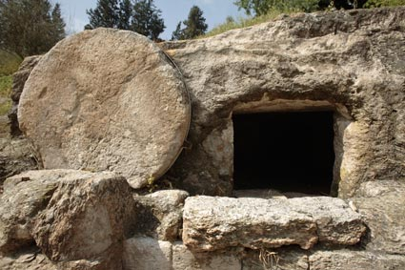
 INTRODUCTION 
ANASTASIS (pronounced: ah-NAH-stah-sis) is perhaps
the MOST power-FULL word in Christianity regarding our
salvation. It is translated, “resurrection.” I really like
this power-FULL word and its literal meaning. Anastasis
is composed of two Greek words: stand (stάsis) and up (anά).
Yes, literally meaning to STAND UP.
I really love that literal STAND UP idea and the resurrection of Jesus Christ out from among dead bodies (dead folks), which is also a more literal rendering of our English phrase “from the dead.” Jesus walked out from (surrounded by) dead corpses, dead people – the DEAD!
Here is my listing of 10 Personal Benefits (at least ten) of the Resurrection of Jesus, the Christ for believers. I’ll give them individually with Scriptures and an invitation for you to “Your Personal Reflection or Affirmation.”
Be Blessed in His Resurrection Power,
KH
Your Coach

Slide 3
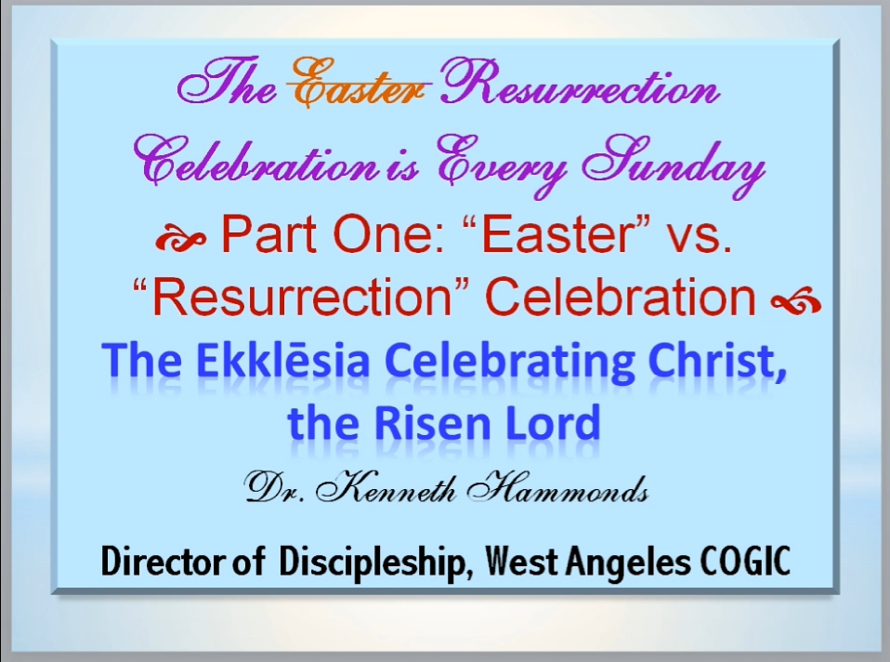
See the KH “Encore” Presentation of 2020
YOUTUBE TITLE: The Easter [RESURRECTION] Celebration is EVERY Sunday, Part One
YouTube Search: kenneth hammonds easter celebration

Slide 4
The Anastasis (Resurrection)
10 Personal Benefits of
the Resurrection of Jesus, the Christ
(The Resurrection of the Living Lord and Christ, and Abundant Living In Him)
Personal Benefit #1
You can conquer any fear invading your life.
Hebrews 2:15 New King James Version (NKJV)
and release those who through fear of death were all their lifetime subject to bondage [NIV held in slavery]. (The resurrection of Christ quells and conquers the sometimes all-consuming fear of death.)
Psalm 27:1 King James Version (KJV)
The Lord is my light and my salvation [Hebrew: YES-shah = deliverance, rescue, safety, welfare]; whom shall I fear? the Lord is the strength of my life; of whom shall I be afraid?
Bible Study Note: Hebrew Word = Strong’s Concordance #H3468 (YES-shah)
Just type “Strong’s Hebrew 3468 biblehub” in a search engine, you’ll see it. Note the parallel verses using this word to the right of the page.
Personal Question: What things are you afraid of (or afraid to face) in your daily living?
Your Personal Reflection or Affirmation: Because of my Resurrected, Living Lord Jesus Christ I . . .
SPECIAL SONG: If fear seems to grip you far too often, this powerfully strong song will really speak to your need. (Watch it fully – It starts slowing and thoughtfully and then crescendoes.)
See on YouTube: Veronica Petrucci (Angelo & Veronica) - No Fear on TCT

Slide 5
The Anastasis (Resurrection)
10 Personal Benefits of
the Resurrection of Jesus, the Christ
(The Resurrection of the Living Lord and Christ, and Abundant Living In Him)
Personal Benefit #2
You no longer need to see the future as a personal uncertainty. You have certainty and confidence in Christ.
Philippians 1:6 New King James Version (NKJV)
being confident of this very thing, that He who has begun a good work in you will complete it until the day of Jesus Christ;
Proverbs 23:18 New International Version (NIV)
There is surely a future hope for you, and your hope will not be cut off.
Jeremiah 29:11 New International Version (NIV)
“For I know the plans I have for you,” declares the Lord, “plans to prosper you and not to harm you, plans to give you hope and a future.”
Personal Question: What personal matter(s) of uncertainty do you privately have some (or great) concern(s)? [Please be honest with yourself and God.] 1 Peter 5:7 – casting [Greek = THROWING] all your anxieties on him, because he cares for you. (English Standard)
Your Personal Reflection or Affirmation: Because of my Resurrected, Living Lord Jesus Christ I . . .

Slide 6
The Anastasis (Resurrection)
10 Personal Benefits of
the Resurrection of Jesus, the Christ
(The Resurrection of the Living Lord and Christ, and Abundant Living In Him)
Personal Benefit #3
You have the personal empowerment to exceed far beyond your present resources.
Ephesians 1:19-20 New Revised Standard Version (NRSV)
¹⁹ and what is the immeasurable greatness of his power for us who believe, according to the working of his great power. ²⁰ God put this power to work in Christ when he raised him from the dead and seated him at his right hand in the heavenly places.
Philippians 4:13 New King James Version (NKJV)
I can do all things [anything God requires of me or approves of me doing] through Christ who strengthens me.
Ephesians 3:20 King James Version (KJV)
Now unto him that is able to do exceeding abundantly above all that we ask or think, [NIV “imagine”] according to the power that worketh in us.
Personal Question: What challenge is there in your life that you are sure you cannot do? Think again, and again, and again. Are you SURE God will not reveal the answer to you?
Your Personal Reflection or Affirmation: Because of my Resurrected, Living Lord Jesus Christ I . . .

Slide 7
The Anastasis (Resurrection)
10 Personal Benefits of
the Resurrection of Jesus, the Christ
(The Resurrection of the Living Lord and Christ, and Abundant Living In Him)
Personal Benefit #4 (Part One)
Because of the resurrection there is a Church and gifted persons (LIKE YOU) within the Body.
KH EXPOSITION:
After His resurrection, the Lord Jesus Christ sent the gifts to the Church (like YOU). And He is the Head of the Church – providing protection, direction, and support for you personally. And the “gifted” persons who are also individually “gifts” to the Church, provide nurture, encouragement, and growth to all the members of the Body.
Ephesians 1:22 King James Version (KJV) [after His resurrection and ascension]
And hath put all things under his feet, and gave him to be the head over all things to the church.
Ephesians 4:16 New International Version (NIV)
From him [Christ] the whole body, joined and held together by every supporting ligament, [each part is important and necessary] grows and builds itself up in love, as each part does its work.
“every supporting ligament” – NAPA automotive parts in a TV commercial ad featuring a very small auto part, has said, “There are no unimportant parts.”

Slide 8

The Anastasis (Resurrection)
10 Personal Benefits of
the Resurrection of Jesus, the Christ
(The Resurrection of the Living Lord and Christ, and Abundant Living In Him)
Personal Benefit #4 (Part Two – Personal Application)
Because of the resurrection there is a Church and gifted persons (LIKE YOU) within the Body.
KH EXPOSITION:
Ephesians 4:7-8 King James Version (KJV)
⁷ But unto every one of us is given grace according to the measure of the gift of Christ. ⁸ Wherefore he saith, When he ascended up on high, he led captivity captive, and gave gifts unto men. [Christ has given you and me to the fellowship of believers for the benefit of the Body.]
1 Corinthians 12:4 New Revised Standard Version (NRSV)
Now there are varieties of gifts, but the same Spirit.
Each of us has our own special imprint of spiritual gifts, talents and skills.
In my work, God Wants You To Be Wealthy (How to Release the Wealth
Builder Within), I call your EKG’S (Experience, Knowledge, Gifts, and Skills)
[Pages: 45, 52, 67, 77, 78, 81, 125, 252]
Personal Challenge: FULLY utilize and engage your spiritual gifts for the next three months and afterwards see where you are spiritually and what God will reveal to you.
Your Personal Reflection or Affirmation: Because of my Resurrected, Living Lord Jesus Christ I . . .

Slide 9
The Anastasis (Resurrection)
10 Personal Benefits of
the Resurrection of Jesus, the Christ
(The Resurrection of the Living Lord and Christ, and Abundant Living In Him)
Personal Benefit #5
You can access power over the evil forces of demonic activity.
Luke 10:19 New King James Version (NKJV)
To the spiritually prepared and aggressive, the Lord Jesus, the Christ, stated this:
“Behold, I give you the authority to trample on serpents and scorpions [spiritual adversaries], and over all the power of the enemy, and nothing shall by any means hurt you.”
KH Comment: “over ALL the power”? Wow, what a declaration! What authority! What a statement of deliverance! What assurance and confidence in times of spiritual attack!
THINK ON THAT!
Colossians 2:12-15 New King James Version (NKJV)
¹² buried with Him in baptism, in which you also were raised with Him through faith in the working of God, who raised Him from the dead. ¹⁵ Having disarmed principalities and powers, He made a public spectacle of them, triumphing over them in it.
Your Personal Reflection or Affirmation: Because of my Resurrected, Living Lord Jesus Christ I . . .

Slide 10
The Anastasis (Resurrection)
10 Personal Benefits of
the Resurrection of Jesus, the Christ
(The Resurrection of the Living Lord and Christ, and Abundant Living In Him)
Personal Benefit #6
You have a new, holy, empowering way of living in this world through a new attitude and wise (healthy, sensible) actions.
Colossians 3:1-11 New International Version (NIV)
¹ Since, then, you have been raised with Christ, set your hearts on things above, where Christ is, seated at the right hand of God. ² Set your minds on things above, not on earthly things. ³ For you died, and your life is now hidden with Christ in God. ⁴ When Christ, who is your life, appears, then you also will appear with him in glory.
Hebrews 10:19-20 King James Version (KJV)
¹⁹ Having therefore, brethren, boldness to enter into the holiest by the blood of Jesus,
²⁰ By a new and living way, which he hath consecrated for us, through the veil, that is to say, his flesh;
Your Personal Reflection or Affirmation: Because of my Resurrected, Living Lord Jesus Christ I . . .

Slide 11
The Anastasis (Resurrection)
10 Personal Benefits of
the Resurrection of Jesus, the Christ
(The Resurrection of the Living Lord and Christ, and Abundant Living In Him)
Personal Benefit #7
You can Rejoice and be Victorious (Overcomer) in life, and you can have a Winner Attitude.
1 John 5:4 New King James Version (NKJV)
For whatever is born of God overcomes the world. And this is the victory that has overcome the world—our faith.
1 Corinthians 15:57-58 (KJV)
¹⁴ And if Christ has not been raised, our preaching is useless and so is your faith. (NIV)
⁵⁷ But thanks be to God, which giveth us the victory through our [resurrected] Lord Jesus Christ.
⁵⁸ Therefore, my beloved brethren, be ye stedfast, unmoveable, always abounding in the work of the Lord, forasmuch as ye know that your labour is not in vain in the Lord.
Your Personal Reflection or Affirmation: Because of my Resurrected, Living Lord Jesus Christ I . . .

Slide 12
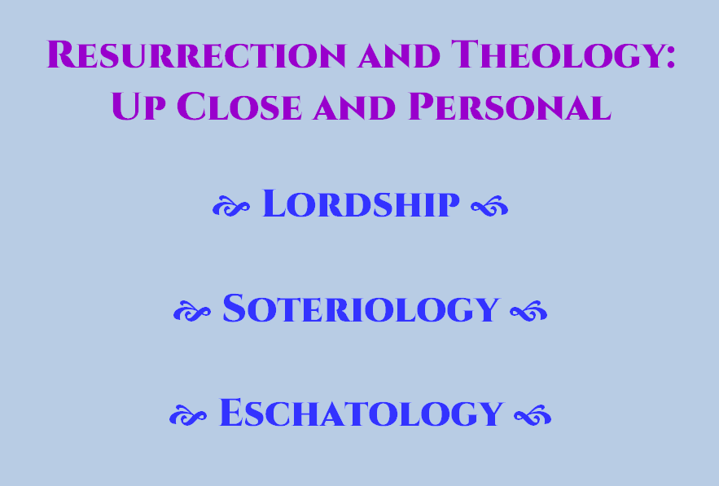

Slide 13
The Anastasis (Resurrection)
10 Personal Benefits of
the Resurrection of Jesus, the Christ
(The Resurrection of the Living Lord and Christ, and Abundant Living In Him)
Personal Benefit #8 Lordship: Up Close and Personal
Jesus, the Christ is Lord Over All Creation (Our Lord and My Lord)
Romans 1:4 English Standard Version (ESV)
And was declared to be the Son of God in power according to the Spirit of holiness by his resurrection from the dead, Jesus Christ our Lord.
KH NOTE: Christ’s resurrection ratifies and confirms His authoritative lordship over all.
Acts 10:36 New International Version (NIV)
You know the message God sent to the people of Israel, announcing the good news [gospel] of peace through Jesus Christ, who is Lord of all. (“Jesus the Messiah,” International Standard Version)
Acts 2:36 New International Version (NIV)
Therefore let all Israel be assured of this: God has made this Jesus, whom you crucified, both Lord and Messiah. (KJV - both Lord and Christ)
Your Personal Reflection or Affirmation: Because of my Resurrected, Living Lord Jesus Christ I . . .

Slide 14
The Anastasis (Resurrection)
10 Personal Benefits of
the Resurrection of Jesus, the Christ
(The Resurrection of the Living Lord and Christ, and Abundant Living In Him)
Personal Benefit #9 Soteriology: Up Close and Personal
You are saved (born again) and enjoy the present possession the life (zōē) of God.
Romans 10:9 English Standard Version (ESV)
Because, if you confess with your mouth that Jesus is Lord and believe in your heart that God raised him from the dead, you will be SAVED.
1 Peter 1:3b English Standard Version (ESV)
According to his (God’s) great mercy, he has caused us to be BORN AGAIN to a living hope through the resurrection of Jesus Christ from the dead.
Romans 4:25 English Standard Version (ESV)
Who was delivered up for our trespasses and raised for our JUSTIFICATION.
Romans 8:34 English Standard Version (ESV)
Who is to condemn? Christ Jesus is the one who died—more than that, who was raised—who is at the right hand of God, who indeed is INTERCEDING for us. (He ever liveth to make intercession . . . Hebrews 7:25)
Your Personal Reflection or Affirmation: Because of my Resurrected, Living Lord Jesus Christ I . . .

Slide 15
The Anastasis (Resurrection)
10 Personal Benefits of
the Resurrection of Jesus, the Christ
(The Resurrection of the Living Lord and Christ, and Abundant Living In Him)
Personal Benefit #10 Eschatology: Up Close and Personal
Your New Body: Unending Existence (INCORRUPTIBLE) and Without the Possibility of Death (IMMORTAL)  Enjoying the consummation of eternal life (zōē).
An Age-old Question of Human Existence:
If a human dies — will she or he live again? Job 14:14
John 11:25 English Standard Version (ESV)
Jesus said to her, “I am the resurrection and the life. Whoever believes in me, though he die, yet shall he live.”
Revelation 1:17-18 English Standard Version (ESV)
¹⁷ When I saw him, I fell at his feet as though dead. But he laid his right hand on me, saying, “Fear not, I am the first and the last, ¹⁸ and the living one. I died, and behold I am alive forevermore, and I have the keys of Death and Hades.”
Acts 17:31 English Standard Version (ESV)
Because he has FIXED A DAY [resurrection and a time of accountability/reckoning i.e. JUDGMENT] on which he will judge the world in righteousness by a man whom he has appointed; and of this he has given assurance to all by raising him from the dead.”
Your Personal Reflection or Affirmation: Because of my Resurrected, Living Lord Jesus Christ I . . .

Slide 16

The Anastasis (Resurrection)
10 Personal Benefits of
the Resurrection of Jesus, the Christ
(The Resurrection of the Living Lord and Christ, and Abundant Living In Him)
1 Corinthians 15:54 King James Version
So when this corruptible shall have put on INCORRUPTION, and this mortal shall have put on IMMORTALITY, then shall be brought to pass the saying that is written, Death is swallowed up (Greek: Literally, katapinō – to drink down (καταπίνω); Used figuratively here to mean,
Death is swallowed, gulped down, i.e.. devoured, completely destroyed, consumed)
in (by) victory. Katapinō to CAUSE THE END OF SOMETHING – here DEATH.
Acts 3:15 King James Version
And killed the Prince of life, whom God hath raised from the dead; whereof we are witnesses.
Exposition Part 1:
“Prince of life”: ton archēgon tēs zōēs (τὸν Ἀρχηγὸν τῆς ζωῆς)
The Prince, Originator, Author, Founder, Leader
See the King James Version’s translations of this Greek word in various contexts.
Acts 3:15 “Prince of life” Acts 5:31 “a Prince and a Saviour” Hebrews 2:10 “the captain of their salvation” Hebrews 12:2 “the author and finisher (Greek: “perfecter” of our faith”)

Slide 17
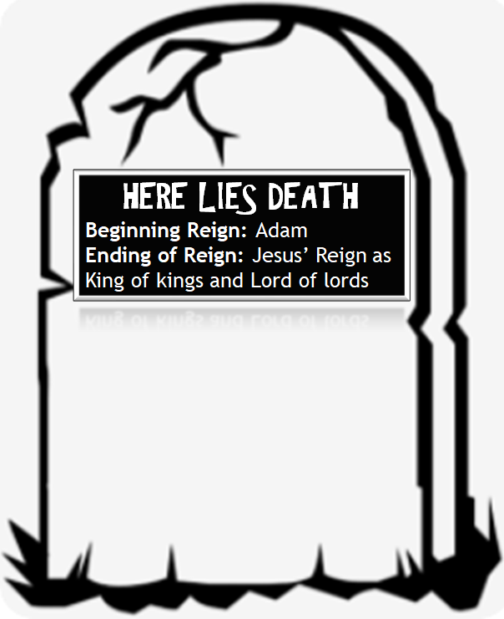
The last enemy that shall be destroyed is death.
1 Corinthians 15:26
Formerly: Public Enemy #1

Slide 18

Acts 3:15 King James Version
And killed the Prince of life, whom God hath raised from the dead; whereof we are witnesses.
Exposition Part 2:
“from the dead”: Greek literally “out of dead (plural = dead ones, corpses) Free translation “out from among the corpses” or more simply “out from among the dead.”
See the next slide for more on the Greek word preposition, “ek.” to come out from WITHIN
JESUS

Slide 19
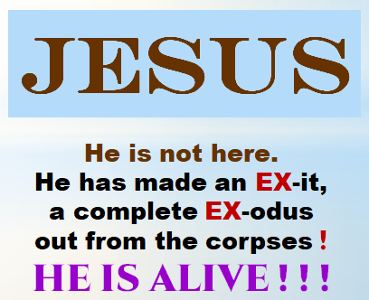
THE RESURRECTION OF CHRIST AND
THE SIGNIFICANCE OF THE GREEK PREPOSITION “EK”
Acts 3:15 King James Version
And killed the Prince of life, whom God hath raised from the dead; whereof we are witnesses.
Exposition Part 2:
“from the dead”: Greek literally “out of dead (plural = dead ones, corpses) Free translation “out from among the corpses” or more simply “out from among the dead.”
More on the Greek word preposition, “ek also, ex ” to come out from WITHIN
Your Personal Reflection or Affirmation: Because of my Resurrected, Living Lord Jesus Christ I . . .
ex

Slide 20
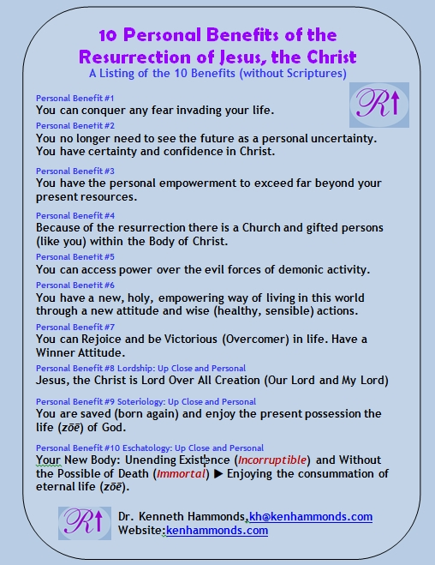
You can request this page/poster format (PDF) for the 10 Personal Benefits.
Go to Threebibleteachers.com
or send a request to: kh@kenhammonds.com

