Slide 1


Slide 2


Slide 3


Slide 4


Slide 5
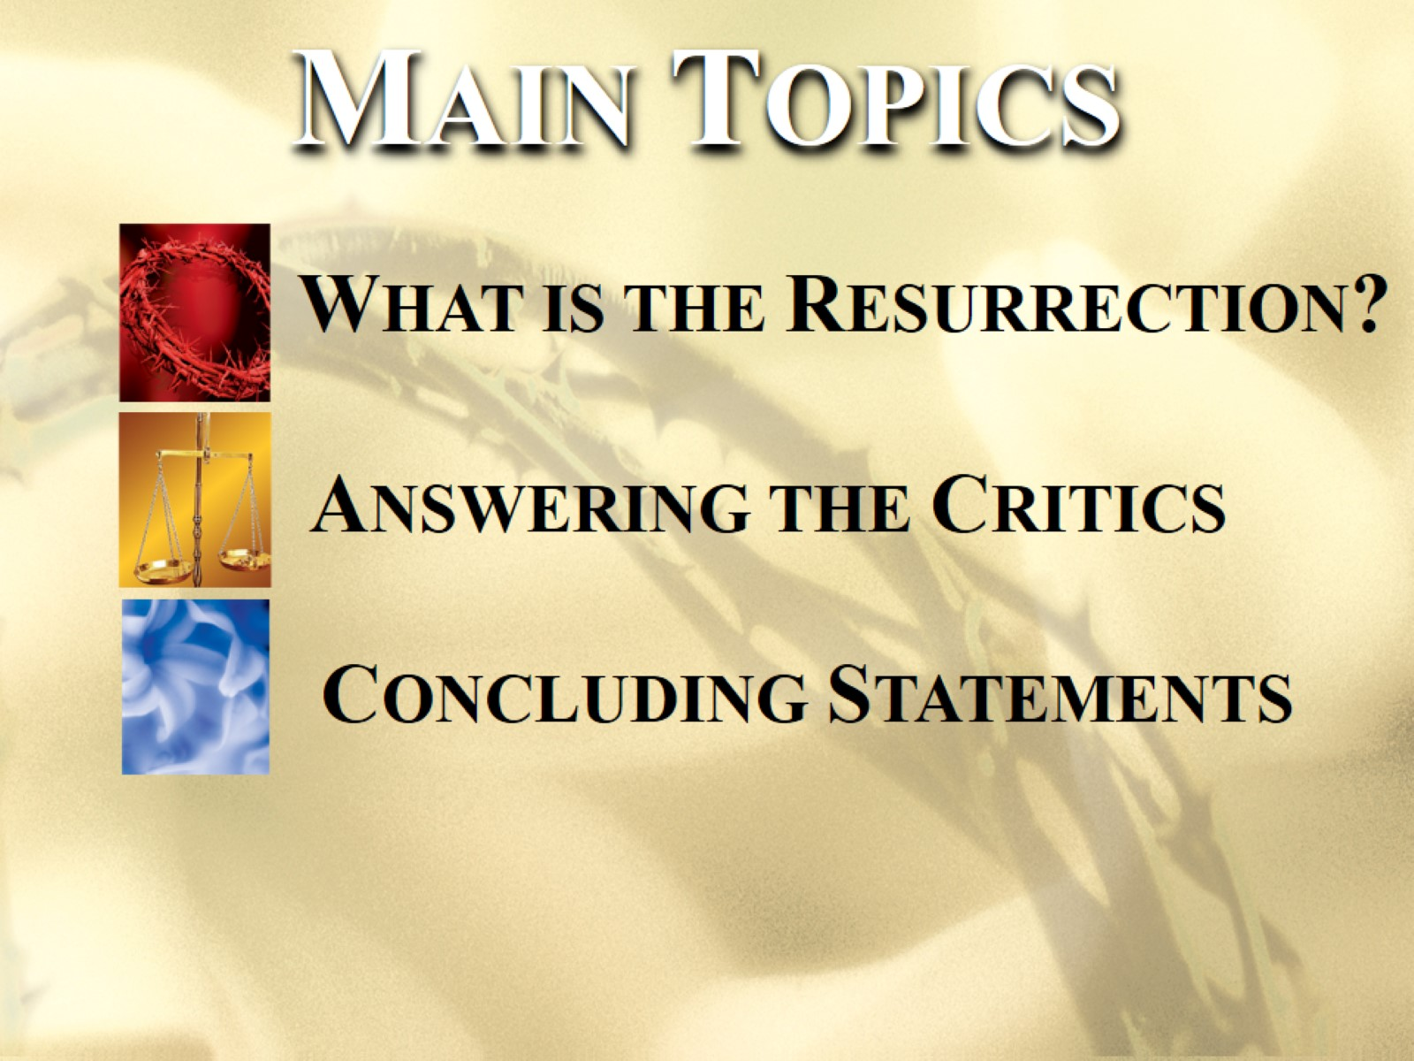

Slide 6


Slide 7
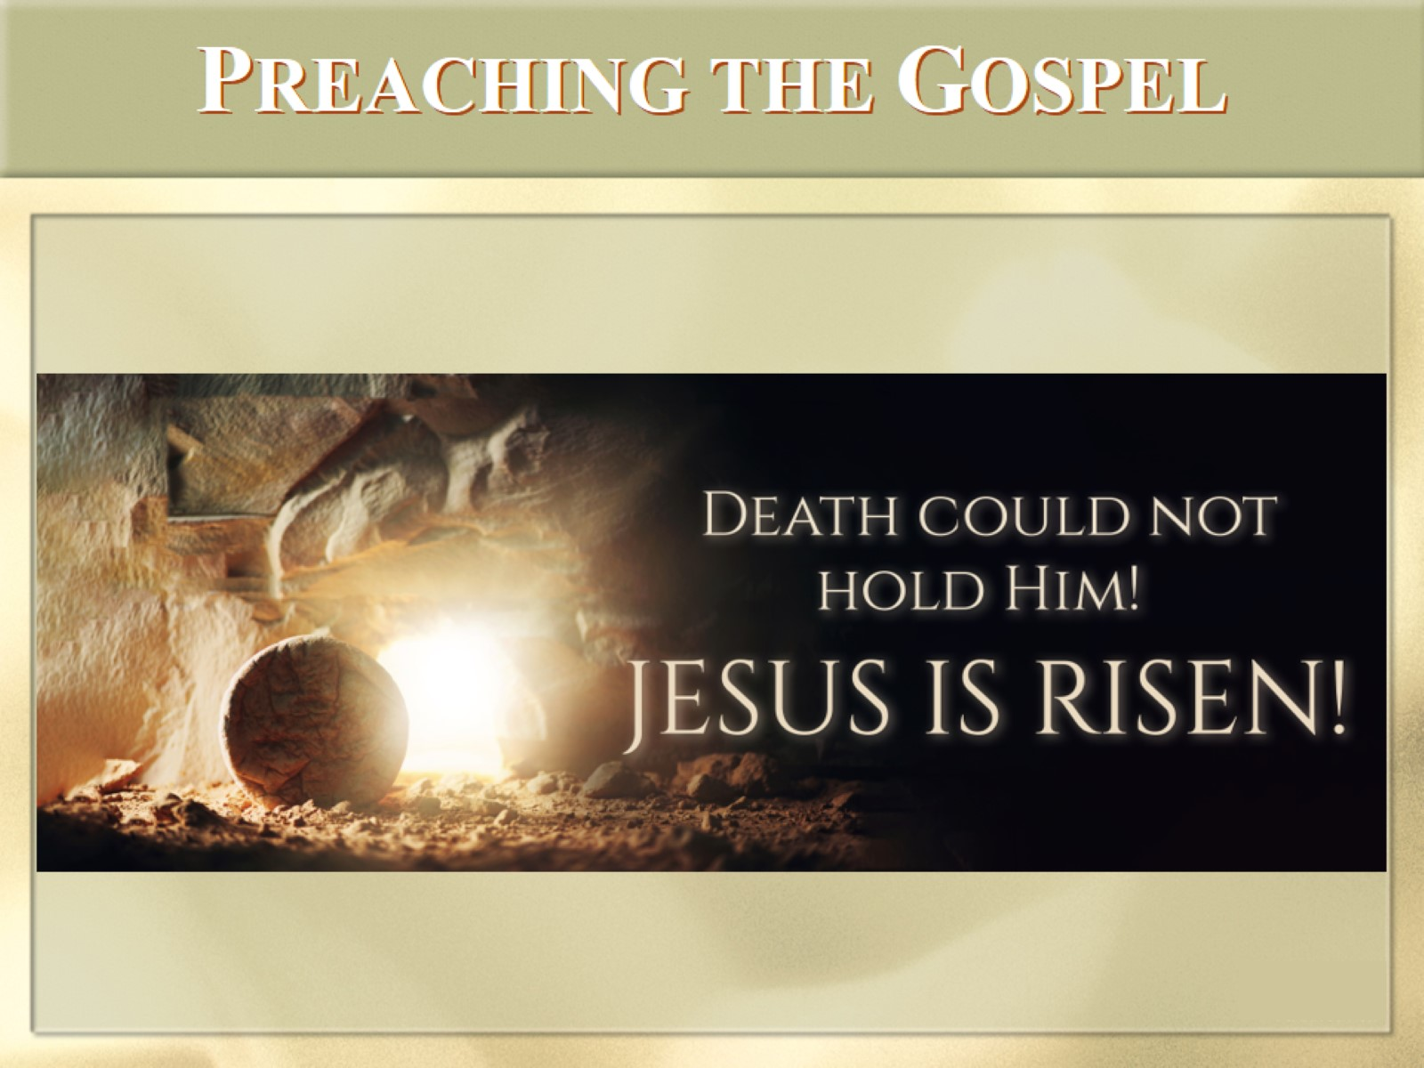
PREACHING THE GOSPEL

Slide 8
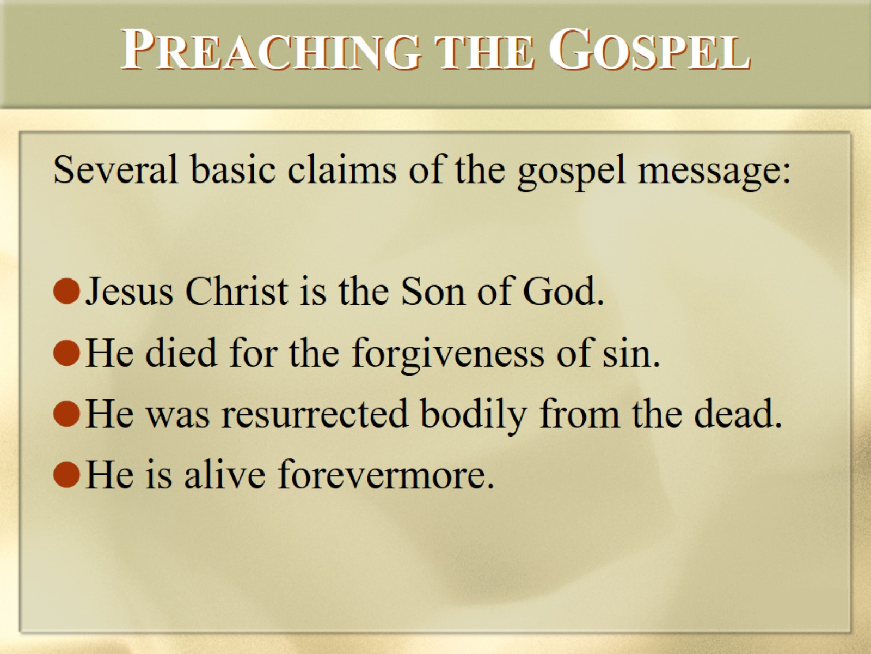
PREACHING THE GOSPEL

Slide 9
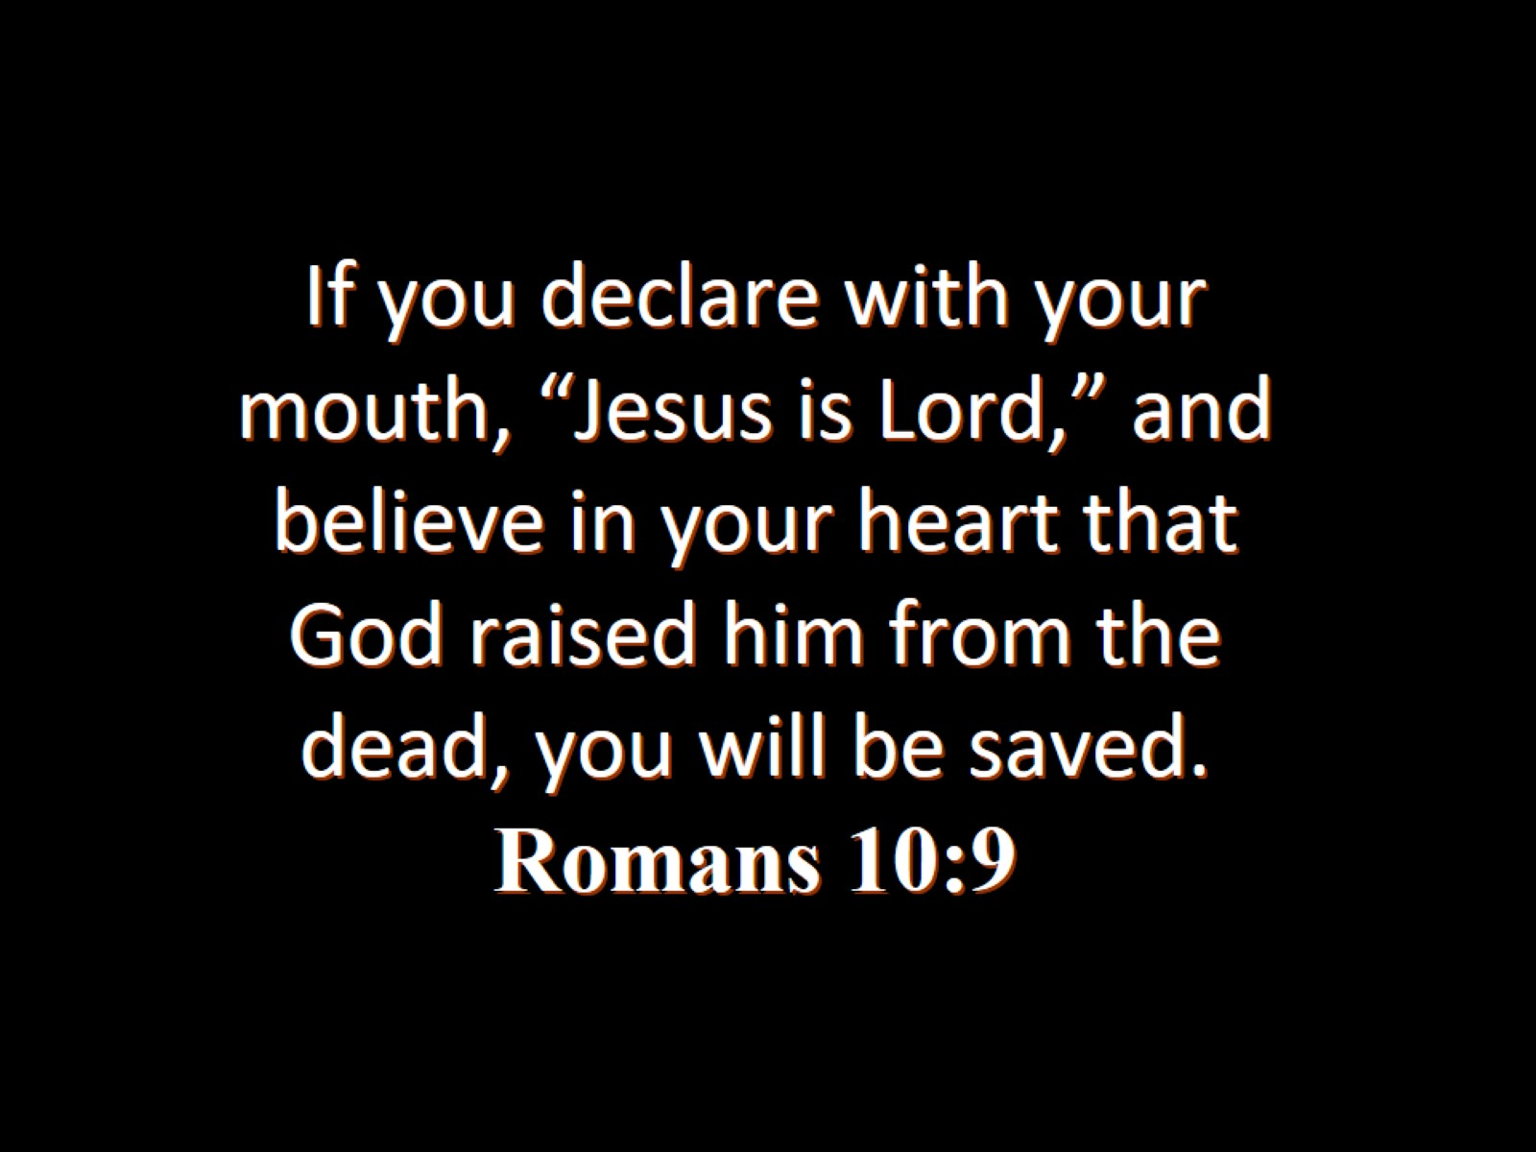
If you declare with your mouth, “Jesus is Lord,” and believe in your heart that God raised him from the dead, you will be saved.
Romans 10:9

Slide 10
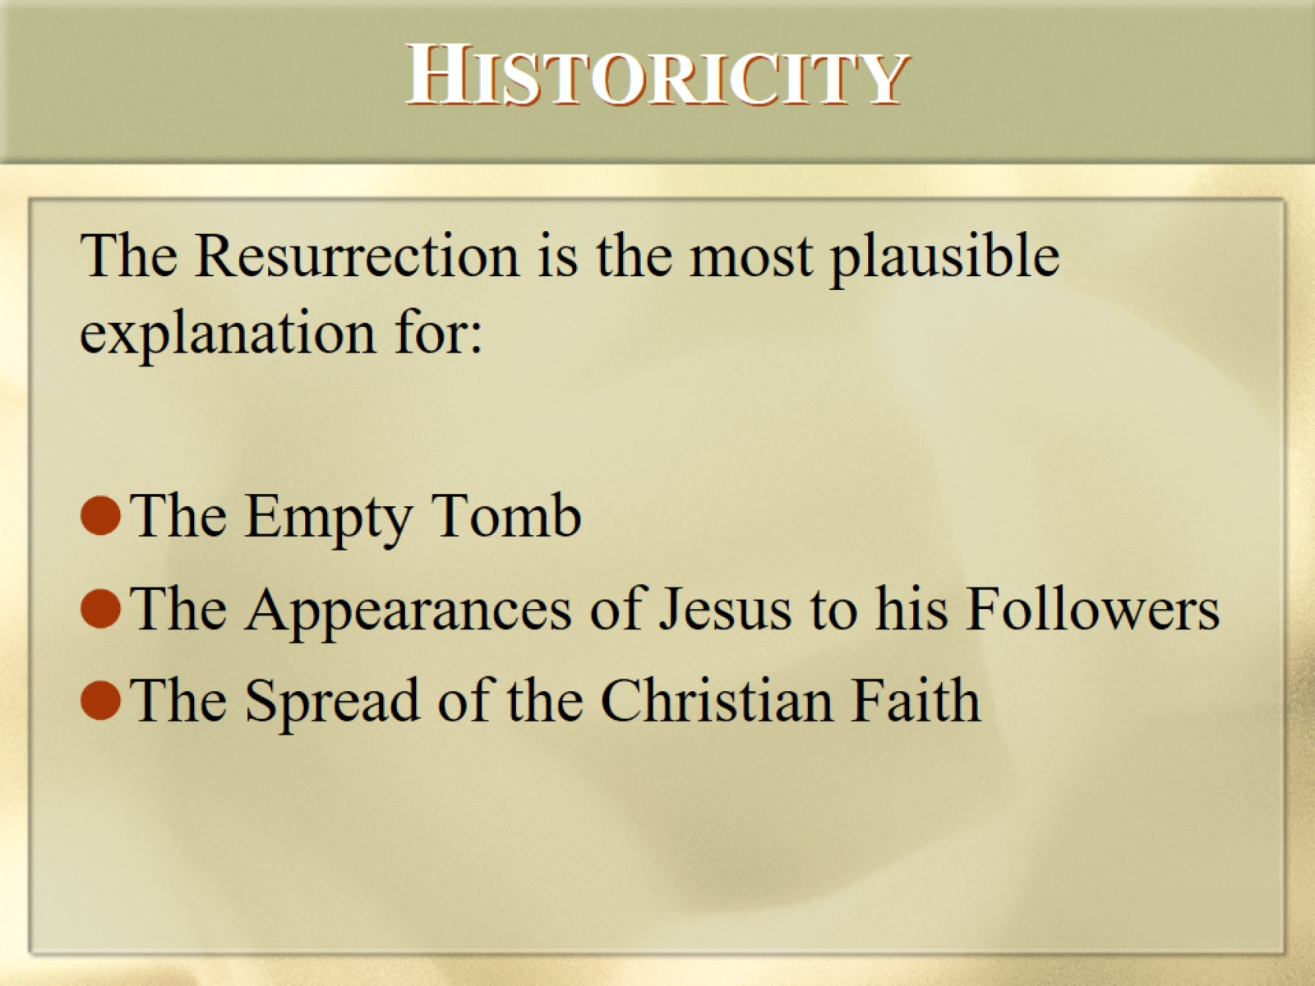
HISTORICITY

Slide 11
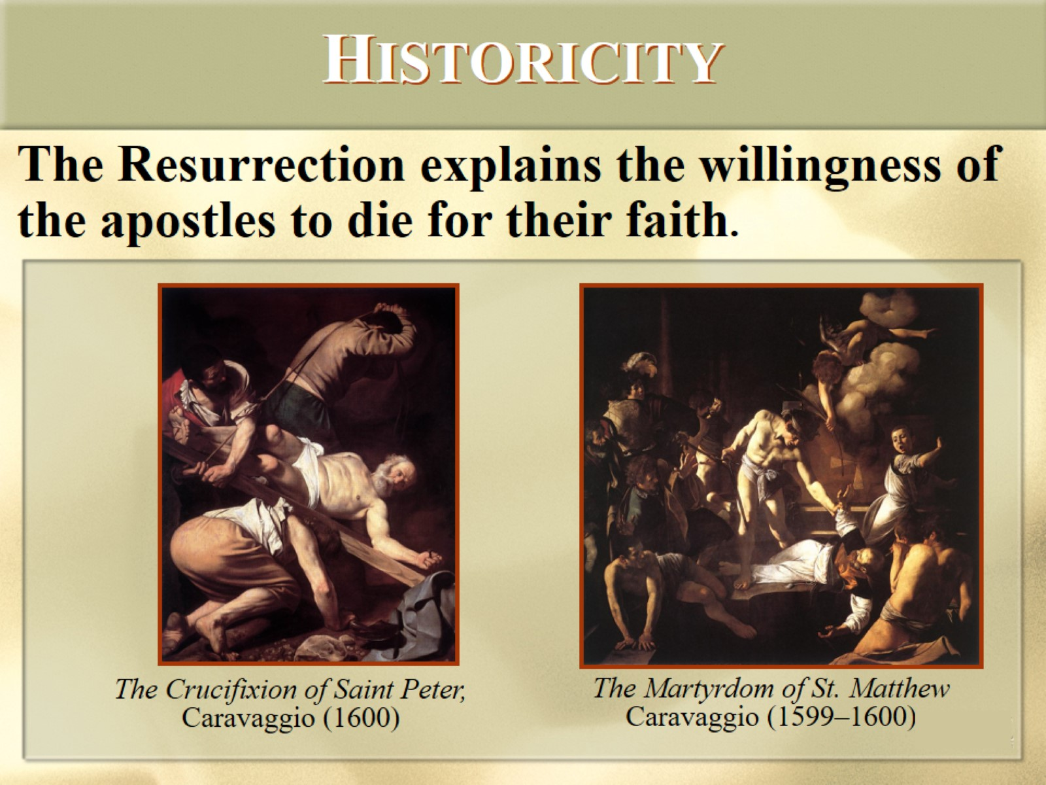
HISTORICITY

Slide 12
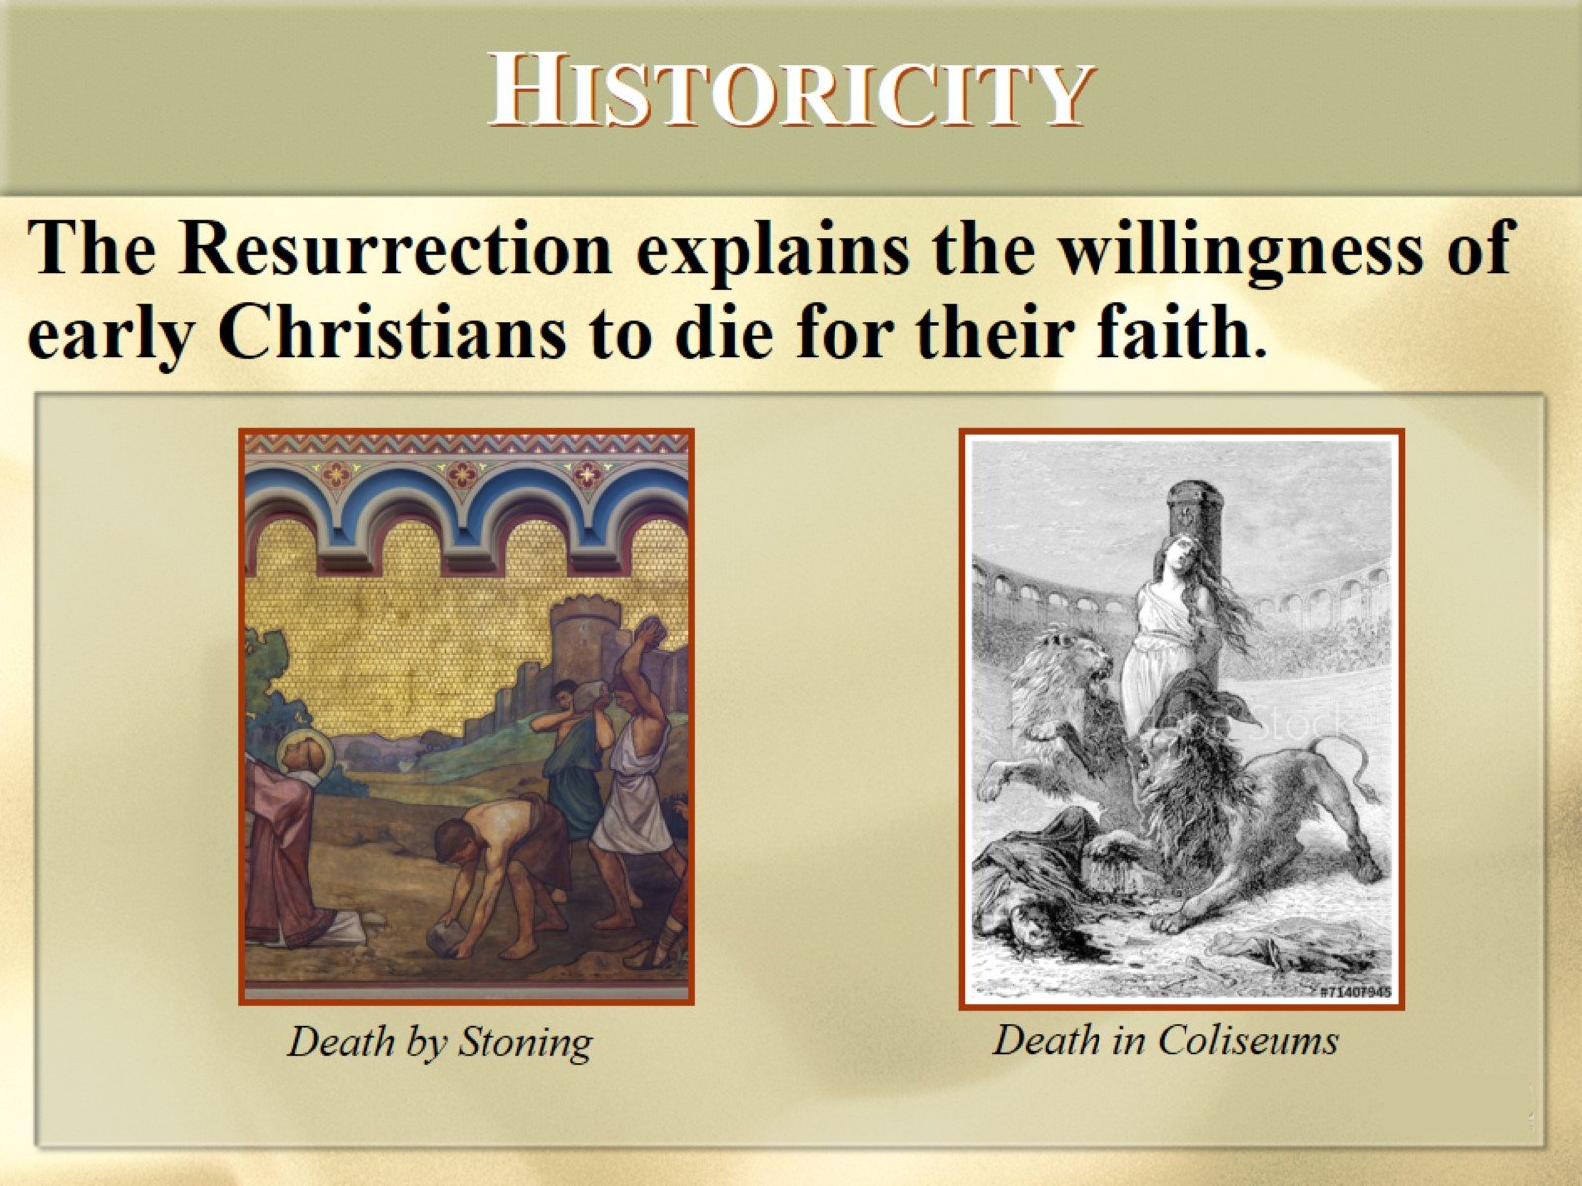
HISTORICITY

Slide 13
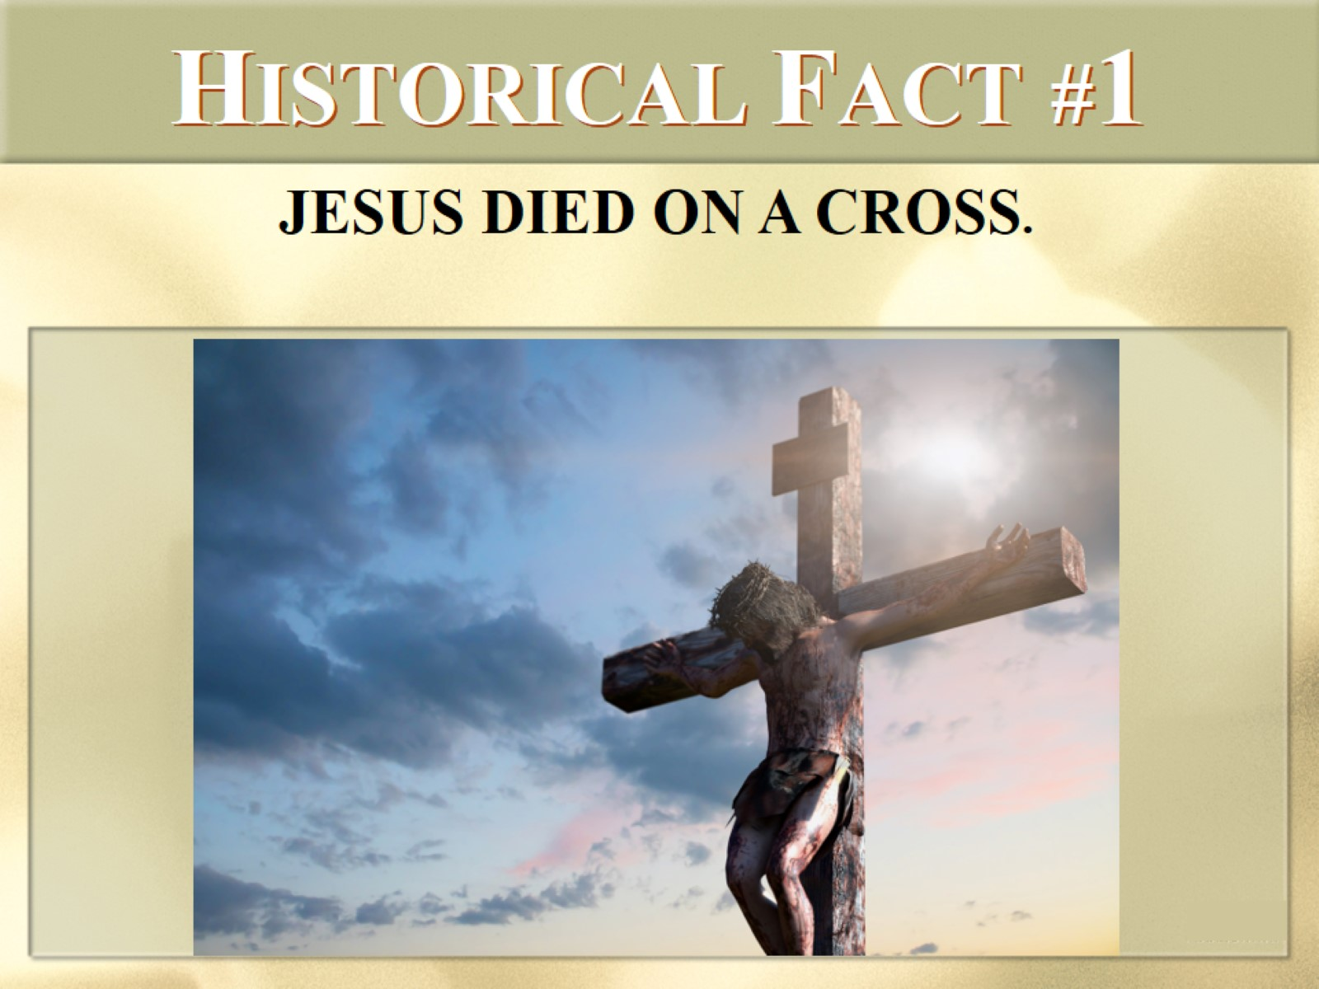
HISTORICAL FACT #1

Slide 14
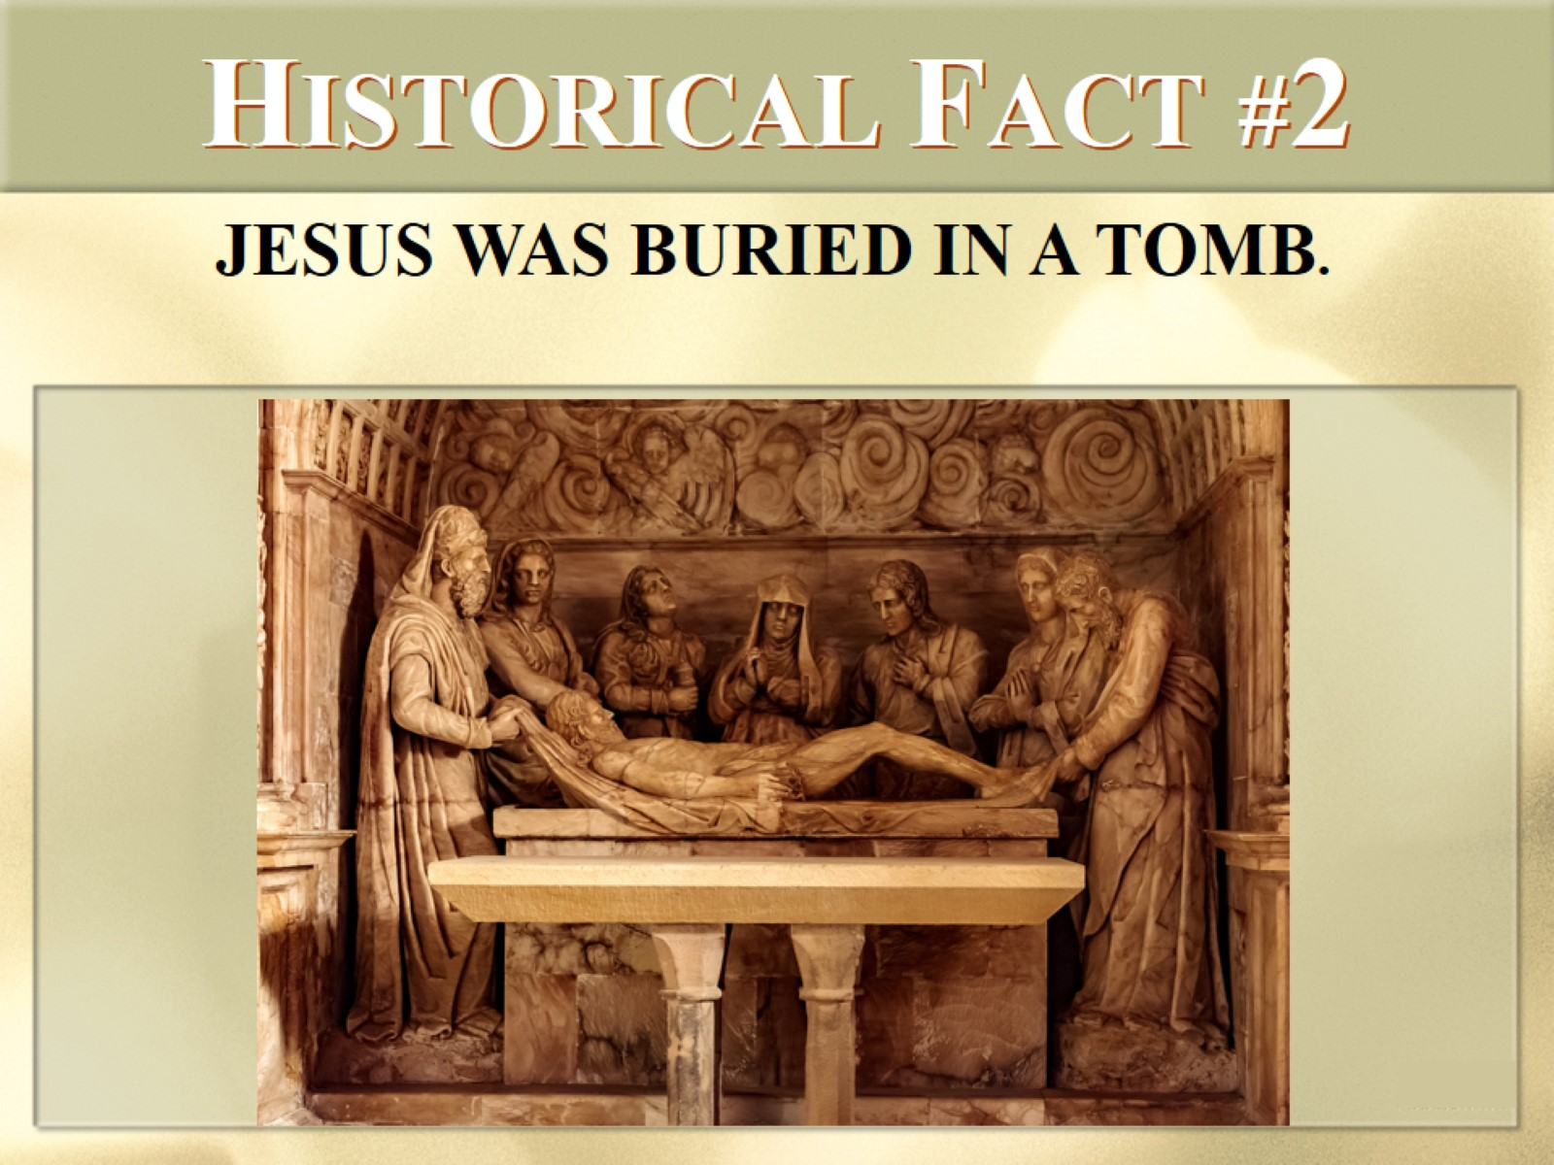
HISTORICAL FACT #2

Slide 15
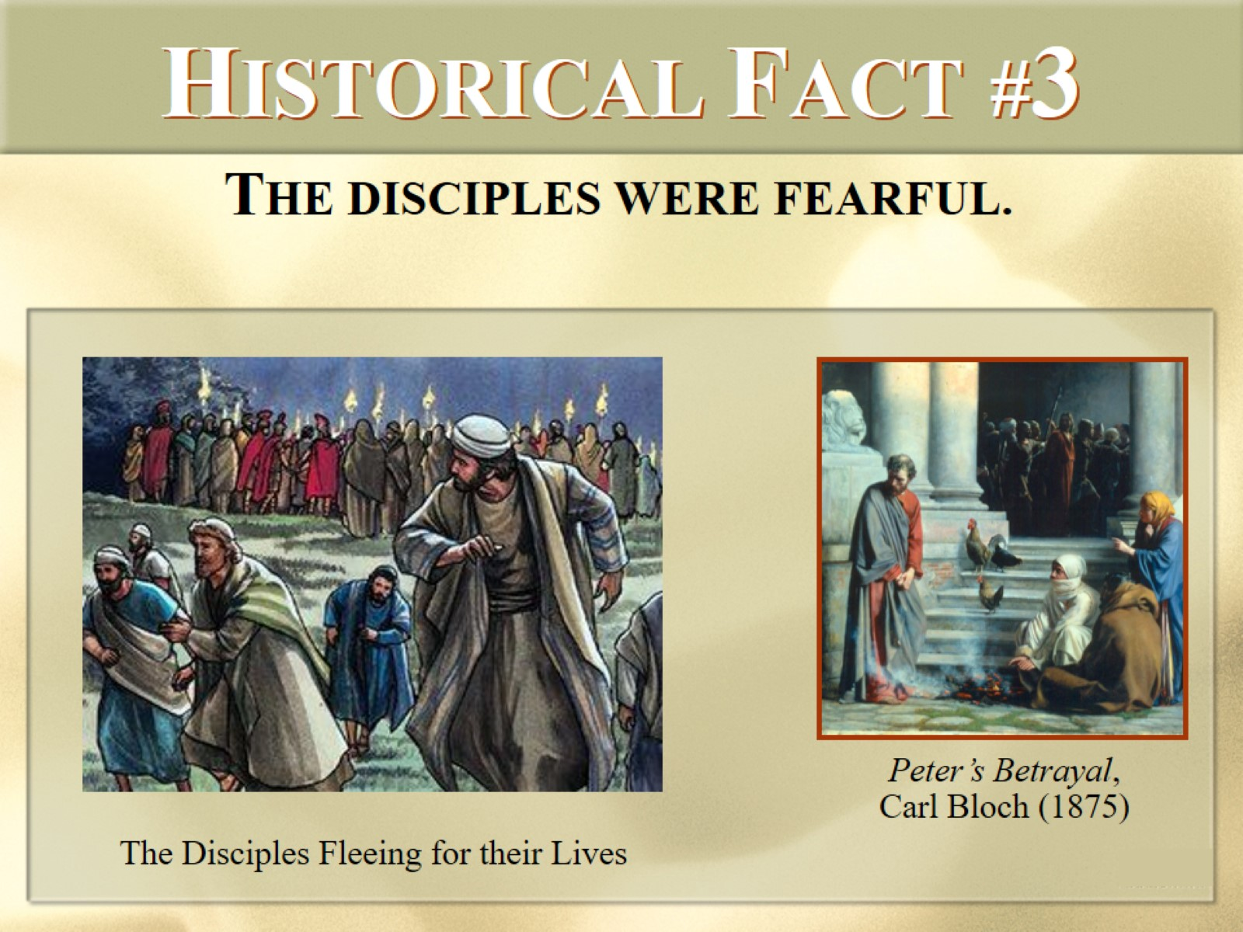
HISTORICAL FACT #3

Slide 16
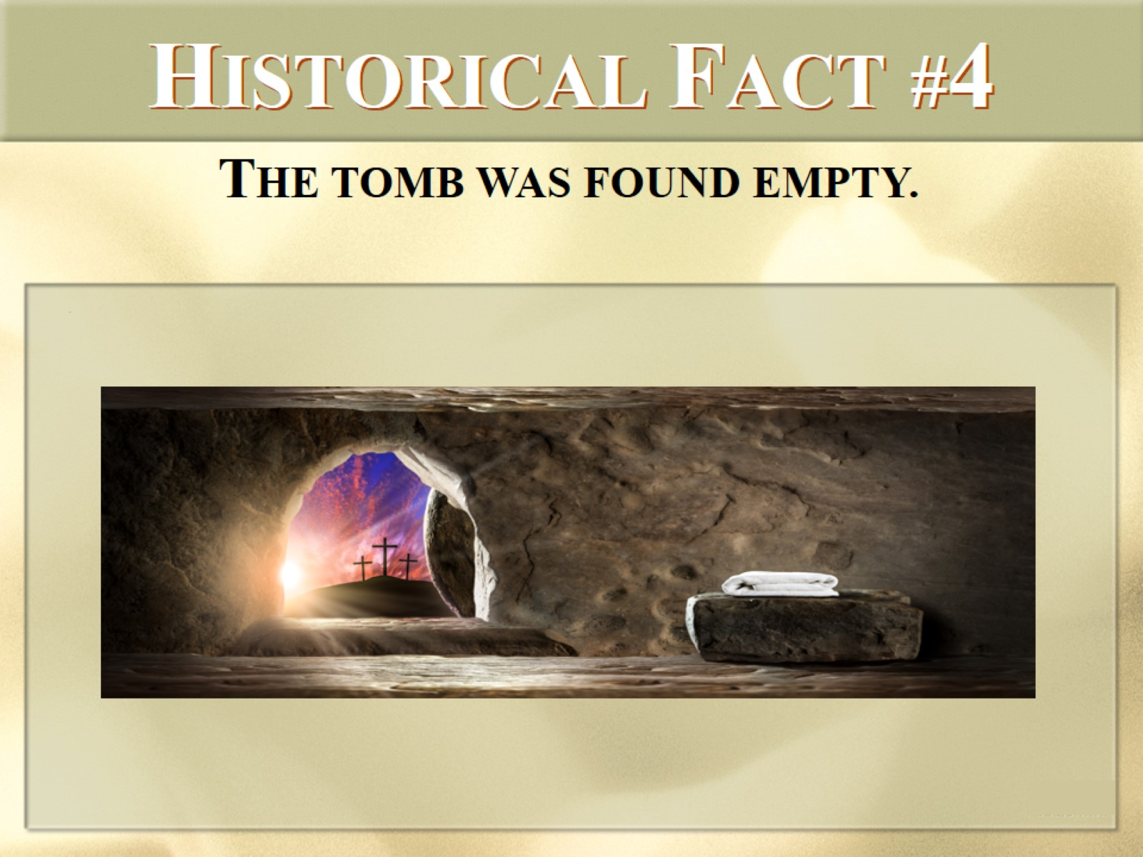
HISTORICAL FACT #4

Slide 17
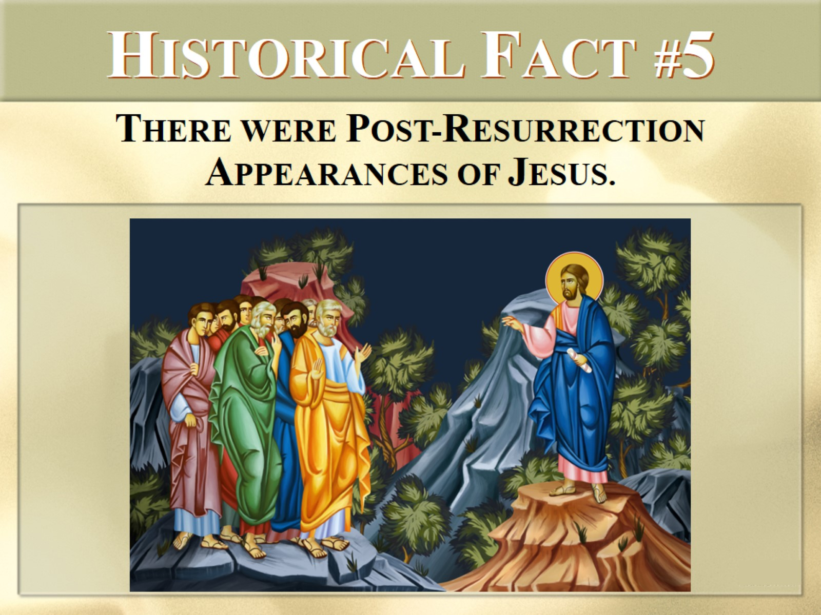
HISTORICAL FACT #5

Slide 18
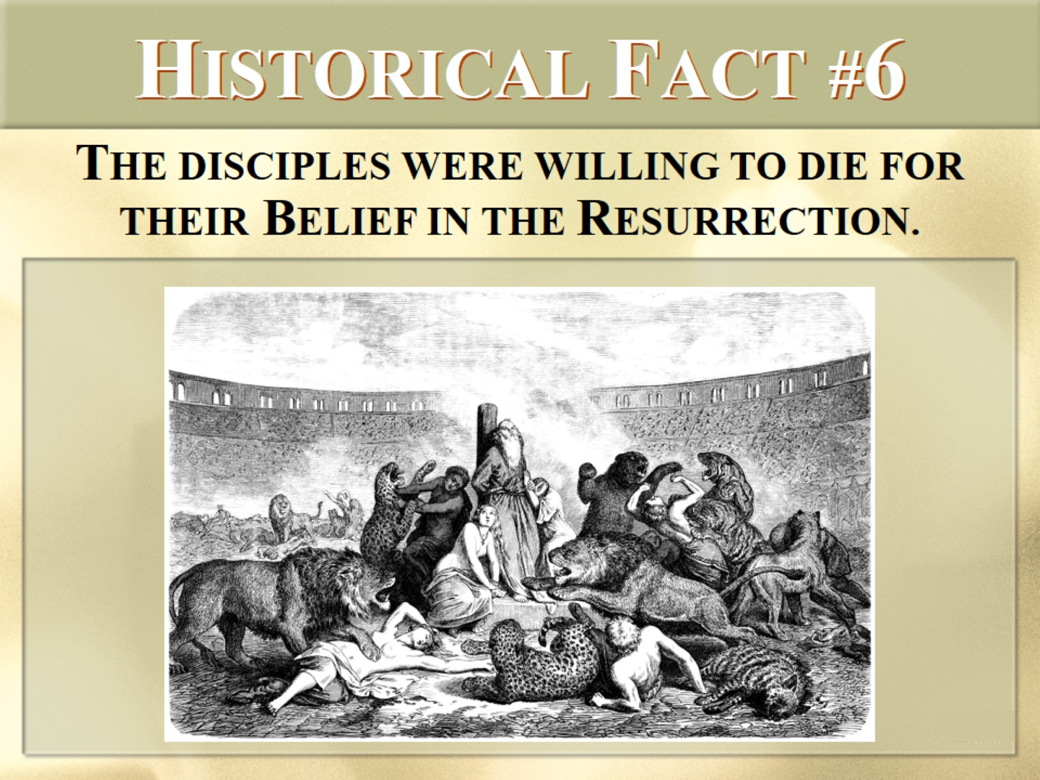
HISTORICAL FACT #6

Slide 19
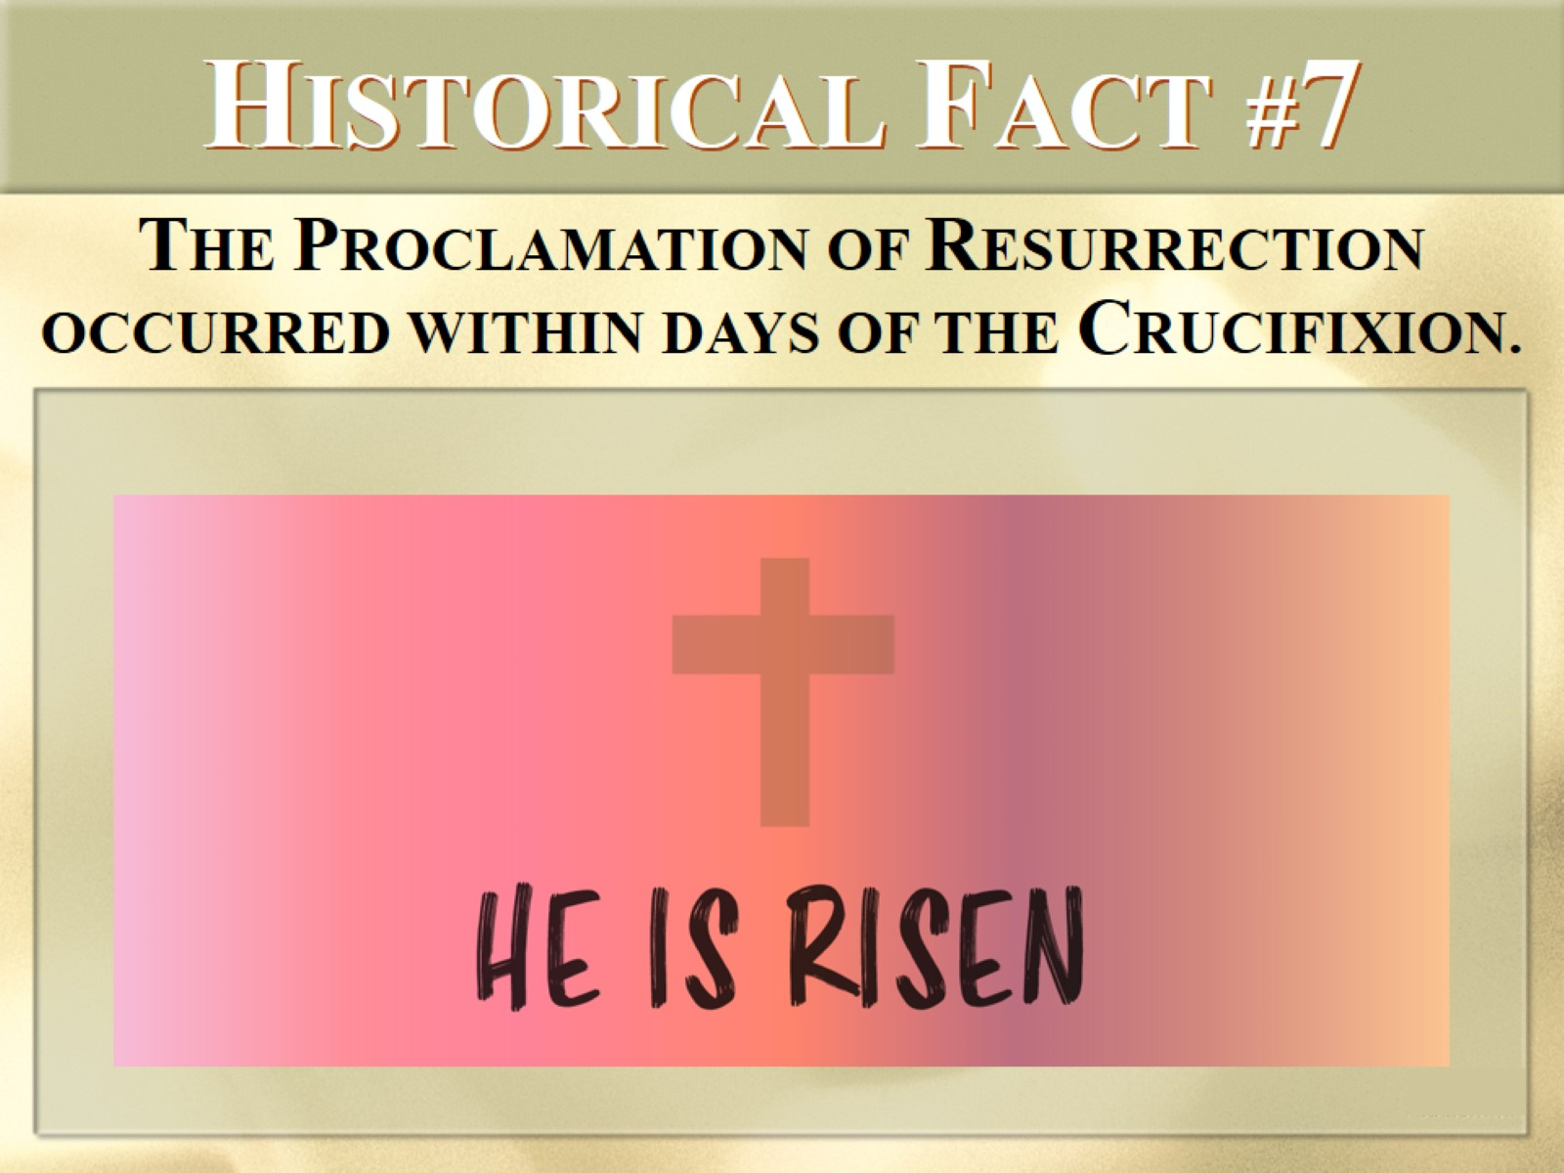
HISTORICAL FACT #7

Slide 20
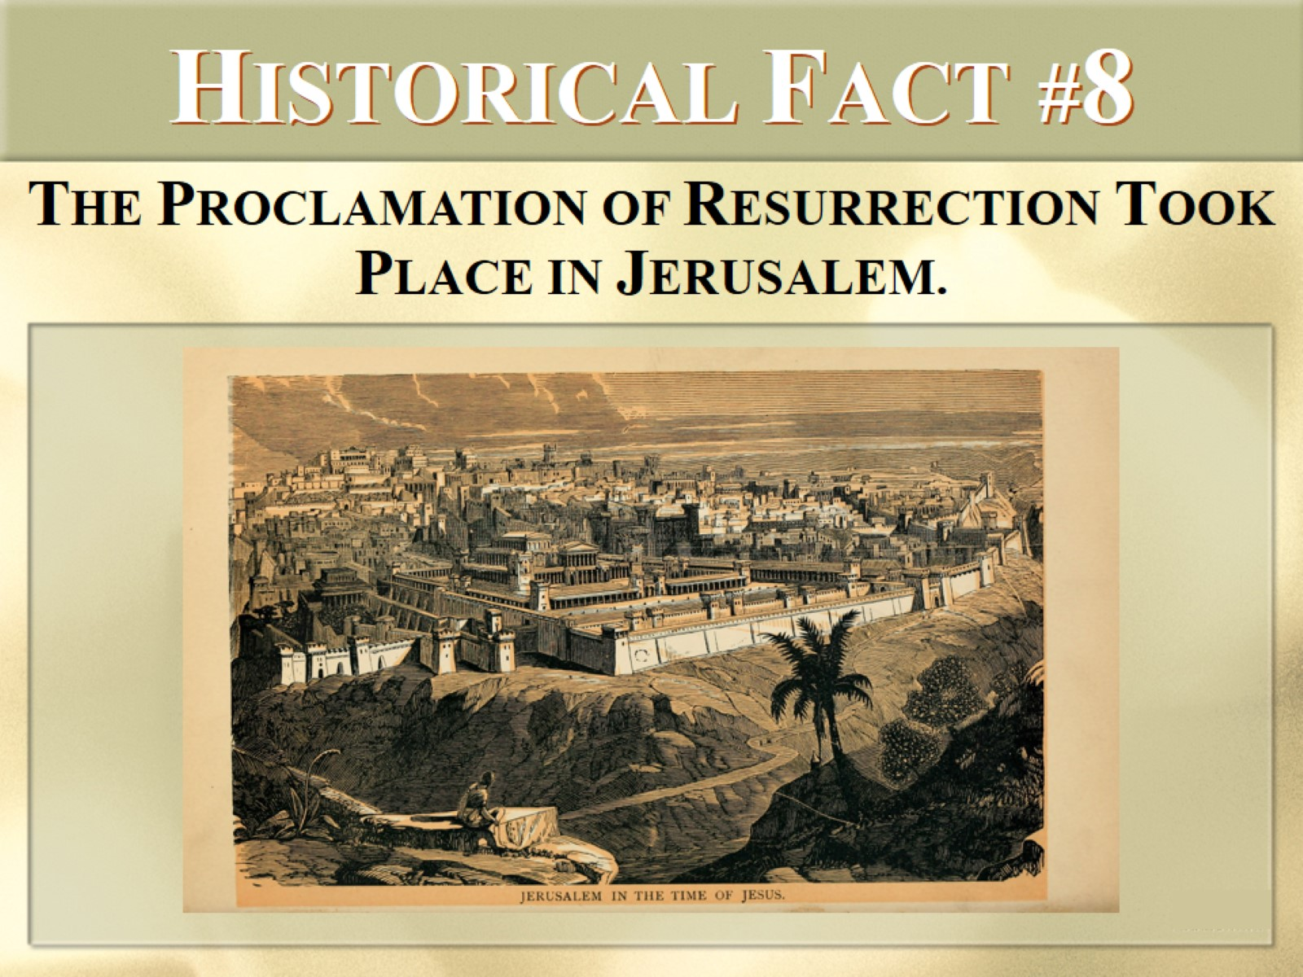
HISTORICAL FACT #8

Slide 21

HISTORICAL FACT #9

Slide 22
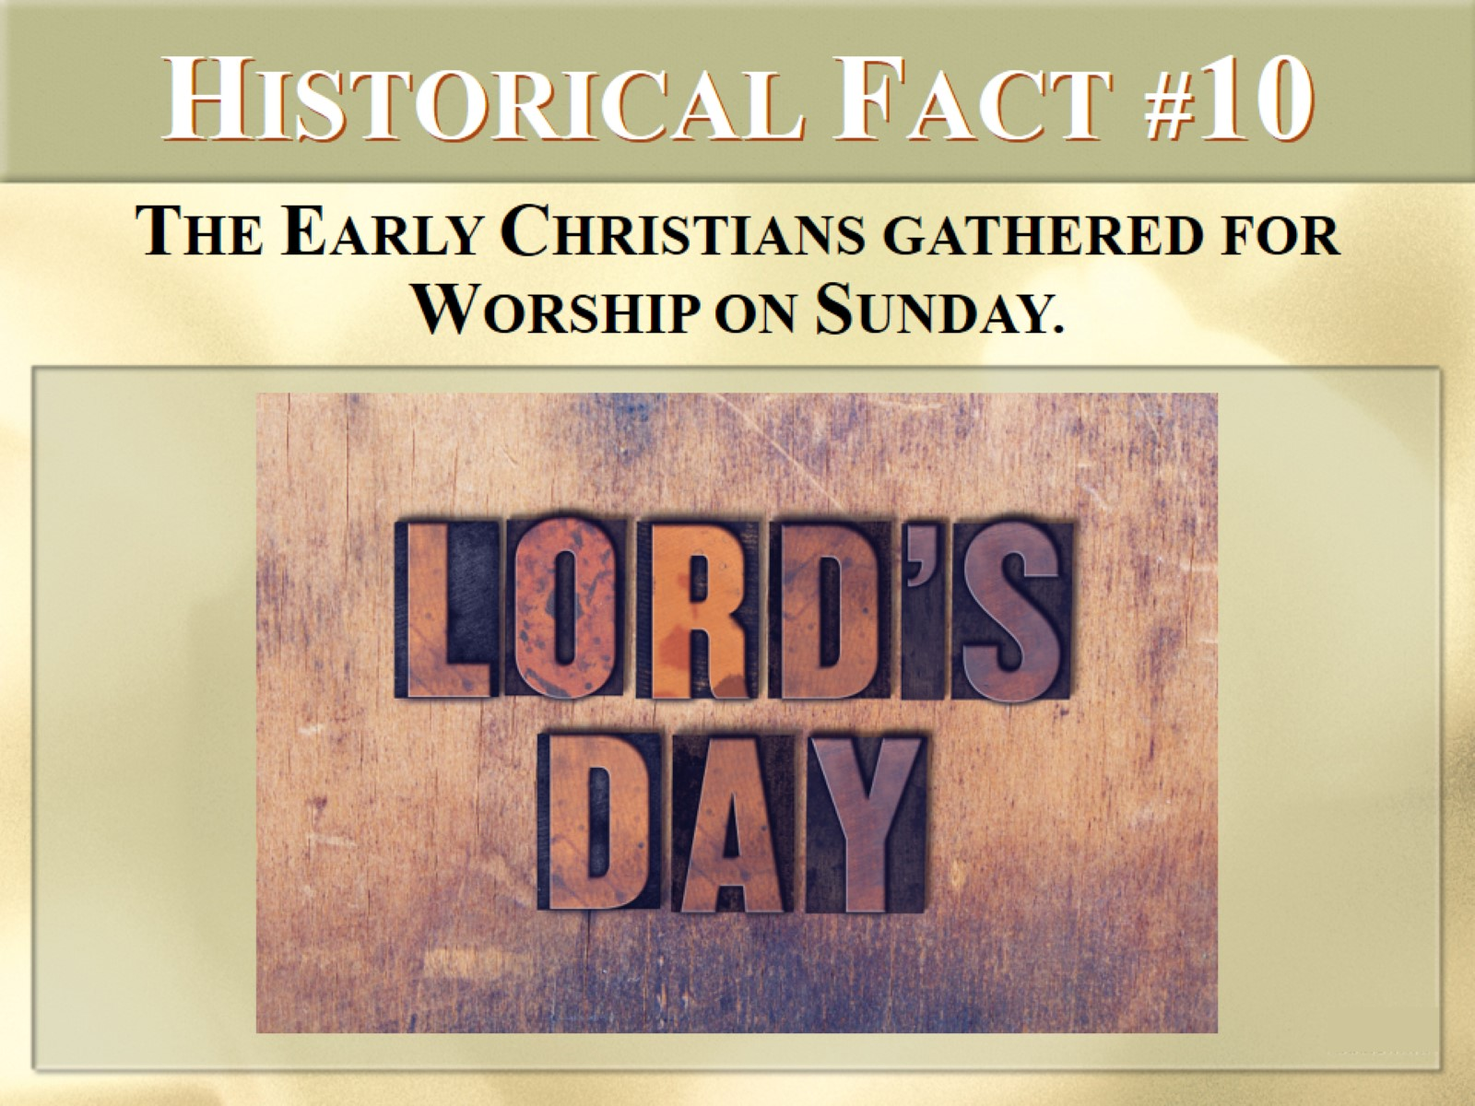
HISTORICAL FACT #10

Slide 23
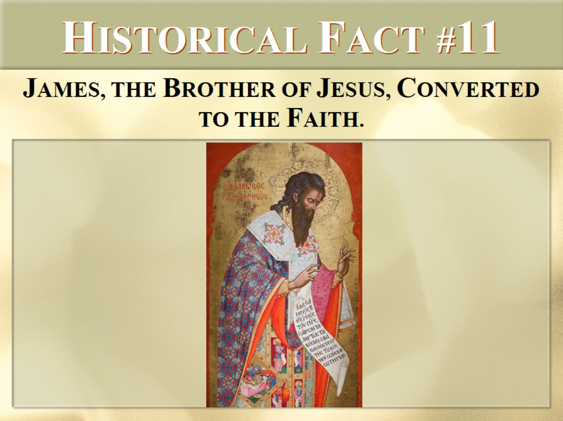
HISTORICAL FACT #11

Slide 24
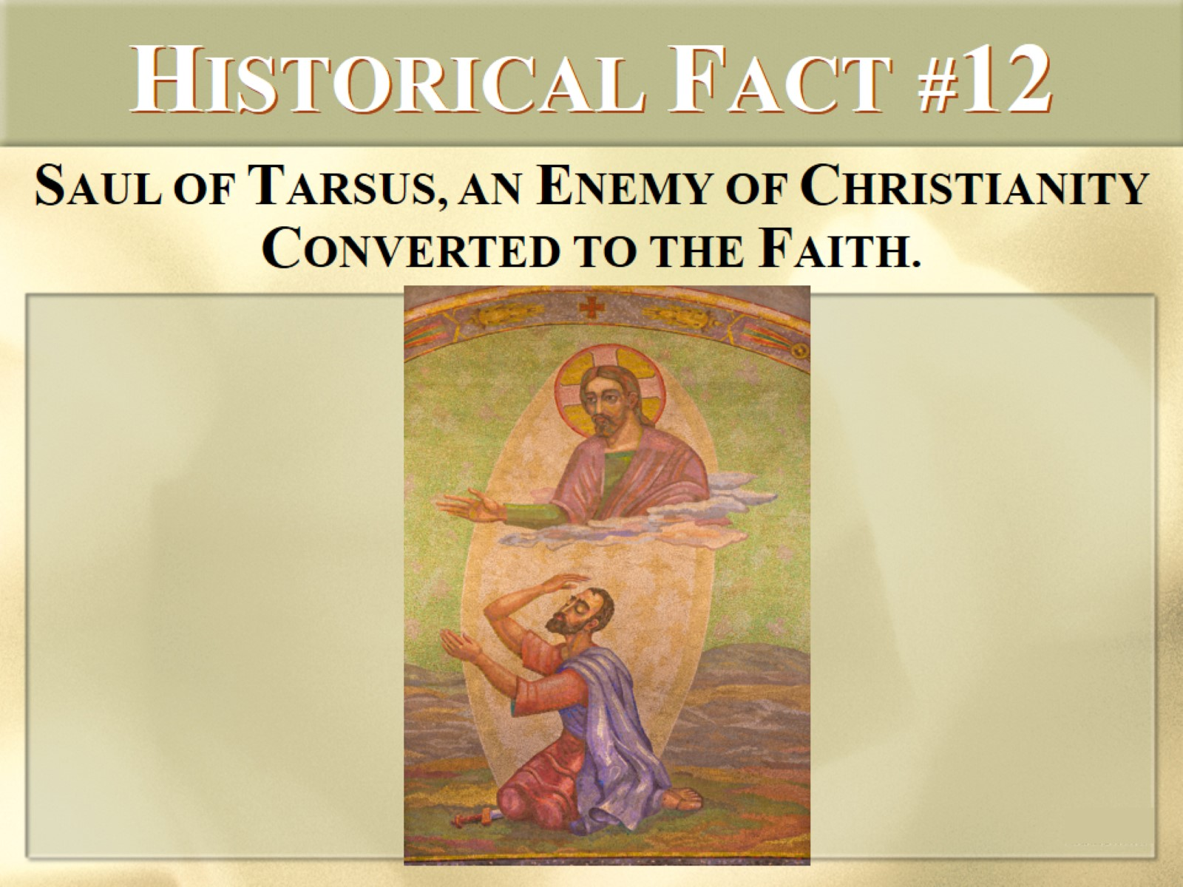
HISTORICAL FACT #12

Slide 25


Slide 26
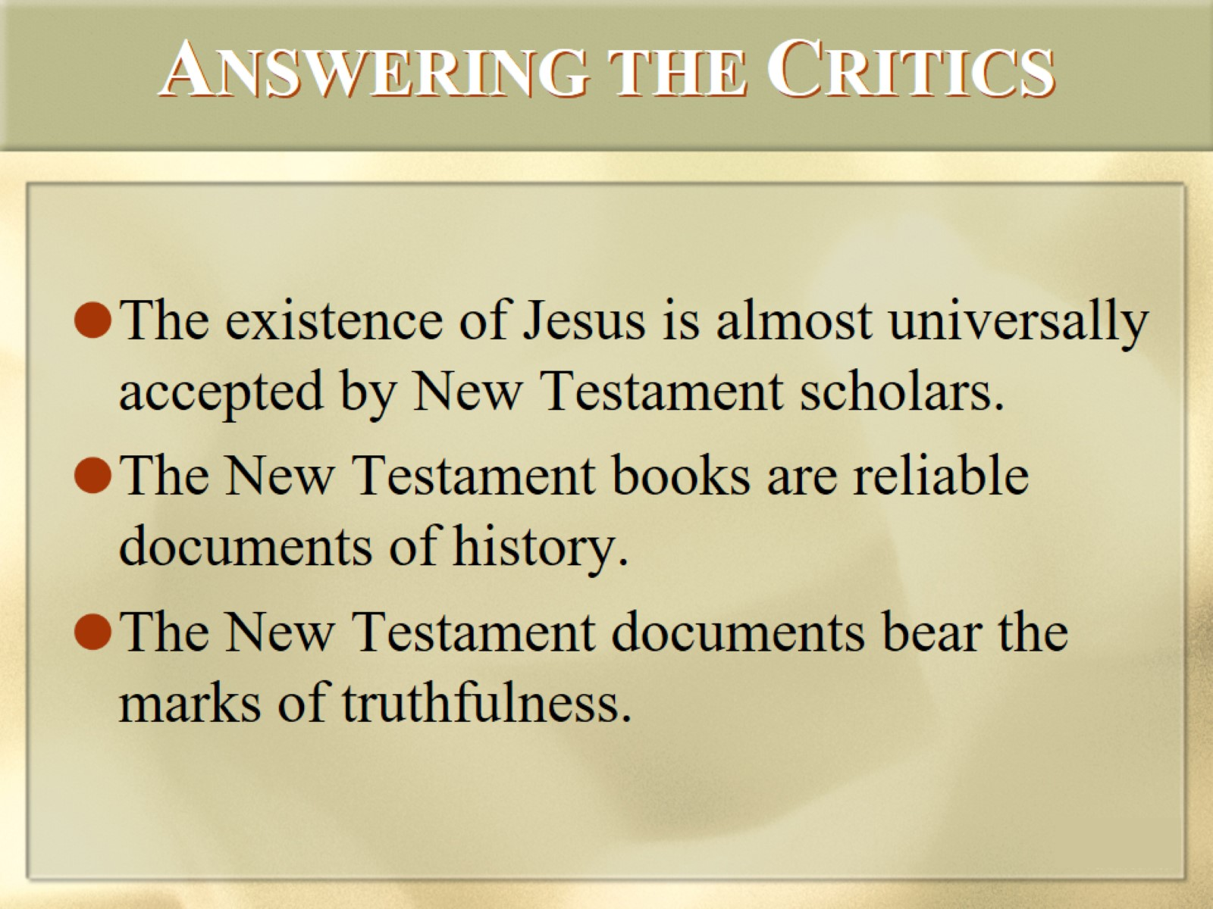
ANSWERING THE CRITICS

Slide 27
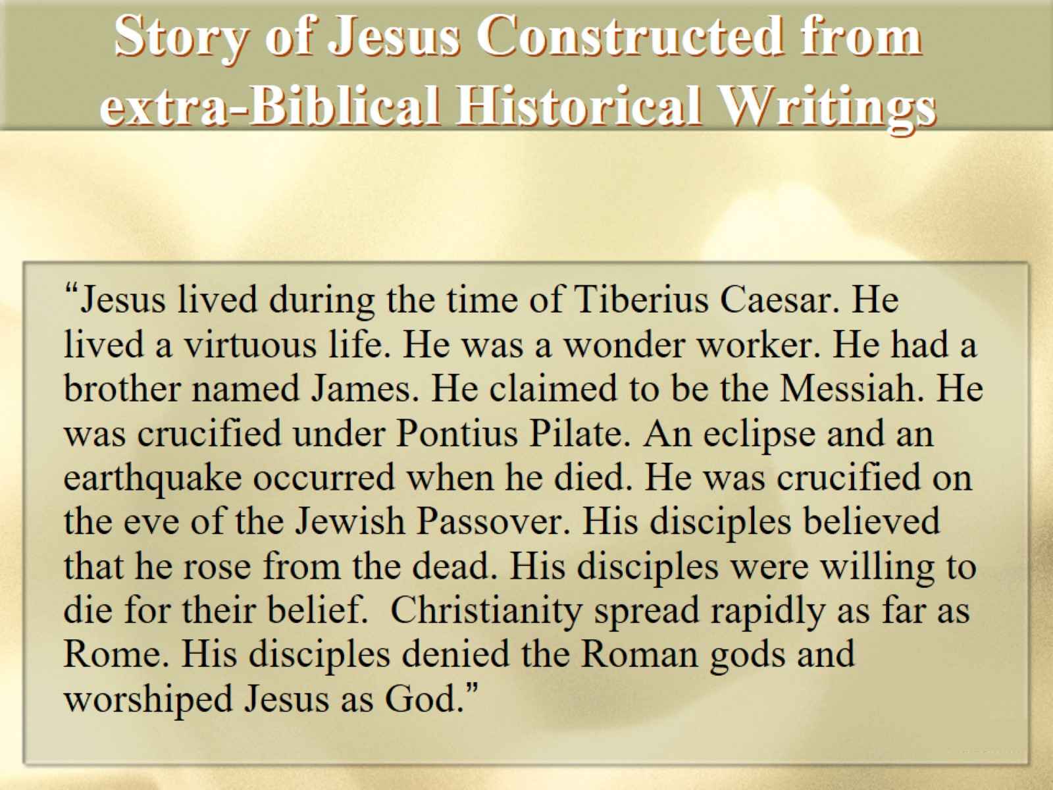
Story of Jesus Constructed from extra-Biblical Historical Writings

Slide 28
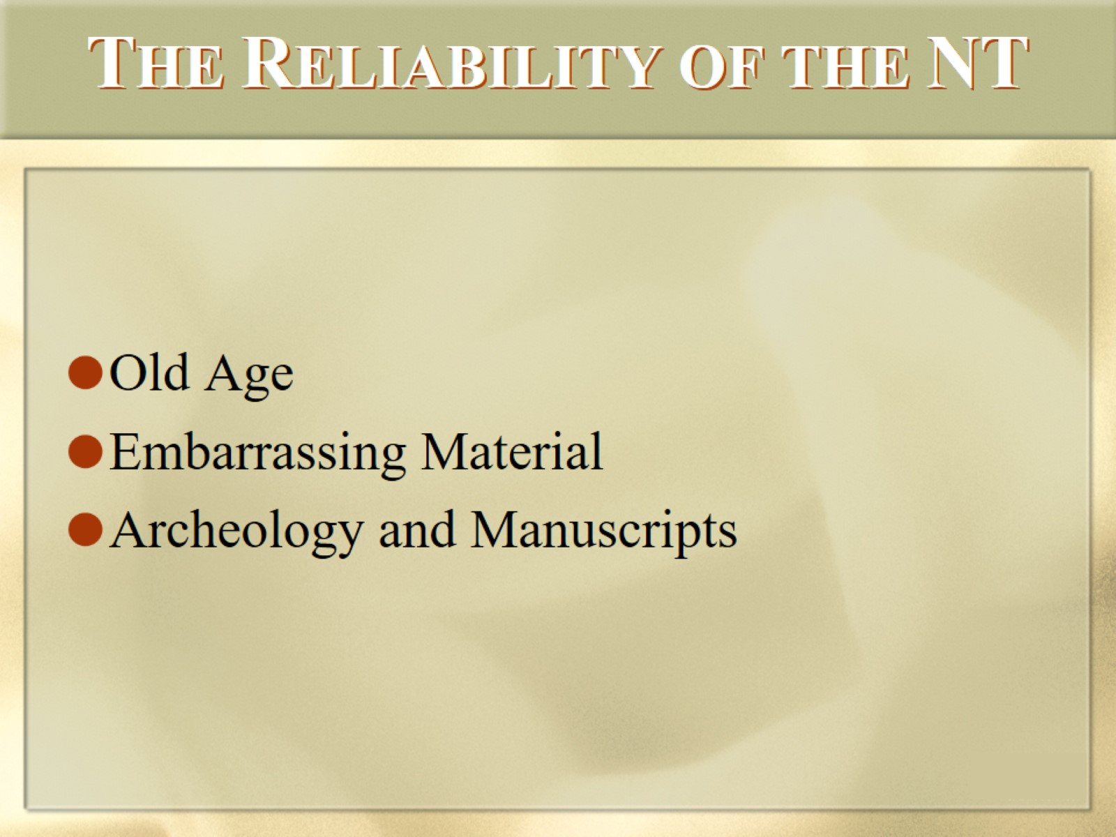
THE RELIABILITY OF THE NT

Slide 29
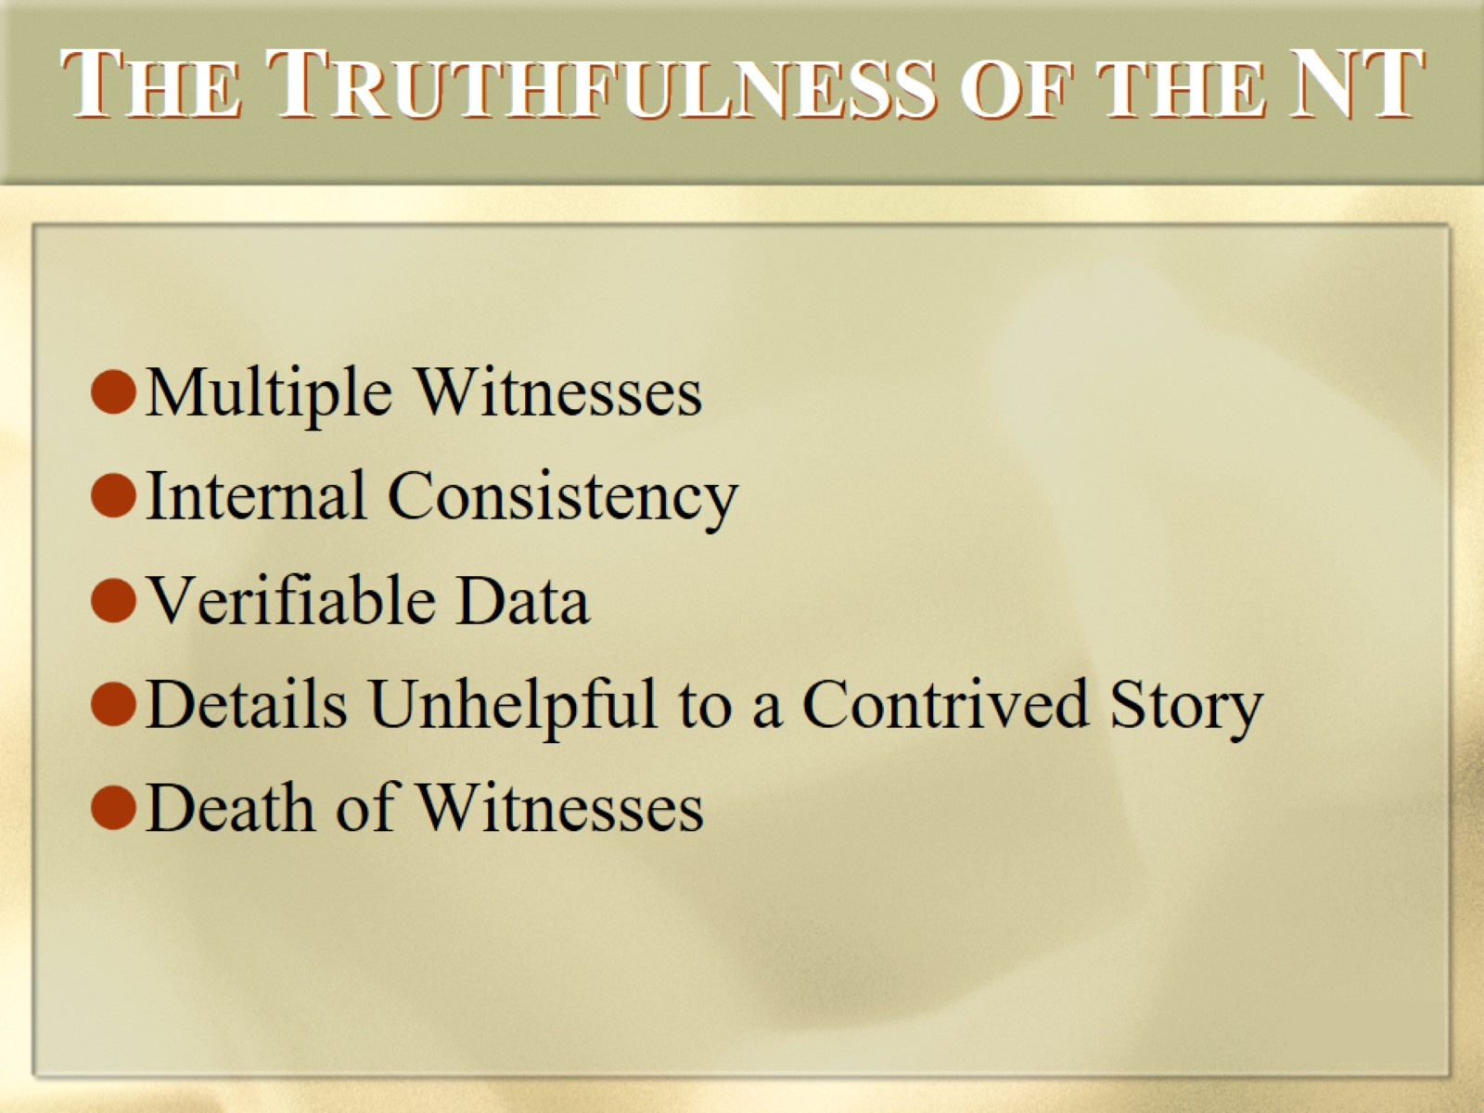
THE TRUTHFULNESS OF THE NT

Slide 30


Slide 31
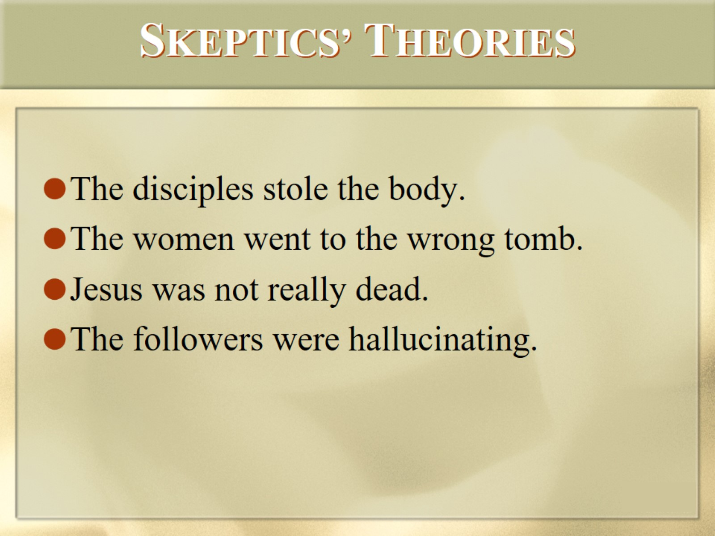
SKEPTICS’ THEORIES

Slide 32


Slide 33


