Slide 1

A Brief Introduction to Christian Apologetics

Slide 2
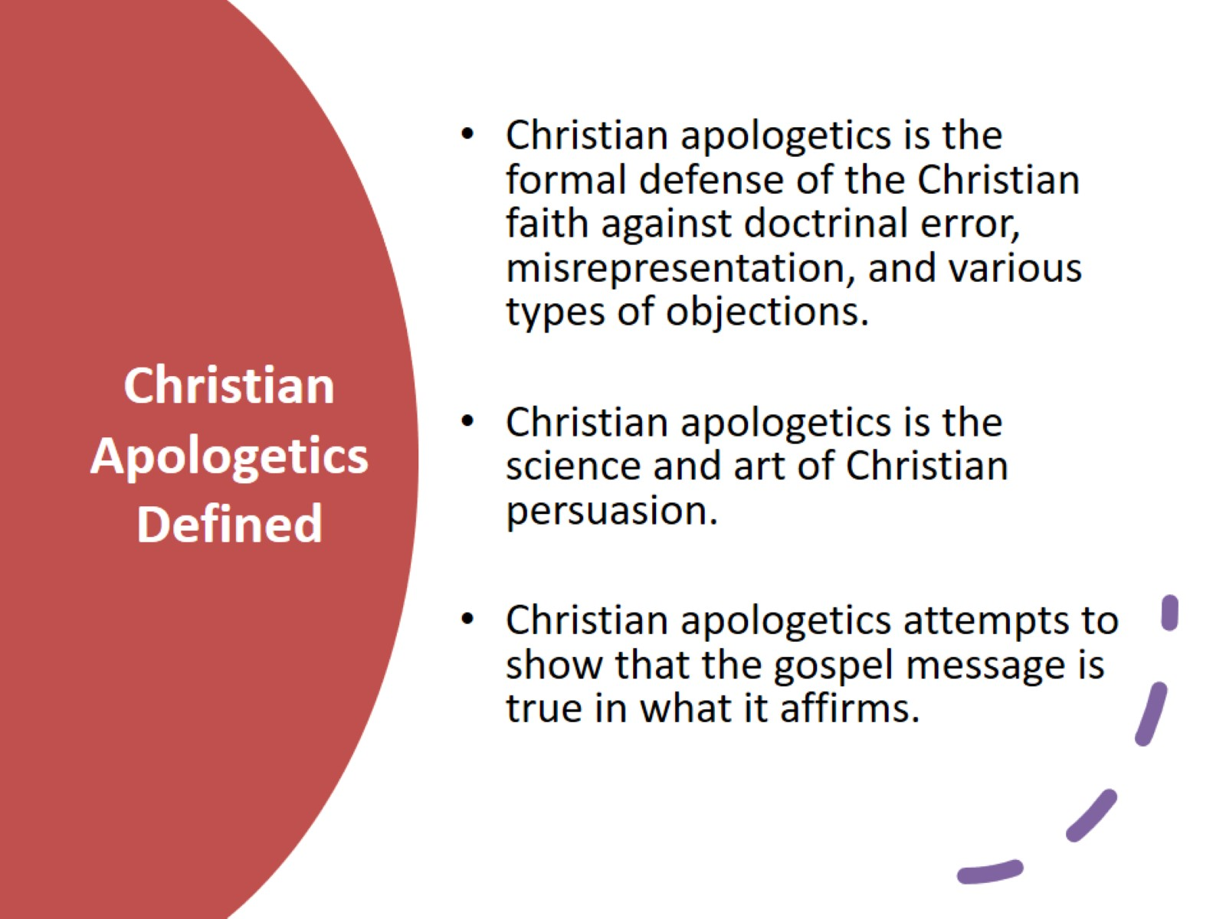
Christian Apologetics Defined

Slide 3

1 Peter 3:15

Slide 4
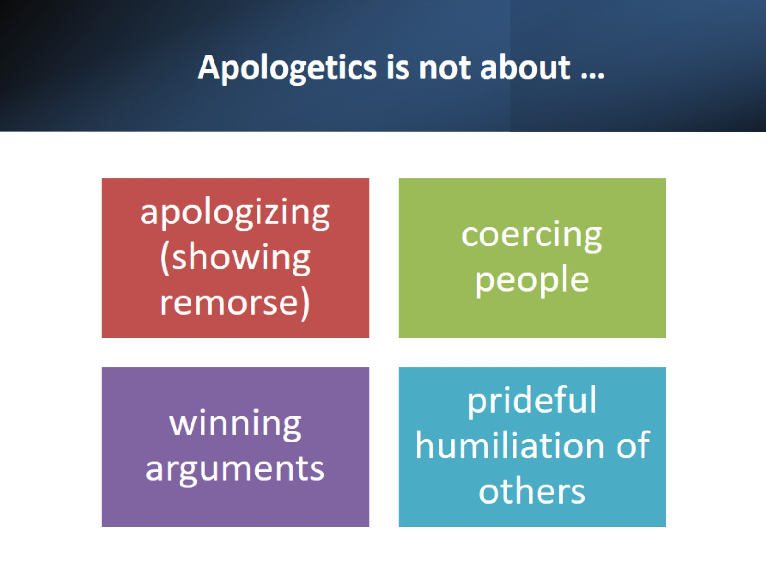
Apologetics is not about …

Slide 5
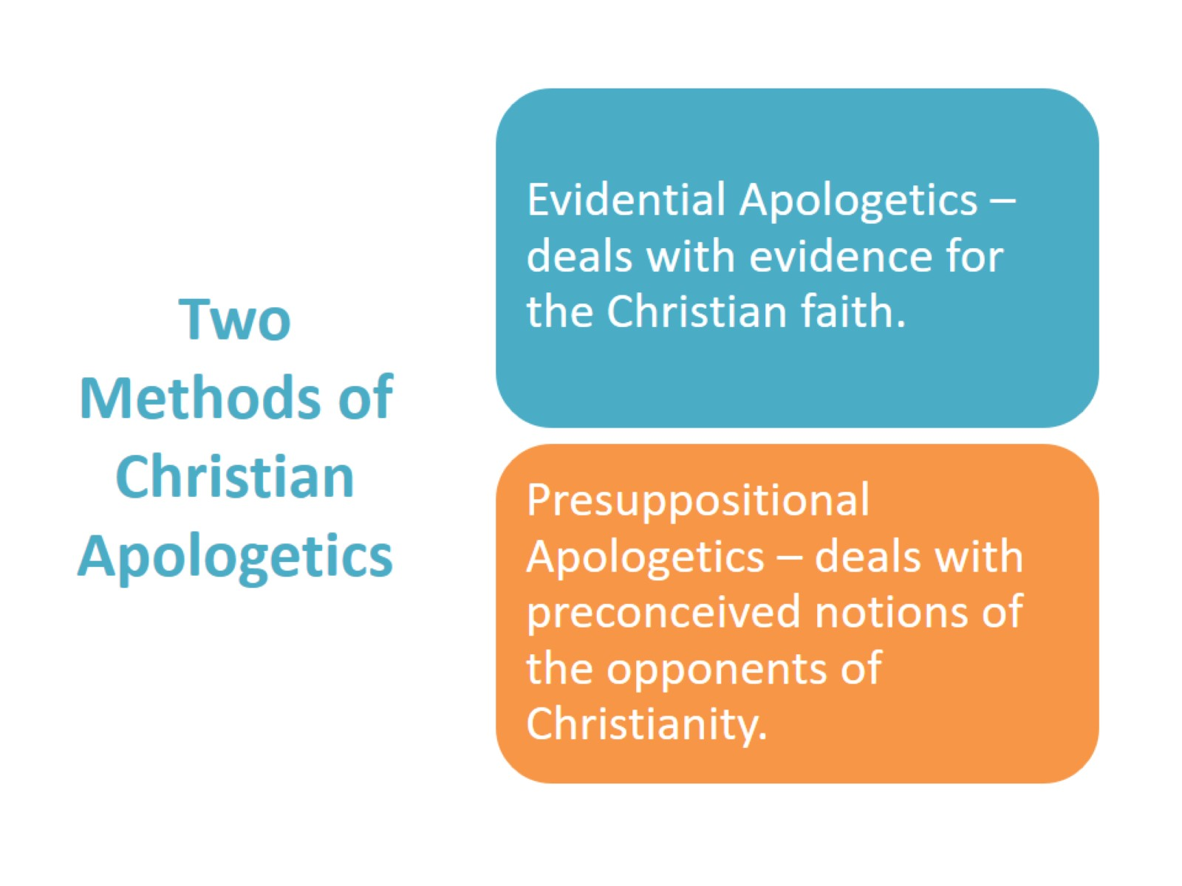
Two Methods of Christian Apologetics

Slide 6
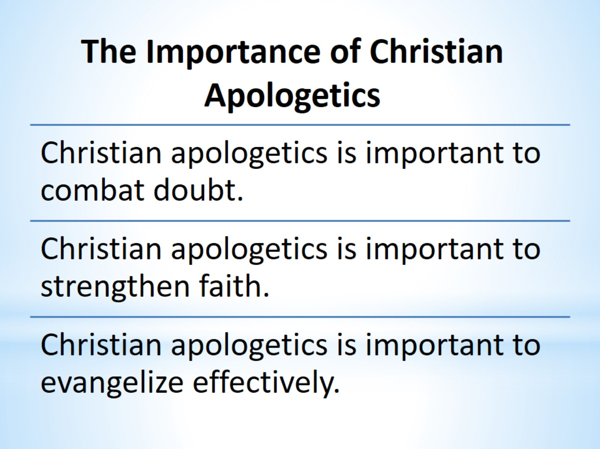
The Importance of Christian Apologetics

Slide 7

Christian apologetics combats doubt.

Slide 8
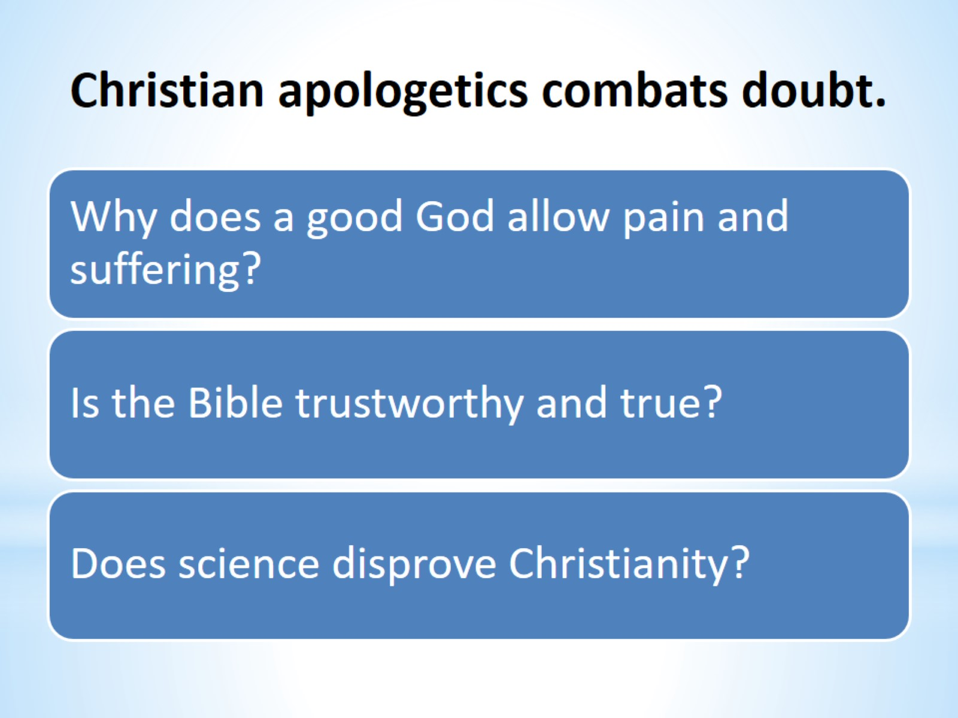
Christian apologetics combats doubt.

Slide 9
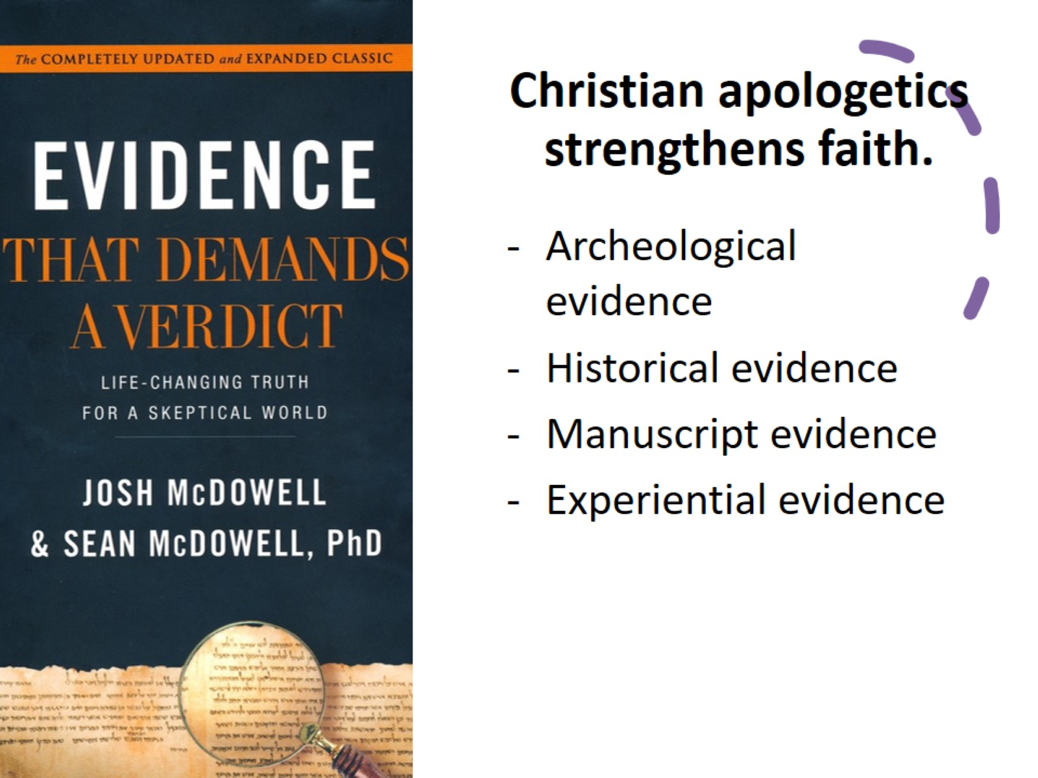
Christian apologetics strengthens faith.

Slide 10

Faith Formula

Slide 11
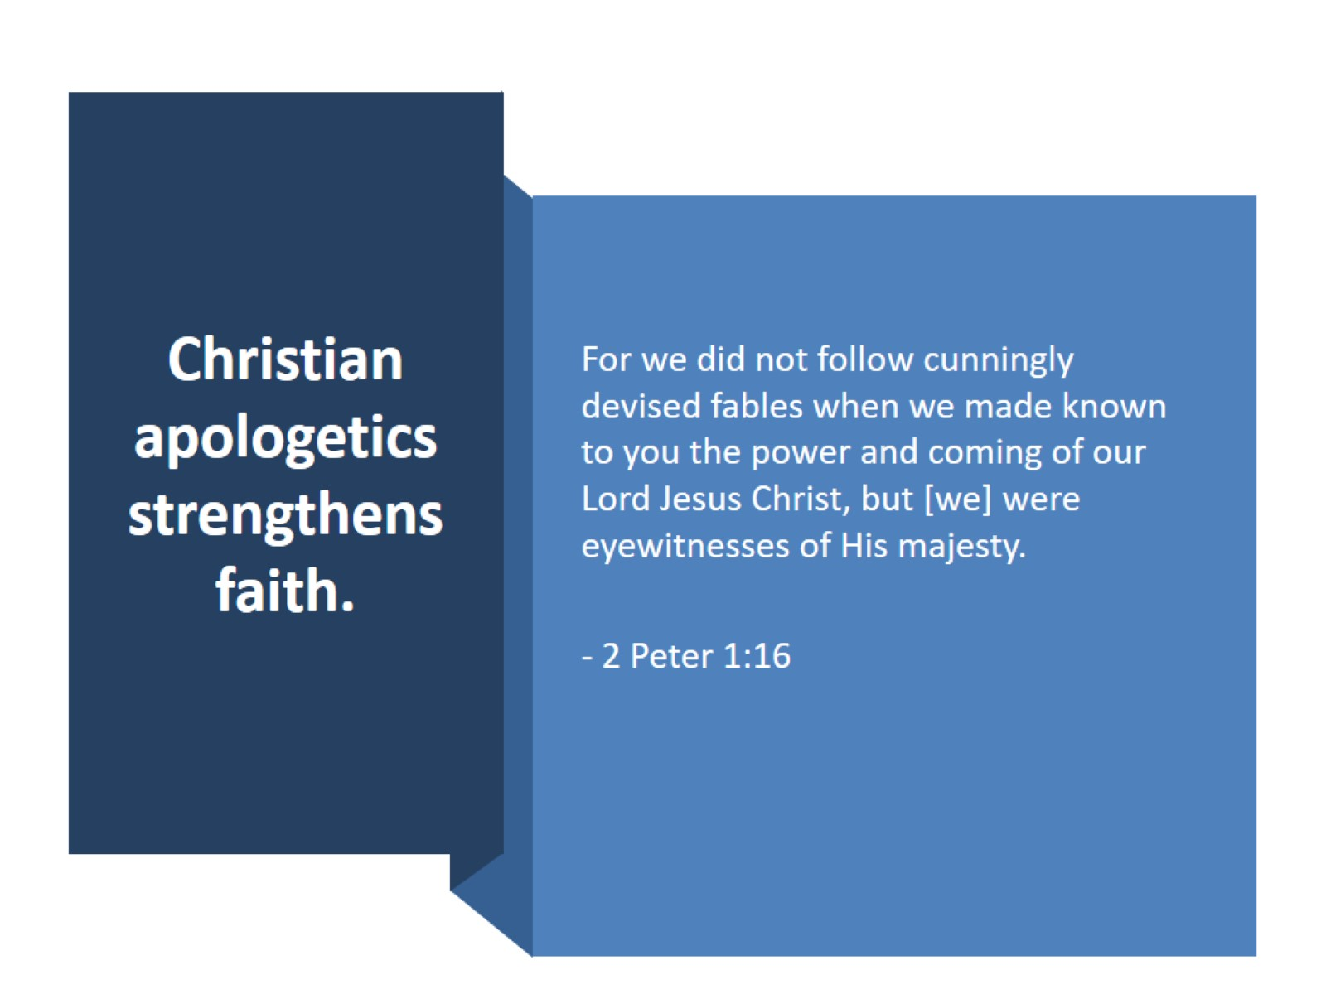
Christian apologetics strengthens faith.

Slide 12
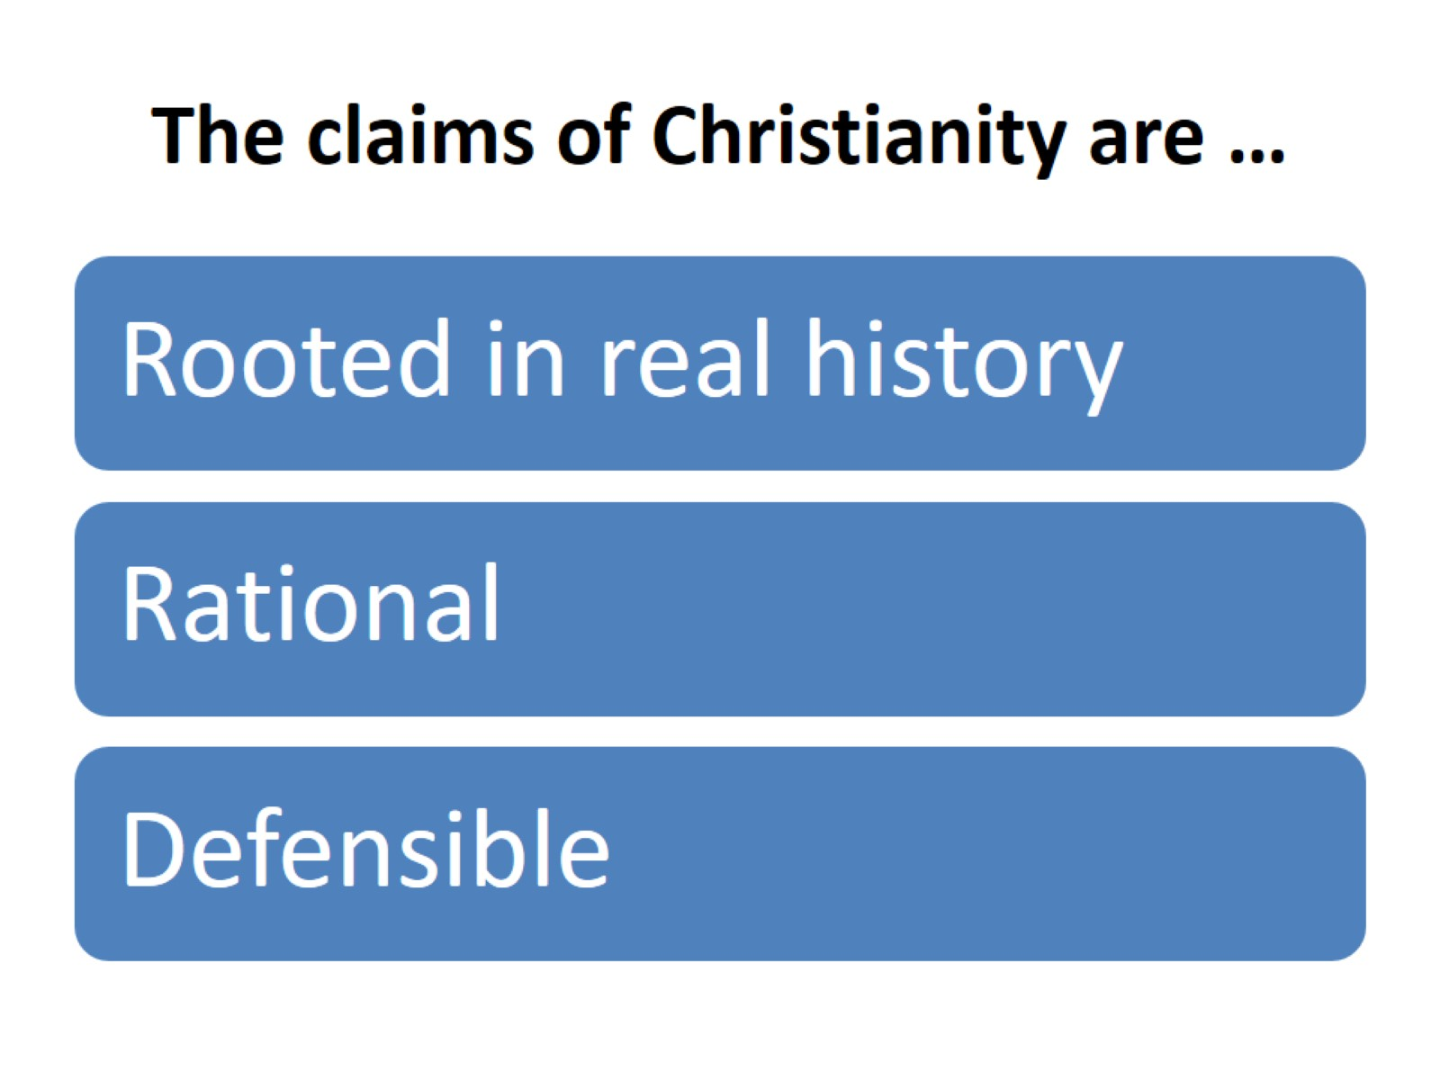
The claims of Christianity are …

Slide 13
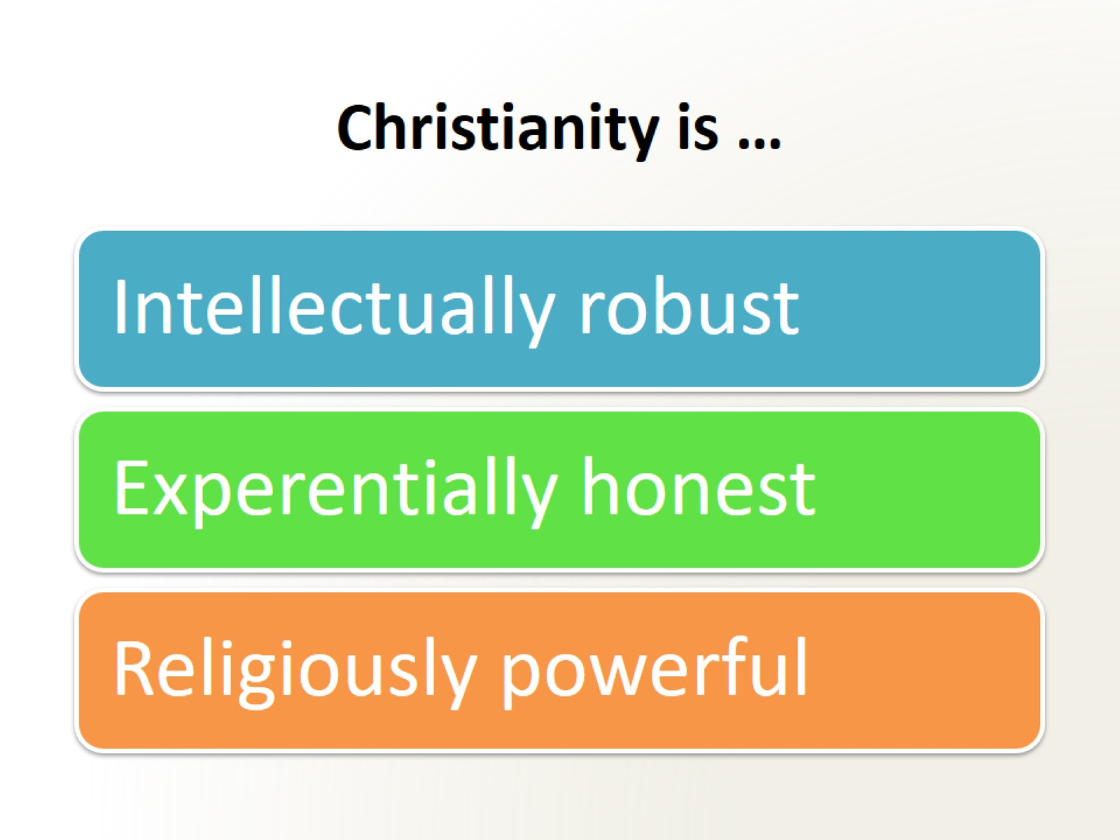
Christianity is …

Slide 14
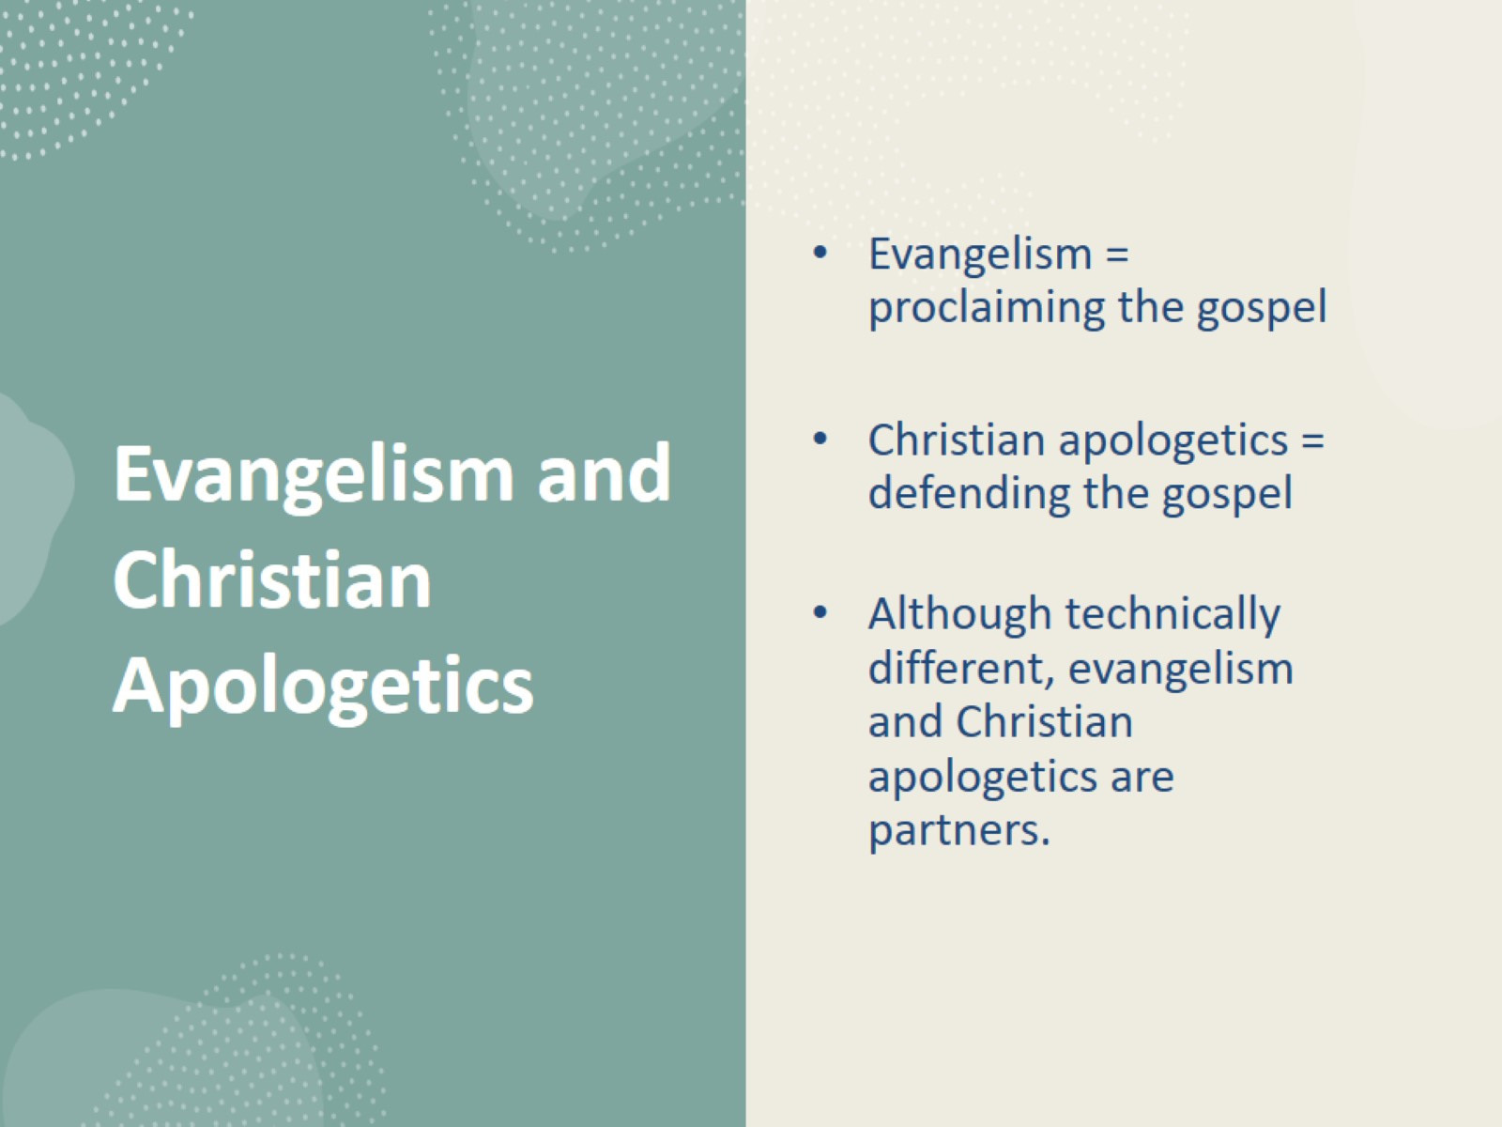
Evangelism and Christian Apologetics

Slide 15
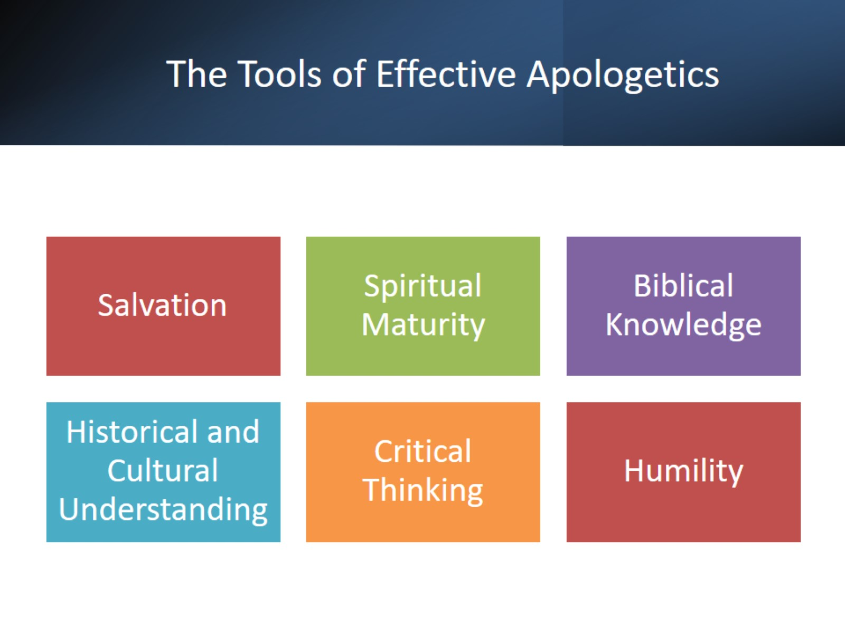
The Tools of Effective Apologetics

