Slide 1

Witnessing to Intellectuals

Slide 2
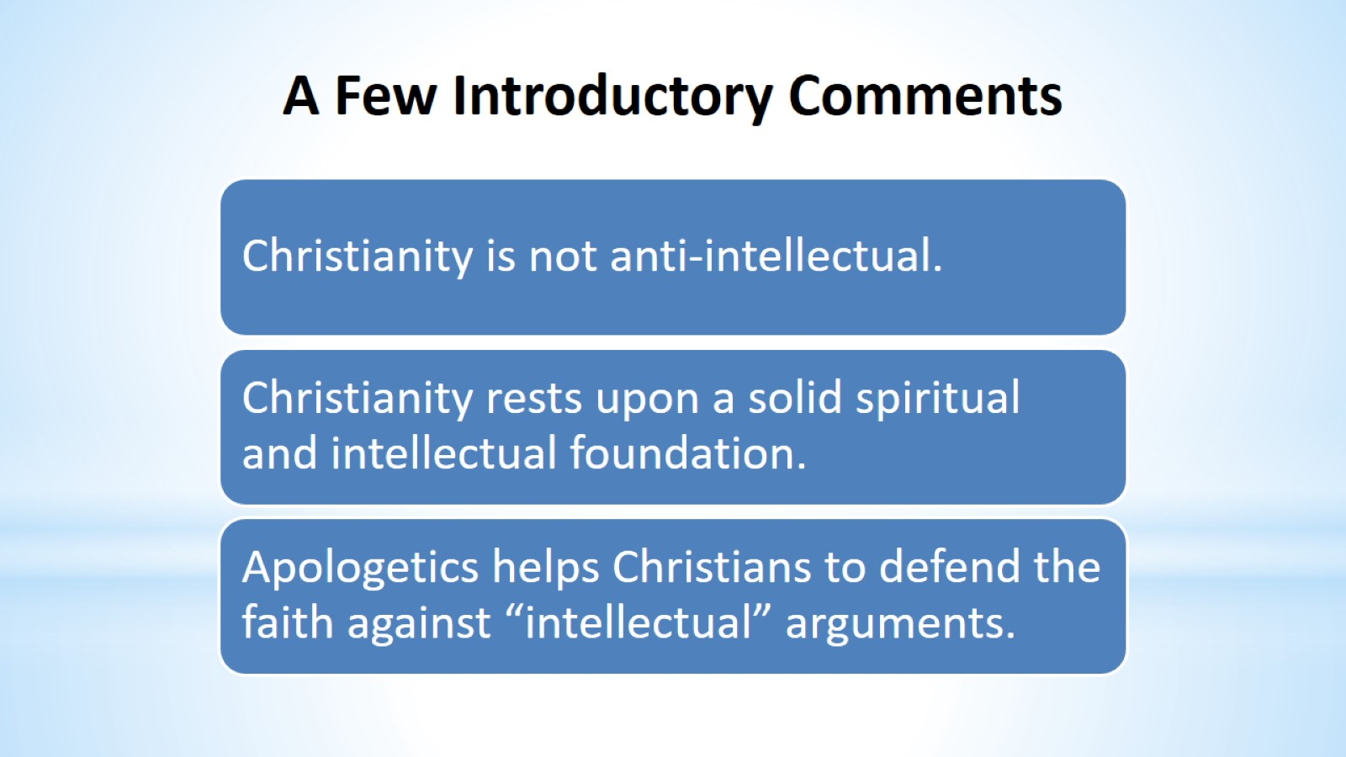
A Few Introductory Comments

Slide 3
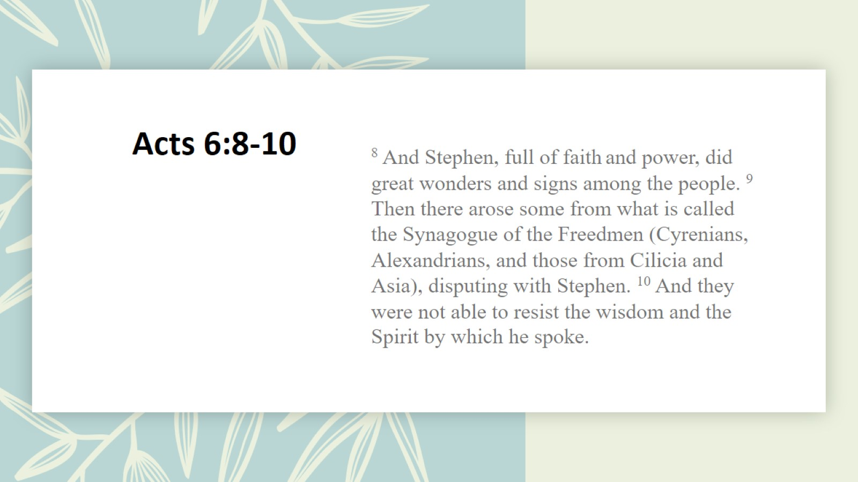
Acts 6:8-10

Slide 4
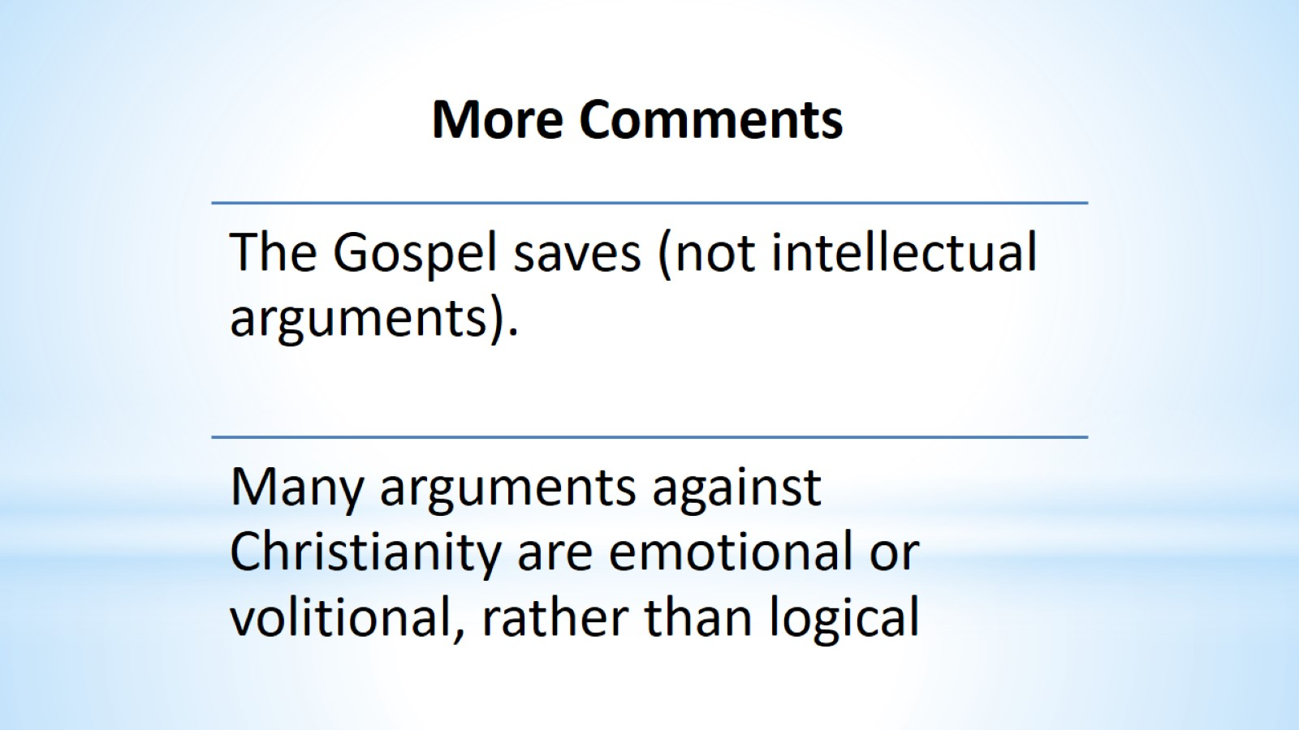
More Comments

Slide 5
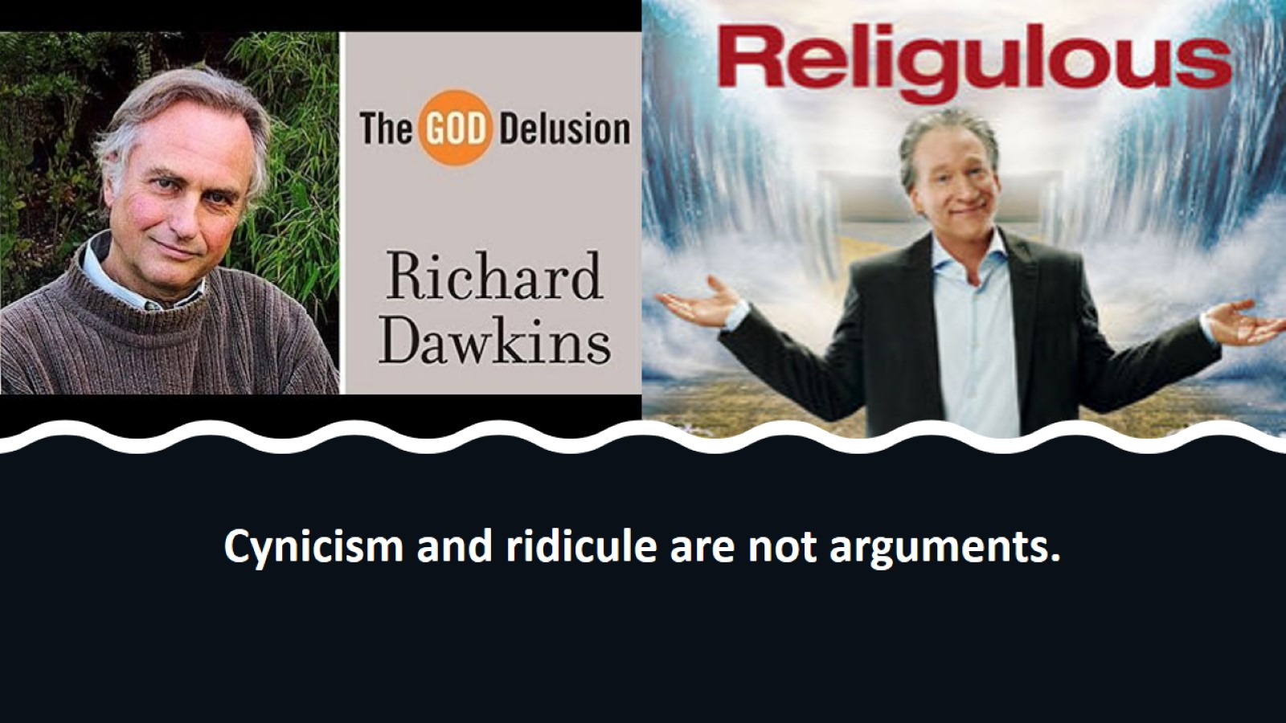
Cynicism and ridicule are not arguments.

Slide 6
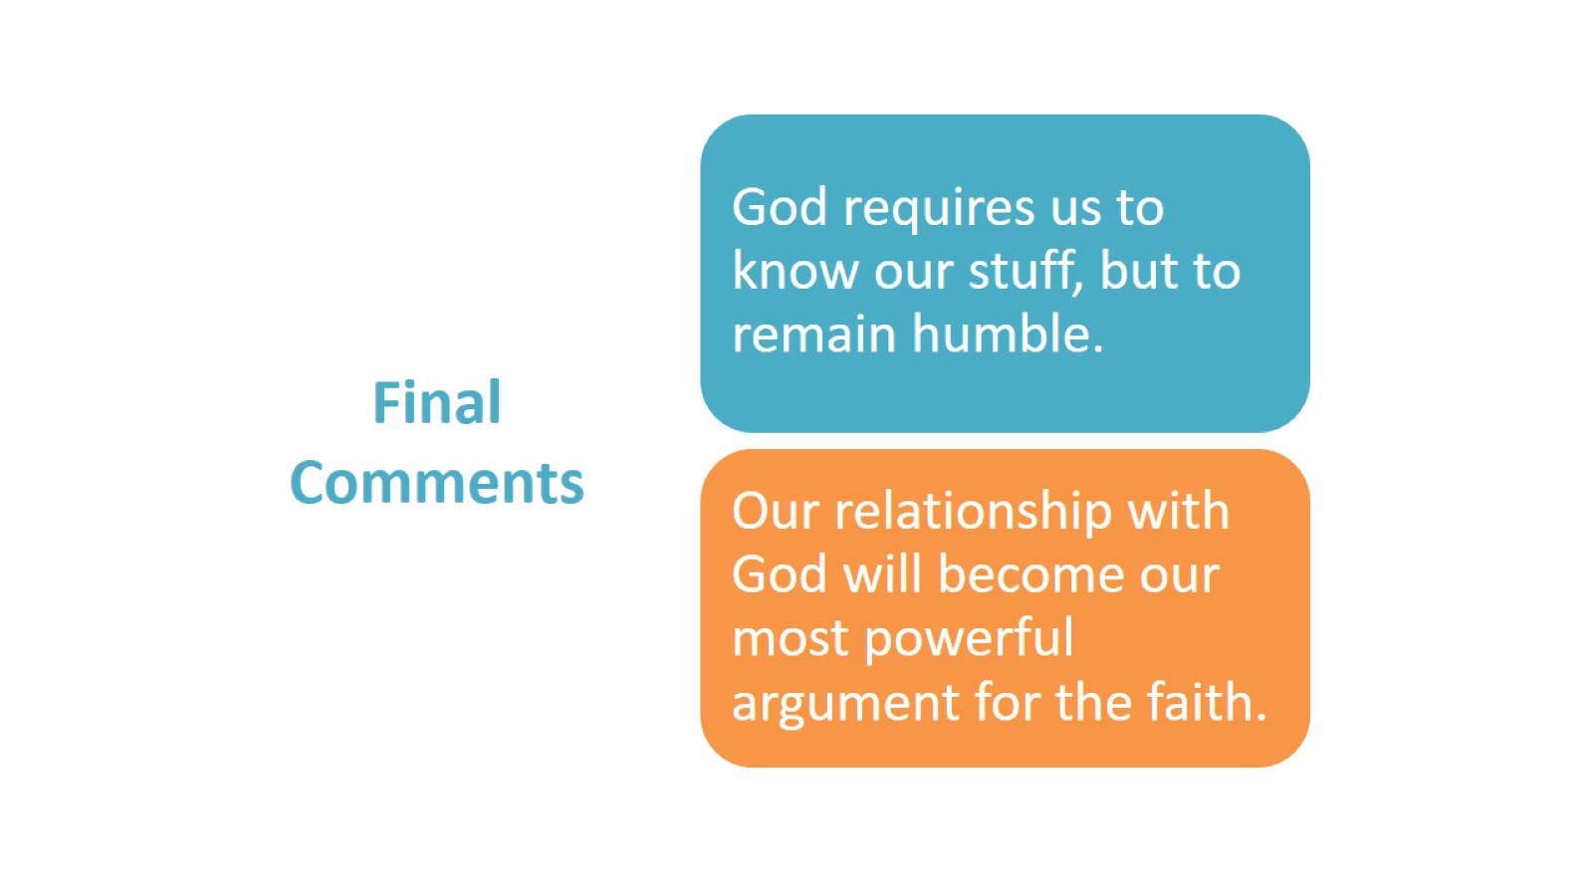
Final Comments

Slide 7

2 Timothy 2:15

Slide 8
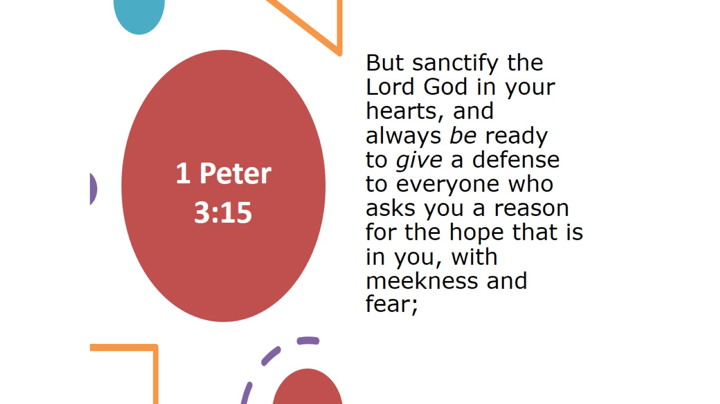
1 Peter 3:15

Slide 9
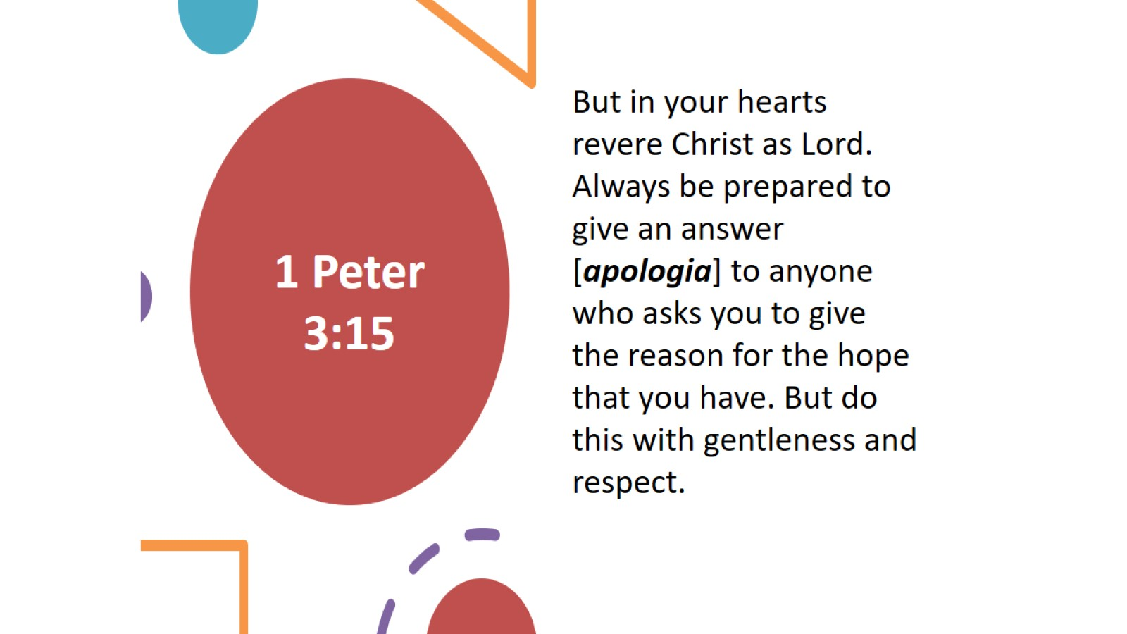
1 Peter 3:15

Slide 10
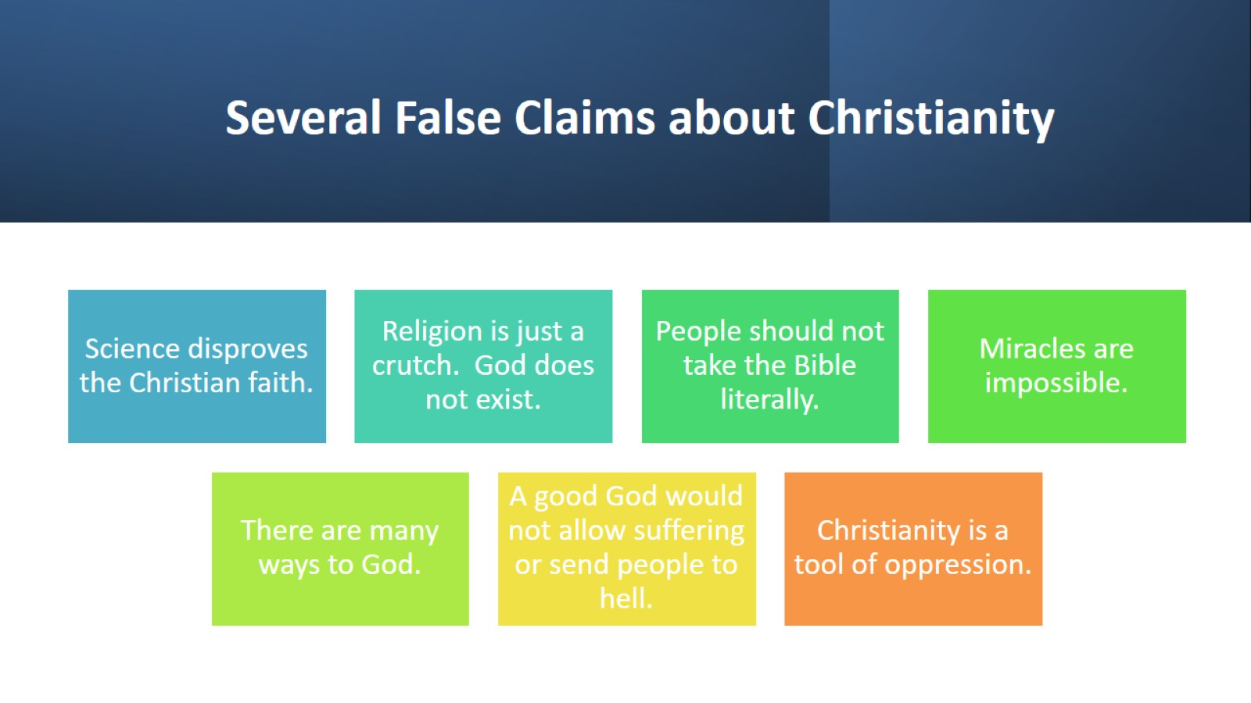
Several False Claims about Christianity

Slide 11
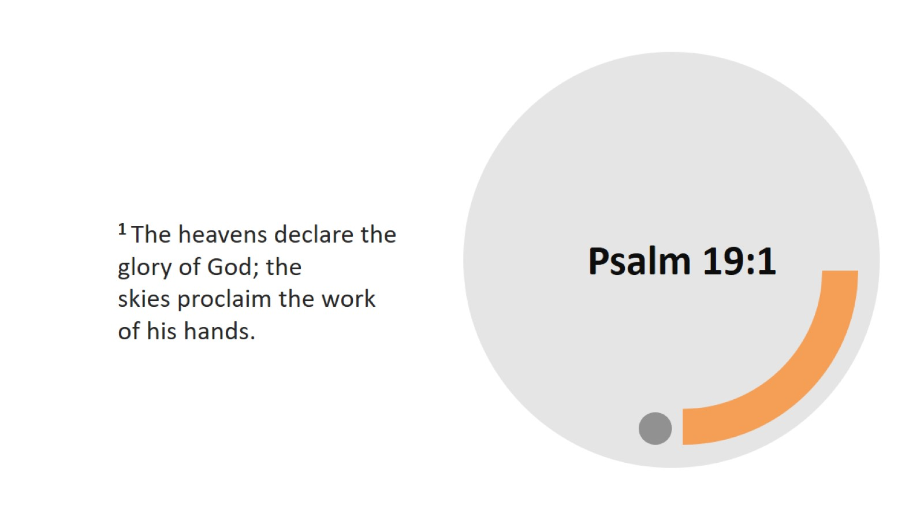
Psalm 19:1

Slide 12
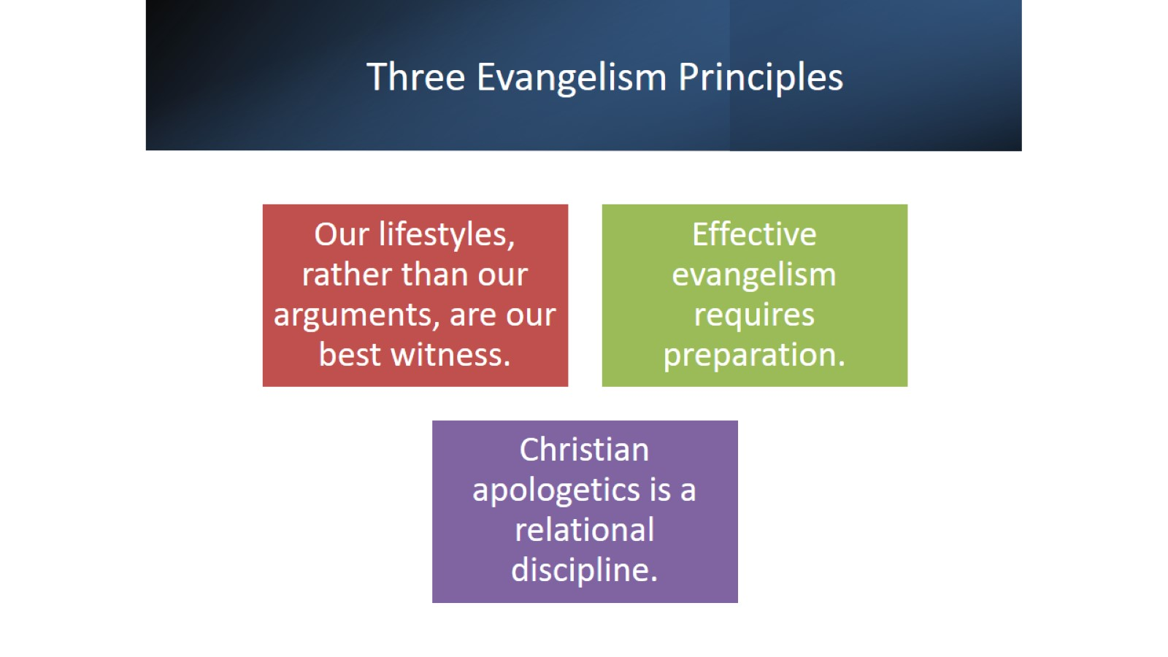
Three Evangelism Principles

Slide 13

Apologetics and Evangelism

