Slide 1

Ancient African Christian presence and contributions to early Christianity

Slide 2
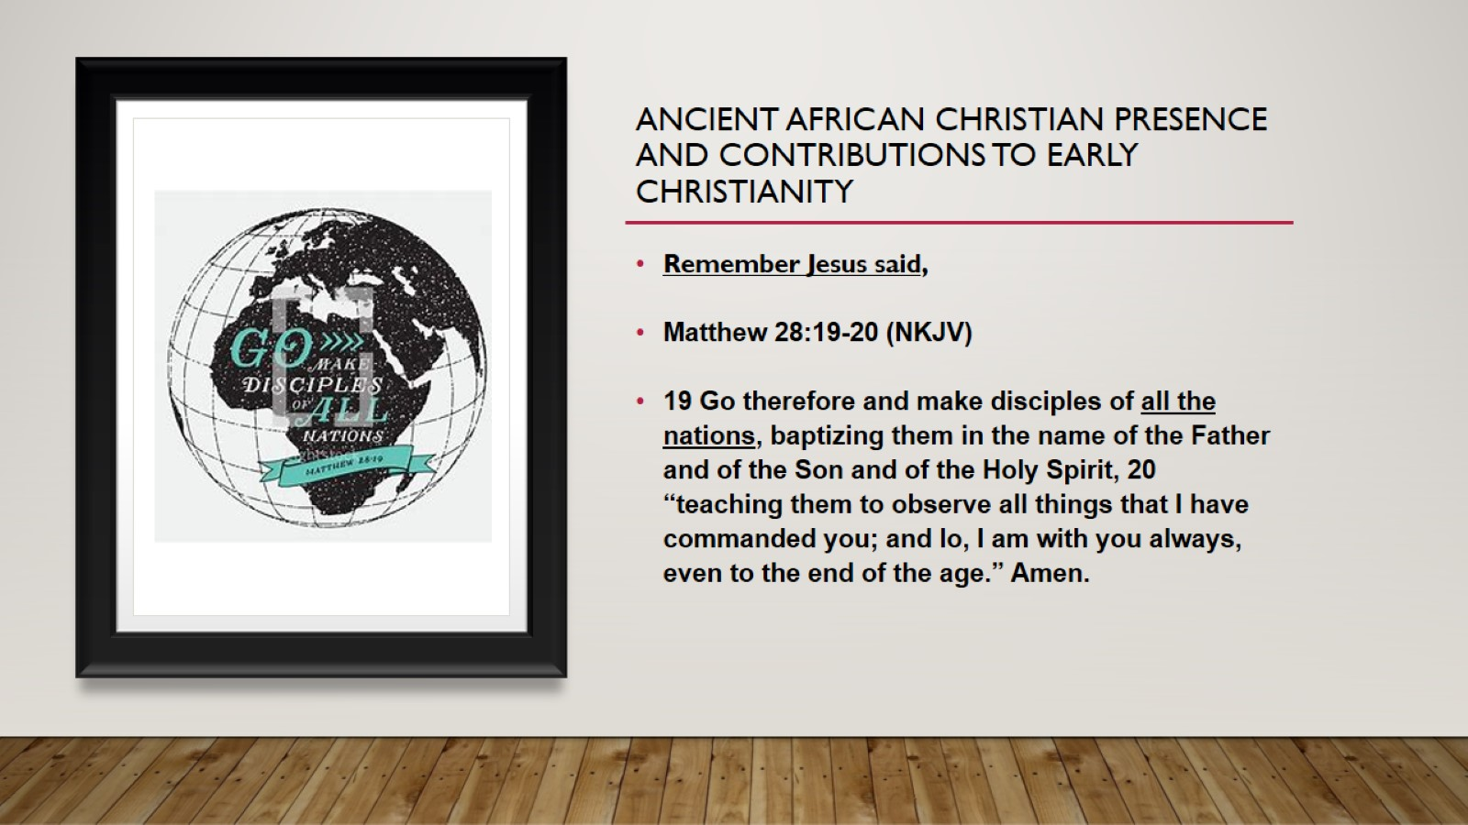
Ancient African Christian presence and contributions to early Christianity

Slide 3
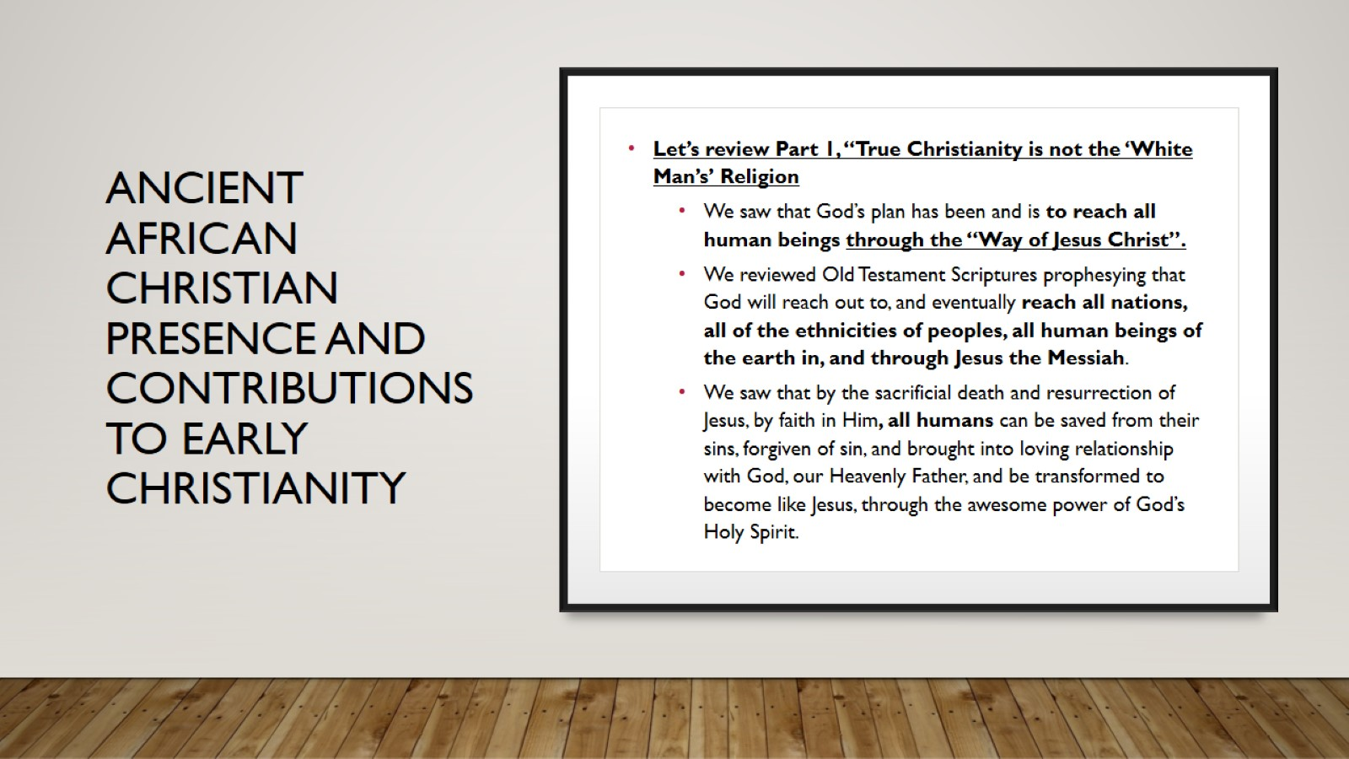
Ancient African Christian presence and contributions to early Christianity

Slide 4
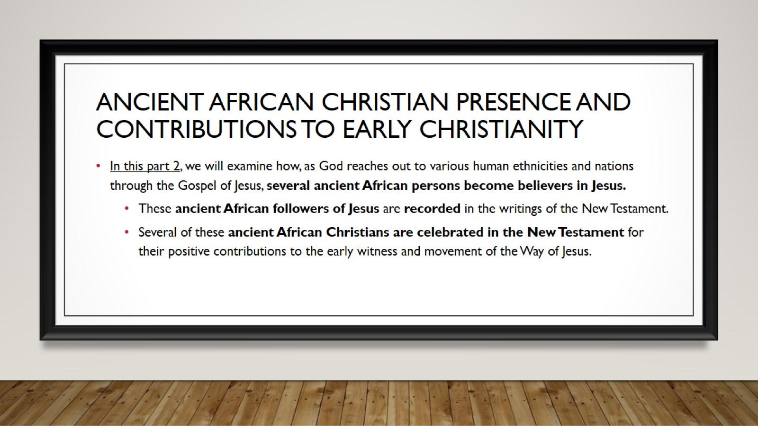
Ancient African Christian presence and contributions to early Christianity

Slide 5
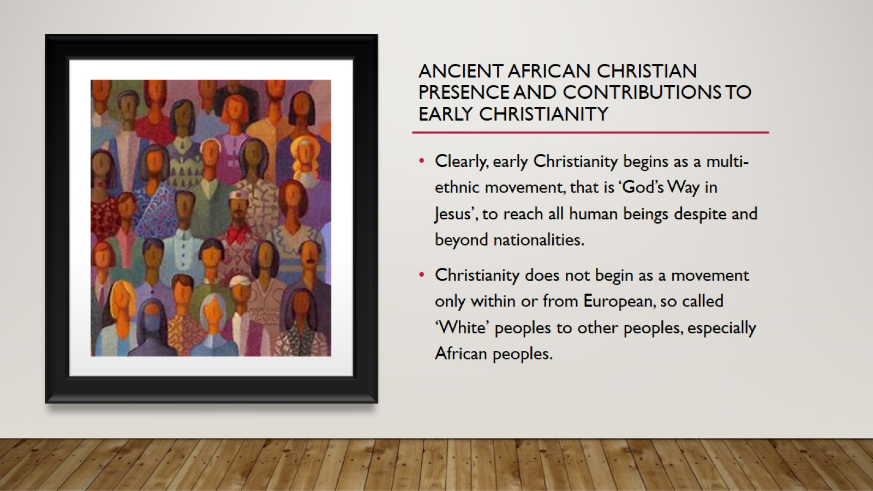
Ancient African Christian presence and contributions to early Christianity

Slide 6

Ancient African Christian presence and contributions to early Christianity

Slide 7
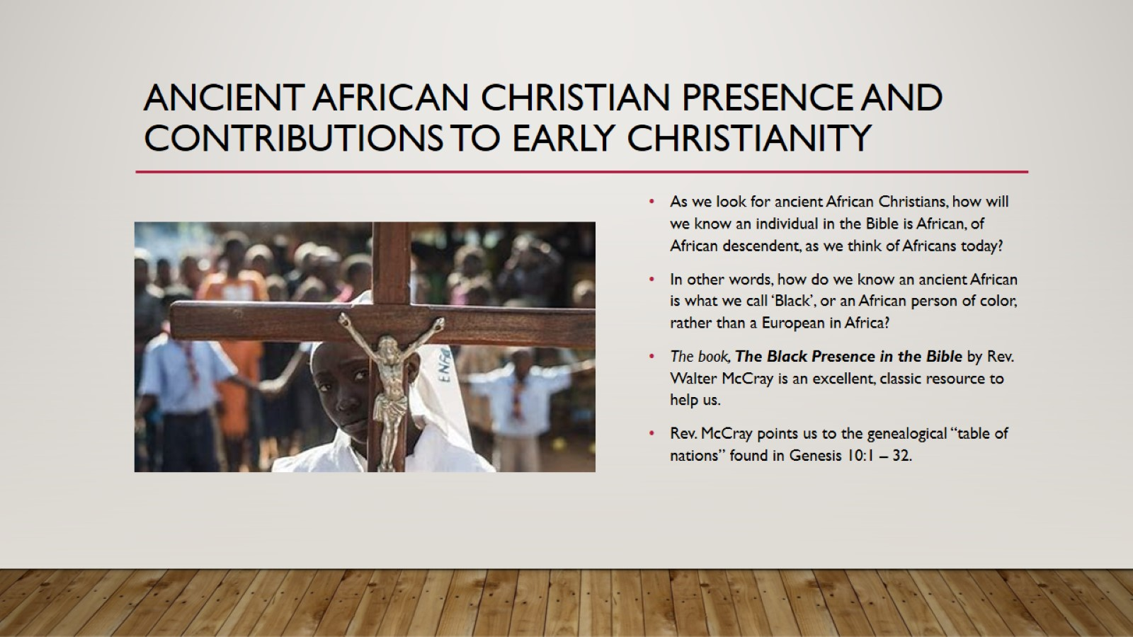
Ancient African Christian presence and contributions to early Christianity

Slide 8
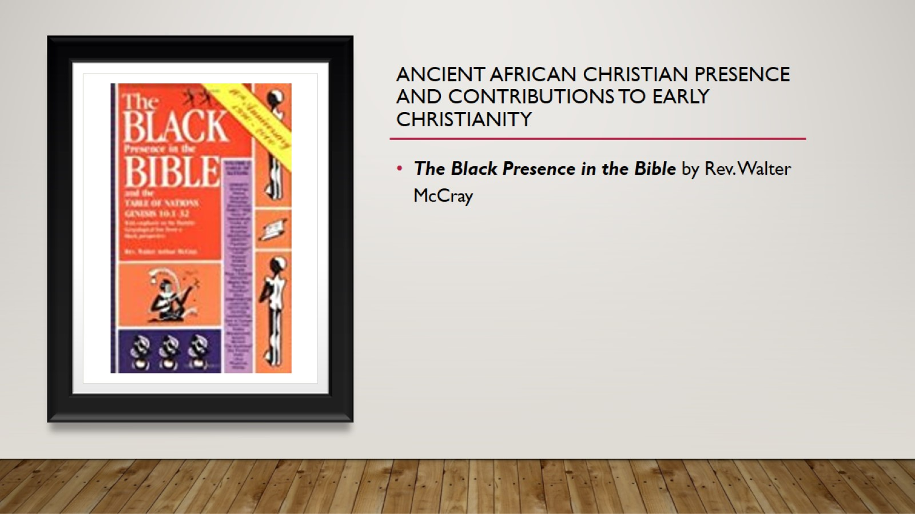
Ancient African Christian presence and contributions to early Christianity

Slide 9
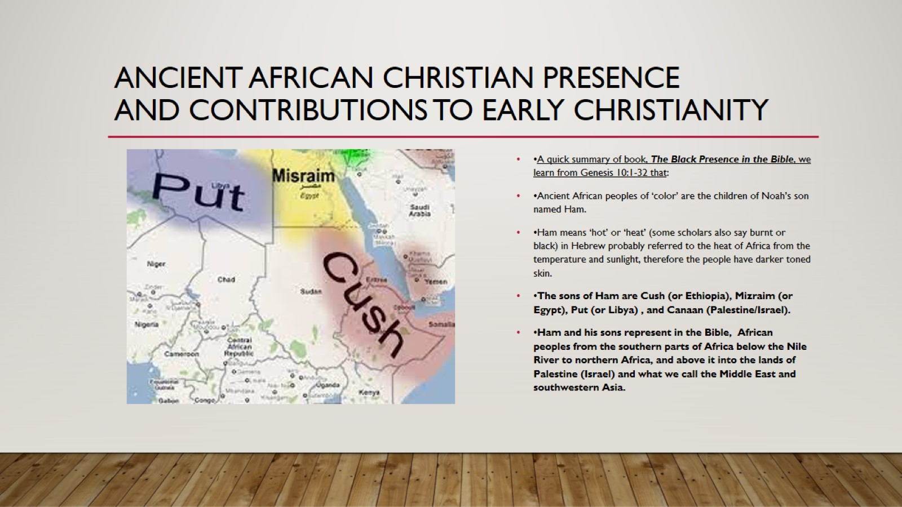
ANCIENT AFRICAN CHRISTIAN PRESENCE AND CONTRIBUTIONS TO EARLY CHRISTIANITY

Slide 10
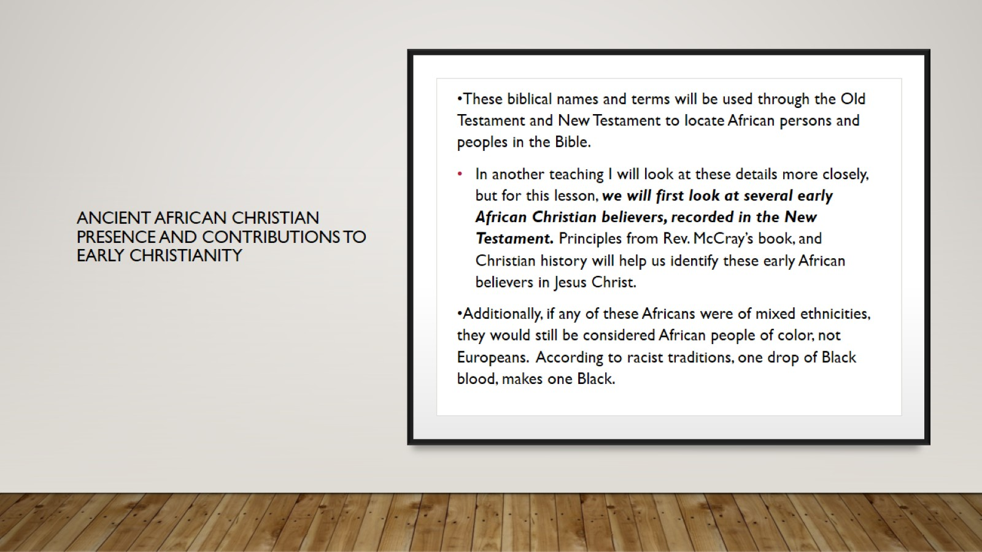
ANCIENT AFRICAN CHRISTIAN PRESENCE AND CONTRIBUTIONS TO EARLY CHRISTIANITY

Slide 11
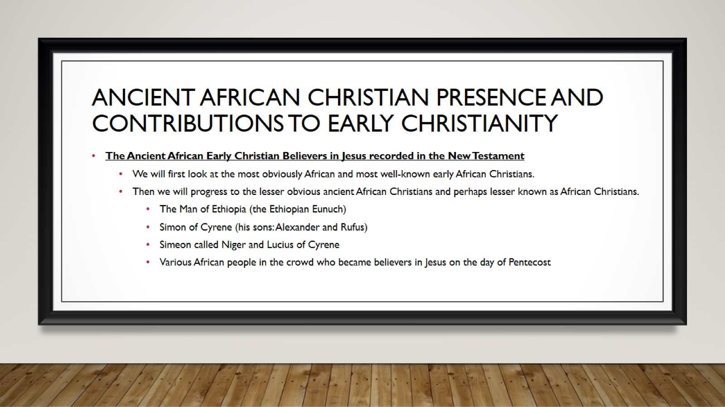
Ancient African Christian presence and contributions to early Christianity

Slide 12
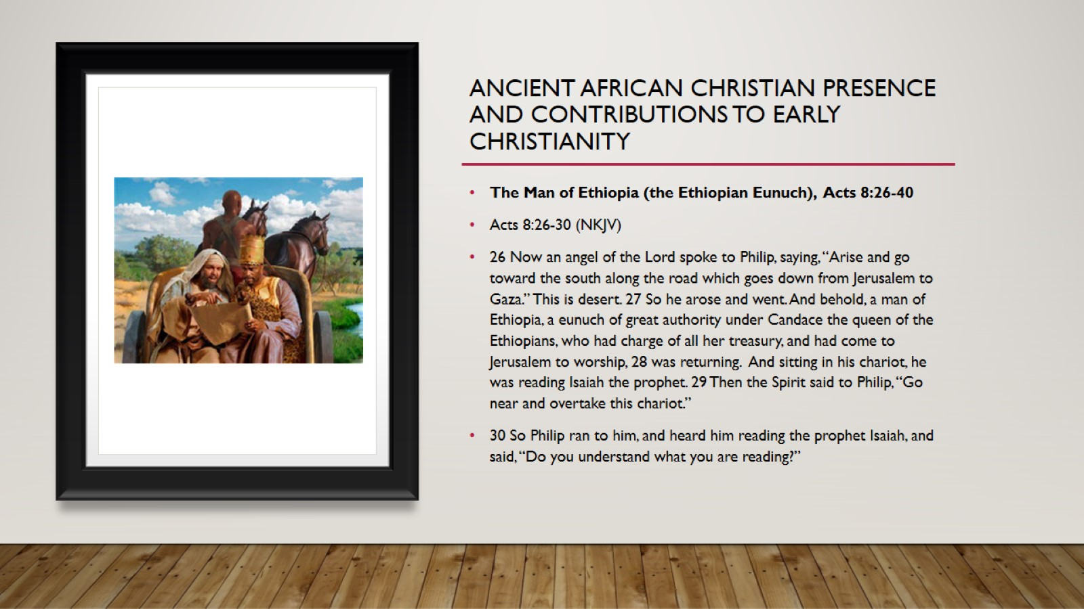
Ancient African Christian presence and contributions to early Christianity

Slide 13
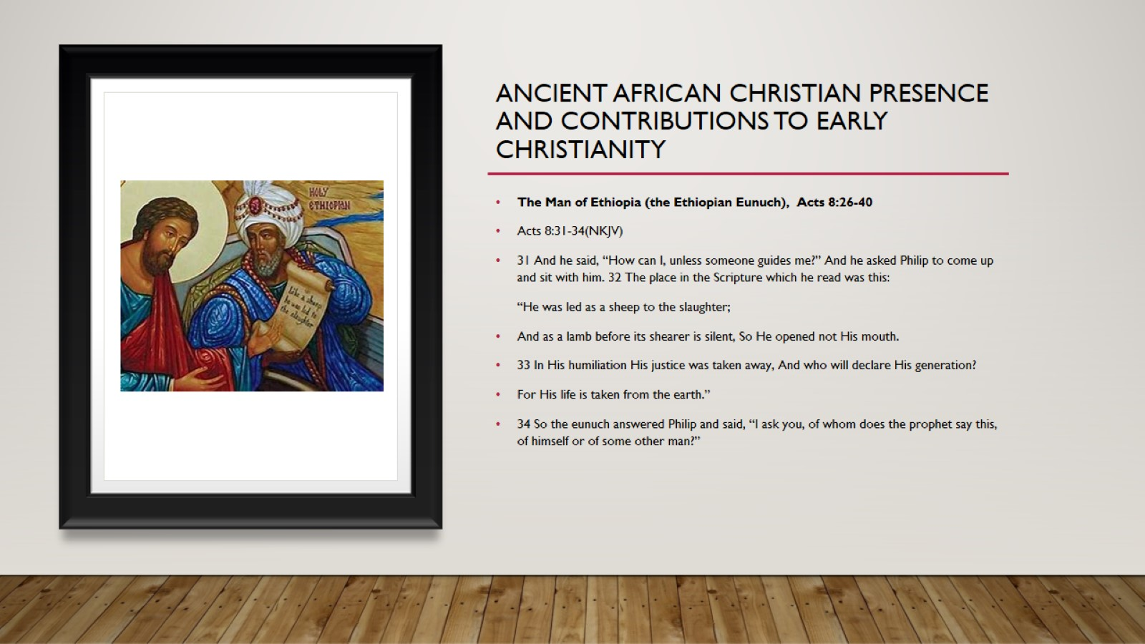
Ancient African Christian presence and contributions to early Christianity

Slide 14
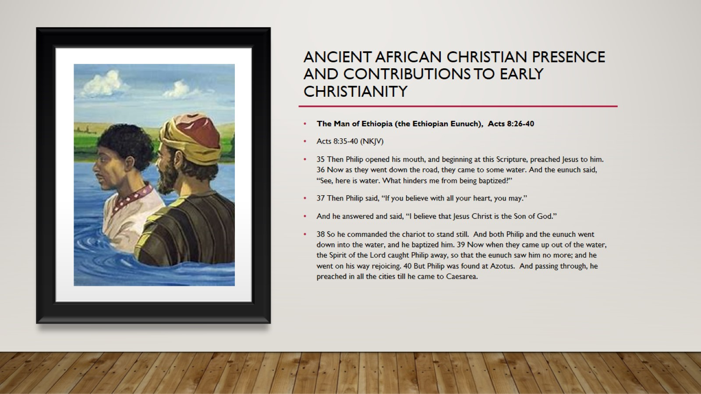
Ancient African Christian presence and contributions to early Christianity

Slide 15
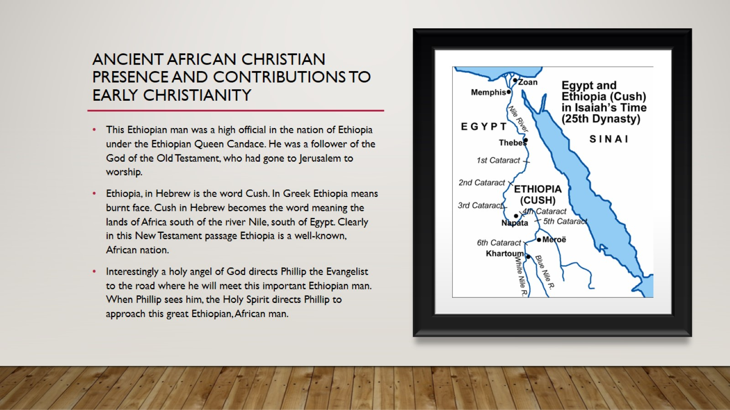
Ancient African Christian presence and contributions to early Christianity

Slide 16
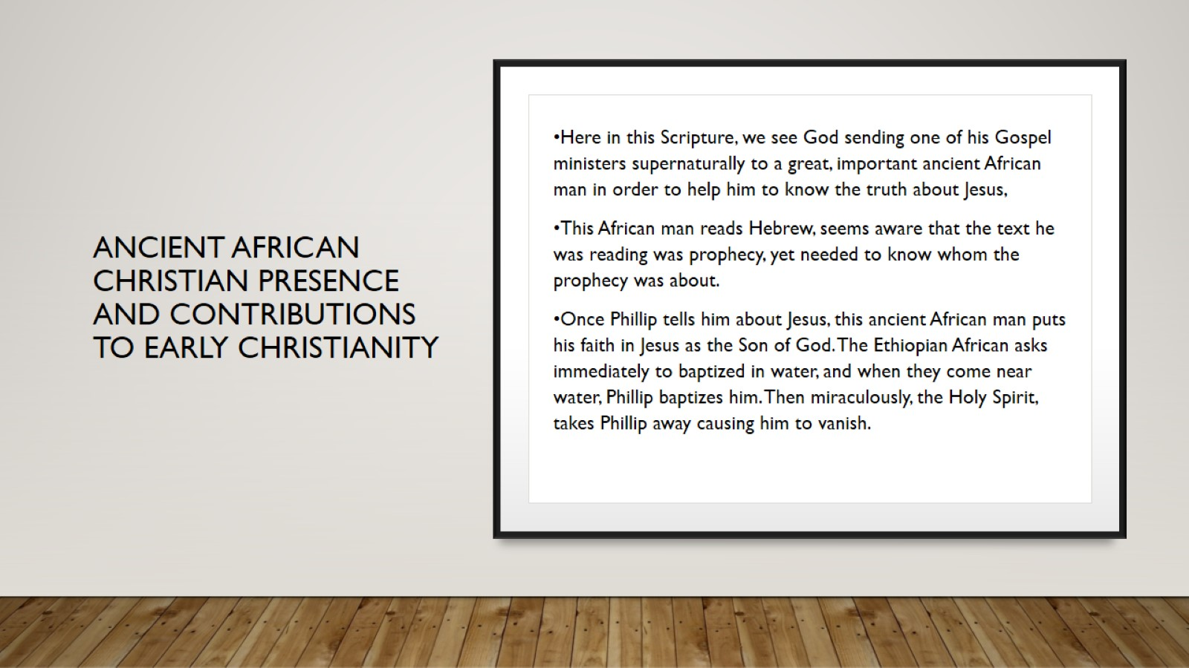
ANCIENT AFRICAN CHRISTIAN PRESENCE AND CONTRIBUTIONS TO EARLY CHRISTIANITY

Slide 17
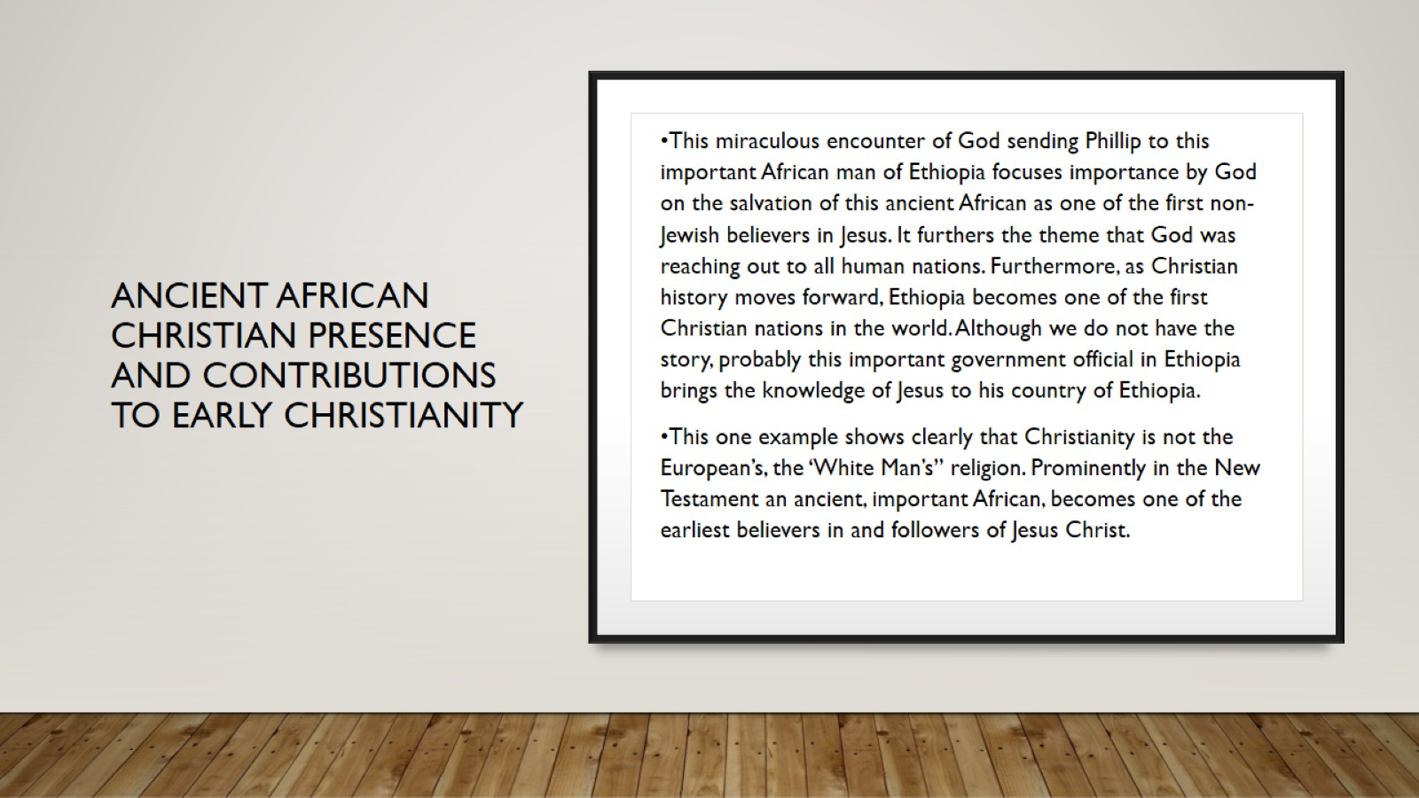
ANCIENT AFRICAN CHRISTIAN PRESENCE AND CONTRIBUTIONS TO EARLY CHRISTIANITY

Slide 18
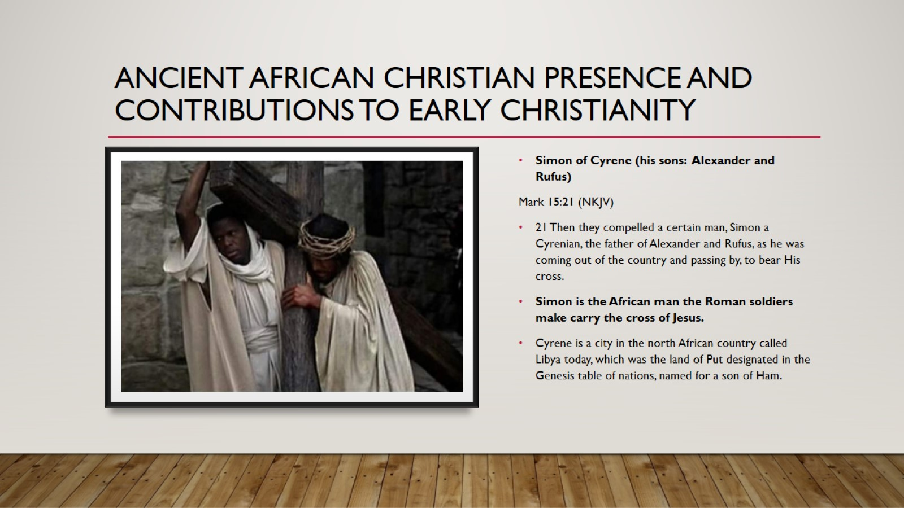
Ancient African Christian presence and contributions to early Christianity

Slide 19
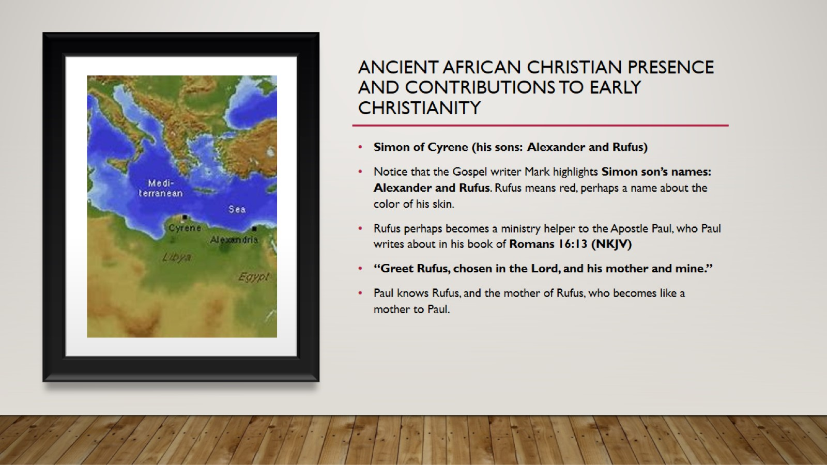
Ancient African Christian presence and contributions to early Christianity

Slide 20
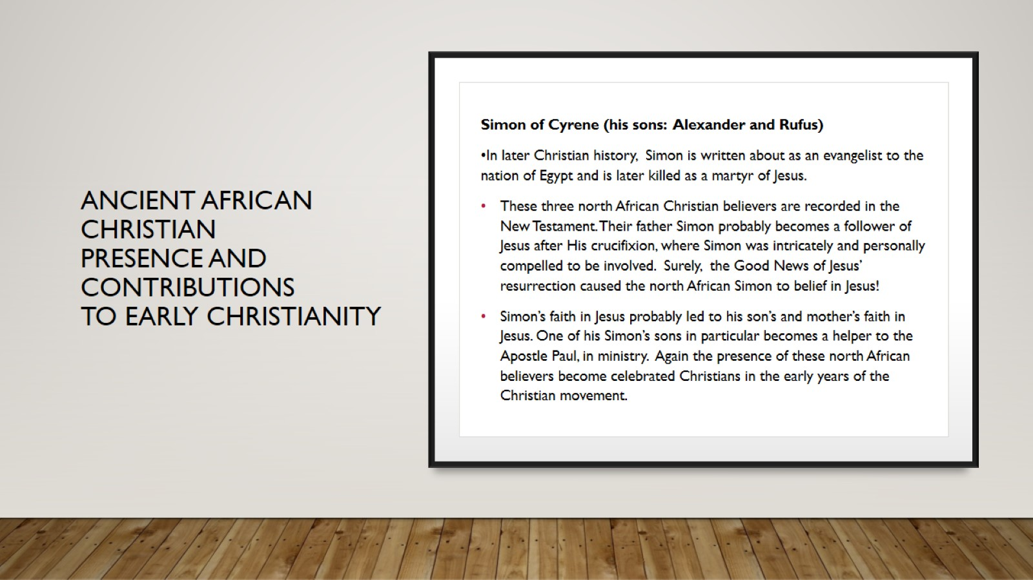
ANCIENT AFRICAN CHRISTIAN PRESENCE AND CONTRIBUTIONS TO EARLY CHRISTIANITY

Slide 21
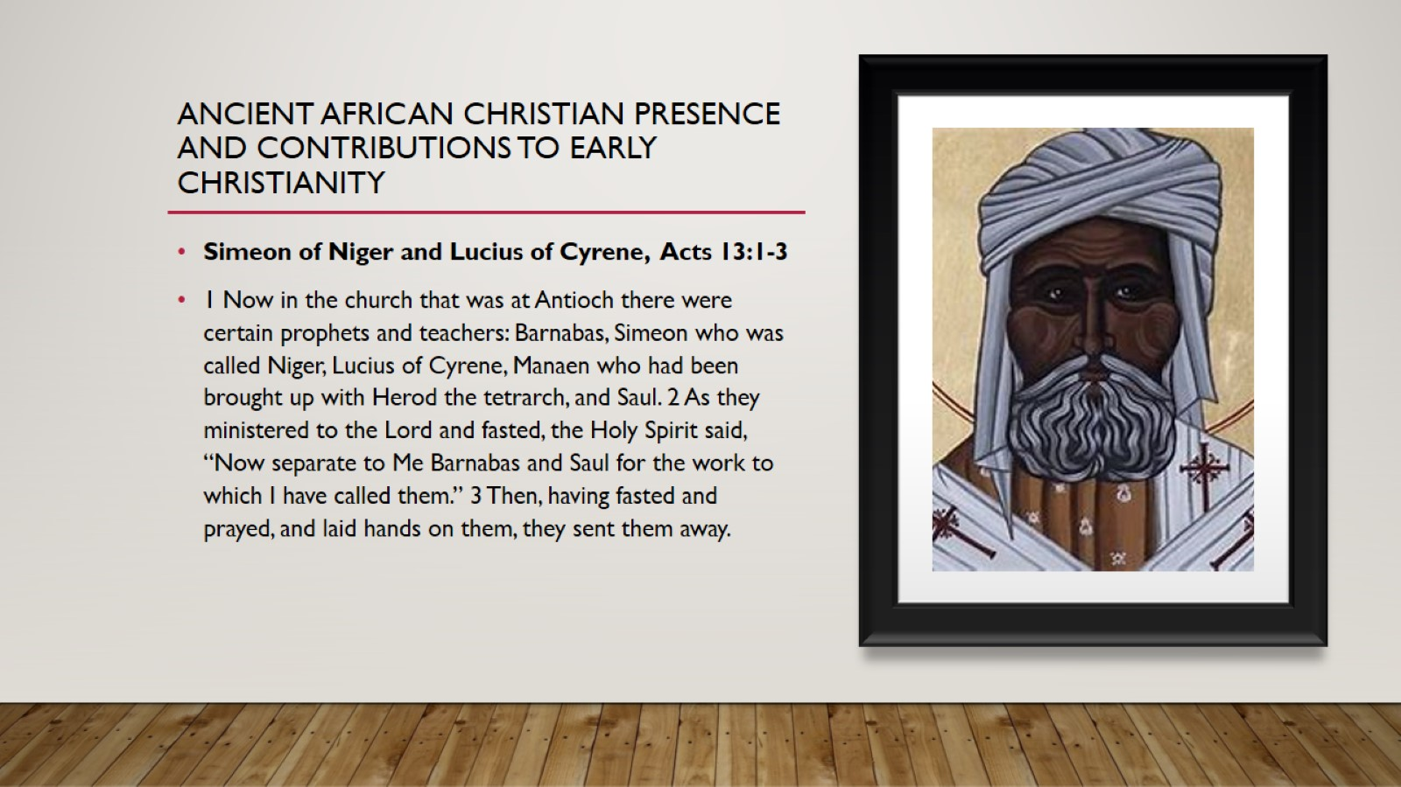
Ancient African Christian presence and contributions to early Christianity

Slide 22
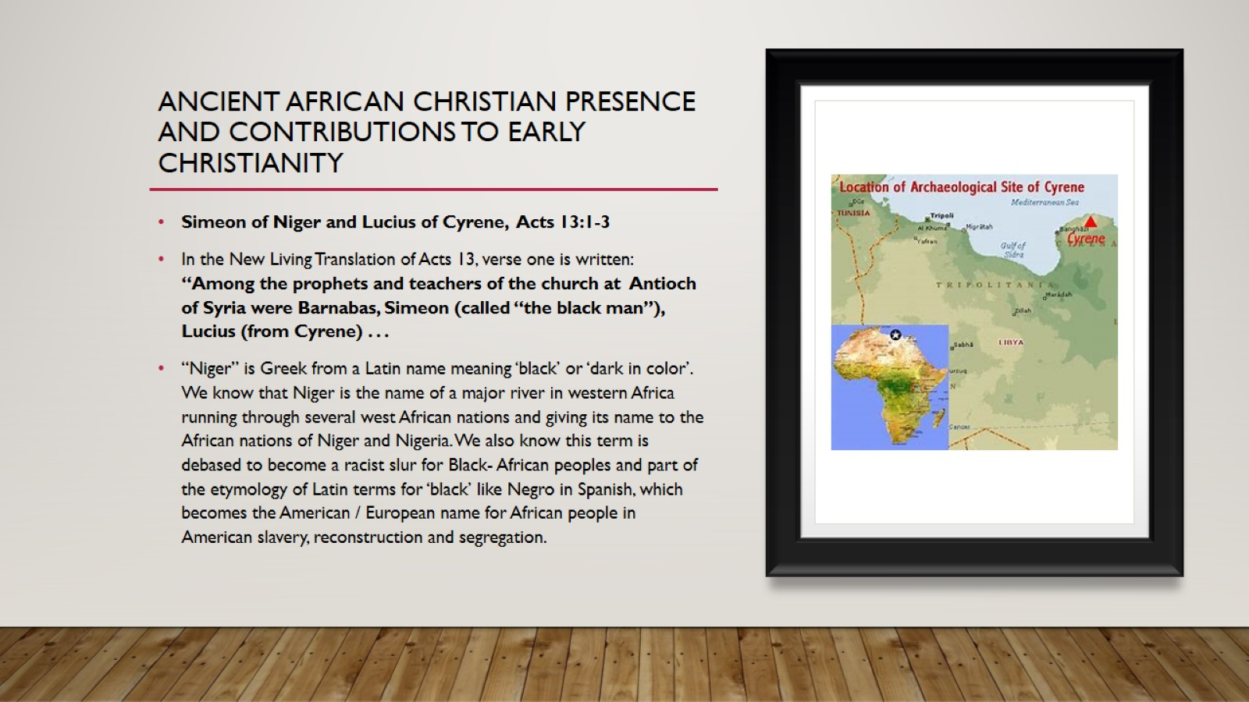
Ancient African Christian presence and contributions to early Christianity

Slide 23
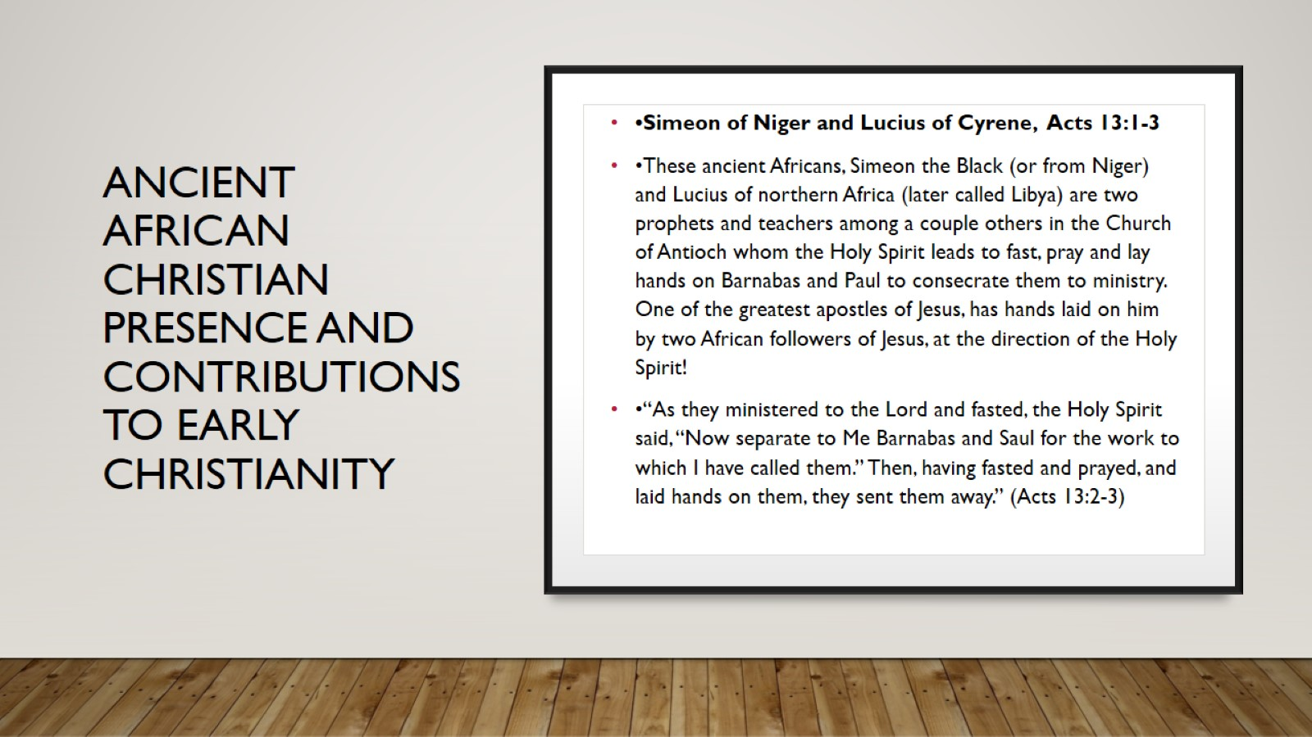
aNCIENT AFRICAN
CHRISTIAN PRESENCE AND
CONTRIBUTIONS
TO EARLY CHRISTIANITY

Slide 24
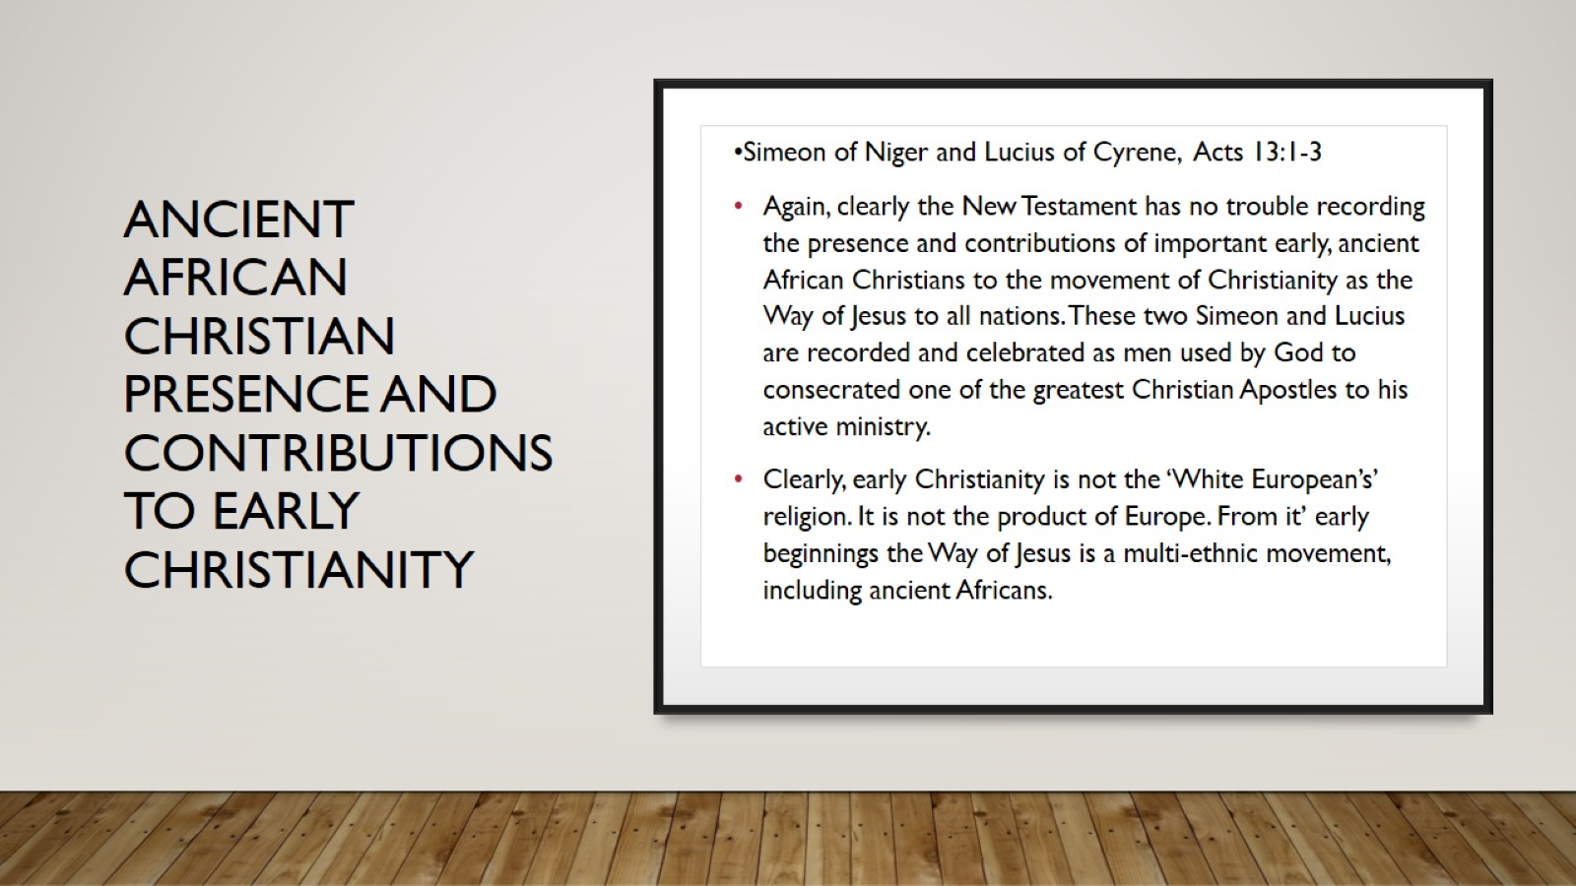
aNCIENT AFRICAN
CHRISTIAN PRESENCE AND
CONTRIBUTIONS
TO EARLY CHRISTIANITY

Slide 25
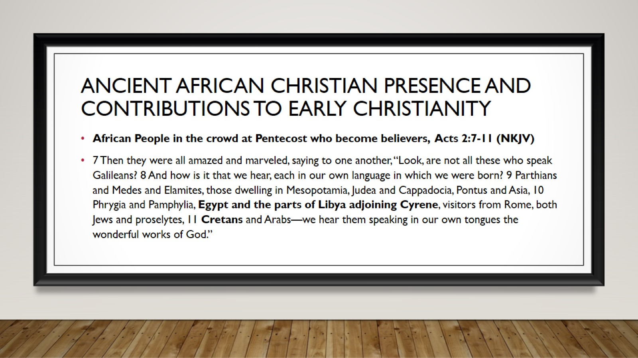
Ancient African Christian presence and contributions to early Christianity

Slide 26
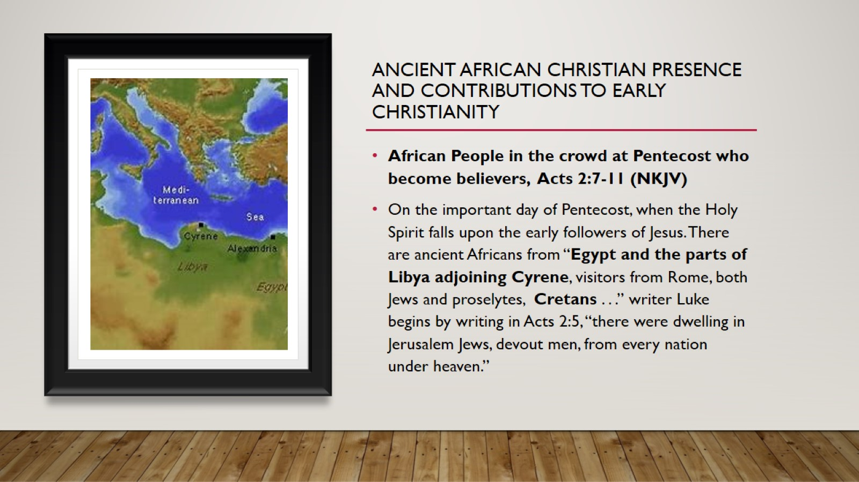
Ancient African Christian presence and contributions to early Christianity

Slide 27
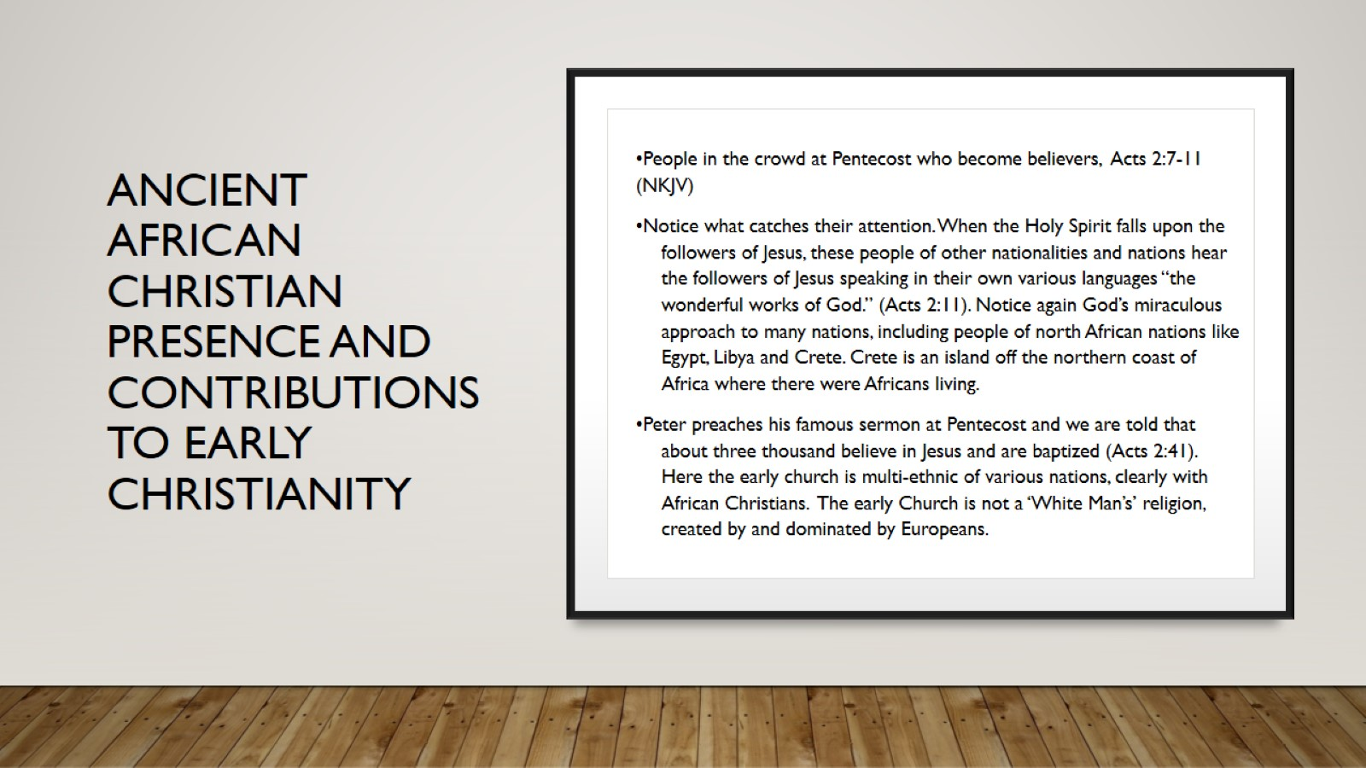
aNCIENT AFRICAN
CHRISTIAN PRESENCE AND
CONTRIBUTIONS
TO EARLY CHRISTIANITY

Slide 28

Ancient African Christian presence and contributions to early Christianity

Slide 29
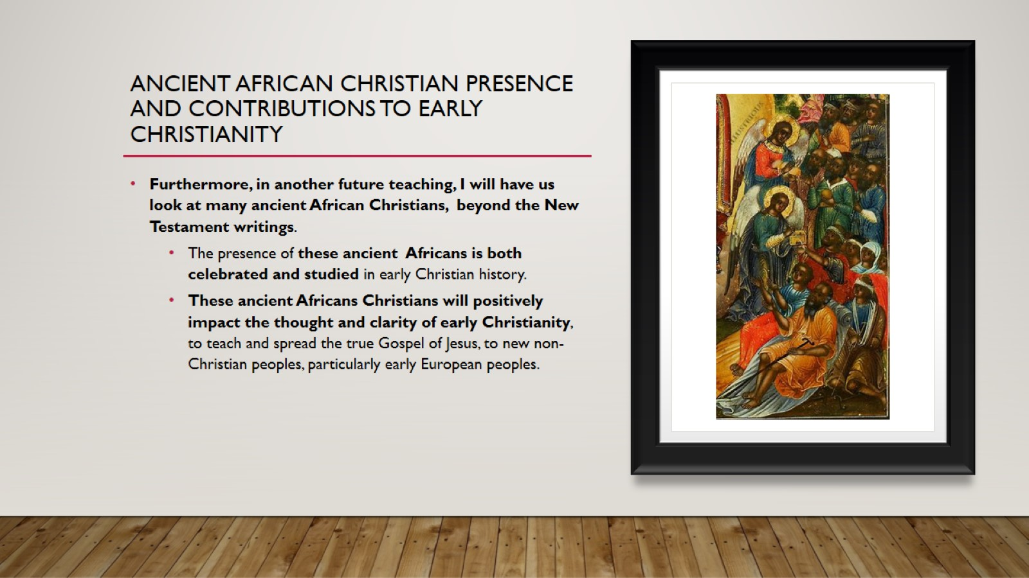
Ancient African Christian presence and contributions to early Christianity

Slide 30
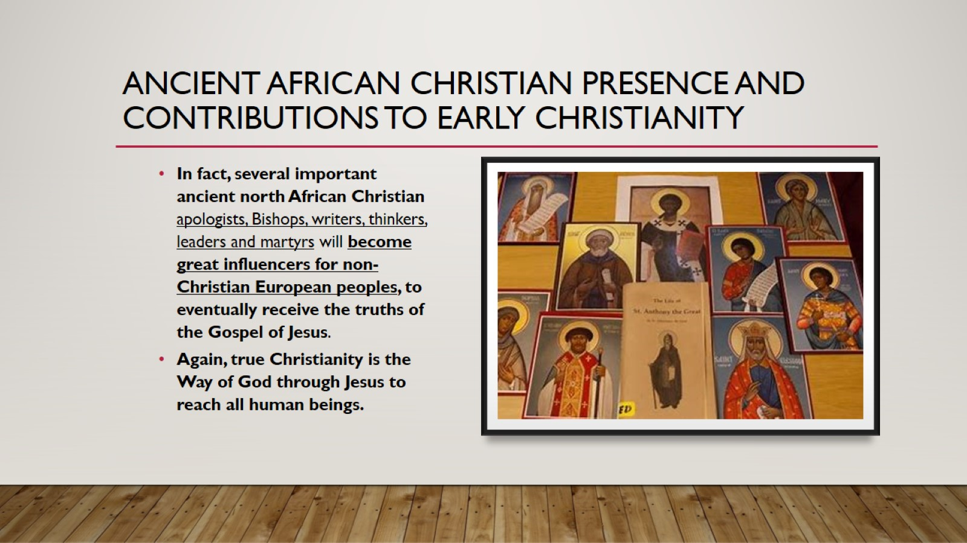
Ancient African Christian presence and contributions to early Christianity

Slide 31

Ancient African Christian presence and contributions to early Christianity

Slide 32
Ancient African Christian presence and contributions to early Christianity

