Slide 1



Slide 2


THE SEARCH FOR A
BLACK identity
?

Slide 3
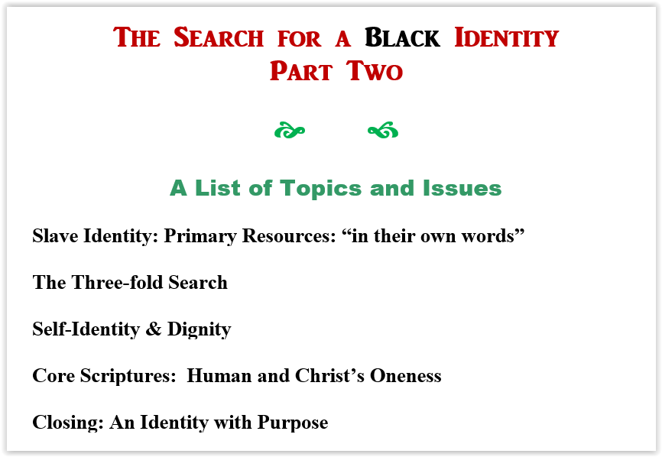

Slide 4

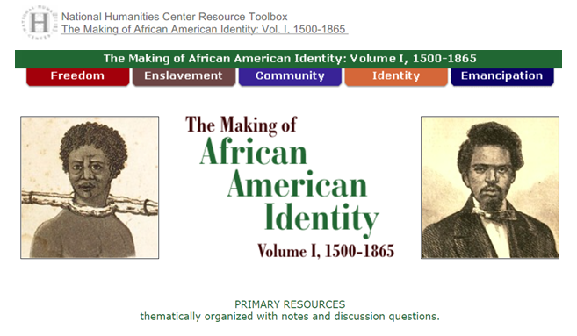

Slide 5
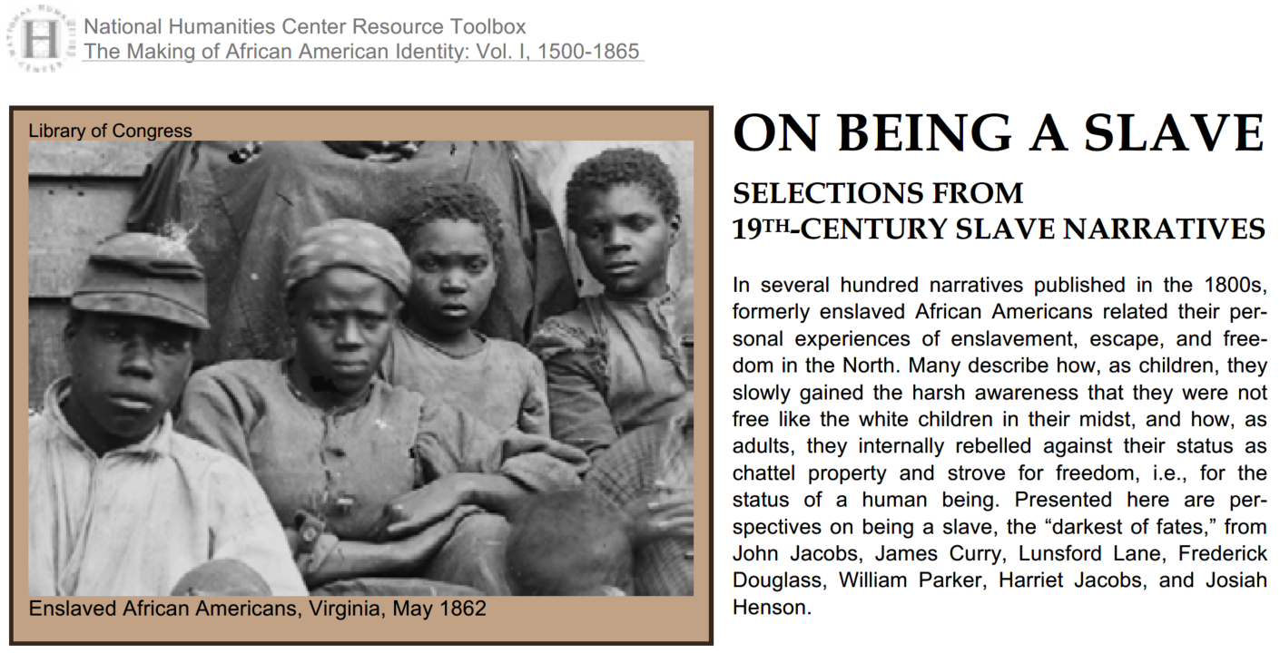

Slide 6
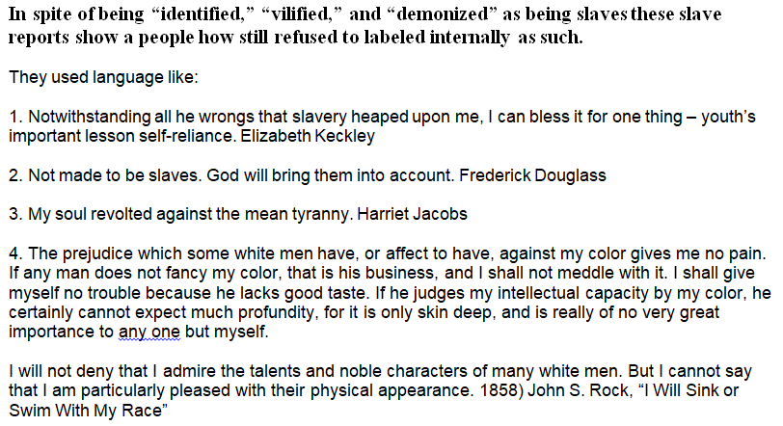

Slide 7

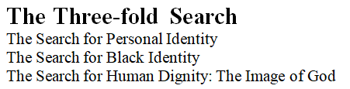

Slide 8
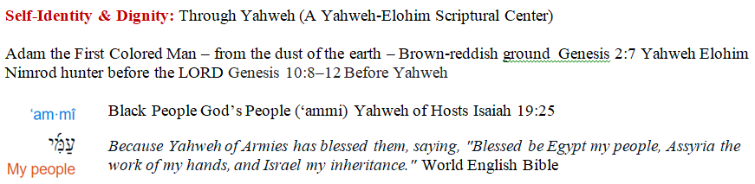
SELF-IDENTITY & DIGNITY: Through the Clear Lens of Scripture
SELF-IDENTITY & DIGNITY: Through Yahweh (A Yahweh-Elohim Scriptural Center)
SELF-IDENTITY & DIGNITY: Through Jesus (A Christological Center)
SELF-IDENTITY & DIGNITY: Through the Holy Spirit (A Pneumatological Center)
SELF-IDENTITY & DIGNITY: Through Personal History and Experiences (Christian
and Cultural)

Slide 9
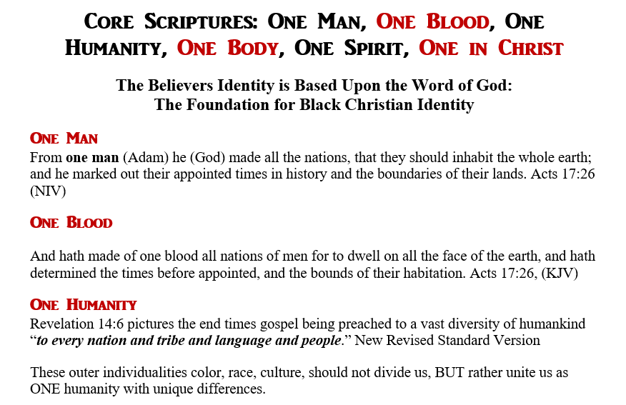

Slide 10
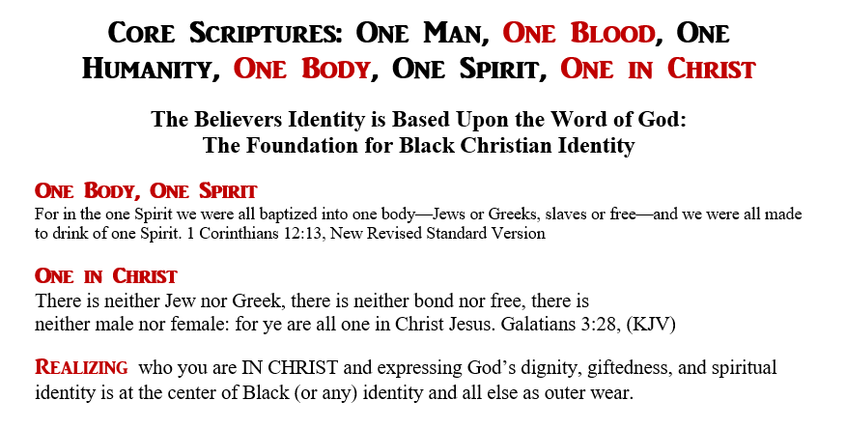

Slide 11
