Slide 1
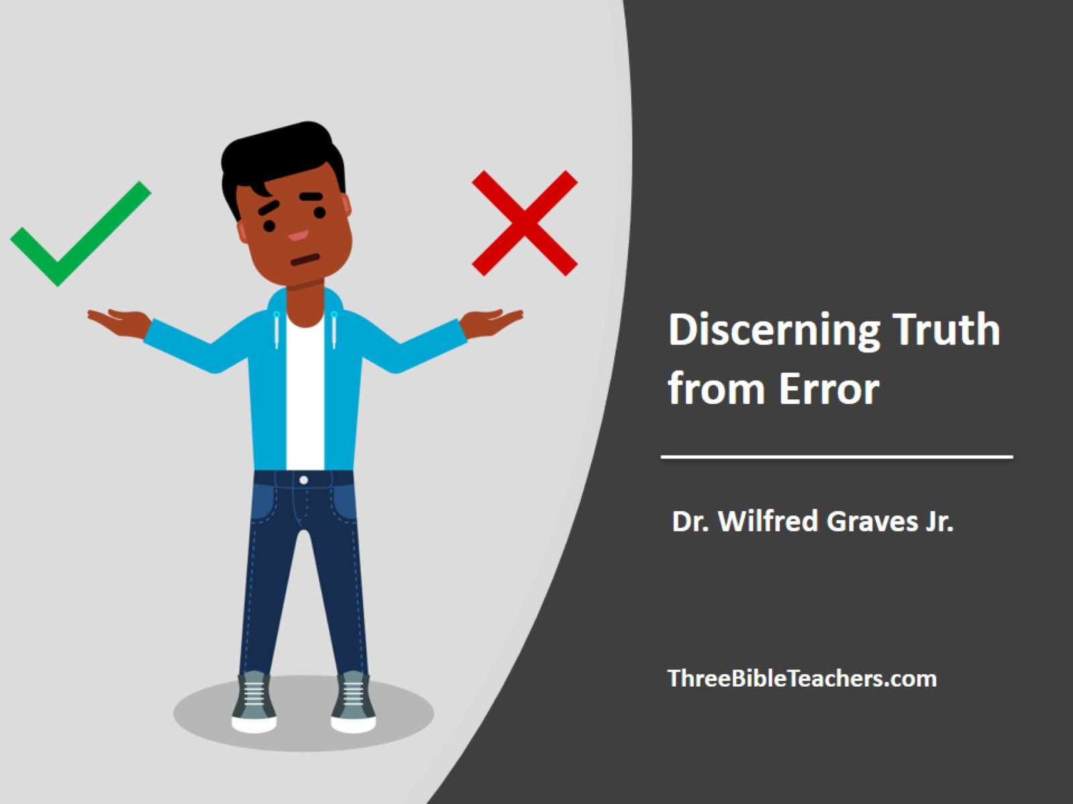
Discerning Truth from Error

Slide 2
Discerning Truth from Error

Slide 3
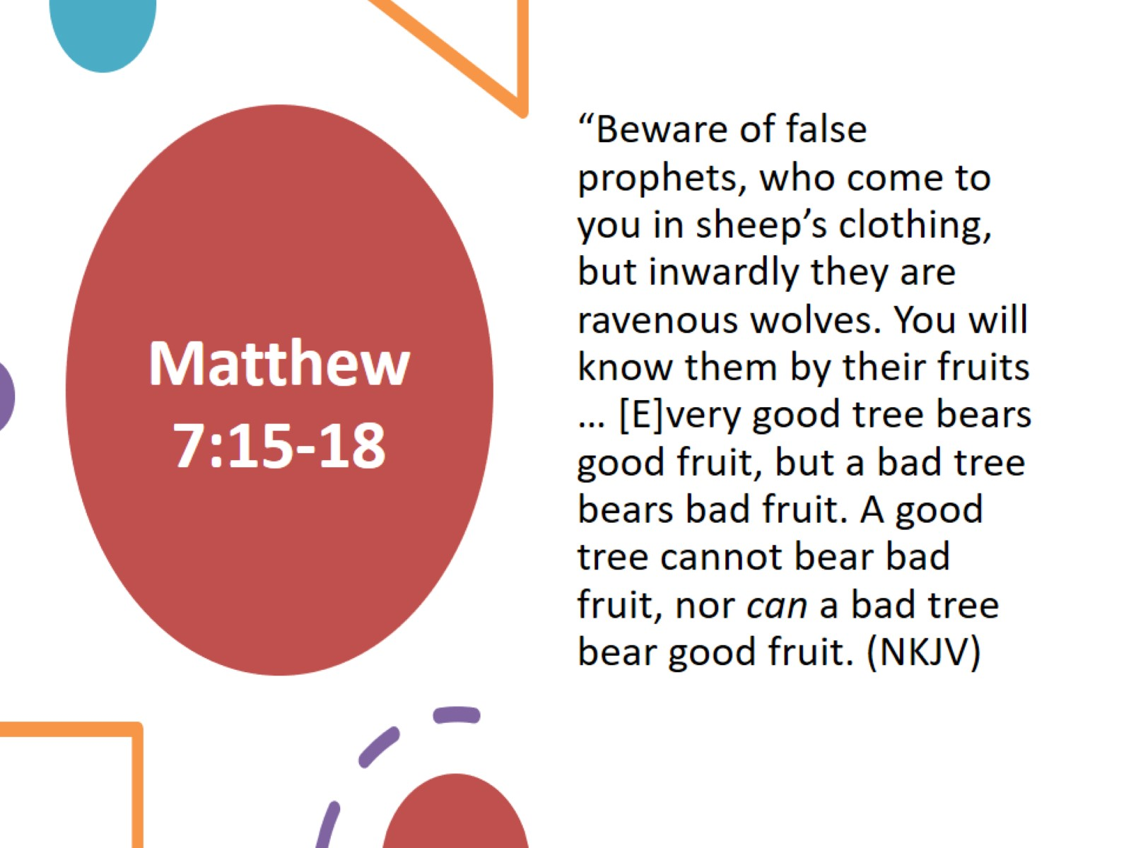
Matthew 7:15-18

Slide 4
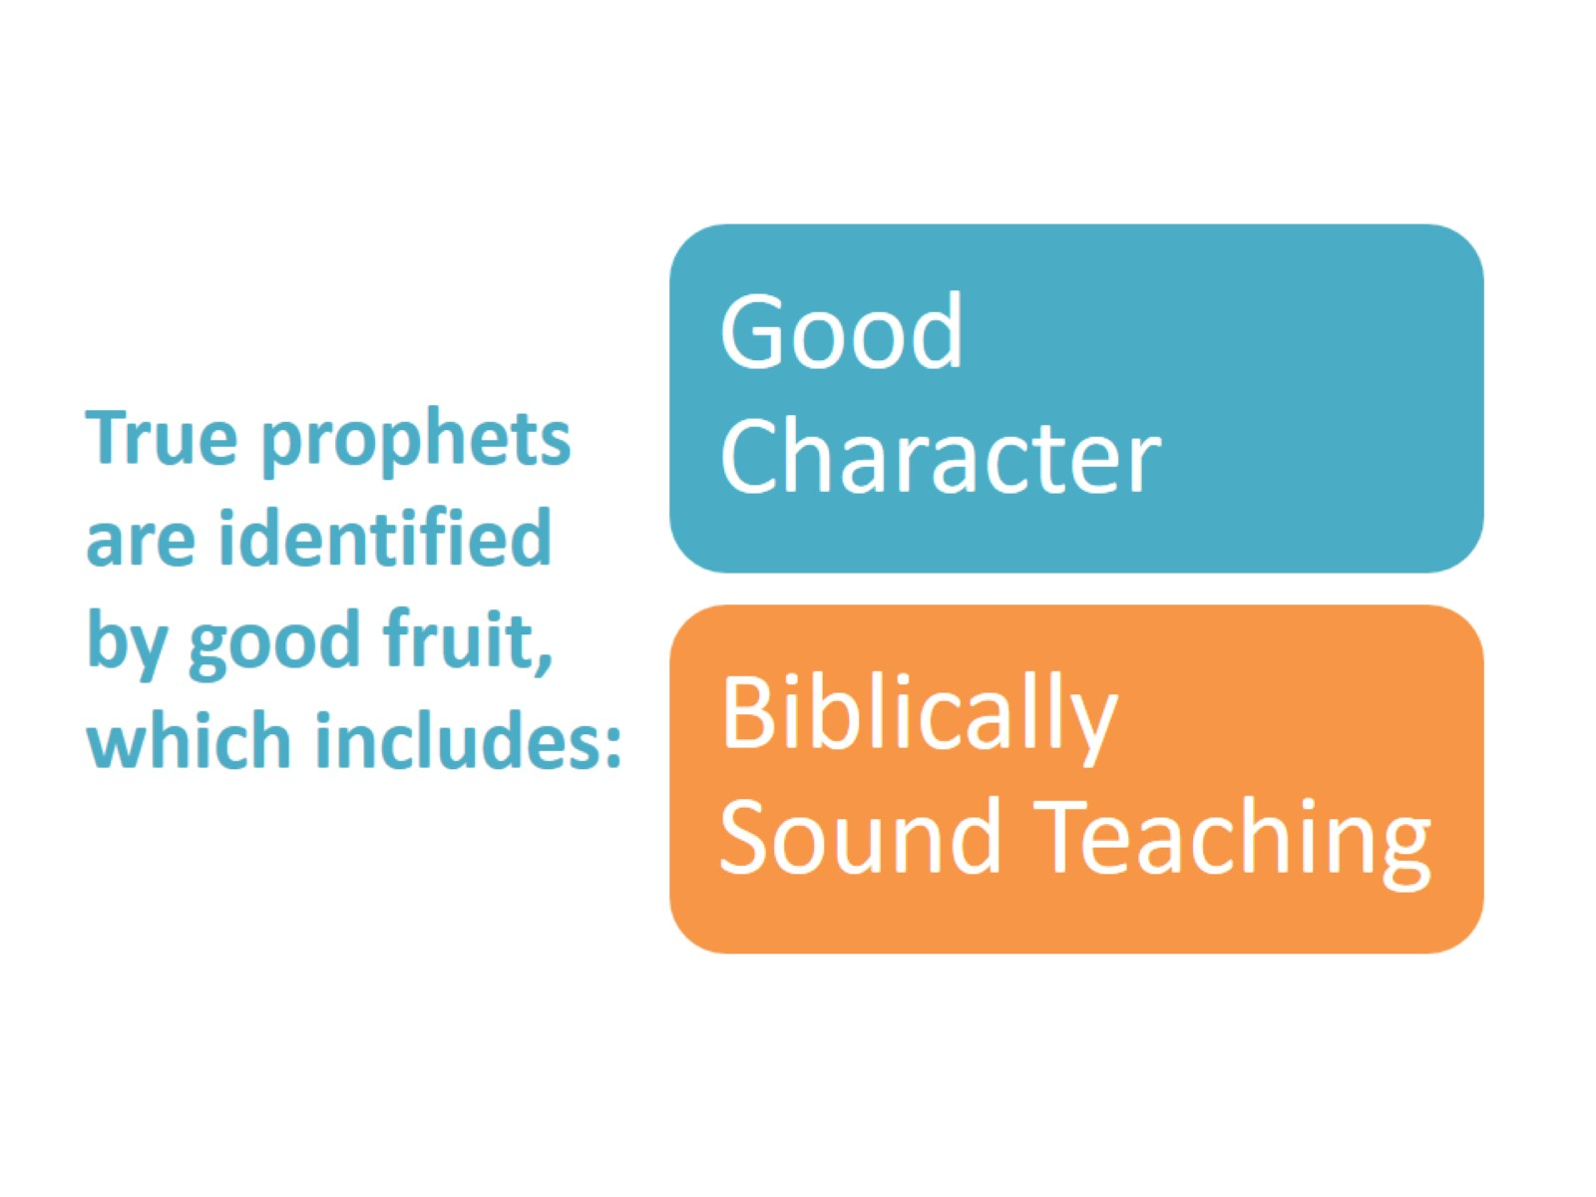
True prophets are identified by good fruit, which includes:

Slide 5
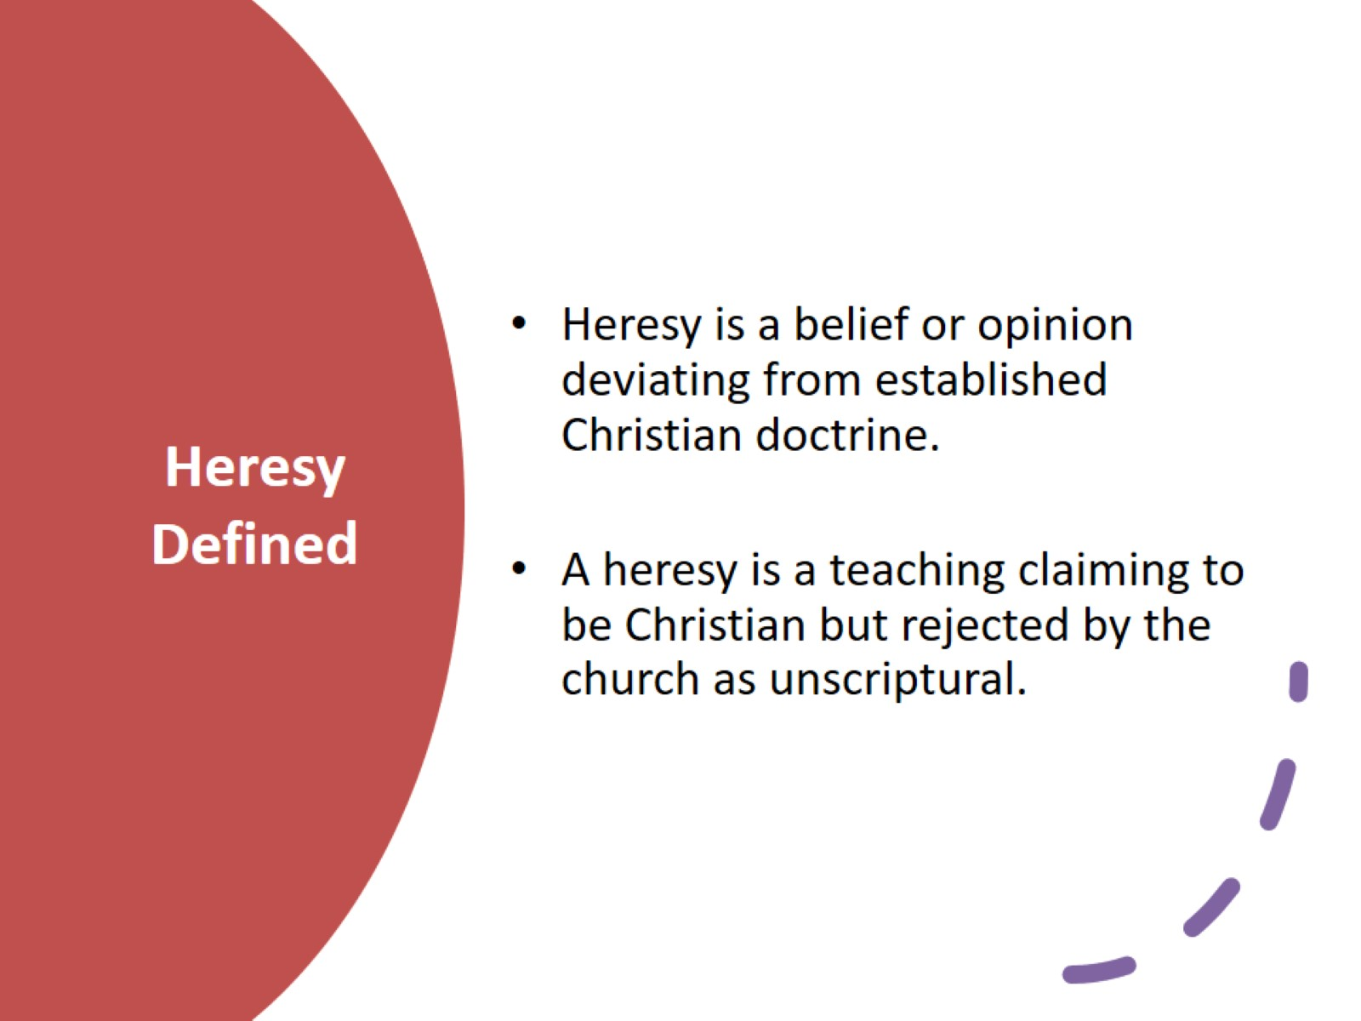
Heresy Defined

Slide 6
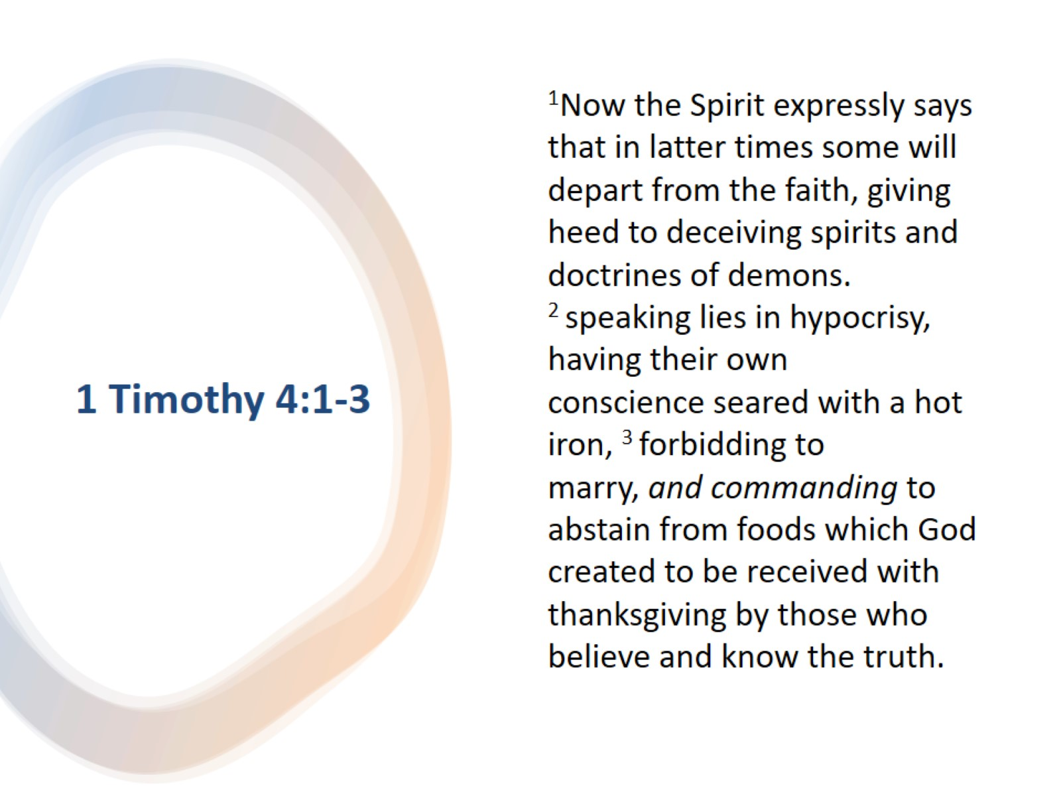
1 Timothy 4:1-3

Slide 7
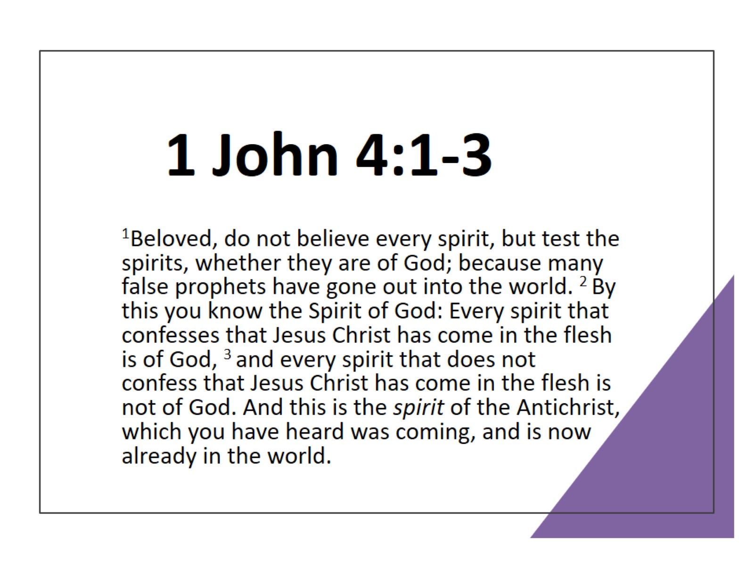
1 John 4:1-3

Slide 8
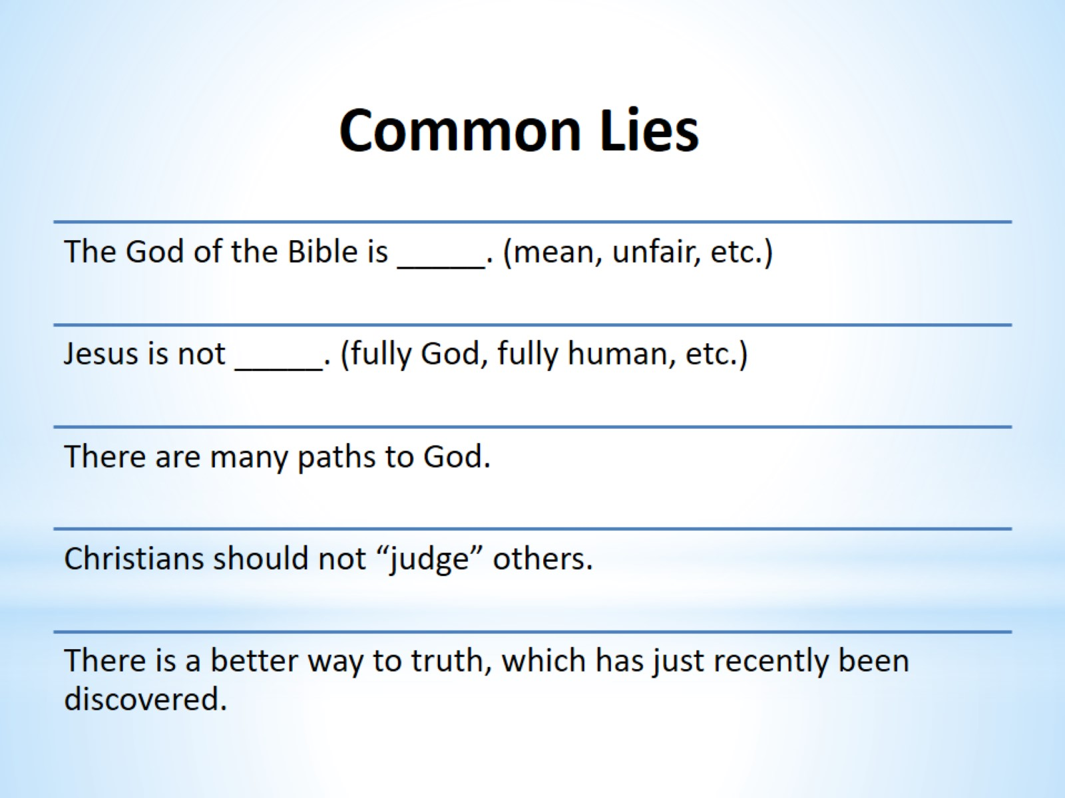
Common Lies

Slide 9

Lie #1

Slide 10
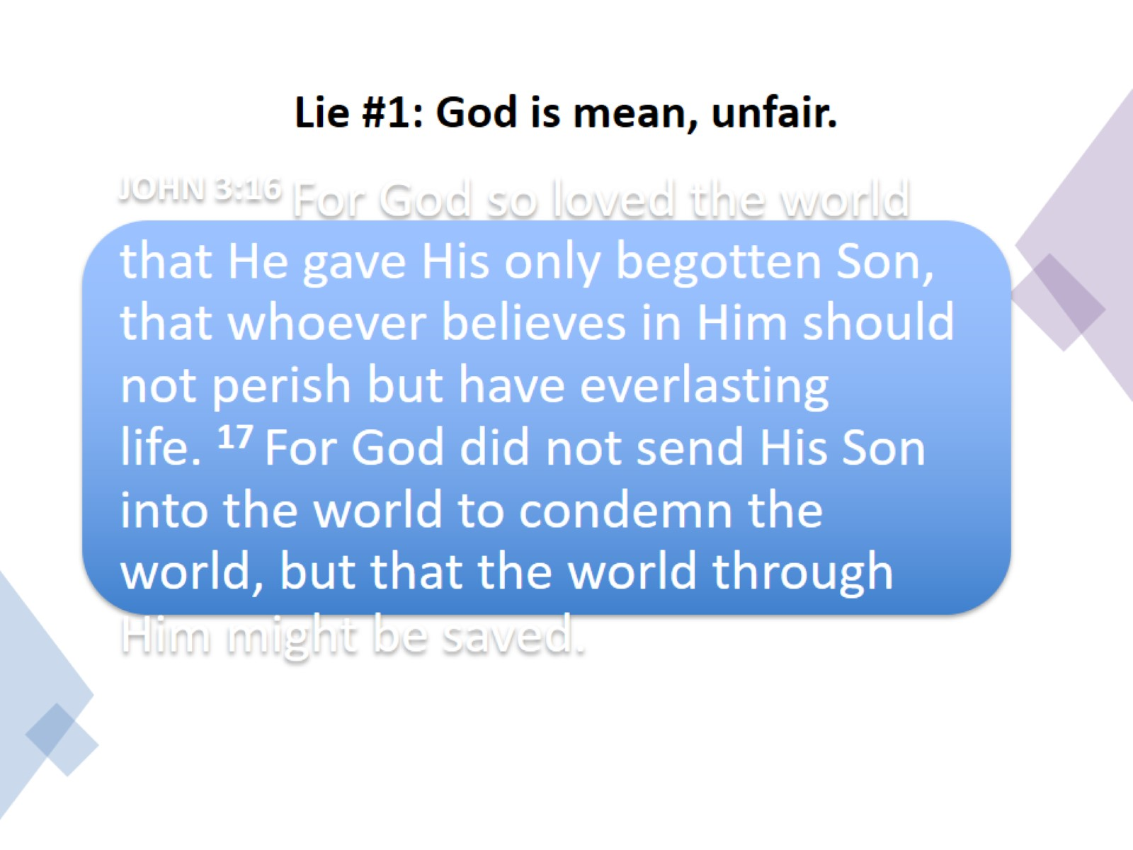
Lie #1: God is mean, unfair.

Slide 11
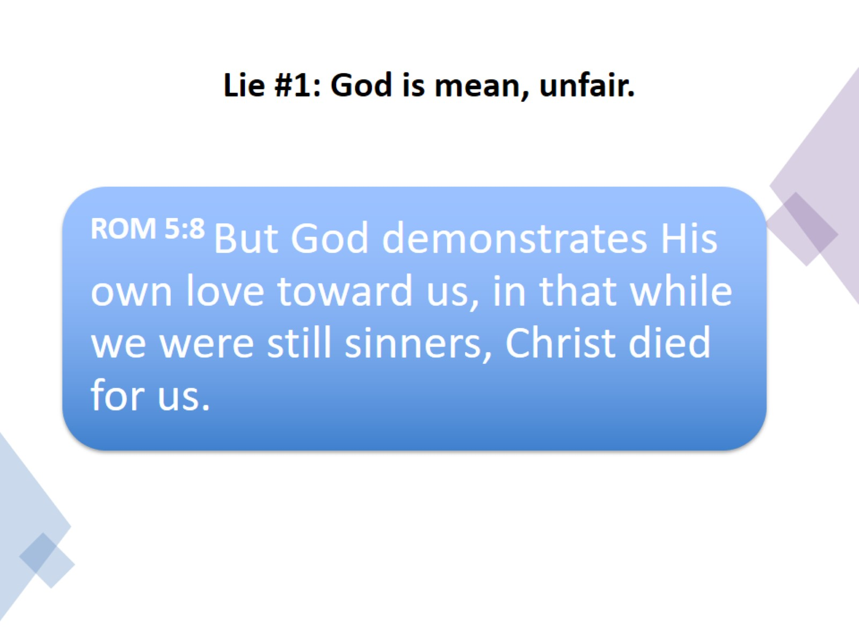
Lie #1: God is mean, unfair.

Slide 12

Lie #2

Slide 13
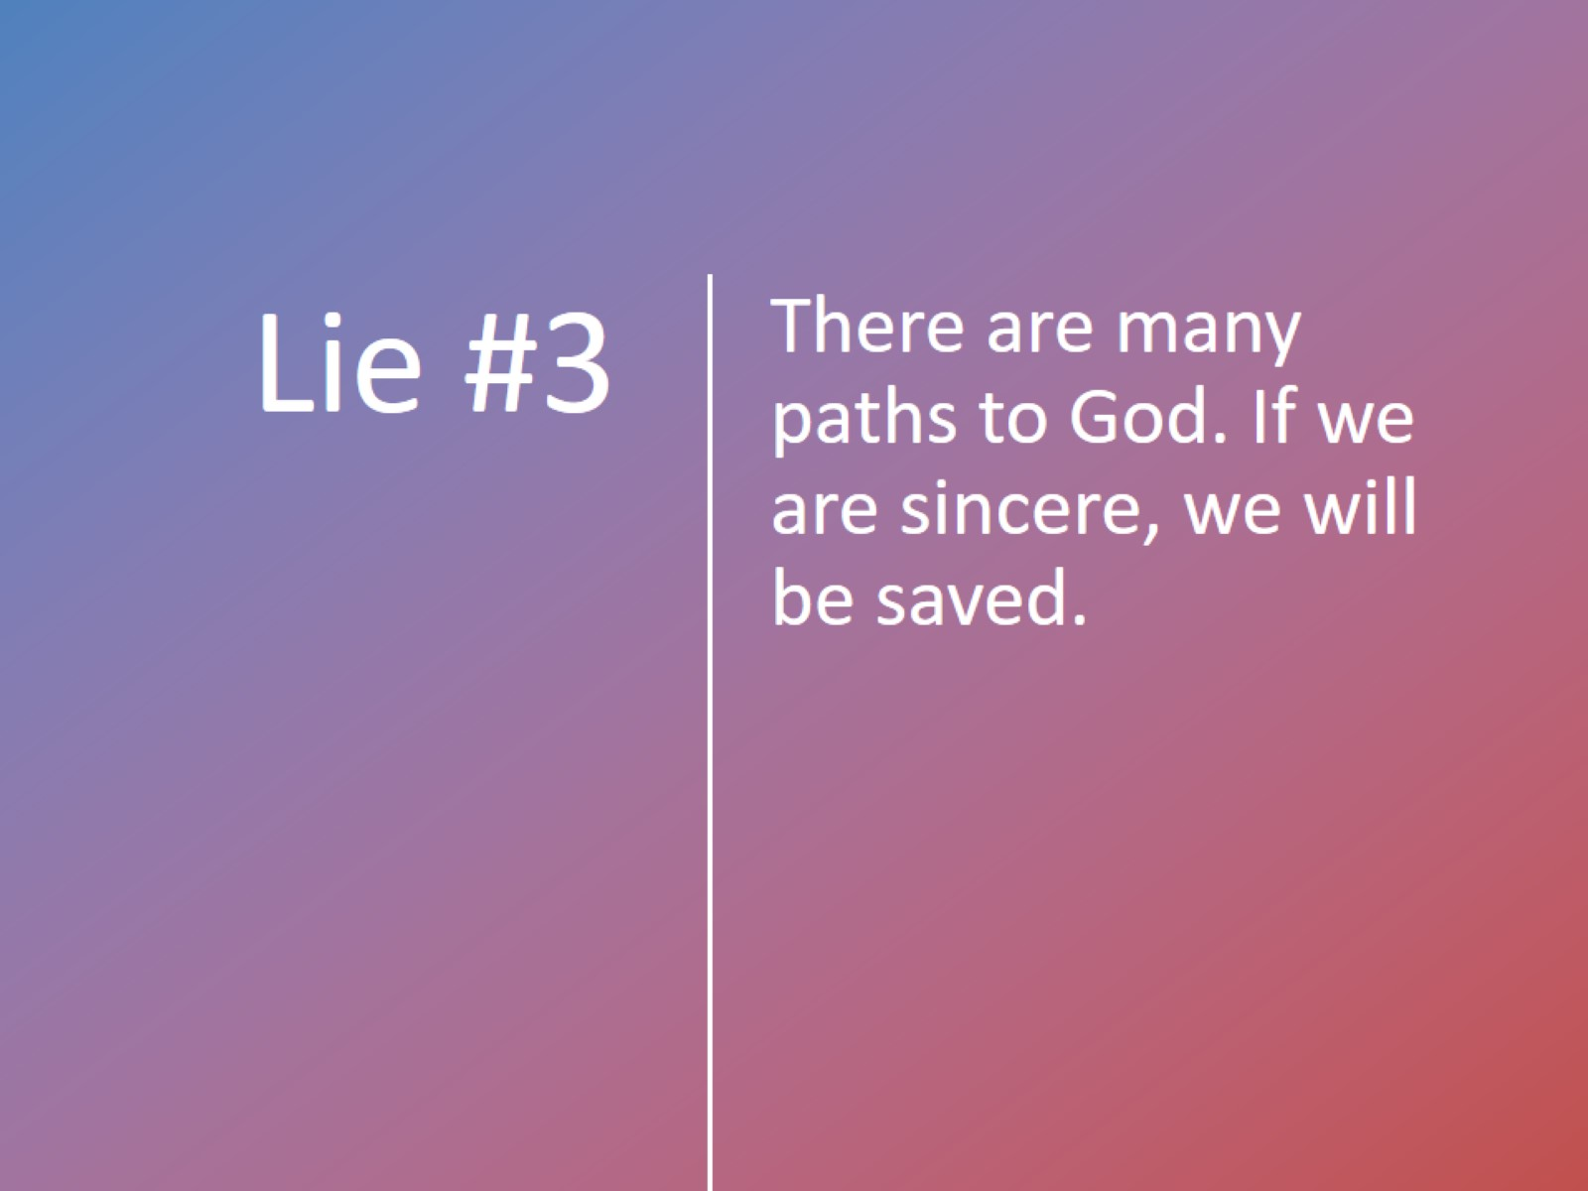
Lie #3

Slide 14
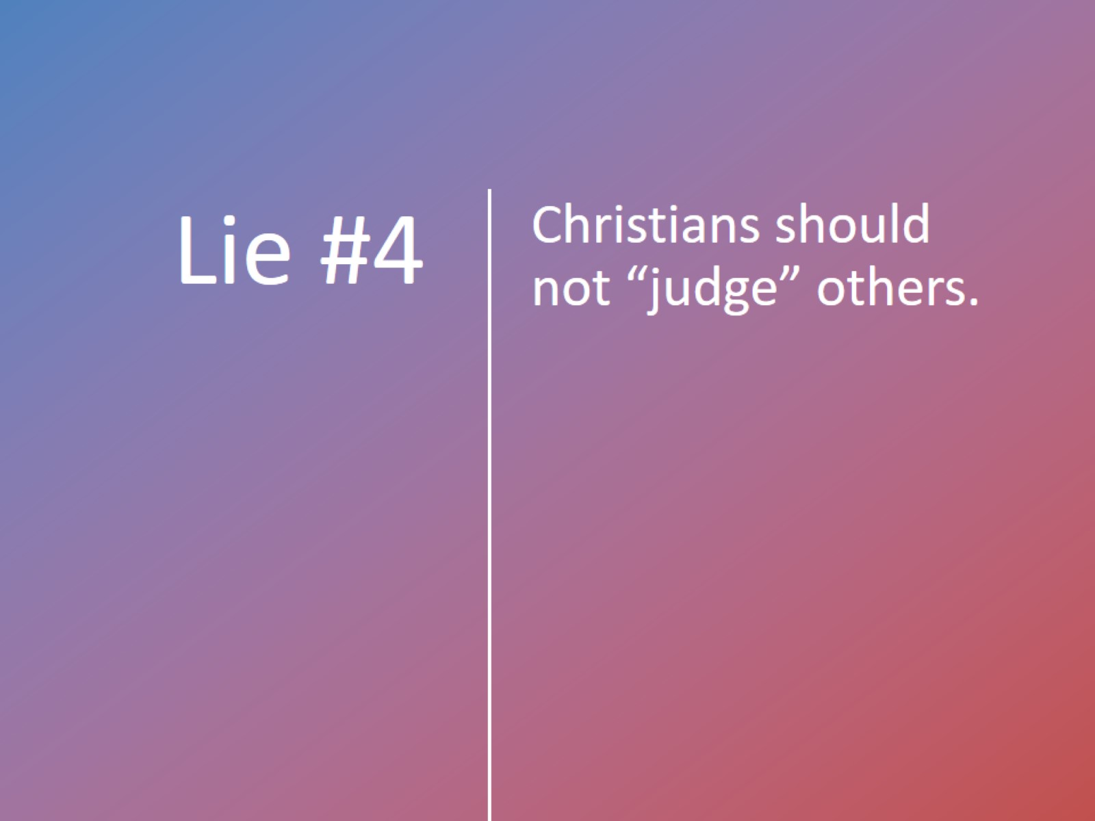
Lie #4

Slide 15
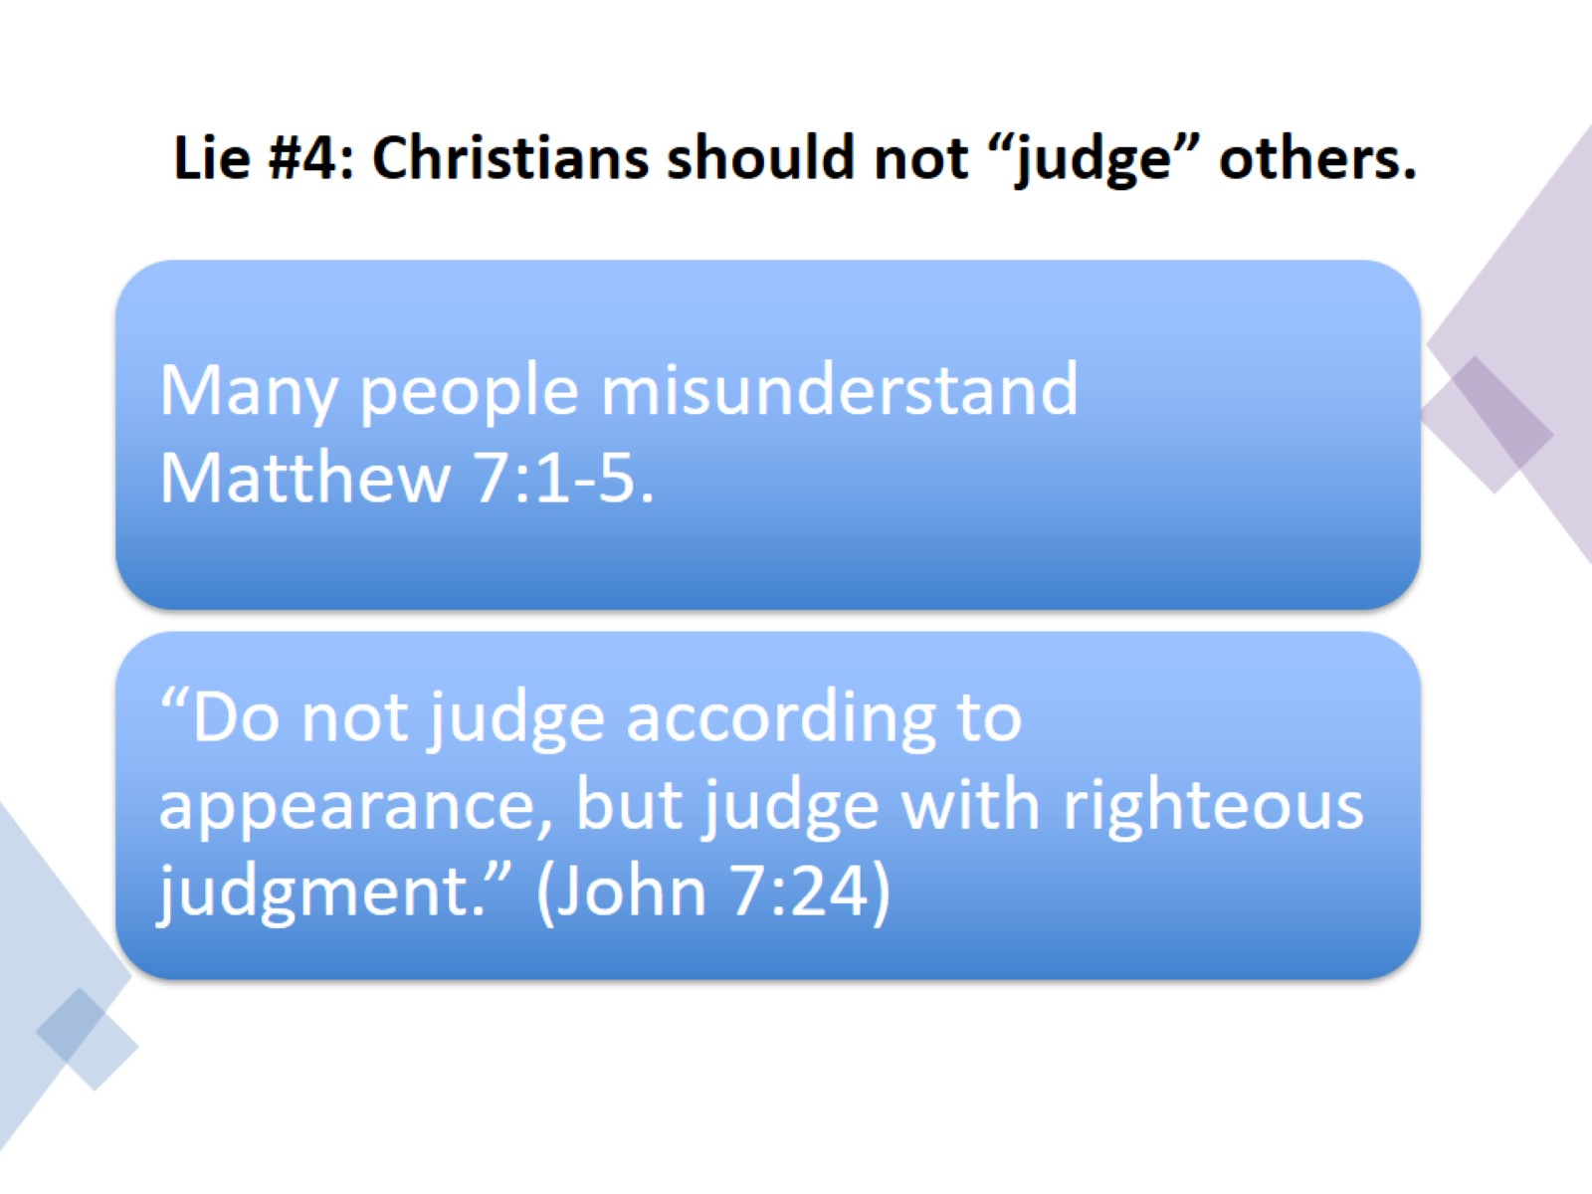
Lie #4: Christians should not “judge” others.

Slide 16

Lie #5

Slide 17
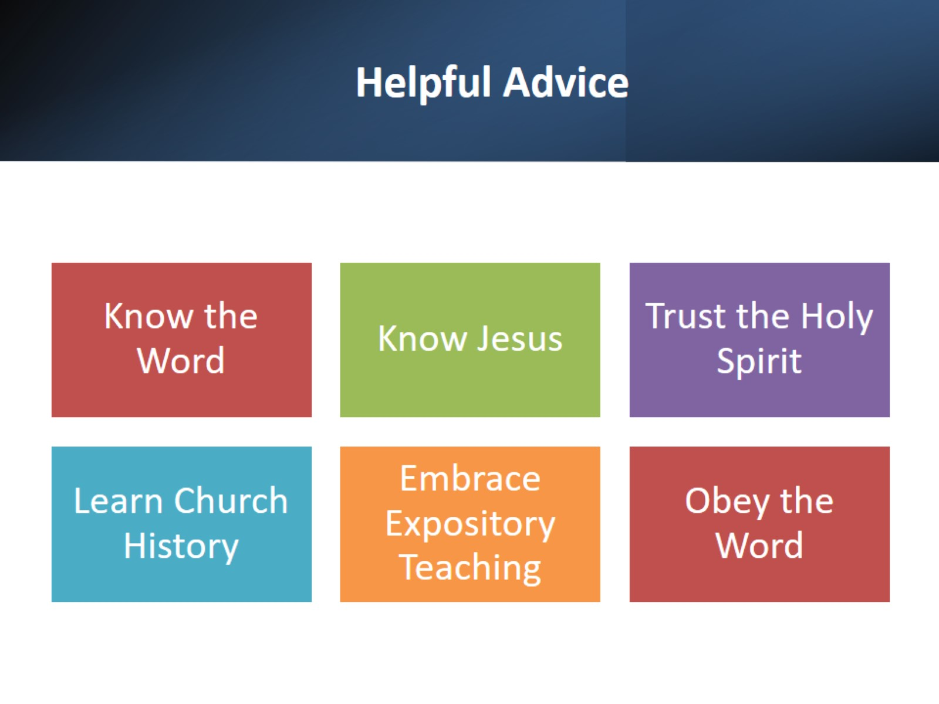
Helpful Advice

Slide 18

Three Bible Teachers

