Slide 1

Cultivating Friendship with god

Slide 2
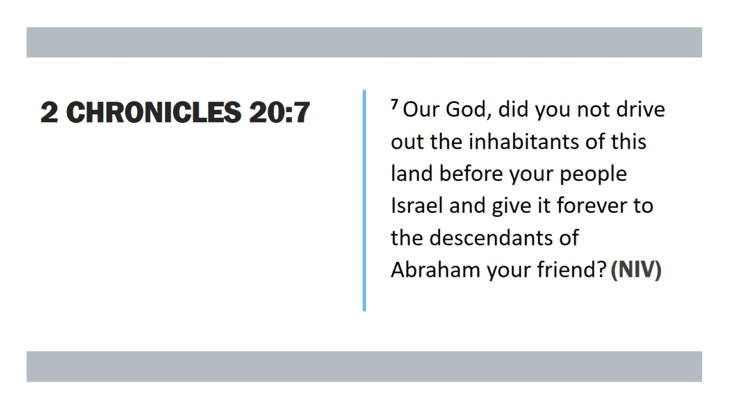
2 chronicles 20:7

Slide 3
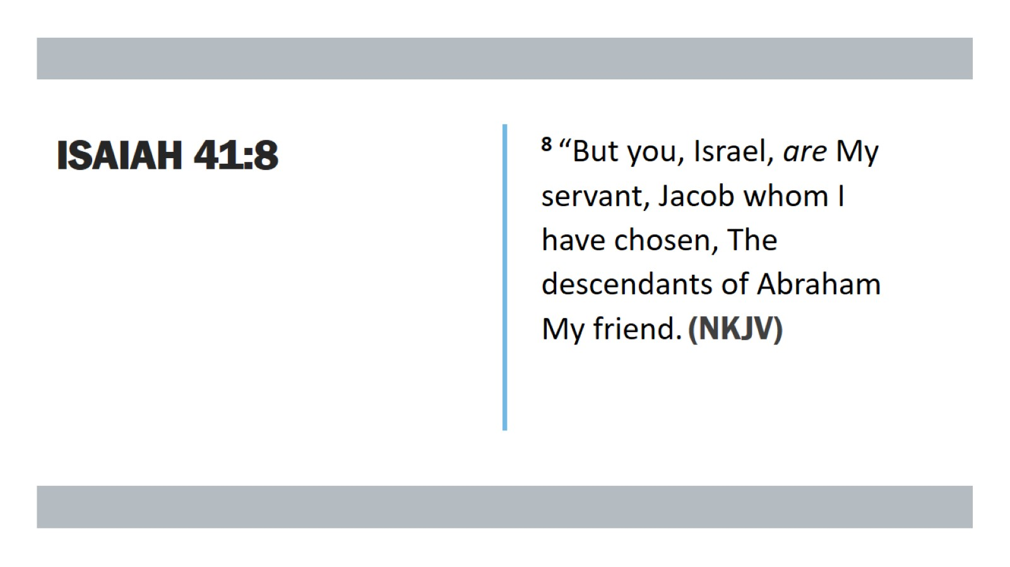
Isaiah 41:8

Slide 4
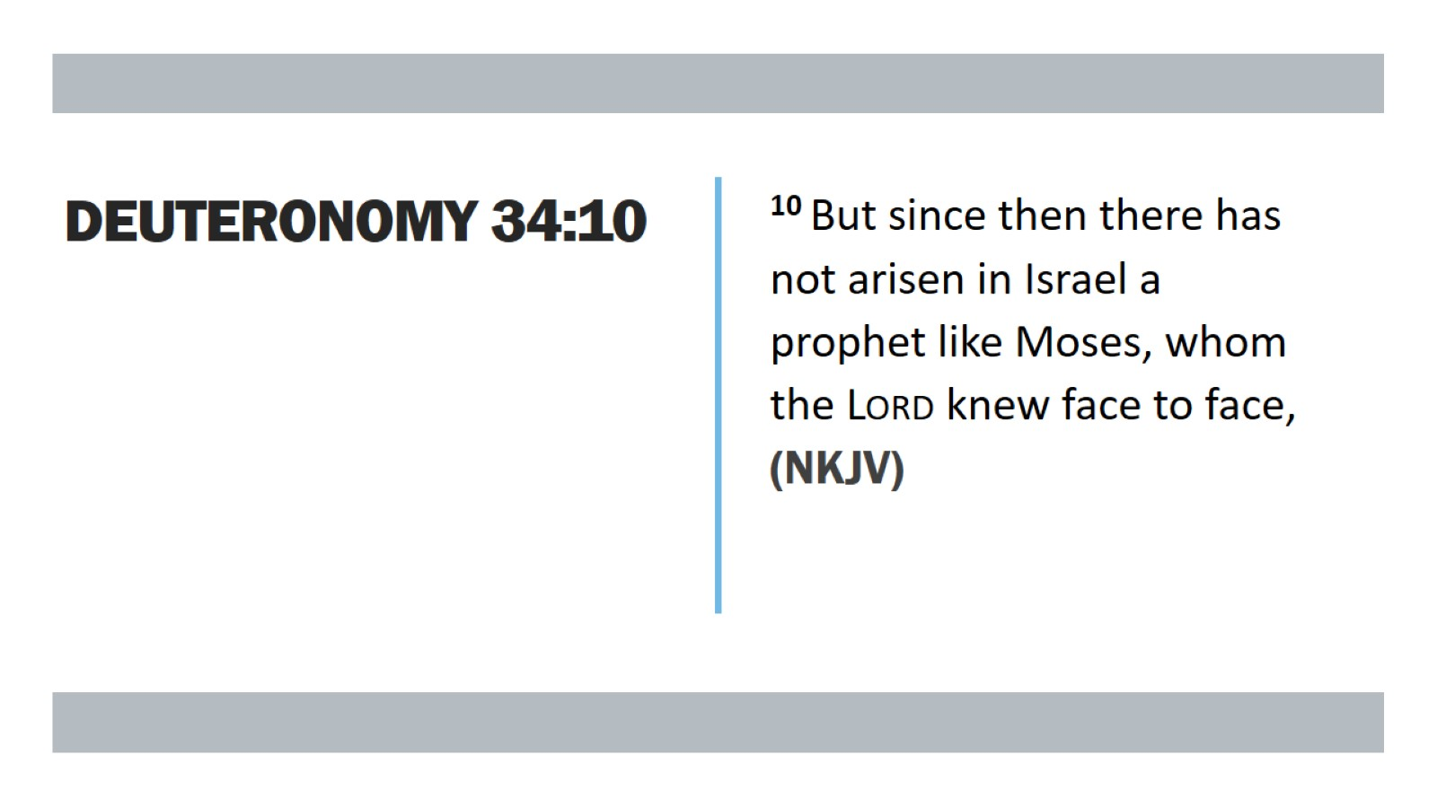
Deuteronomy 34:10

Slide 5
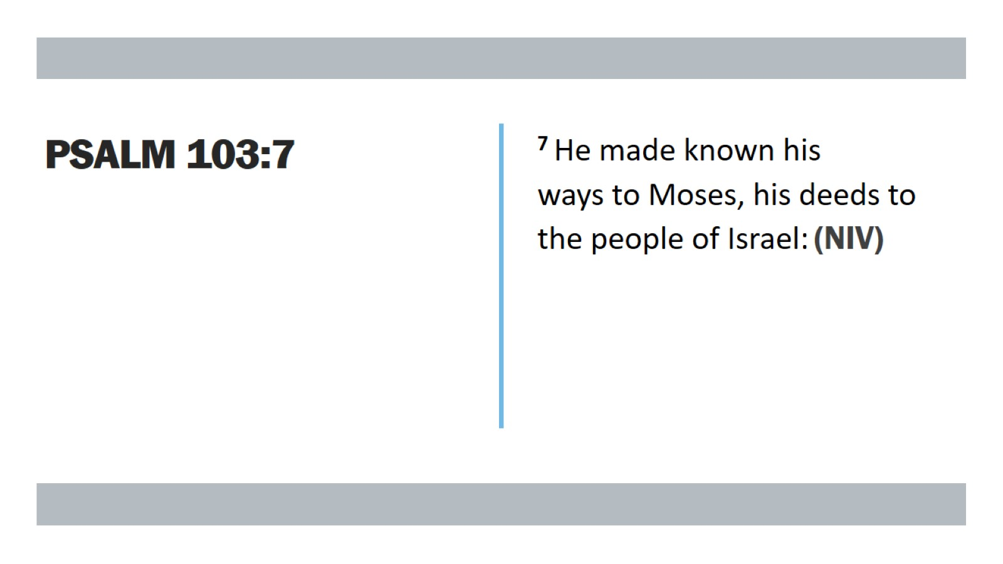
Psalm 103:7

Slide 6
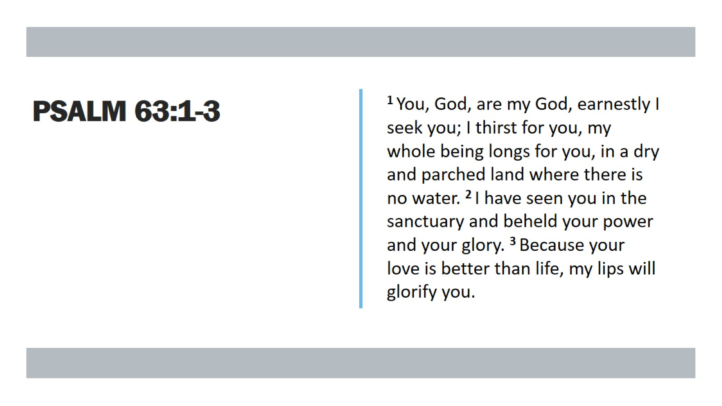
Psalm 63:1-3

Slide 7

Biblical Hermeneutics

Slide 8
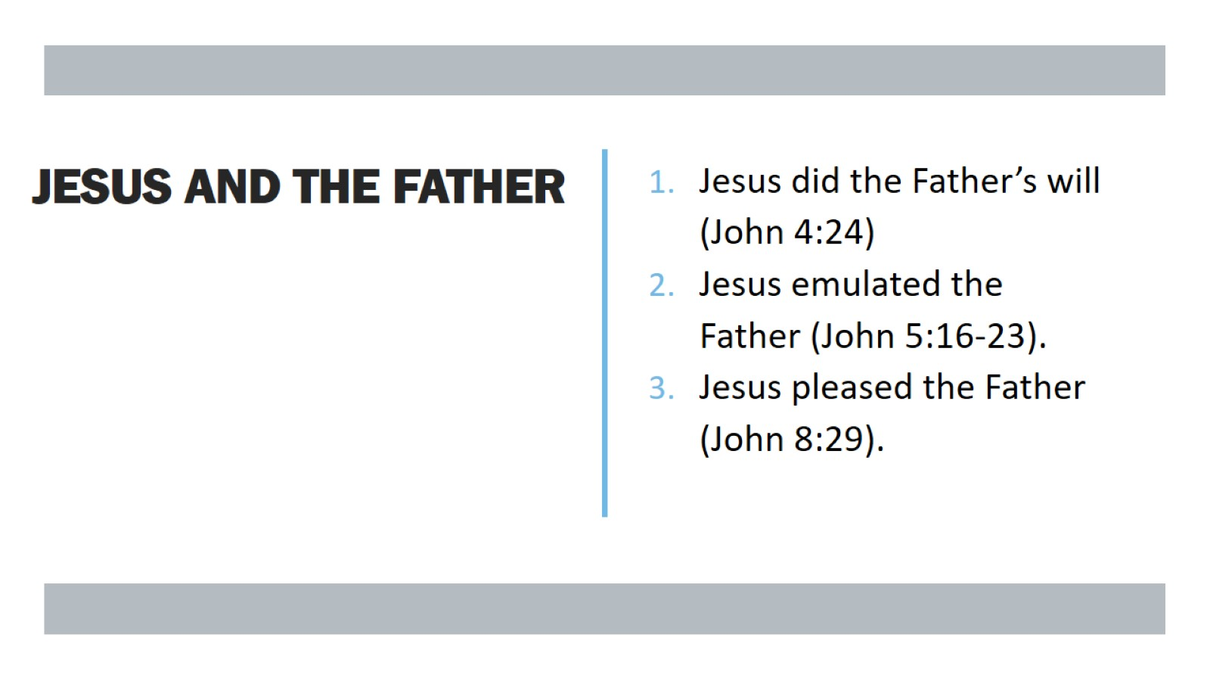
Jesus and the father

Slide 9
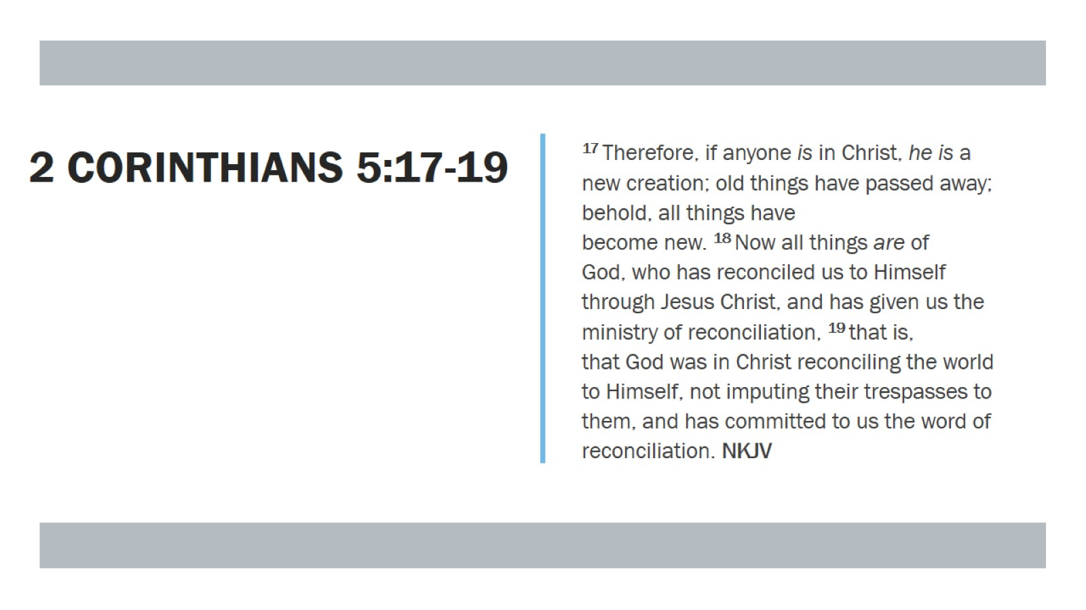
2 Corinthians 5:17-19

Slide 10
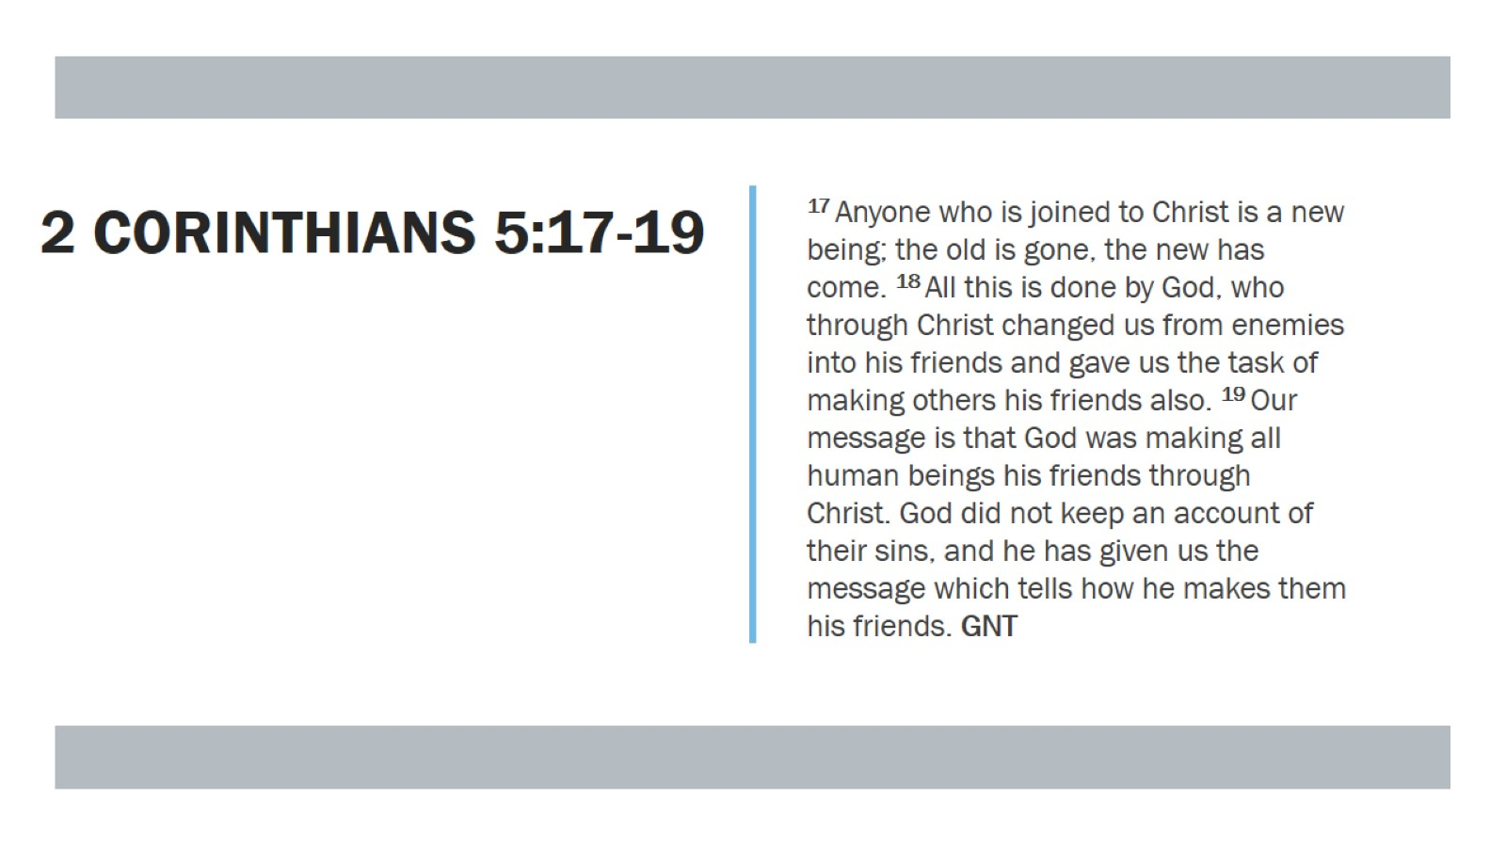
2 Corinthians 5:17-19

Slide 11
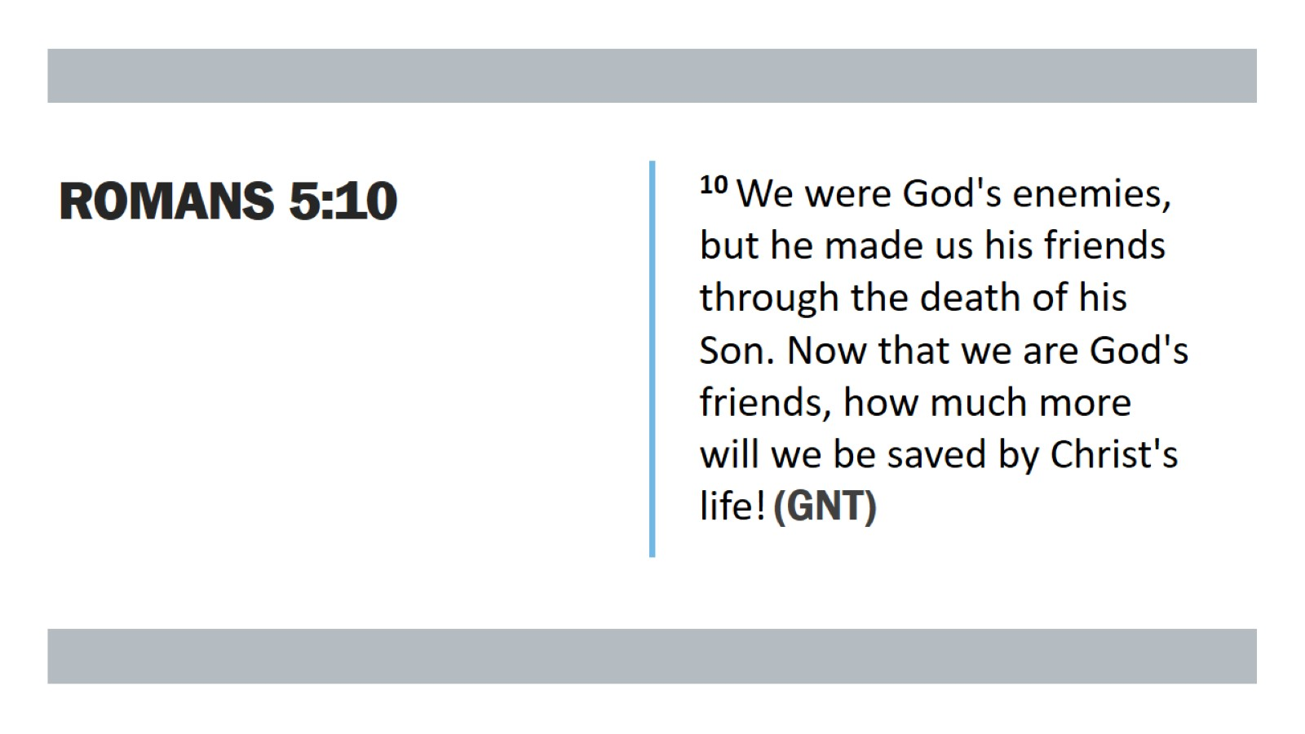
Romans 5:10

Slide 12
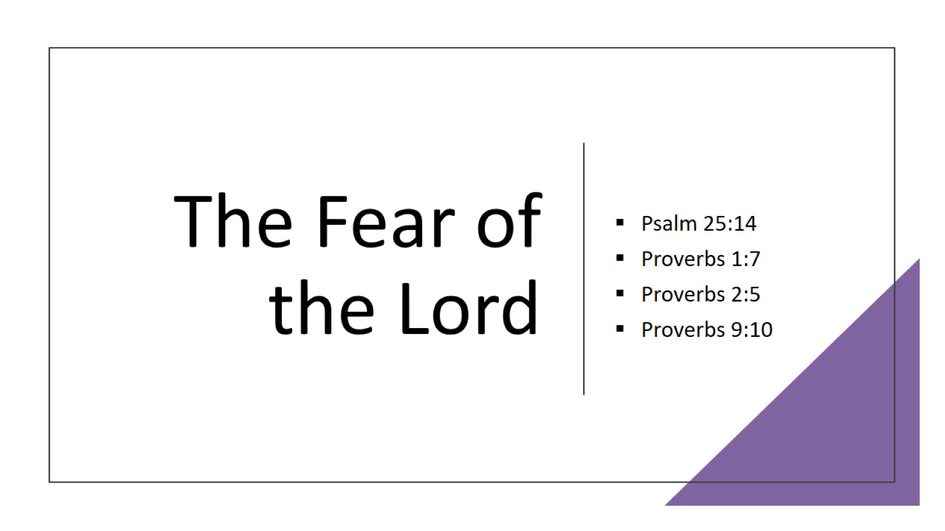
The Fear of the Lord

Slide 13
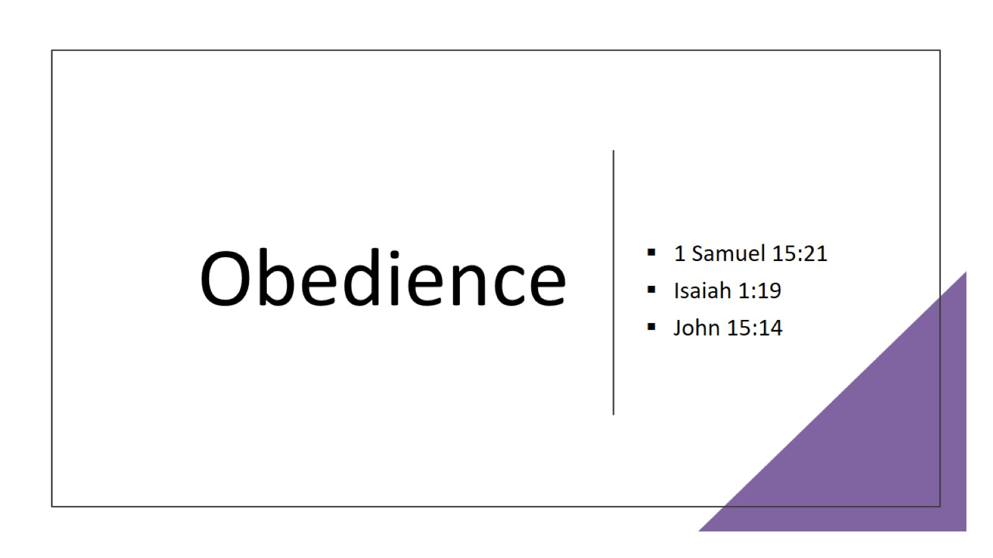
Obedience

Slide 14
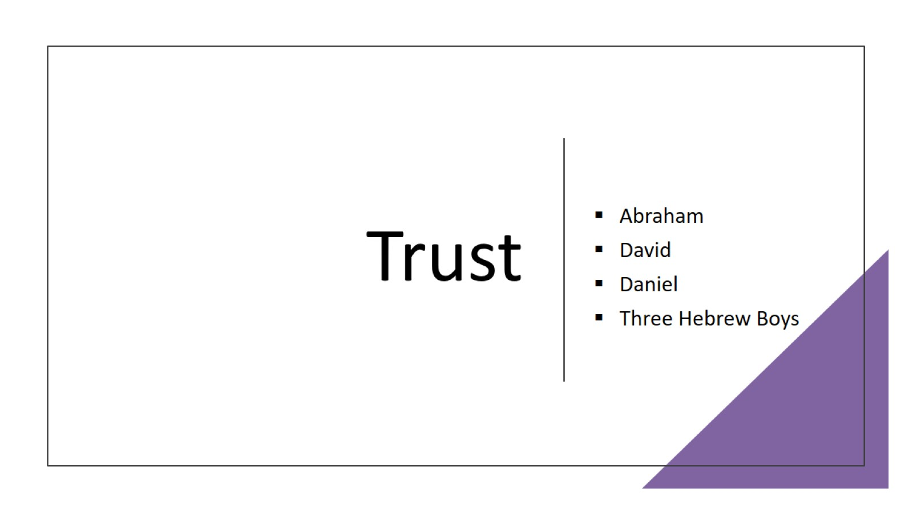
Trust

Slide 15
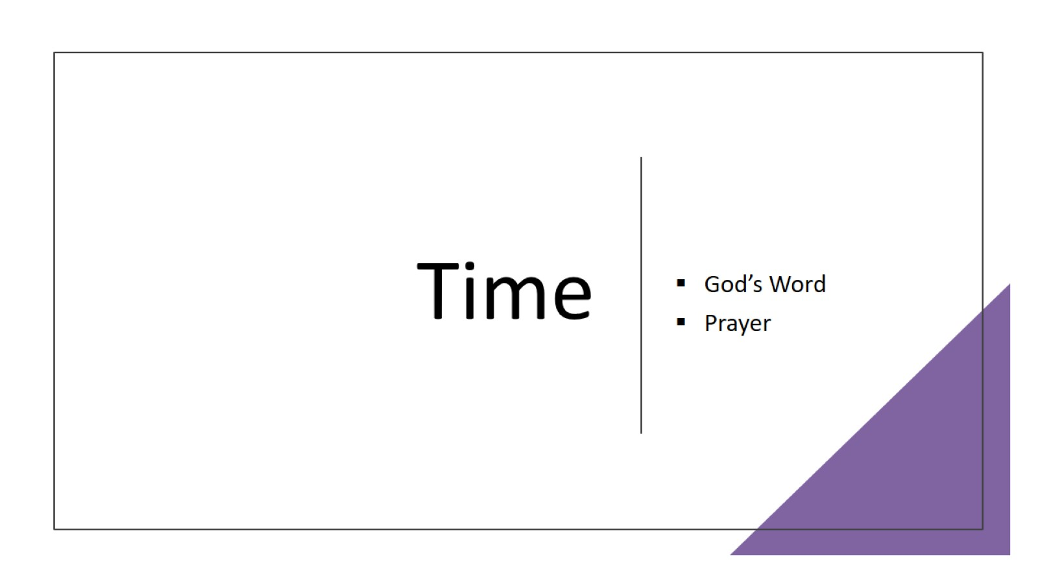
Time

Slide 16

Adoration

