Slide 1

Union with Christ

Slide 2
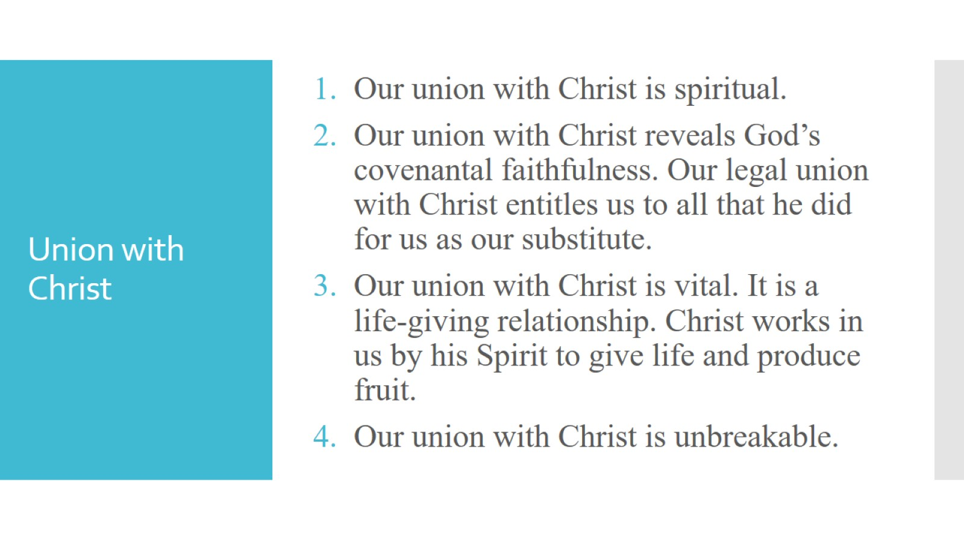
Union with Christ

Slide 3
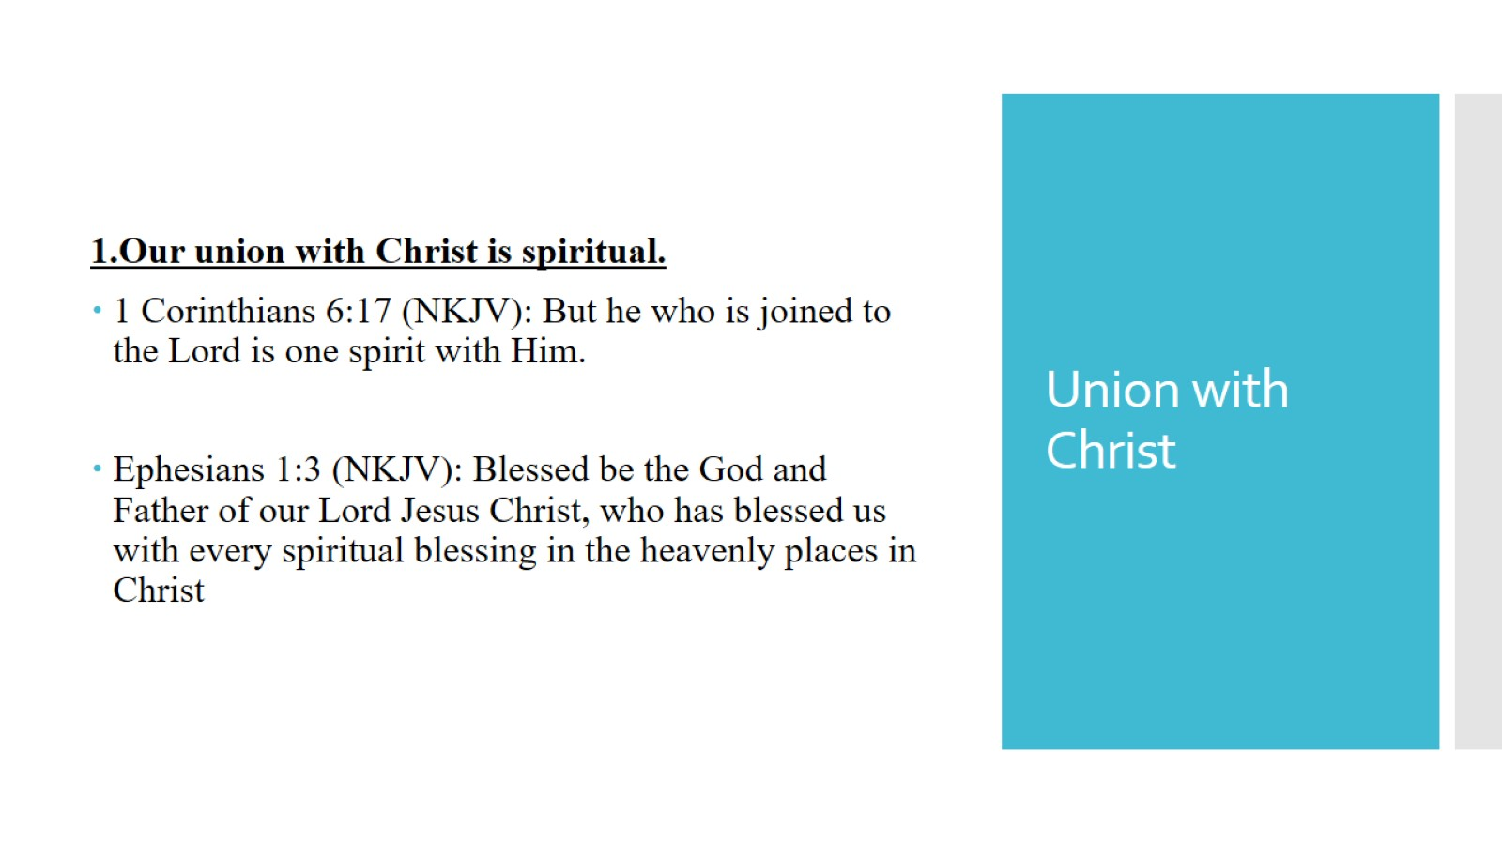
Union with Christ

Slide 4
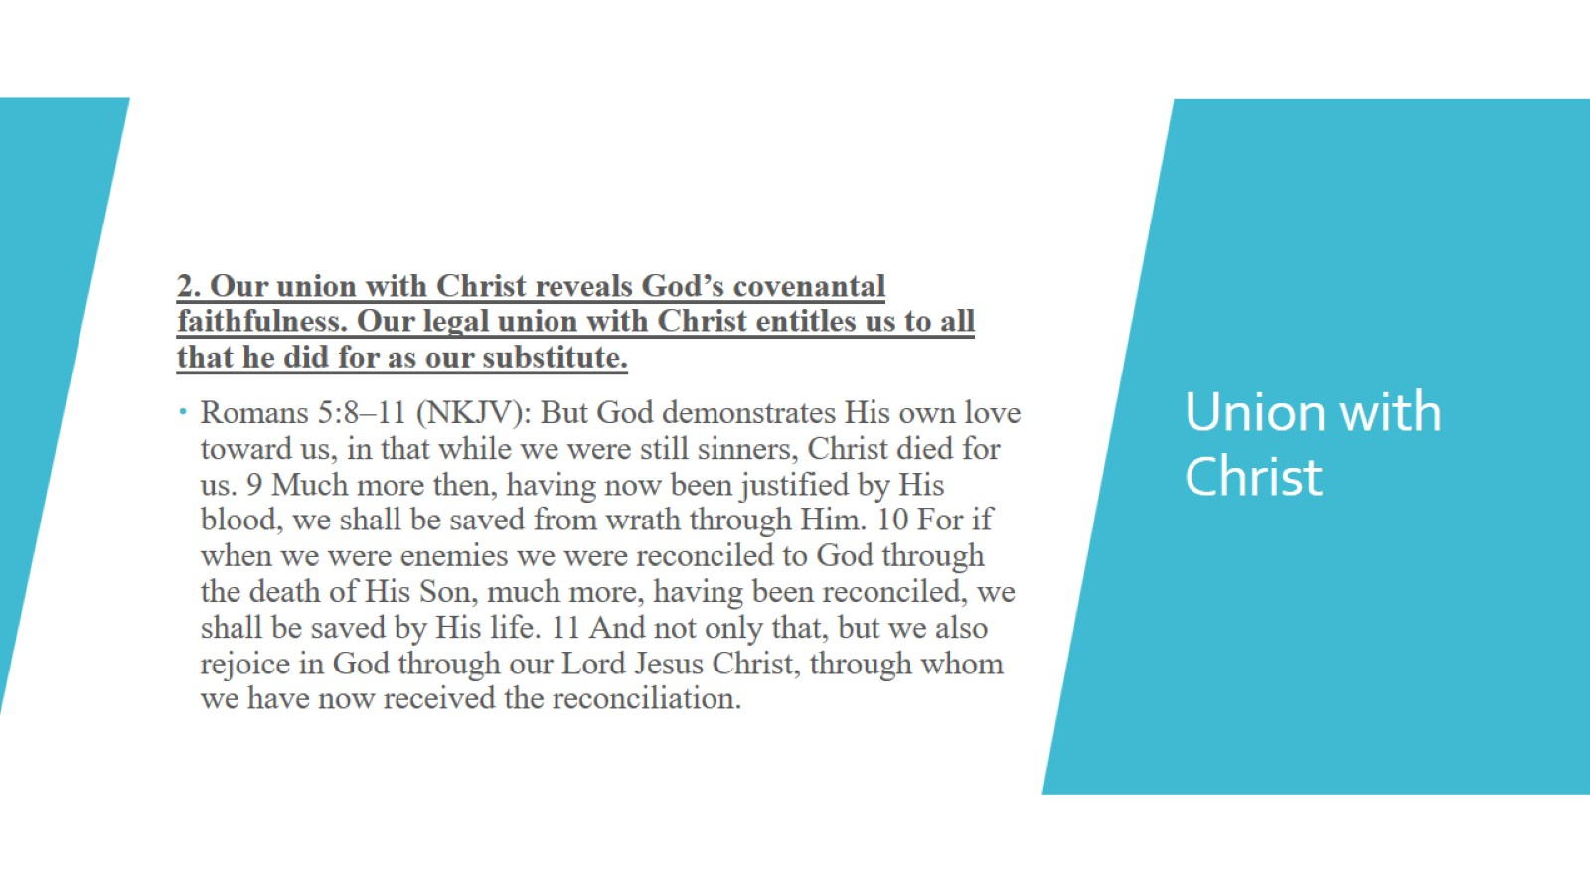
Union with Christ

Slide 5
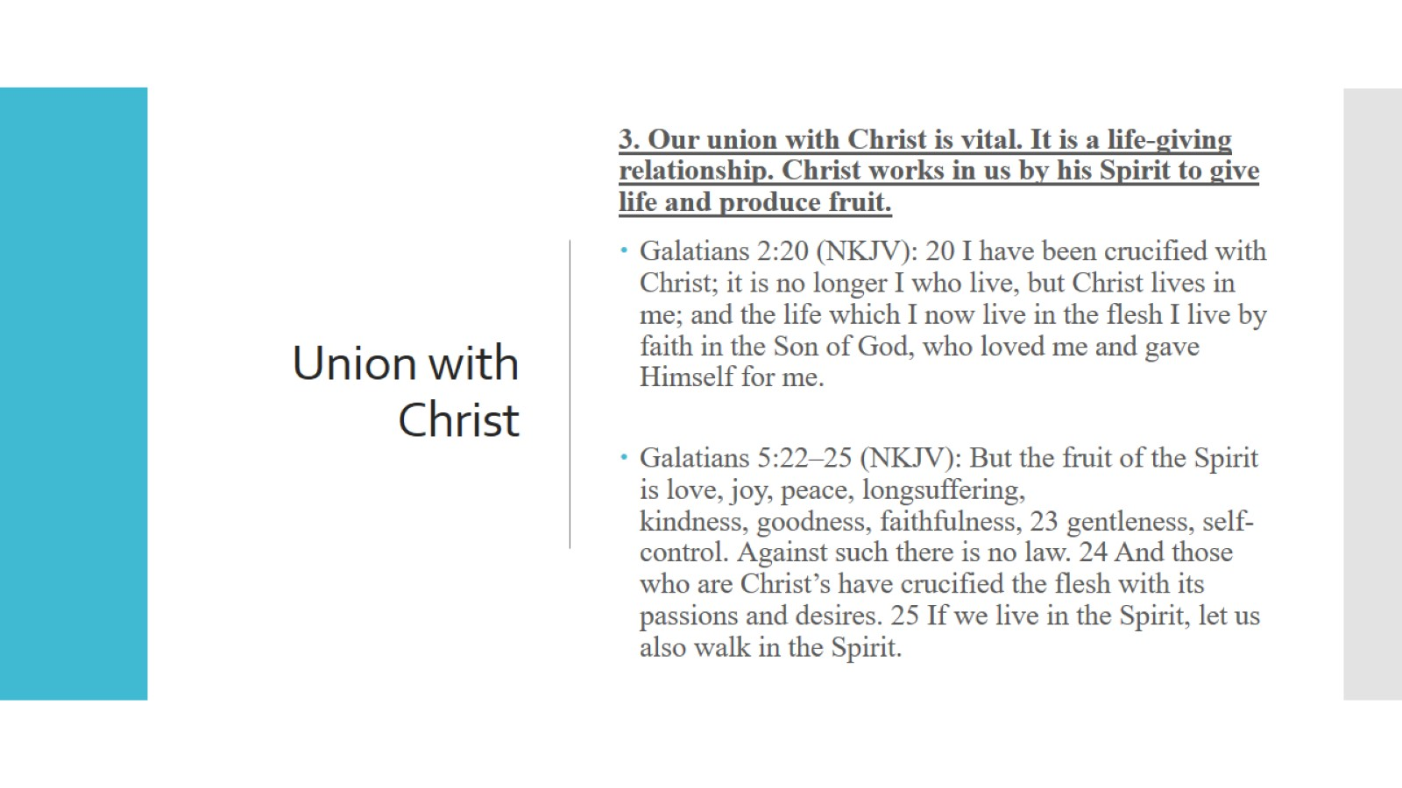
Union with Christ

Slide 6
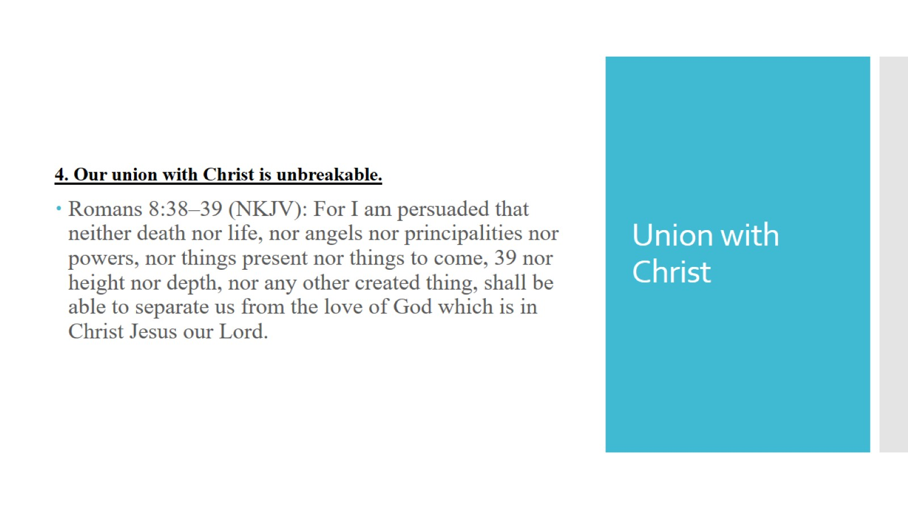
Union with Christ

Slide 7
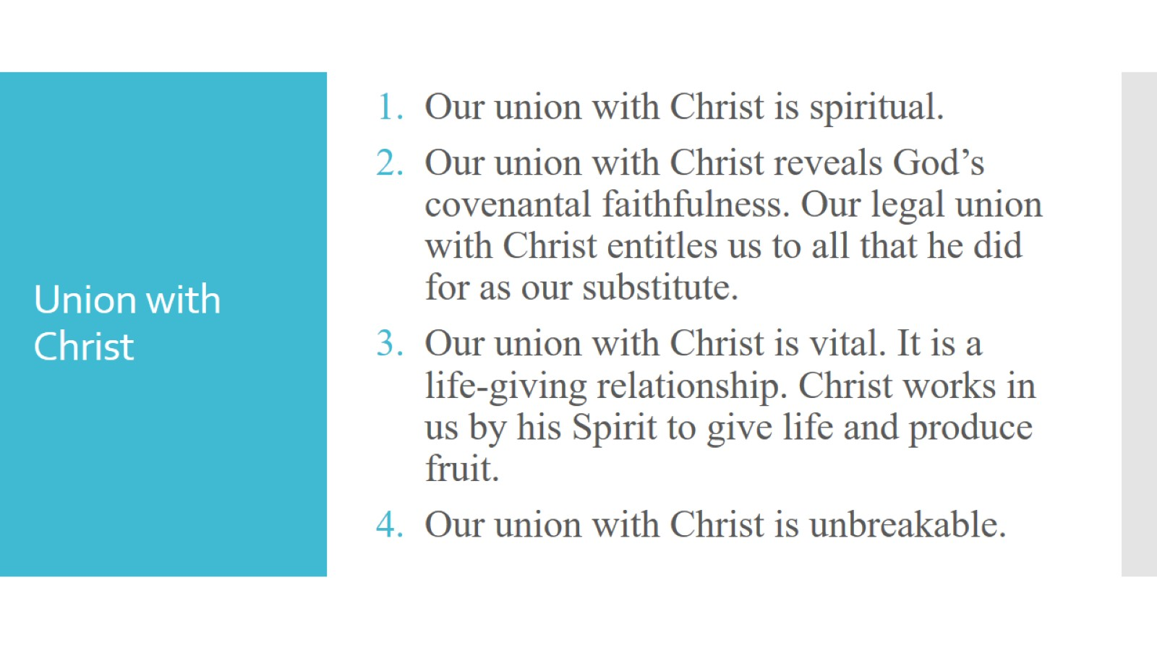
Union with Christ

Slide 8

Union with Christ

