Slide 1

The Believer’s Life in Christ

Slide 2
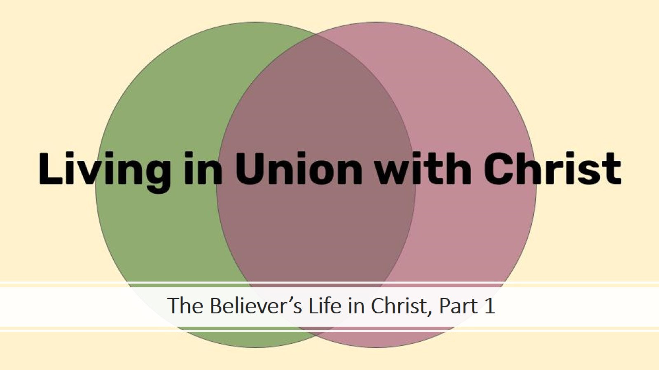
The Believer’s Life in Christ, Part 1

Slide 3
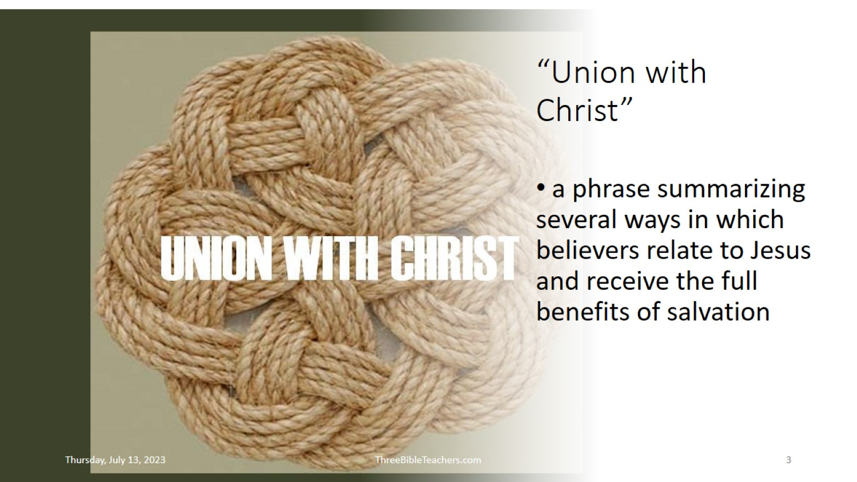
“Union with Christ”

Slide 4


Slide 5


Slide 6


Slide 7


Slide 8


Slide 9


Slide 10


Slide 11
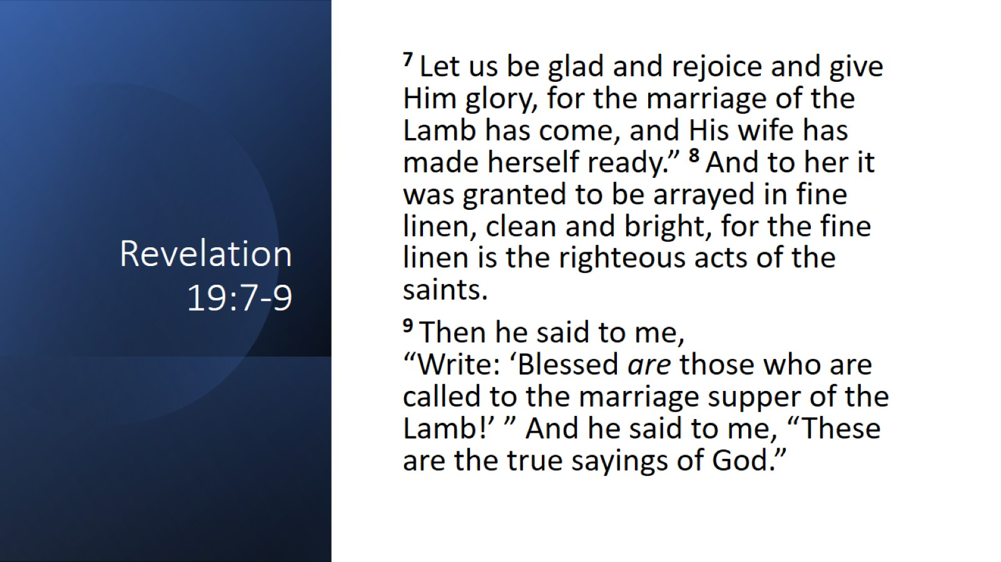
Revelation 19:7-9

Slide 12


Slide 13
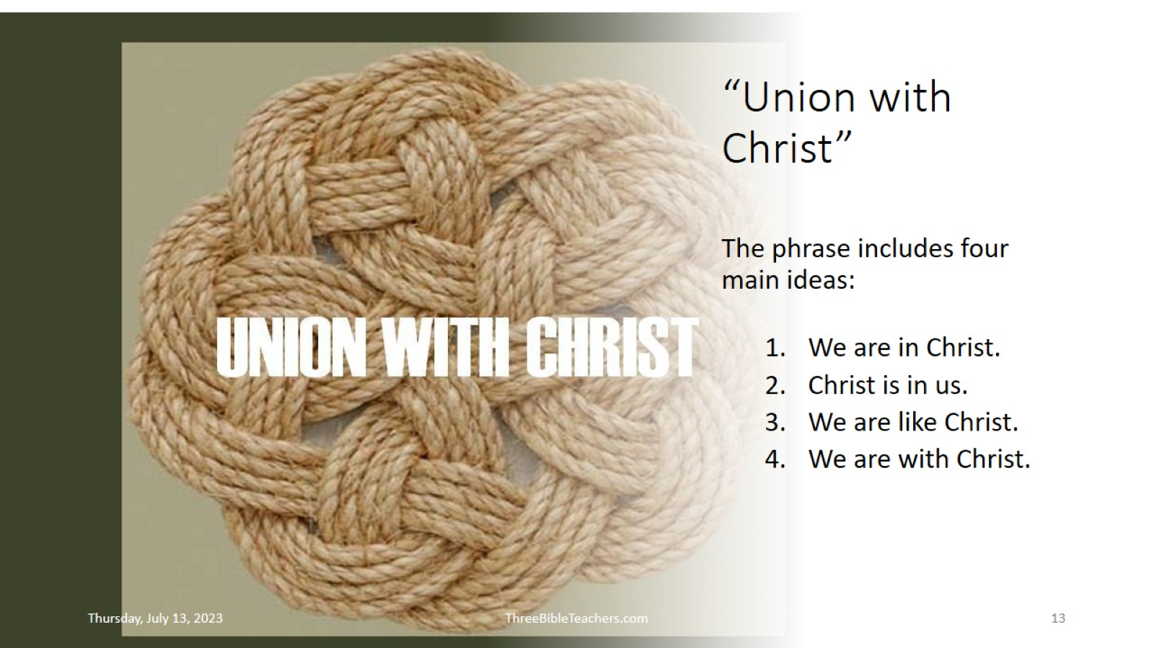
“Union with Christ”

Slide 14
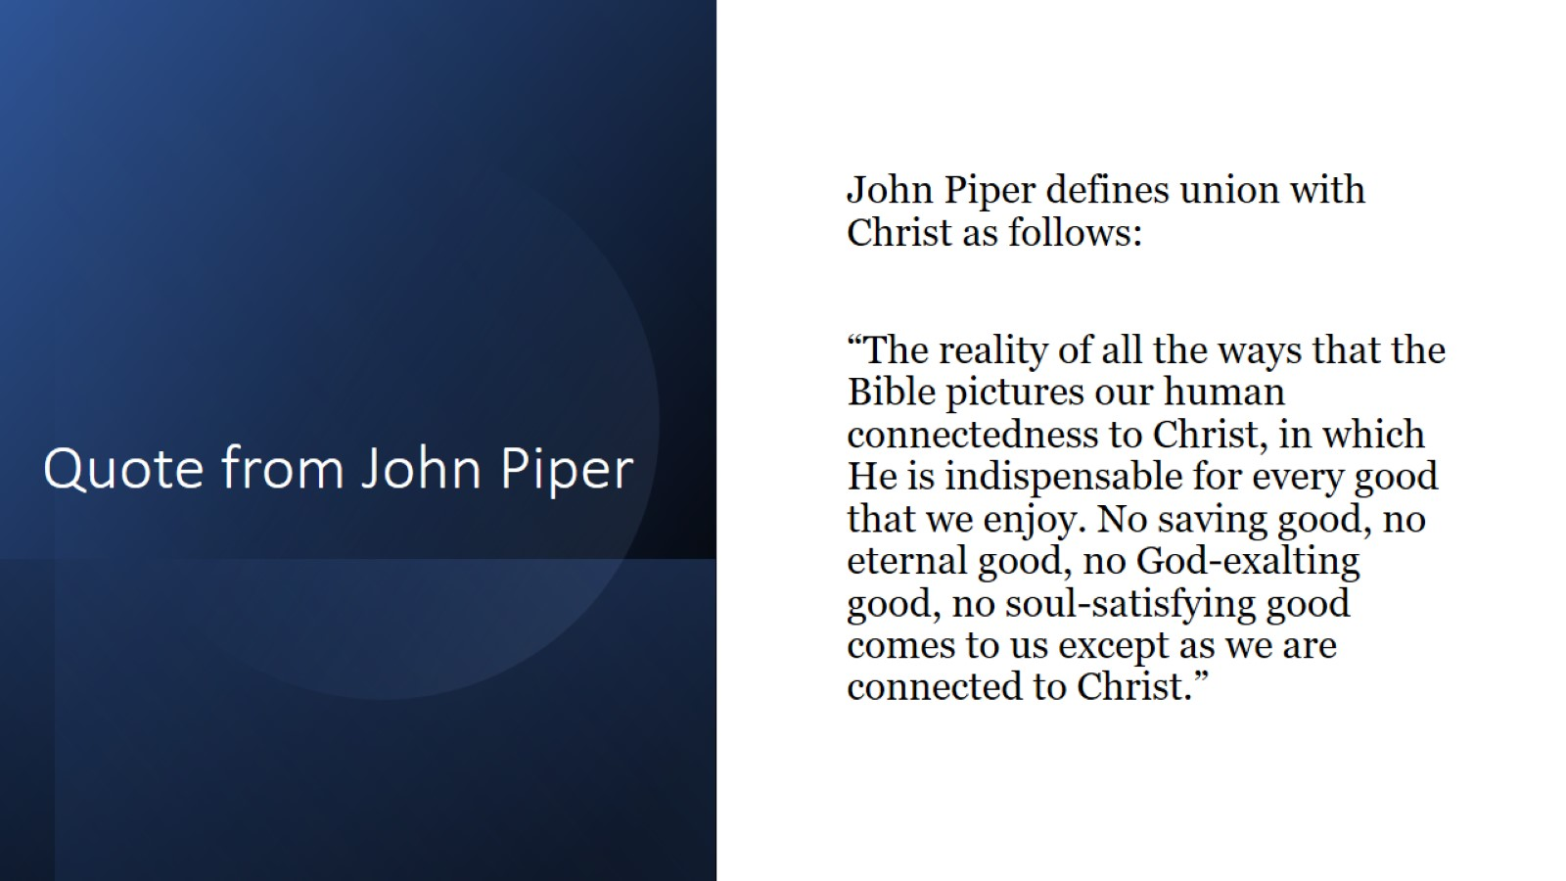
Quote from John Piper

