Slide 1

The Believer’s Life in Christ

Slide 2

The Believer’s Life in Christ, Part 1

Slide 3

“Union with Christ”

Slide 4


Slide 5

The Believer’s Life in Christ, Part 2

Slide 6


Slide 7


Slide 8
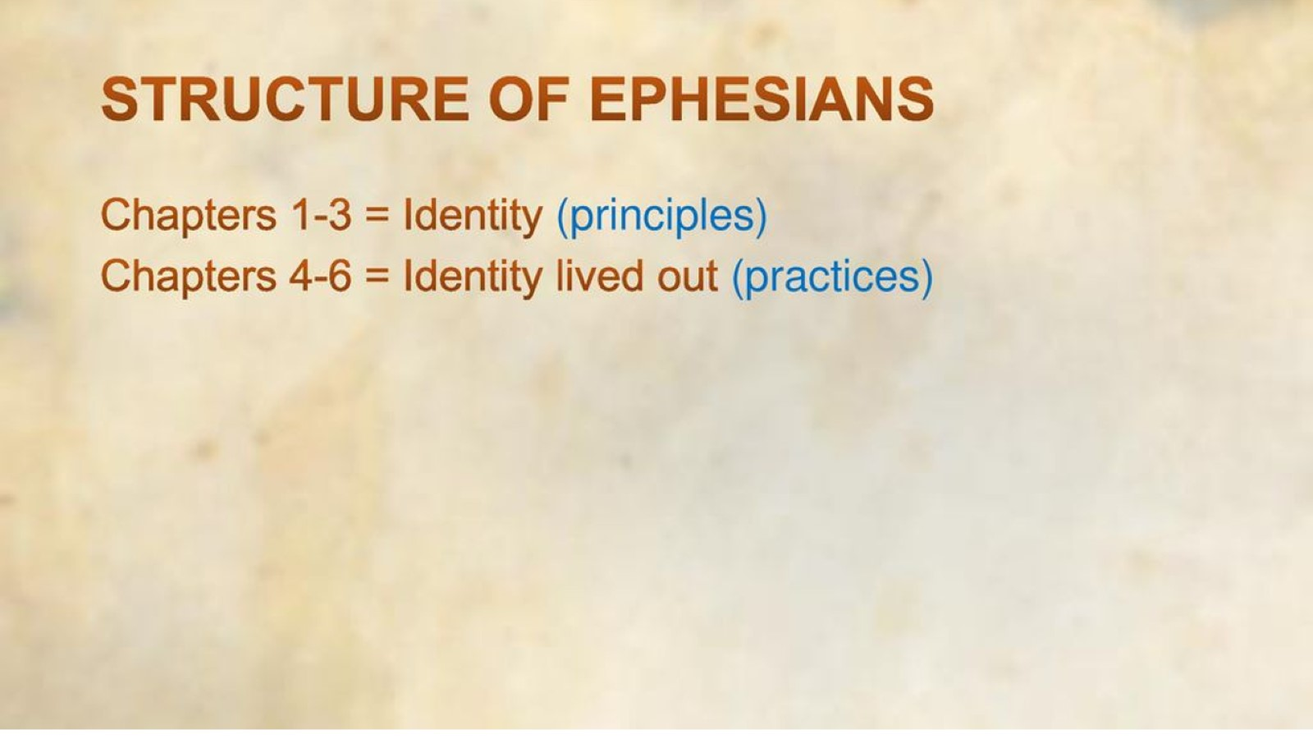

Slide 9

Main Topics by Chapter

Slide 10

Ephesians Outline

Slide 11
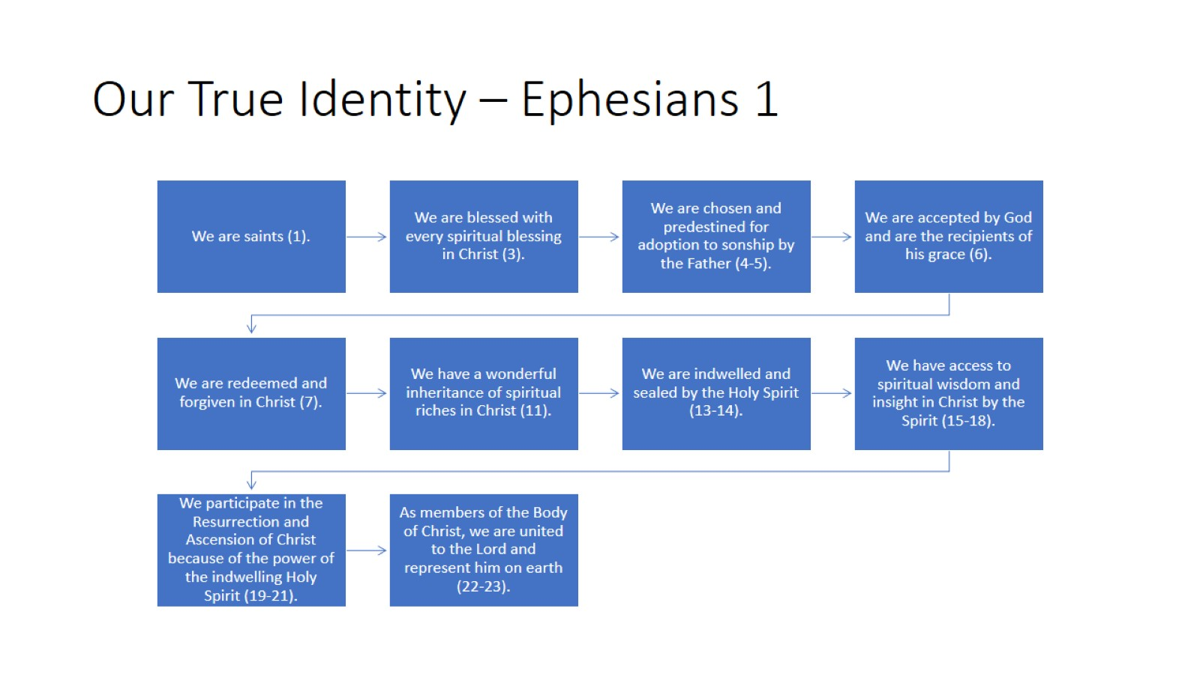
Our True Identity – Ephesians 1

Slide 12
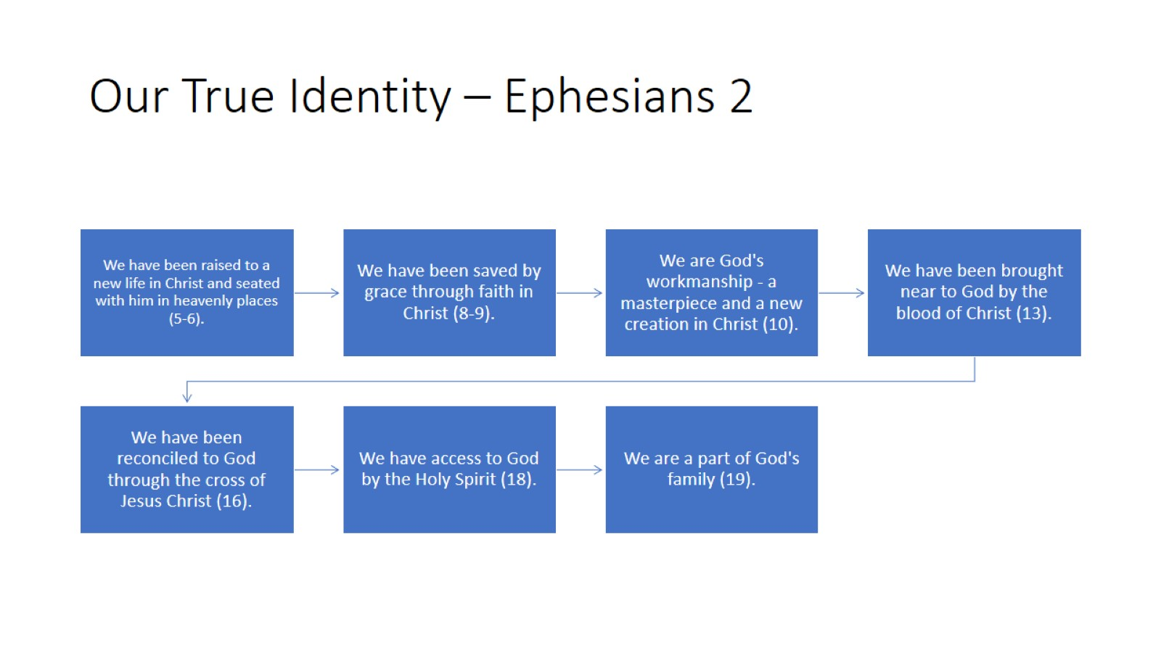
Our True Identity – Ephesians 2

