Slide 1

The Believer’s Life in Christ

Slide 2
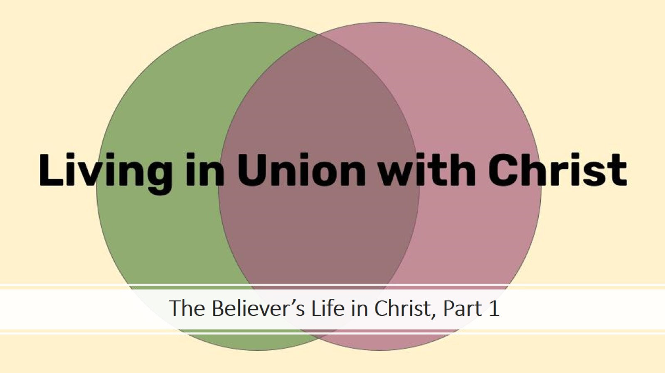
The Believer’s Life in Christ, Part 1

Slide 3

The Believer’s Life in Christ, Part 2

Slide 4
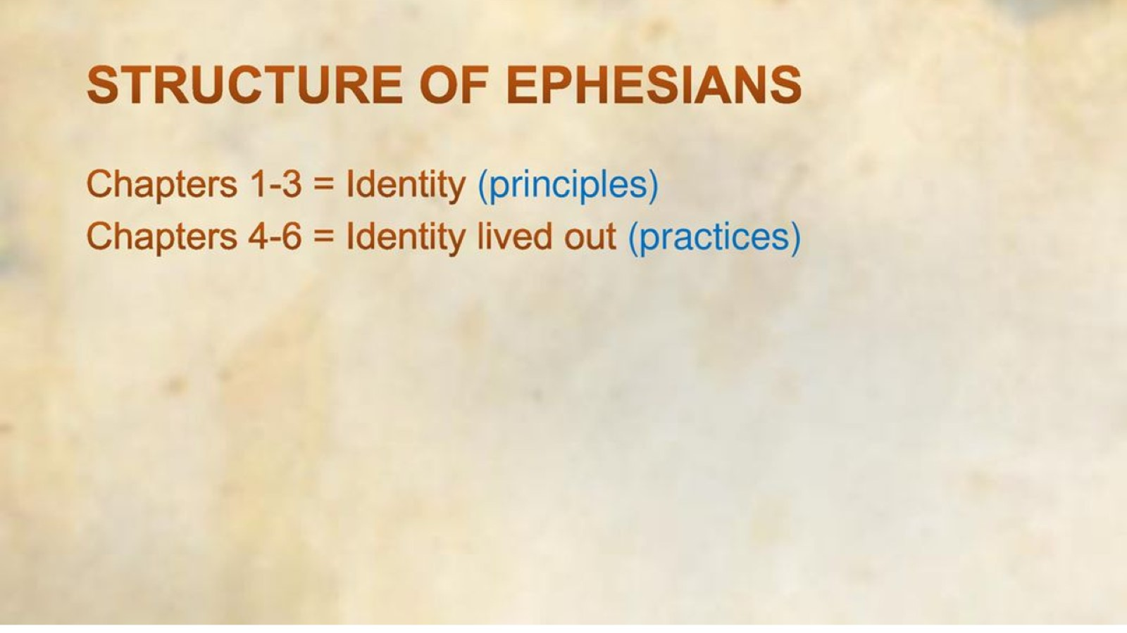

Slide 5

Seeing Yourself as God Sees You

Slide 6
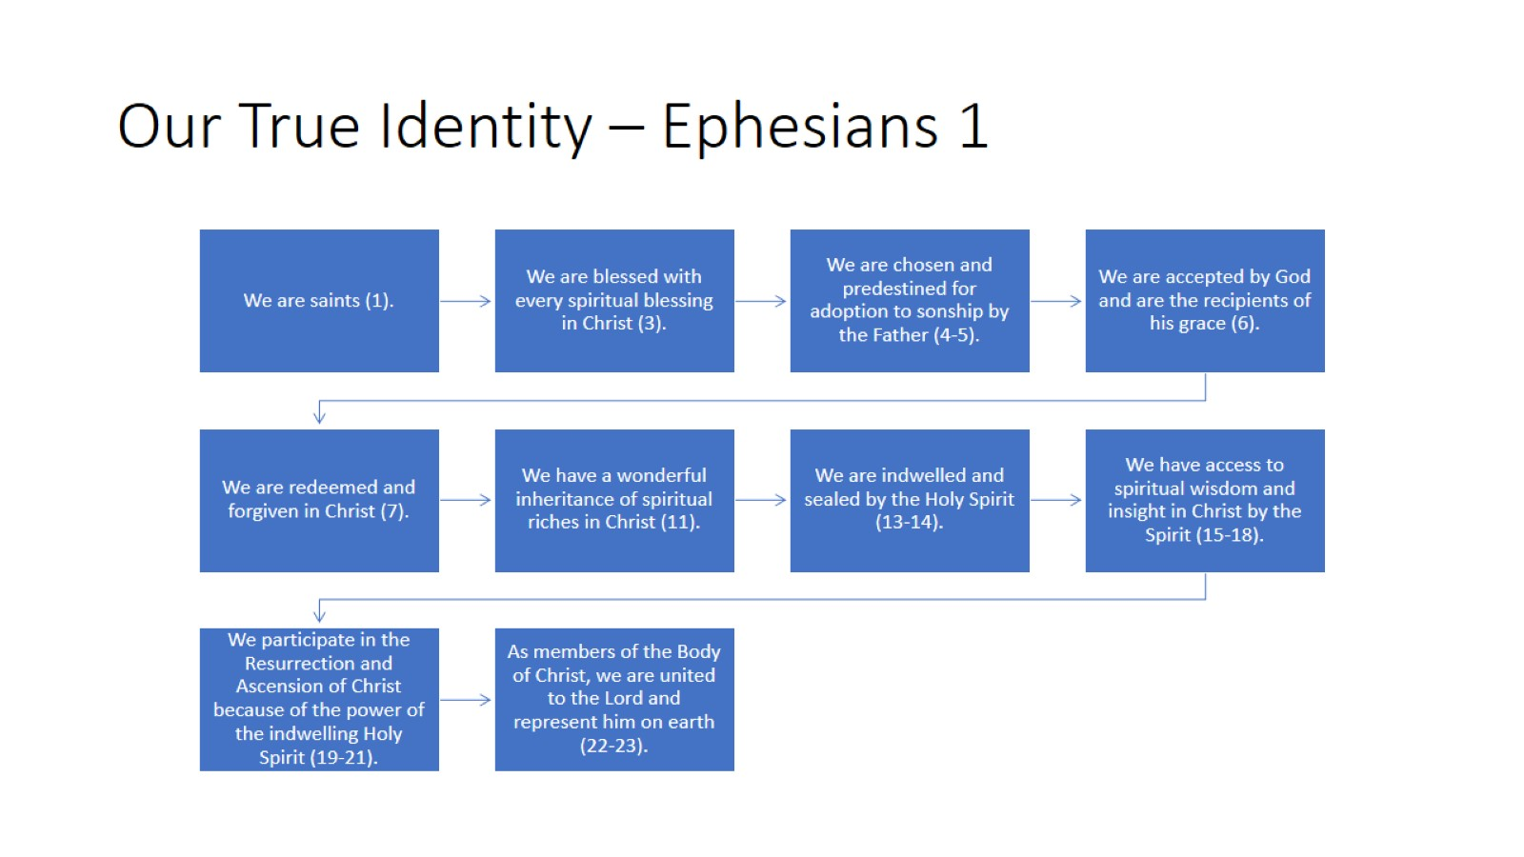
Our True Identity – Ephesians 1

Slide 7
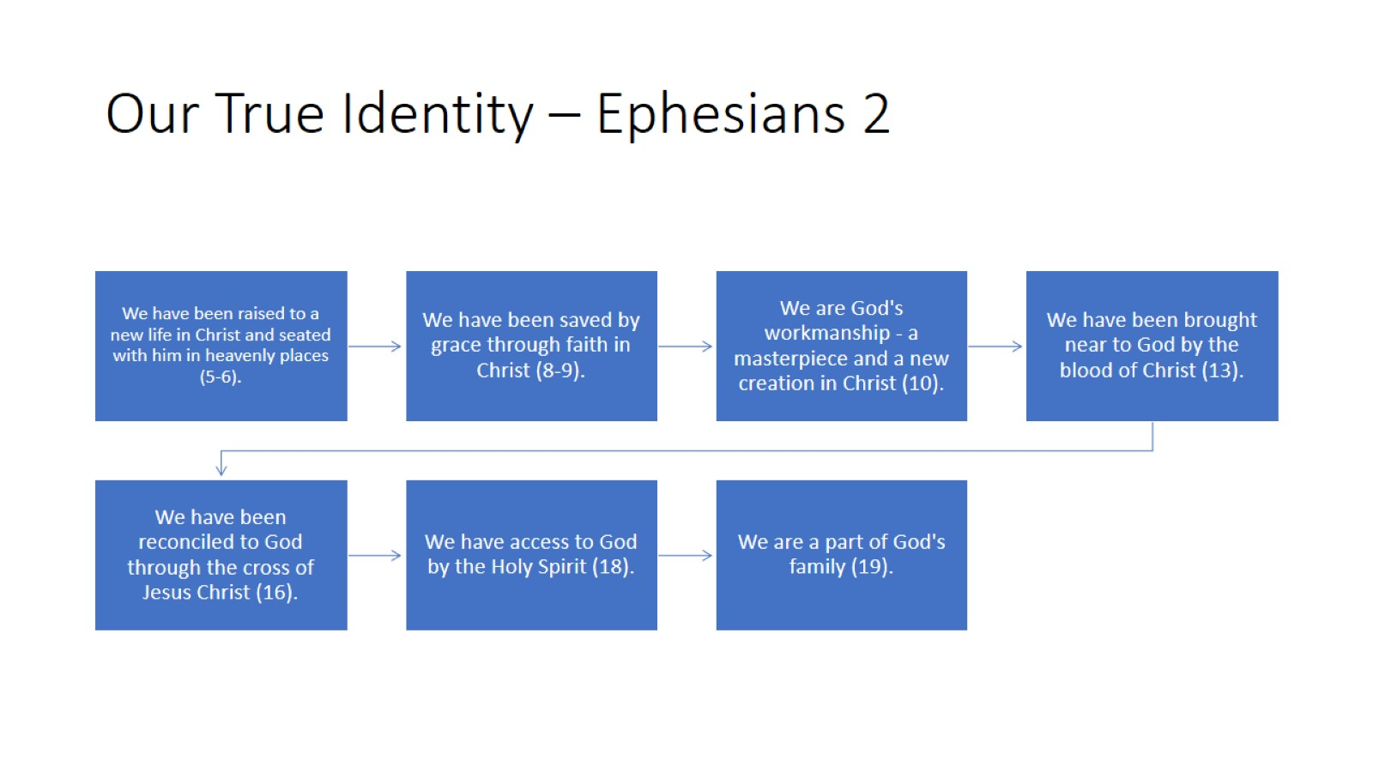
Our True Identity – Ephesians 2

Slide 8
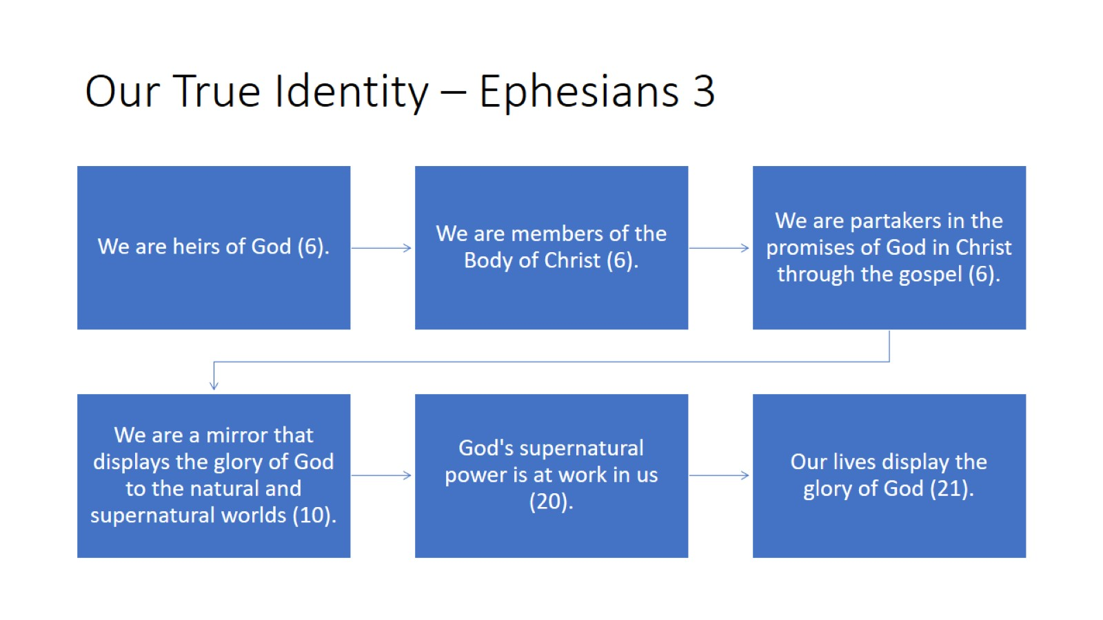
Our True Identity – Ephesians 3

Slide 10

Important Lesson From Ephesians 4-6

Slide 11
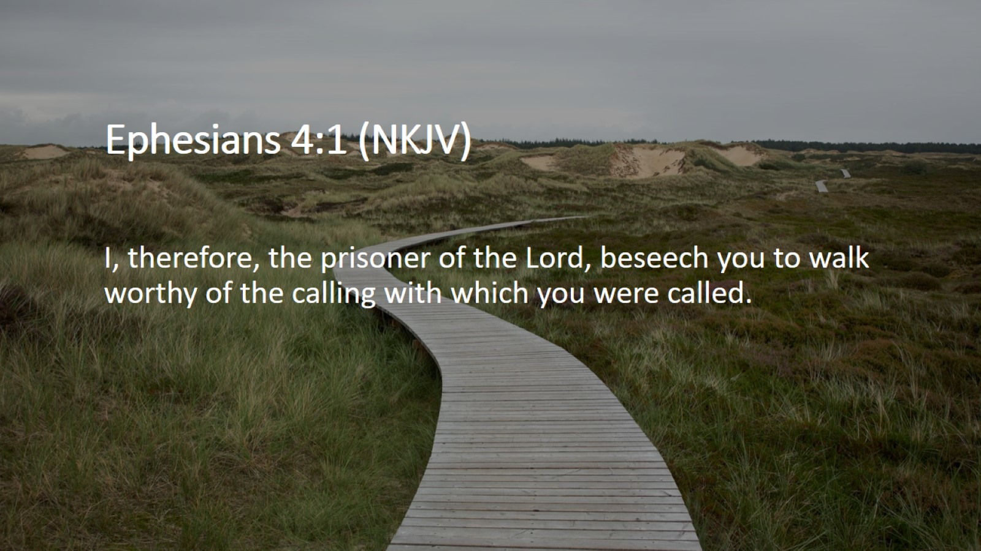
Ephesians 4:1 (NKJV)

Slide 12

Ephesians 4:1 (NIV)

Slide 13
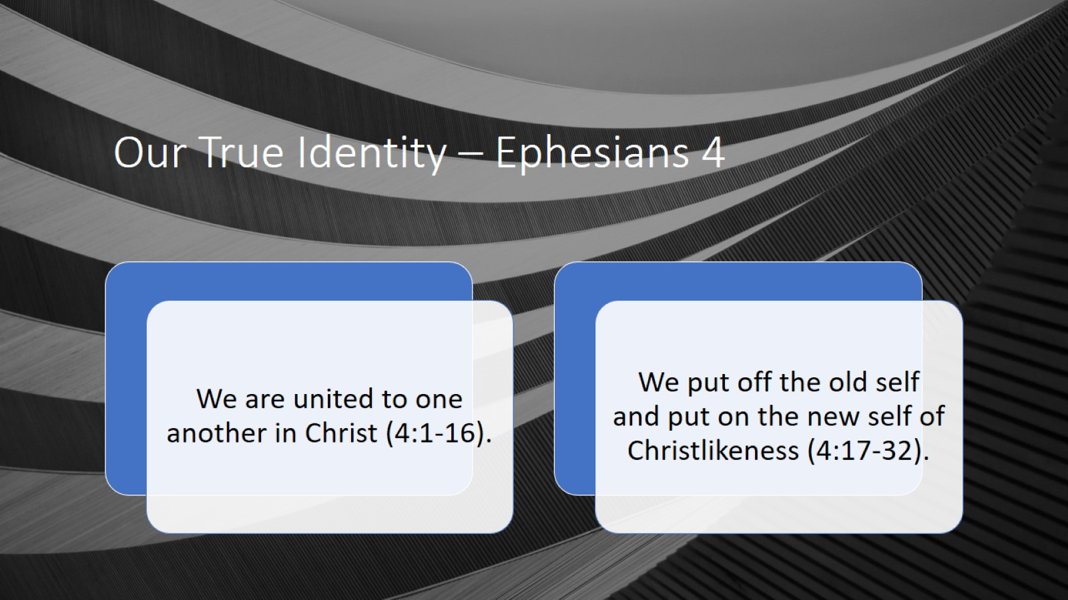
Our True Identity – Ephesians 4

Slide 14
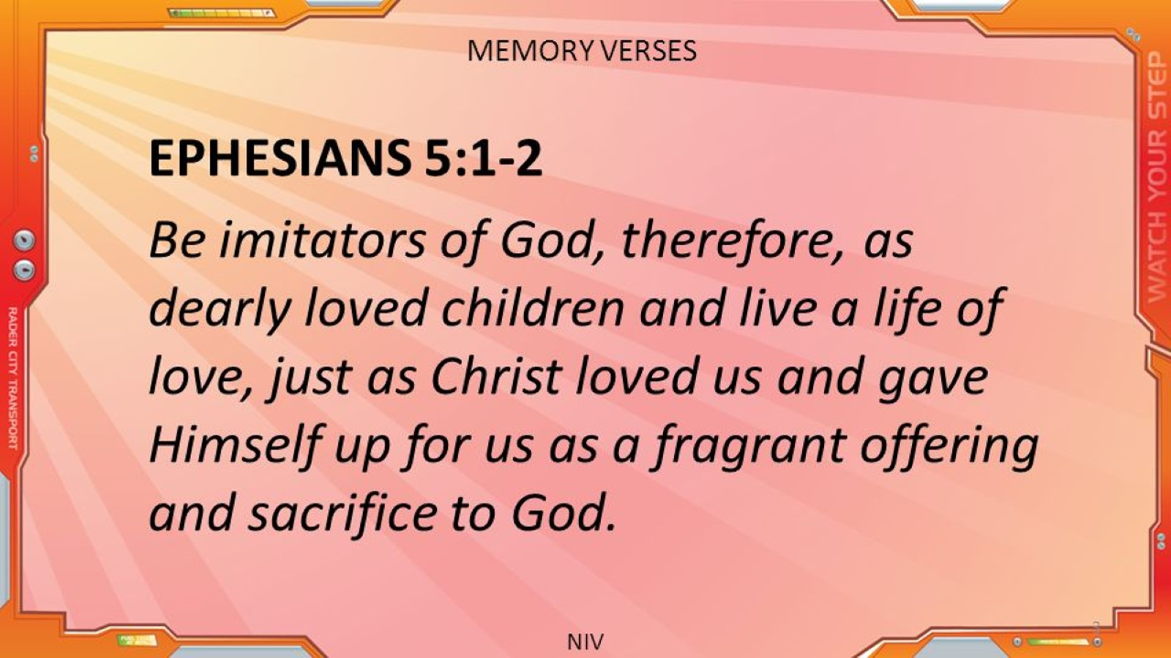

Slide 15
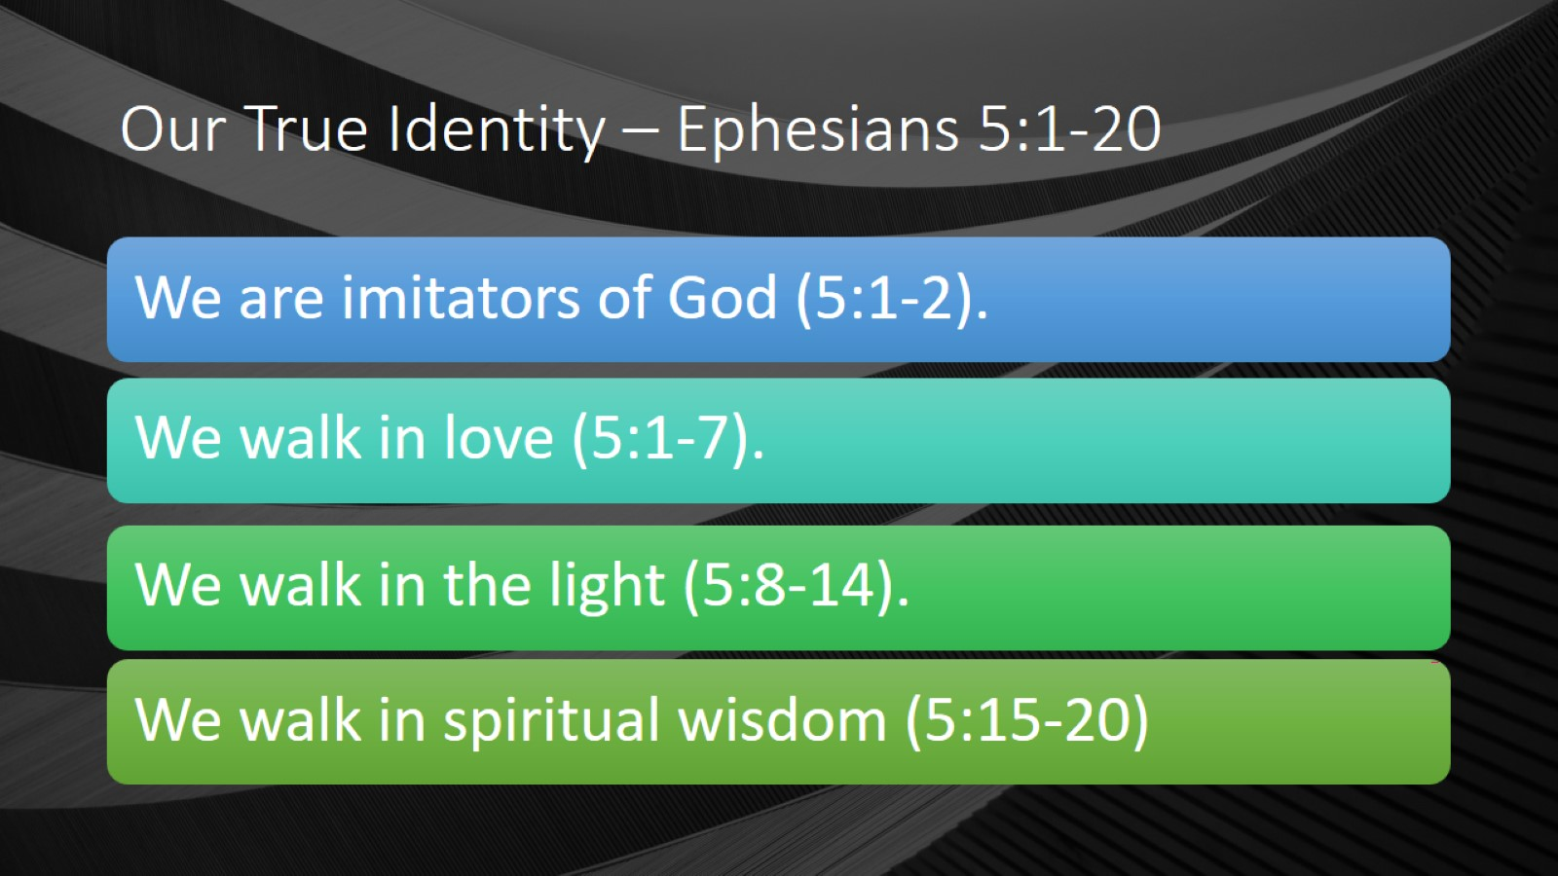
Our True Identity – Ephesians 5:1-20

Slide 16
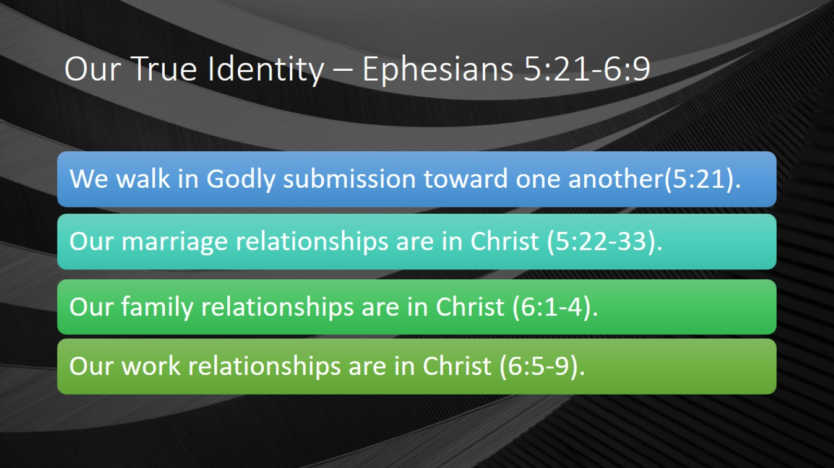
Our True Identity – Ephesians 5:21-6:9

Slide 17
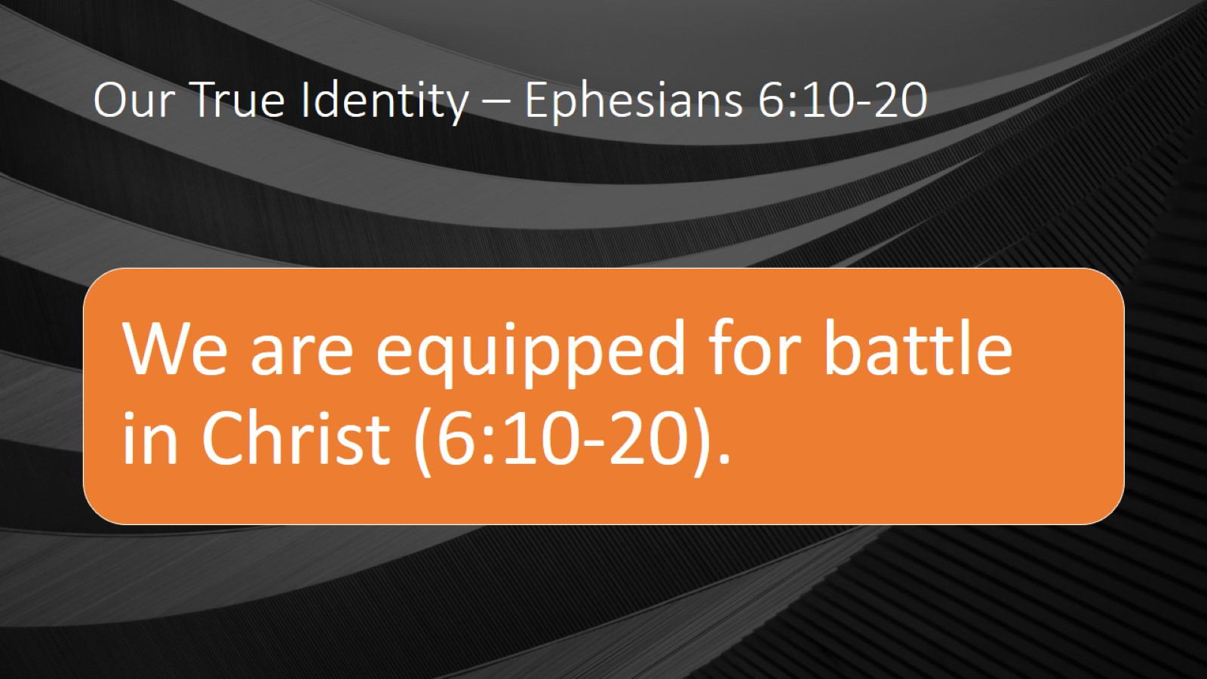
Our True Identity – Ephesians 6:10-20

Slide 18


Slide 19

Main Topics by Chapter

